Slide 1
FY16 Ethics Training-
Back to Basics

Slide 2
Introduction
Welcome to the FY16 Ethics training
This year, the theme of the training is Back to Basics
Understanding the MTS Values and Code of Conduct are critical building blocks of our Business Ethics and Compliance Program
A Speak Up culture creates an environment where employees readily raise questions and concerns about the way the company is conducting business without fear of retaliation
MTS encourages everyone to Speak Up

Slide 3
Learning Objectives
Define the purpose of our Business Ethics and Compliance Program
Review our MTS Values
Highlight our Code of Conduct
  Speak Up Culture
  Respectful Workplace
  Non-Retaliation Policy
Focus on Anti-Corruption Concepts

Slide 4
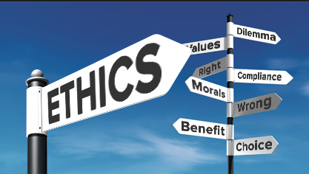
The Purpose of our MTS Business Ethics and Compliance Program
The MTS Business Ethics and Compliance Program is designed to promote an organizational culture that:
  encourages ethical conduct
  a commitment to MTS values
  compliance with the law

Slide 5
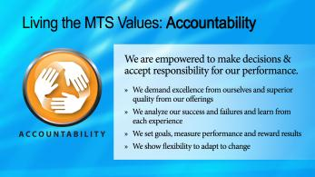
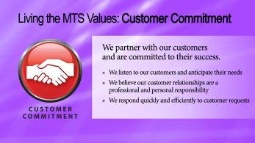
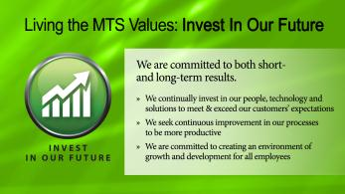
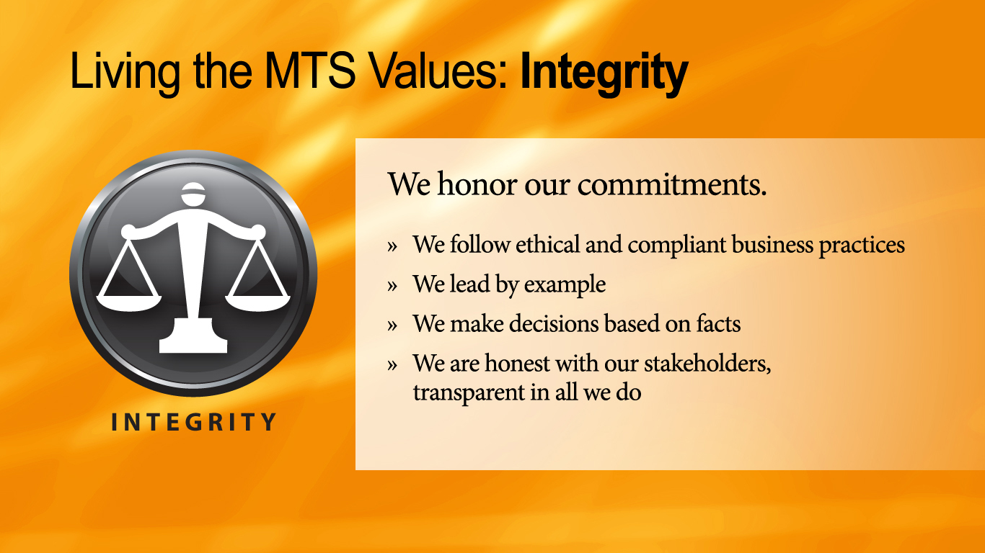
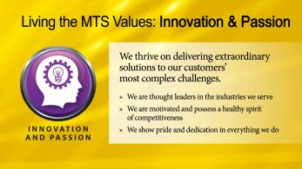
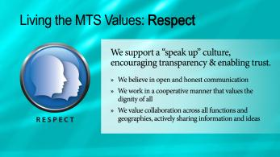
Our MTS Core Values
Our MTS Values define the operating principles that guide our organization's internal conduct as well as its relationship with its customers, partners, and shareholders

Slide 6
MTS Global Code of Ethical Business Conduct
Our Global Code of Ethical Business Conduct Builds upon the MTS Core Values
The Code has been updated and enhancements include:
  The Code is an interactive electronic document that can be found on our intranet
  Added risk areas: Employee Data Privacy, Anti Trust, Fair Dealing and Competition, Product Quality and Safety, Protecting Company Reputation, Environmental Compliance, Lobbying, Political and Charitable Contributions
  Q&A’s and Tips embedded in document
  Hyperlinks are available for additional resources
Our Code is not a substitute for good judgment, nor does it cover every situation encountered, so when in doubt Speak Up
In the end, our confidence must rest, as it always has, on the honesty, integrity and good sense within each of us

Slide 7
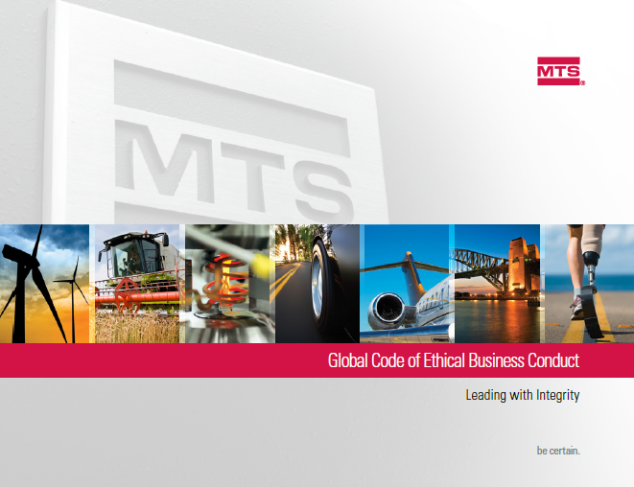
Speak Up Culture
A speak up culture is essential to the health of the company
  A speak up culture reflects on the ability and comfort of employees to ask questions and report concerns
  Speaking up supports our values
MTS has multiple avenues for Speaking Up:
  Supervisors
  Human Resources
  Local Business Ethics Committees
  Director Business Ethics & Compliance
  Office of General Counsel
  AlertLine

Slide 8
MTS AlertLine
The AlertLine is operated by a third party
Callers have the ability to remain anonymous
  Those reporting are provided a code to follow-up on concerns
  Employees are encouraged to contact the AlertLine often to see if there is further information they can provide
Translators are available
Matters are treated confidentially
Employees can submit concerns via the internet to our AlertLine
Each and every matter is investigated
  Investigators have been trained
  Investigation protocol is in place
  Escalation process is defined
*Some locations may restrict anonymous access to the AlertLine or the role of the
business ethics committee

Slide 9


Speak Up Culture Question
Volkswagen’s reputation was recently tarnished due to a massive scandal involving cheating on the emissions testing of 11 million diesel-powered cars sold in recent years
  Share price fell by nearly 30 percent.
  VW lost $26 billion in total value
  Recall costs and fines are heading for the multibillion-dollar range
Taketa's exploding airbags caused eight deaths and hundreds of injuries
  Employees have said that quality problems resulted from the pressure to meet intense delivery schedules
  Failure to meet schedule would cost Takata thousands of dollars per minute through fines
What is one of the root causes of these scandals?

Slide 10
Speak Up Culture Answer
In each of these instances the organizations culture, the inability to speak up, played a major role in ethical misconduct
The health of our company relies on the ability to Speak Up and bring questions and concerns forward
People managers have a special obligation when an employee brings a concern to them
  56% of employees look to their supervisor as a model of ethical behavior
  Thank the person for bringing the matter to you
  Enlist the aid of Human Resources and Business Ethics and Compliance to investigate the matter
  Follow-up if there is action to be taken

Slide 11
Respectful Work Environment
We are committed to creating and maintaining a workplace that drives the success of MTS by working together respectfully and inclusively
Advantages of a Respectful Workplace
  Respectful workplaces are productive, rewarding, and enjoyable for everyone
  They are environments where employees work well together and recognize that:
    Behaviors and attitudes affect others
    Building upon individual strengths and abilities fosters a positive workforce
    Each individual is unique and has the right to be treated with respect and dignity
Respectful workplaces don't just happen, they are built!

Slide 12
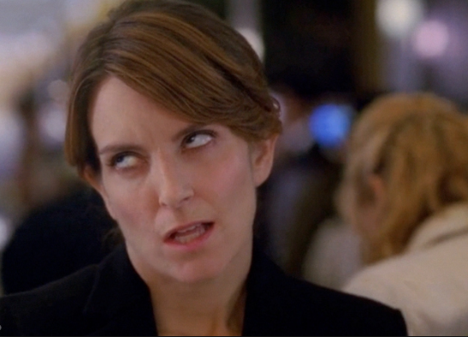
Respectful Work Environment Question
Signs of Disrespect
Eye rolling
Sighing
Clicking your tongue
Talking over another colleague
Bullying
Discrimination
Inappropriate Internet Usage
Using vulgar language
Name-calling
What can you do to help build a respectful work environment?
I just rolled my eyes so hard, I hurt myself – Tina Fey as Liz Lemon in 30Rock

Slide 13
Respectful Work Environment Question
How to Create a Respectful Work Environment
1. Focus on others’ needs and consider how your words and actions will impact others before you speak or act
2. Be intentional in your communications
3. Become a bridge builder and act in a manner that creates an inclusive work environment
4. Appreciate the value of diverse opinions in developing approaches to varying situations
5. Avoid tendencies to become caught up in gossip, complaining, or other forms of negativity in day-to-day interactions
6. View today’s difficult situations from a broader perspective
7. Be supportive of your organization in your communications both inside and outside of the workplace
8. Pay attention to how respectful you are in your communications and other actions on an ongoing basis

Slide 14
Non-Retaliation Policy
MTS forbids retaliation against anyone who asks questions or voices a concern in good faith
Retaliation is prohibited by law and the MTS Global Code of Ethical Business Conduct
Retaliation occurs when an employee suffers an adverse employment action (punishment) for reporting a concern or cooperating in an investigation
The Ethics Resource Center developed a list of common retaliation workplace abuses suffered as a result of reporting ethical violations or other wrongdoings
  Left out: 64% report they were excluded from decisions and work activity by supervisors or management
  Exclusion: 62% report they were excluded by other employees
  Potential Job Loss: 56% report they almost lost their jobs
  No Promotion: 55% report they were passed over for a raise or promotion
  Hit The Road: 44% report they were relocated or reassigned
Retaliation has no place in the MTS workplace

Slide 15

Retaliation-What You Can Do
There is less retaliation in companies where employees at all levels share a commitment to integrity
Retaliation declines dramatically when top managers and supervisors make ethics a priority and model ethical conduct
Retaliation is at war with a strong ethical culture
No organization can expect employees to come forward with concerns if they do not trust that the corporate culture and processes will protect them
Speak Up if you feel you have experienced retaliation by talking with:
    Supervisors
    Human Resources
    Local Business Ethics Committees
    Director, Business Ethics & Compliance
    Office of General Counsel
    AlertLine

Slide 16
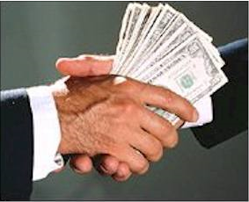
Focus on Anti-Corruption
What is Corruption?
  Corruption is the abuse of public power for private gain.
  Corruption includes bribery, extortion, fraud, deception, collusion and money-laundering
Why Should We Care?
  According to World Bank estimates, between $1 trillion and $1.6 trillion dollars are lost globally to illegal activities each year
  Allows criminal activities such as money laundering, extortion and drug trafficking to thrive
  Many countries have anti-corruption laws and are vigorously enforcing them
  Non-U.S. enforcement actions have more than doubled since 2012
  MTS has two Foreign Corrupt Practices Act (FCPA) voluntary disclosures-we don’t want a third!

Slide 17
U.S. Anti-Corruption Basic Concepts
U.S. Foreign Corrupt Practices Act
  MTS is a U.S. company and this Act applies to all of our locations
  Two components
    Anti-bribery
      Elements of a bribe:
        An offer, promise, or authorization
        Made corruptly
        To give anything of value
        To a foreign official
        Directly or indirectly
        To obtain or retain business or improper advantage
    Books and records
      MTS is required to keep records, which have reasonable detail, to accurately reflect transactions in order to detect, avoid and control unauthorized payments
      Create a system of internal accounting controls that provide reasonable assurance that transactions are properly authorized

Slide 18
Global Anti-Corruption Concepts
U.K. Bribery Act is broader than the FCPA
  Prohibits both private and public bribes
  Punishes payer and payee
  Unlimited criminal fines
Brazil Anti-Corruption Law
  New law enacted March 2015
  Covers offenses committed in Brazil by foreign companies or third parties operating on behalf of foreign companies
China Anti-Corruption Law
  China is enforcing anti-corruption laws
  State Officials are broadly defined and includes employees “engaged in public services” for wholly state-owned entities and, in some cases, partially state-owned entities
We need to understand the affiliation of our customer to address anti-corruption concerns appropriately
The Foreign Corrupt Practice Act Policy (OGC-018) and Gifts, Business Courtesies and Sponsorship Policy (OGC-009) address anti-corruption at MTS

Slide 19

Global Anti-Corruption Question
You are hosting customers for final acceptance testing at your location. A dinner is being arranged to help build the customer relationship. MTS personnel will be in attendance and paying for the meal.
What should you consider when planning the business dinner?

Slide 20
Global Anti-Corruption Answer
Answer:
  Is there language in the contract that prohibits providing anything of value?
  The $100 gifts and business courtesies threshold does not apply. Meals and Entertainment are not subject to the monetary limitation as long as an MTS employee pays for the event and is in attendance, and the meal and entertainment are not excessive per our Gifts, Business Courtesies and Sponsorship policy (OGC-009)
  Are the customers foreign officials?
    Consult with the Office of General Counsel to assure we don’t have anti-corruption concerns prior to the event
    There may be cases where the customer would need to pay for their own meal in order to avoid even the perception of misconduct
  If you are unsure-ASK!

Slide 21
Summary
We have reviewed the Purpose of our Business Ethics and Compliance Program in which the organizational culture promotes
  Ethical conduct
  A commitment to MTS values
  Compliance with the law
Reviewed our MTS Values
  Our values define the operating principles that guide our organization's internal conduct
Highlighted our Code of Conduct
  Speak Up Culture
  Respectful Workplace
  Non-Retaliation Policy
Focused on Anti-Corruption Concepts
  Know your customer and when in doubt-ask questions

