Slide 1
FY16 Ethics Training- Back to Basics

Slide 2
Introduction
Welcome to the FY16 Ethics training
This year, the theme of the training is Back to Basics
Understanding the MTS Values and Code of Conduct are critical building blocks of our Business Ethics and Compliance Program
A Speak Up culture creates an environment where employees readily raise questions and concerns about the way the company is conducting business without fear of retaliation
MTS encourages everyone to Speak Up

Slide 3
Learning Objectives
Define the purpose of our Business Ethics and Compliance Program
Review our MTS Values
Highlight our Code of Conduct
Speak Up Culture
Respectful Workplace
Non-Retaliation Policy

Slide 4
The Purpose of our MTS Business Ethics and Compliance Program
The MTS Business Ethics and Compliance Program is designed to promote an organizational culture that:
encourages ethical conduct
a commitment to MTS values
compliance with the law

Slide 5
Our MTS Core Values
Our MTS Values define the operating principles that guide our organization's internal conduct as well as its relationship with its customers, partners, and shareholders

Slide 6
MTS Global Code of Ethical Business Conduct
Our Global Code of Ethical Business Conduct Builds upon the MTS Core Values
The Code has been updated and enhancements include:
The Code is an interactive electronic document that can be found on our intranet
Added risk areas: Employee Data Privacy, Anti Trust, Fair Dealing and Competition, Product Quality and Safety, Protecting Company Reputation, Environmental Compliance, Lobbying, Political and Charitable Contributions
Q&A’s and Tips embedded in document
Hyperlinks are available for additional resources
Our Code is not a substitute for good judgment, nor does it cover every situation encountered, so when in doubt Speak Up
In the end, our confidence must rest, as it always has, on the honesty, integrity and good sense within each of us

Slide 7
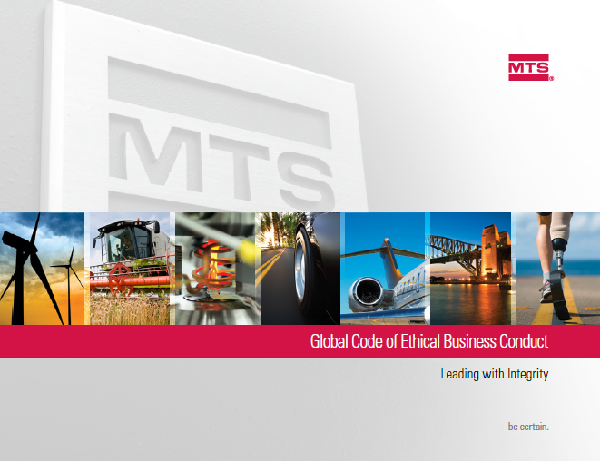
Speak Up Culture
A speak up culture is essential to the health of the company
A speak up culture reflects on the ability and comfort of employees to ask questions and report concerns
Speaking up supports our values
MTS has multiple avenues for Speaking Up:
Supervisors
Human Resources
Local Business Ethics Committees
Director Business Ethics & Compliance
Office of General Counsel
AlertLine

Slide 8
MTS AlertLine
The AlertLine is operated by a third party
Callers have the ability to remain anonymous
Those reporting are provided a code to follow-up on concerns
Employees are encouraged to contact the AlertLine often to see if there is further information they can provide
Translators are available
Matters are treated confidentially
Employees can submit concerns via the internet to our AlertLine
Each and every matter is investigated
Investigators have been trained
Investigation protocol is in place
Escalation process is defined
*Some locations may restrict anonymous access to the AlertLine or the role of the
business ethics committee

Slide 9
Speak Up Culture Question
Volkswagen’s reputation was recently tarnished due to a massive scandal involving cheating on the emissions testing of 11 million diesel-powered cars sold in recent years
Share price fell by nearly 30 percent.
VW lost $26 billion in total value
Recall costs and fines are heading for the multibillion-dollar range
Taketa's exploding airbags caused eight deaths and hundreds of injuries
Employees have said that quality problems resulted from the pressure to meet intense delivery schedules
Failure to meet schedule would cost Takata thousands of dollars per minute through fines
What is one of the root causes of these scandals?

Slide 10
Speak Up Culture Answer
In each of these instances the organizations culture, the inability to speak up, played a major role in ethical misconduct
The health of our company relies on the ability to Speak Up and bring questions and concerns forward
People managers have a special obligation when an employee brings a concern to them
56% of employees look to their supervisor as a model of ethical behavior
Thank the person for bringing the matter to you
Enlist the aid of Human Resources and Business Ethics and Compliance to investigate the matter
Follow-up if there is action to be taken

Slide 11
Respectful Work Environment
We are committed to creating and maintaining a workplace that drives the success of MTS by working together respectfully and inclusively
Advantages of a Respectful Workplace
Respectful workplaces are productive, rewarding, and enjoyable for everyone
They are environments where employees work well together and recognize that:
Behaviors and attitudes affect others
Building upon individual strengths and abilities fosters a positive workforce
Each individual is unique and has the right to be treated with respect and dignity
Respectful workplaces don't just happen, they are built!

Slide 12
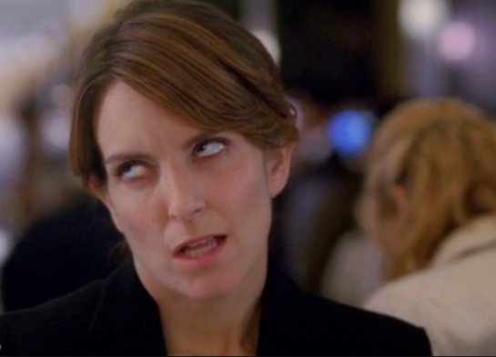
Respectful Work Environment Question
Signs of Disrespect
Eye rolling
Sighing
Clicking your tongue
Talking over another colleague
Bullying
Discrimination
Inappropriate Internet Usage
Using vulgar language
Name-calling
What can you do to help build a respectful work environment?
I just rolled my eyes so hard, I hurt myself – Tina Fey as Liz Lemon in 30Rock

Slide 13
Respectful Work Environment Question
How to Create a Respectful Work Environment
1. Focus on others’ needs and consider how your words and actions will impact others before you speak or act
2. Be intentional in your communications
3. Become a bridge builder and act in a manner that creates an inclusive work environment
4. Appreciate the value of diverse opinions in developing approaches to varying situations
5. Avoid tendencies to become caught up in gossip, complaining, or other forms of negativity in day-to-day interactions
6. View today’s difficult situations from a broader perspective
7. Be supportive of your organization in your communications both inside and outside of the workplace
8. Pay attention to how respectful you are in your communications and other actions on an ongoing basis

Slide 14
Non-Retaliation Policy
MTS forbids retaliation against anyone who asks questions or voices a concern in good faith
Retaliation is prohibited by law and the MTS Global Code of Ethical Business Conduct
Retaliation occurs when an employee suffers an adverse employment action (punishment) for reporting a concern or cooperating in an investigation
The Ethics Resource Center developed a list of common retaliation workplace abuses suffered as a result of reporting ethical violations or other wrongdoings
Left out: 64% report they were excluded from decisions and work activity by supervisors or management
Exclusion: 62% report they were excluded by other employees
Potential Job Loss: 56% report they almost lost their jobs
No Promotion: 55% report they were passed over for a raise or promotion
Hit The Road: 44% report they were relocated or reassigned
Retaliation has no place in the MTS workplace

Slide 15
Retaliation-What You Can Do
There is less retaliation in companies where employees at all levels share a commitment to integrity
Retaliation declines dramatically when top managers and supervisors make ethics a priority and model ethical conduct
Retaliation is at war with a strong ethical culture
No organization can expect employees to come forward with concerns if they do not trust that the corporate culture and processes will protect them
Speak Up if you feel you have experienced retaliation by talking with:
Supervisors
Human Resources
Local Business Ethics Committees
Director, Business Ethics & Compliance
Office of General Counsel
AlertLine

Slide 16
Summary
We have reviewed the Purpose of our Business Ethics and Compliance Program in which the organizational culture promotes
Ethical conduct
A commitment to MTS values
Compliance with the law
Reviewed our MTS Values
Our values define the operating principles that guide our organization's internal conduct
Highlighted our Code of Conduct
Speak Up Culture
Respectful Workplace
Non-Retaliation Policy

