Slide 1
FY17 Global Code of Ethical Business Conduct Training

Slide 2

Overview
This is an overview of the MTS Global Code of Ethical Business Conduct (“Code of Conduct”) and highlights the following key elements.
The purpose and Content of the Code of Conduct
What does it mean to Speak Up?
The MTS AlertLine
Introduction to the Chief Risk and Compliance Officer
Protecting against Retaliation
Compliance Spotlight:
  1. FCPA
  2. Conflict of Interest
Summary

Slide 3
The Purpose of the Code of Conduct
MTS is committed to its core values, ethical conduct, and compliance with the law.
The Code of Conduct is your first resource to:
Guide decision-making based on MTS values
Understand how to comply with laws and regulations
Understand how to Speak Up about unethical or illegal conduct
The MTS Code of Conduct compliments legacy of a strong commitment to ethics, as emphasized through MTS’ leadership, Employee Guide, and policies

Slide 4
The Contents of the Code of Conduct
The Code of Conduct includes:
Summary of MTS’ Core Values
Responsibilities of each MTS employee
Compliance Focus Areas
Q&A and Practical Guidance
Resources to Speak Up
The Code of Conduct is not substitute for good judgment, nor does it cover every situation encountered, so when in doubt ask questions and Speak Up
In the end, our confidence must rest, as it always has, on honesty, integrity and good sense within each of us.

Slide 5
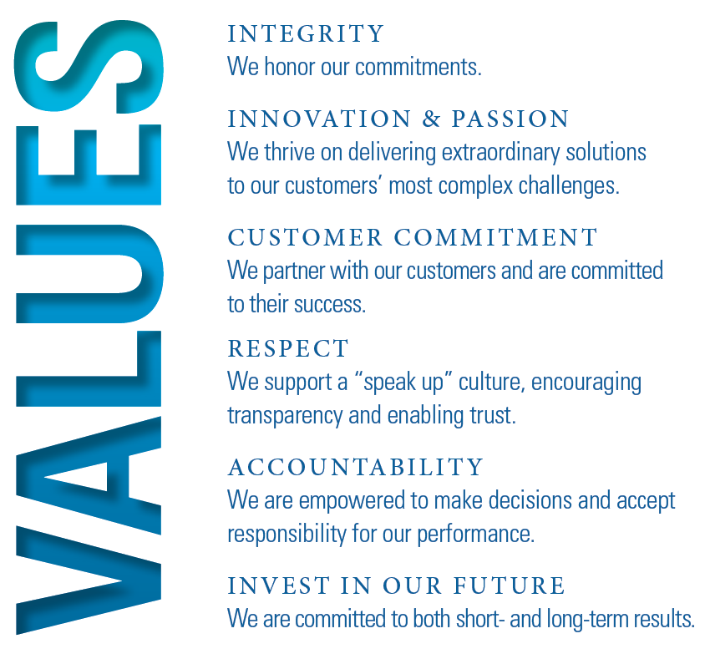






Our MTS Core Values
Our MTS Values reflect the deeply held beliefs that make MTS a vital partner for customers,
employees, vendors and suppliers around the world.
Every day, we reinforce our values through
the collective and individual actions we take on behalf of our Company.

Slide 6
What does it mean to Speak Up?
MTS is a company where we talk openly of the risks of the Company and challenges that employees face in the workplace
We have created multiple options to help you Speak Up:
Supervisors
Human Resources
Local Business Ethics Committees
Chief Risk Office Team
Office of General Counsel
AlertLine
We are all in this together and there are many ways to address challenges, so please ask questions and Speak Up!

Slide 7

The MTS AlertLine
One way to Speak Up is through the MTS AlertLine which is:
Operated by a third party
Easy to get to and accessible in any country
Available in your native language
(translators are also available)
Ability to Remain Anonymous
Employees can submit concerns via the following:
Internet – https://mts.alertline.com/gcs/welcome
Phone 888-321-5562 or via direct access number for various regions
Reporters are provided a unique code to follow up on concerns
Each matter is handled by the Chief Risk Office team and treated confidentially to the extent allowed.

Slide 8

Chief Risk and Compliance Officer
Phyllis Nordstrom – Chief Risk and Compliance Officer
Chief Risk and Compliance Officer
CRO
Corporate Compliance Programs
Business Ethics & Compliance Monitoring
Operational Governance
Lead the execution of compliance programs for topics such as FCPA, Conflict Minerals, and Privacy
Lead activities related to Business Ethics and the MTS Code of Conduct
Lead operations teams that closely impact adherence to MTS compliance policies and procedures
How can you contact Phyllis?
MTS_Risk_&_Compliance@mts.com

Slide 9
Local Business Ethics Committees
Another way to Speak Up is through MTS’ local Business Ethics Committees.
Roles & Responsibilities of Ethics Committees:
Assist employees in understanding and applying the MTS Code of Conduct
Support implementation of the MTS Code of Conduct at the business unit level
Communicate questions and areas of concern to the MTS Corporate Compliance
Meet regularly and report committee activities to MTS Corporate Compliance
MTS Ethics Committees list is available on the intranet

Slide 10


How does MTS protect against retaliation?
MTS prohibits retaliation against anyone who asks questions or voices a concern in good faith
Retaliation occurs when an employee suffers an adverse employment action (punishment) for reporting a concern or cooperating in an investigation
There is less retaliation in companies where employees at all levels share a commitment to integrity
Retaliation declines dramatically when top managers and supervisors make ethics a priority and model ethical conduct
Retaliation is not tolerated at MTS!

Slide 11
Compliance Spotlight: FCPA
“MTS takes a firm stance against corruption. Corruption or bribery runs counter to our Shared Values. These standards apply to all of us, regardless of where we work.” (Code of Conduct, page 14)
U.S. Foreign Corrupt Practices Act (FCPA)
  Enforced by the U.S. Department of Justice (DOJ) and Securities and Exchange Commission (SEC)
  The FCPA prohibits:
WHAT:
offering or paying anything of value, whether directly or through a third party
TO:
any official, employee of a government-owned business, or family member of a foreign official
WHY:
to win business or to obtain an unfair business advantage
Additional laws and regulations apply in each country in which MTS conducts business (e.g. UK, China, Korea, etc.)

Slide 12
Components of FCPA
1
Anti-Bribery Provisions
2
Recordkeeping and Internal Control Provisions

Slide 13
Anti-Bribery Provisions
1
No Company or person may offer or authorize payment of a bribe or anything of value directly or indirectly to any foreign official to obtain or retain business or improper advantage.
Bribe
Offer, payment or gift of money or anything of value for the purpose of obtaining or retaining an unfair business advantage
Cash, loans, gifts, favors, travel, meals or entertainment, charitable/campaign contributions, hiring, overpayment/underpayment of services, directing business to entities related to officials, etc.
Anything of Value
Employees of all levels of government, public international organizations, or state-owned entities (e.g. university, state-owned companies)
Political party officials or military officials, including spouses / dependents / siblings
Foreign Official
Obtain or Retain Business
Winning or retaining a contract, influencing the procurement process, evading taxes or penalties, influencing lawsuits or enforcement actions, obtaining regulatory approvals, or avoiding contract termination
Kickback
Payment made to someone who has facilitated a transaction or appointment, especially illicitly

Slide 14
Recordkeeping and Internal Control Provisions
2
Rule: Requires individuals and businesses to keep accurate and complete records of the transaction in which they engage
To Comply: MTS must maintain books and records that accurately reflect the transaction of the corporation
Rule: Prohibits individuals and businesses from knowingly failing to implement internal controls
To Comply: MTS must maintain a system of internal accounting controls to ensure accurate reporting of transactions and safeguarding of assets must be devised and maintained

Slide 15
FCPA Risk Areas Specific to MTS and Applicable MTS Policy / Procedure
Risk Area / Red Flags Raised | MTS Policy / Procedure
Sales Excessive customer entertainment & lavish hospitality Excessive commissions to agents or incentives to resellers which could create potential for bribes | OGC-001 Code of Conduct OGC-004 Ethical Business Conduct OGC-009 Gifts, Business Courtesies and Sponsorships OGC-018 Foreign Corrupt Practices Act Compliance
Operational activity and disbursements to third parties Improper payments to customs officials to evade customs duties Sponsorships provided with the intent to win or retain business | OGC-001 Code of Conduct OGC-008 Foreign Law Compliance OGC-009 Gifts, Business Courtesies and Sponsorships OGC-009A Event and Sponsorship Request Form OGC-010 Conflict of Interest OGC-018 Foreign Corrupt Practices Act Compliance
Employee-related activity Lodging at luxurious hotels and business/first class airfare Gifts that do not comply with local laws and customs | FIN-008G Global Travel and Expense Reimbursement OGC-001 Code of Conduct OGC-004 Ethical Business Conduct OGC-009 Gifts, Business Courtesies and Sponsorships OGC-018 Foreign Corrupt Practices Act Compliance
Financial recordkeeping and internal controls Lack of adequate approvals and supporting documents Circumvention or evasion of internal controls | OGC-007 Record Retention OGC-004 Ethical Business Conduct OGC-018 Foreign Corrupt Practices Act Compliance

Slide 16
How does the Code of Conduct Address Bribery and Corruption?
The Code of Conduct provides guidance about bribery and corruption risks faced by MTS personnel and about local laws and regulations.
The Code of Conduct also provides questions and answers to certain scenarios to facilitate understanding.
MTS has specific policies and procedures that address bribery and corruption.

Slide 17
Compliance Spotlight: Conflict of Interest
“At MTS, we always expect one another to act in the best interests of the Company. This means that business decisions should be made free from any conflict of interest. They should also be impartial. We must make our decisions based on sound business reasoning.” (Code of Conduct, page 11)
WHEN:
an individual’s outside activities or personal interests conflict, or appear to conflict, with his or her responsibilities to MTS
EXAMPLES:
» Compete against the Company
» Use of position or influence to secure an improper benefit for themselves or others
» Use Company information, assets or resources for personal gain or the improper benefit of others
» Accepting or using a business gratuity or gift from a competitor, supplier or customer that is inconsistent with MTS policy
» Engaging in a personal relationship with another MTS employee that is inconsistent with MTS policy

Slide 18
Summary
MTS Code of Conduct – your FIRST resource to:
Guide decision-making based on MTS Values
Understand how to comply with laws and regulations
Understand how to Speak Up about unethical or illegal conduct

