Slide 1
Global Code of Ethical Business Conduct Training
Updated as of June 2021

Slide 2
Training Overview
After completing this training, you should understand the following:
The importance of ethics in business
How to use the MTS Global Code of Ethical Business Conduct
How to report a concern
MTS’ stance on retaliation
Key highlights:
Privacy and Security
Global Trade
Anti-Bribery (FCPA)
Even considering our pending acquisition, it is still important we follow the guidance included in our Code of Conduct. Please continue to use the Code and company policies related to your role at MTS to help guide your business decisions.
2

Slide 3
The Importance of Ethics in Business
Ethics simply means doing the right thing.
It goes beyond what is allowed by laws and regulations.
When a company uses business ethics as its foundation, it can have a significant impact on long-term business profitability and success.
A strong ethical culture builds confidence and trust with a company’s employees, customers, suppliers, investors and other stakeholders, increasing a company’s competitive advantage.
3

Slide 4
The Importance of Ethics in Business
The MTS Global Code of Ethical Business Conduct (the “Code”) establishes a common understanding of the behavior expected of each of us.
Behavior that guides us in doing the right thing.
By accepting employment at MTS, the Code applies to you.
The Code places an obligation on all of us to take responsibility for our own conduct.
It is important that you read, understand and conduct business as outlined in our MTS Code. It applies to all levels of our Company, including employees, board members and officers alike.
4

Slide 5
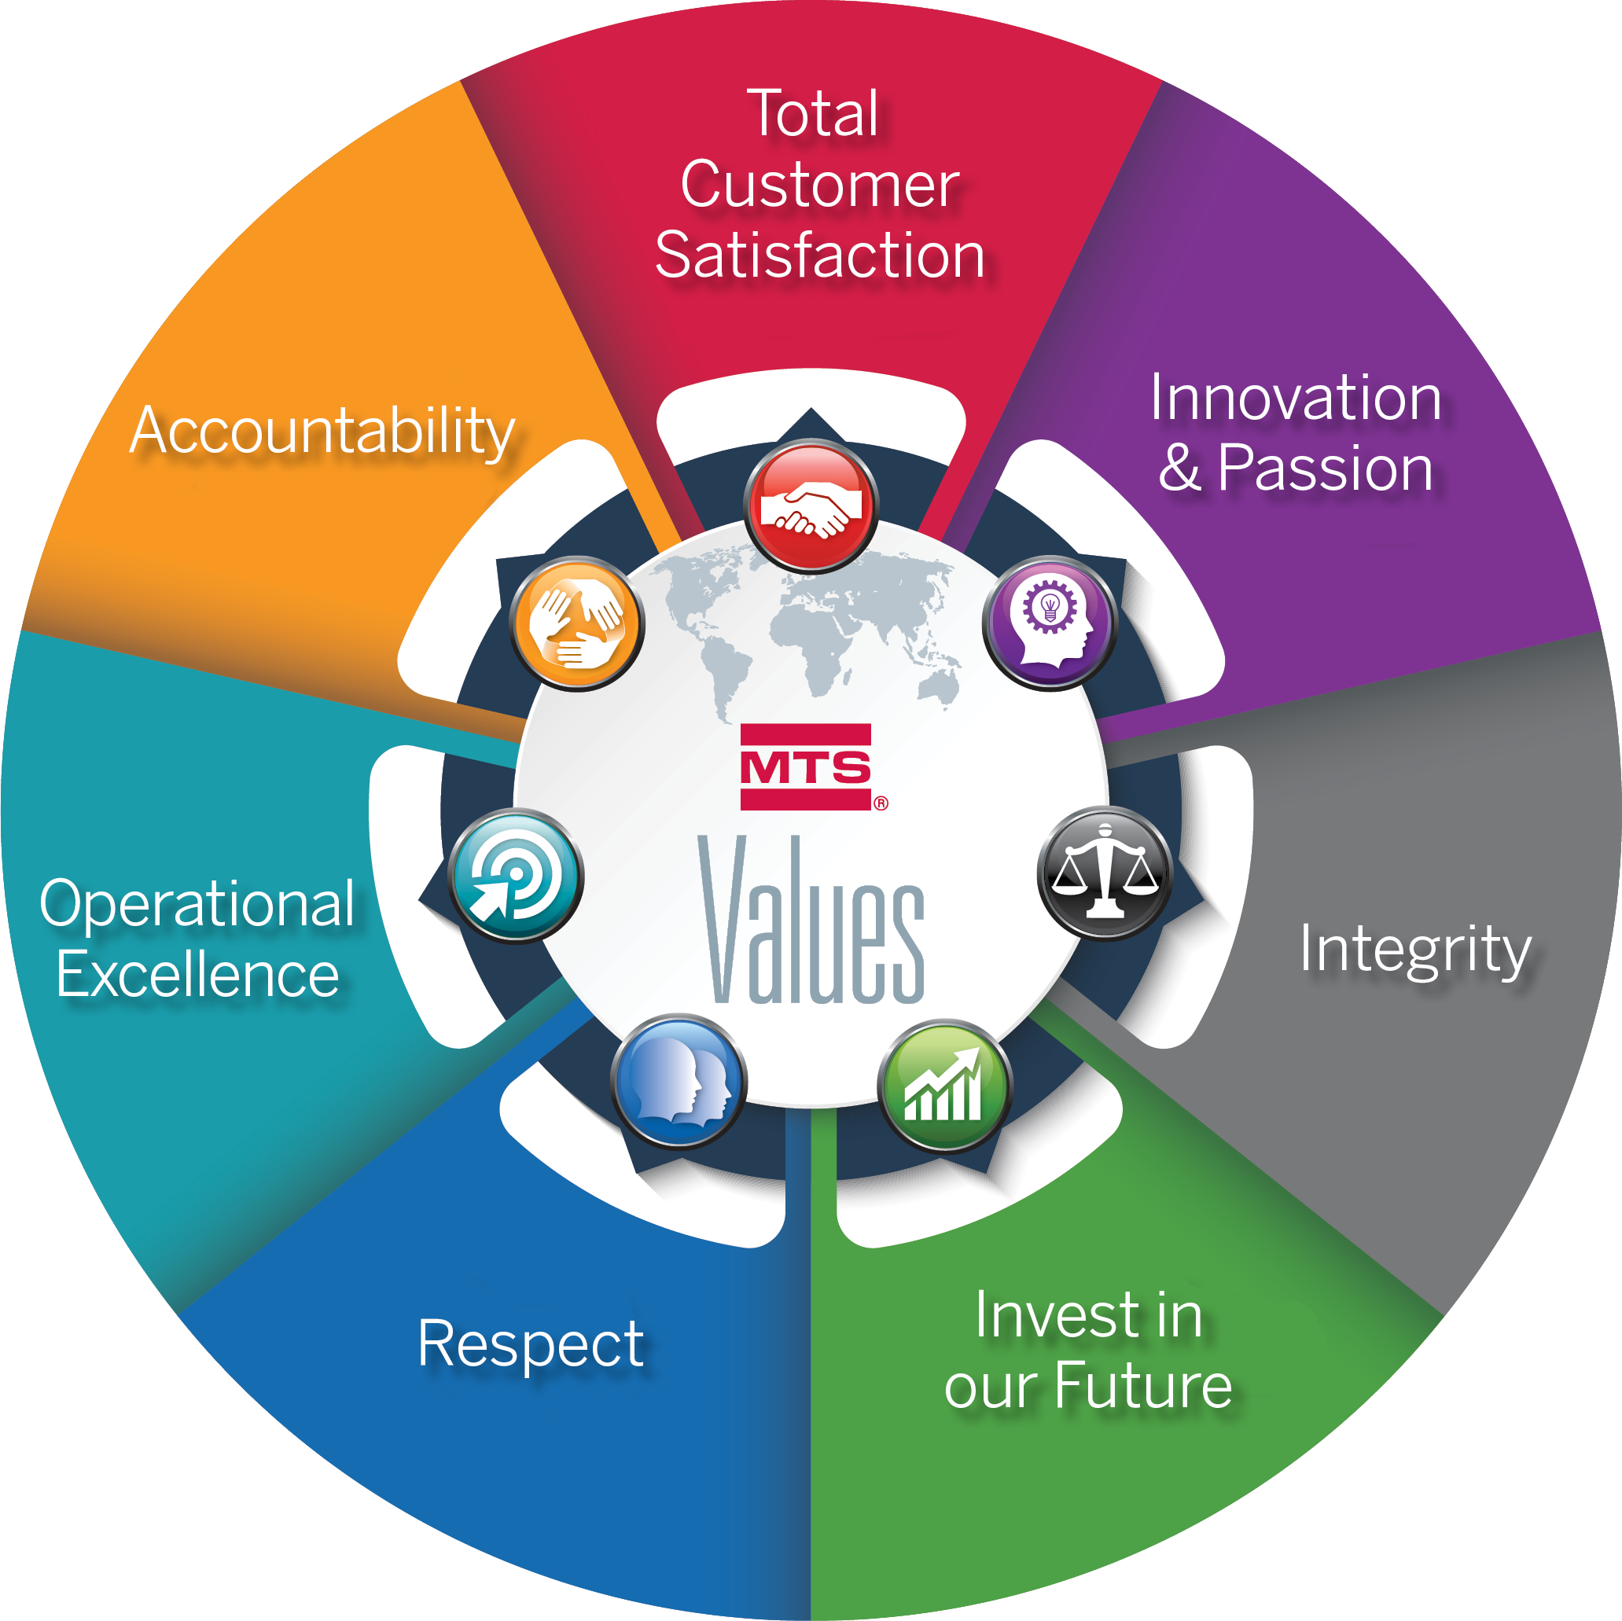
The Importance of Ethics in Business
MTS Values are a key part of the foundation of our Code of Conduct
At MTS, we engineer technology to make the world’s products better. We bring our Company purpose to life through our people and our culture. Our Code of Conduct and MTS Values provide a strong foundation for our culture, guiding how we work as a team and how we engage our customers.
Code of Conduct Content
Our ethical responsibilities
Business focus areas
Q&A and practical guidance
Resources to ask questions and report concerns
5

Slide 6
Using the MTS Code of Conduct
You Have An Important Role
Read through the entire Code
Think about how the Code applies to your job
Follow the Code, Company policies, and laws and regulations that apply to your job
Use the Code questions and answers to help clarify situations encountered
Seek guidance before acting if you have questions
No code or manual can provide complete answers to all questions. In the end, we must rely on our good sense to assess if our actions align to MTS’s high ethical standards. The Office of Risk and Compliance is here to offer support, answer questions, and help address your concerns.
6

Slide 7
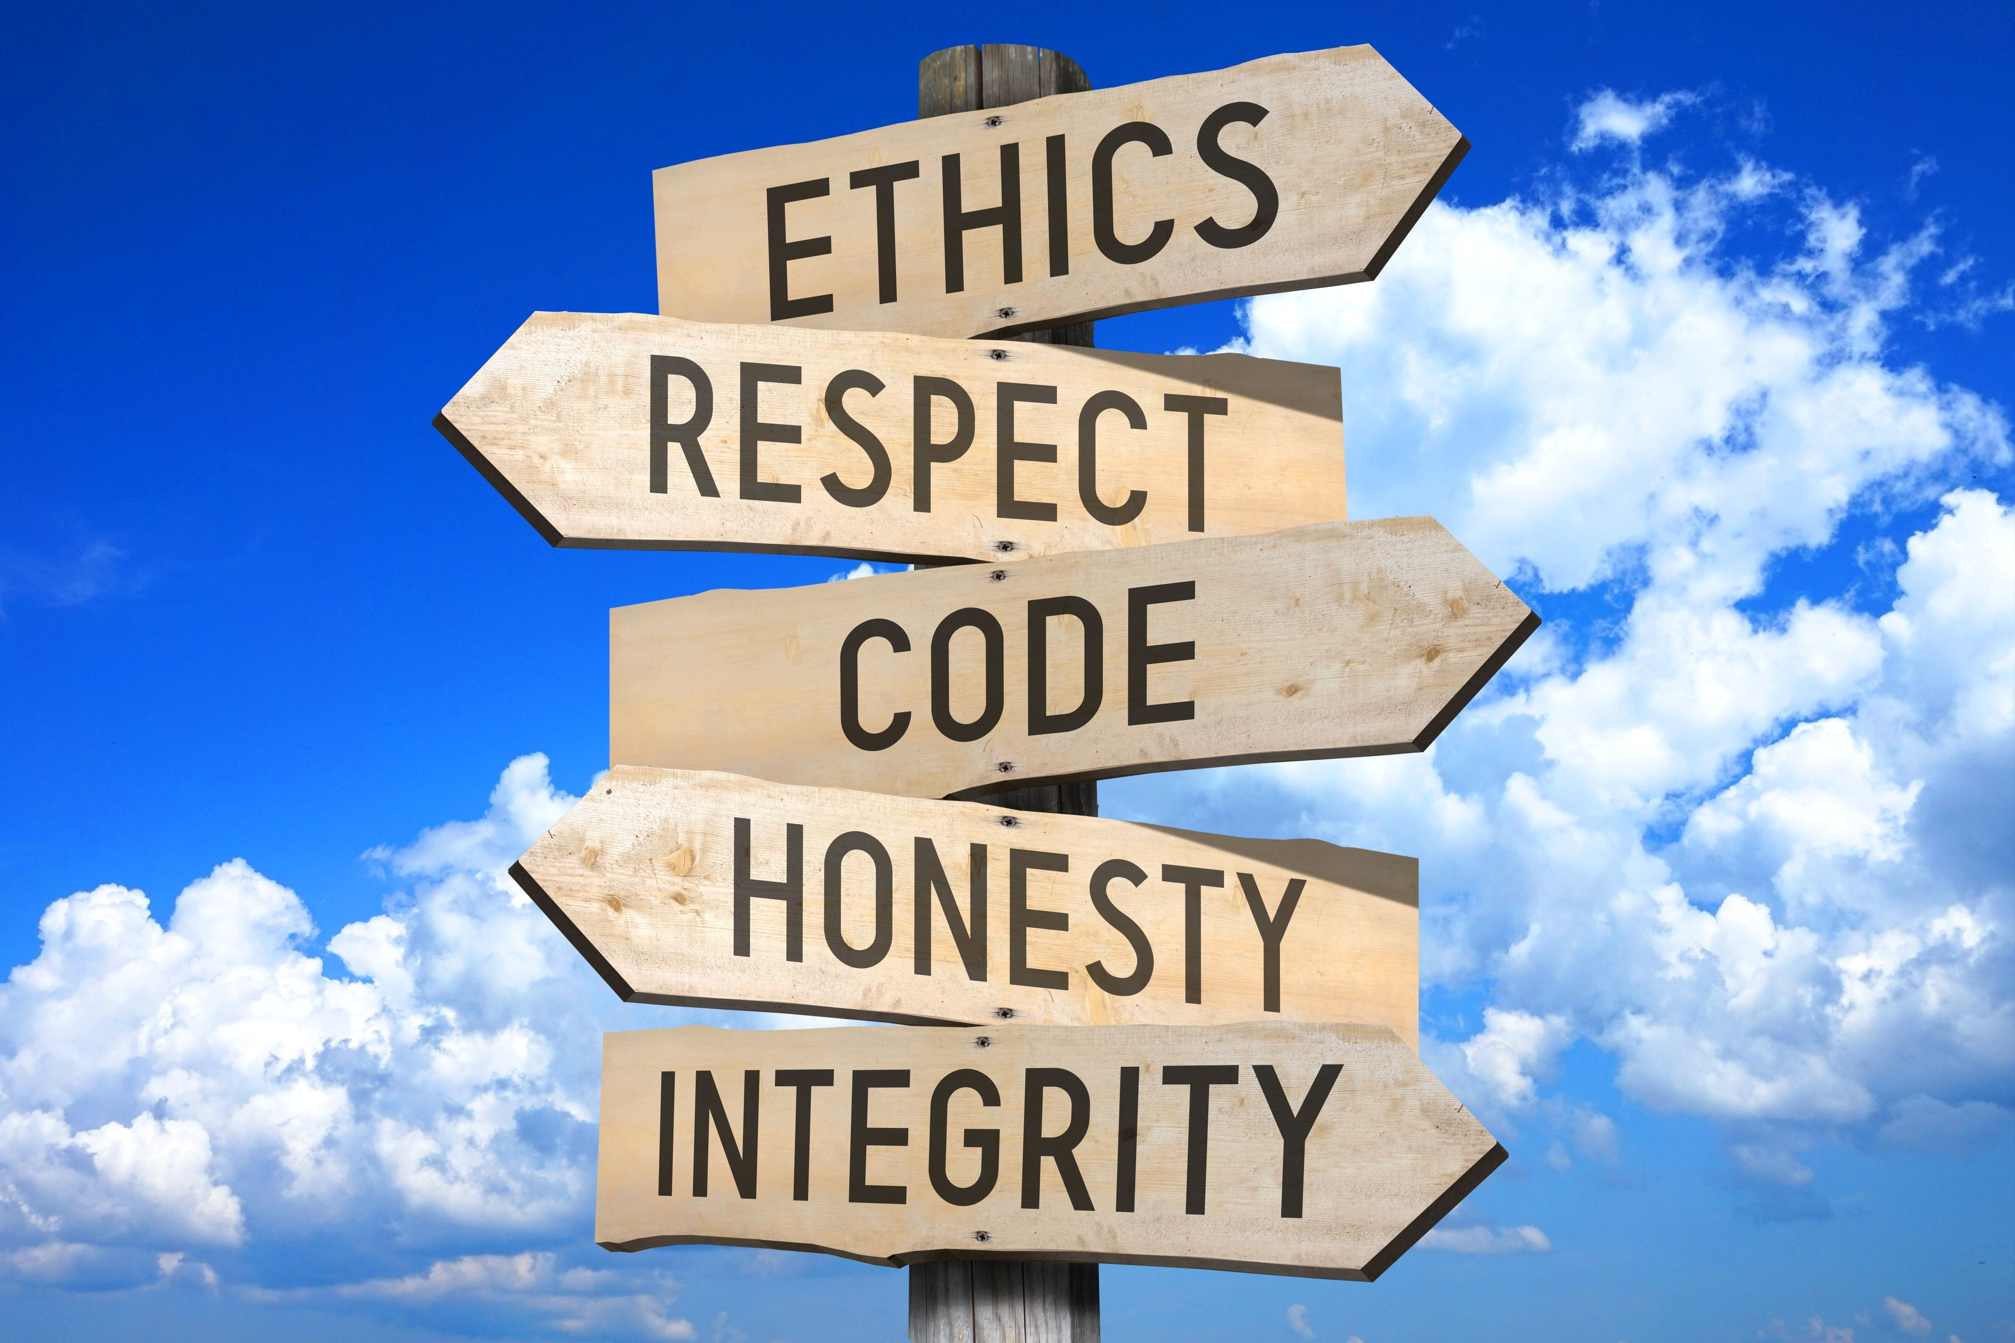
Using the MTS Code of Conduct
Speak Up!
You should feel comfortable seeking guidance, asking questions and reporting concerns about actions that may not adhere to our Code.
Part of our success is MTS’s continued focus on a
Speak Up culture.
We encourage you to talk openly about risks or challenges you may encounter.
There are multiple options for you to Speak Up. See details on slide 10.
7

Slide 8
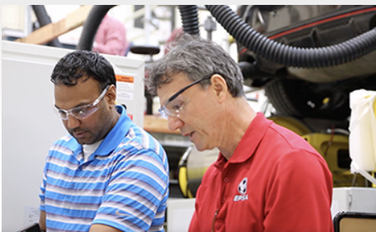
Using the MTS Code of Conduct
Additional Responsibilities for Supervisors
Lead by example
Communicate and promote legal, ethical and compliant practices in adherence to the Code
Create and promote a Speak Up culture
Promptly escalate reports you receive from employees
Acknowledge and appropriately recognize employees for their sound ethical conduct
Ensure employees complete required trainings
8

Slide 9
Using the MTS Code of Conduct
Seek guidance before acting if you have questions
There are no shortcuts in doing what is right. When faced with a difficult situation, ask yourself questions like those below to support making the right ethical decisions.
Is this legal?
Is this consistent with MTS Values?
Does this comply with corporate and local policies and procedures?
Do you feel this may be wrong, but feel pressured to do it anyway?
Do you feel good about your decision?
The Code will never be able to provide an exhaustive list of what to do in every aspect of your work.
It also is not a substitute for good judgment, so when in doubt ask questions and speak up!
9

Slide 10
Using the MTS Code of Conduct
How To Seek Guidance or Report a Concern
Talk to the Office of Risk and Compliance, or your Supervisor, or HR
Email the Office of Risk and Compliance at mts_risk_and_compliance@mts.com
Visit MTS AlertLine - https://alertline.com
Call the AlertLine* Number 888-321-5562 (Regional phone numbers listed in Code)
Reports to the AlertLine have the option to be made anonymously.
10

Slide 11
We Do Not Tolerate Retaliation
MTS prohibits retaliation against anyone who voices a concern in good faith
Anyone who engages in retaliation violates our Code and may face discipline, up to and including termination.
If you have concerns about retaliation, talk with the Office of Risk and Compliance or your HR business partner.
Retaliation
Occurs when an employee suffers punishment or harassment from co-workers, supervisors, or senior management for reporting a concern or cooperating in an investigation.
Good Faith
A sincere belief without any malice or the desire to defraud others. It does not mean that we are always right.
11

Slide 12
Key Highlight
Privacy & Security
12

Slide 13
What is Privacy and Security?
MTS is committed to protecting the privacy and security of personal and confidential
information of its employees, customers, suppliers and other third parties.
Privacy in the workplace refers to protecting information that is considered personal or private from corruption, compromise or loss.
Security is the protection of the confidentiality, integrity and availability of information.
Policies ORC-012, ORC-013, ORC-014, ORC-015
Policies IT-013 and IT-021
Examples of Personal Information
Name
Age
Date and place of birth
Home phone number
Medical records
Scope
Protect information from accidental or intentional unauthorized modification, destruction or disclosure
Secure equipment and software used to process, store and transmit information
13

Slide 14
Our Responsibilities - Privacy
Protecting the privacy of personal information is everyone’s responsibility & there
are security measures we can all take every day in our role at MTS.
Privacy Reminders:
Collect, use, share, and store only the minimum amount of personal information necessary for your work.
Further protect sensitive personal information by adding additional security controls on documents, such as password protection.
Only share personal information with those who need it to do their job.
Keep personal information only to fulfill the reasonable business purposes for which it was collected.
Destroy, delete, or anonymize personal information once it is no longer needed.
Take caution to dispose of sensitive company or personal information on hard drives or network drives when no longer needed.
14

Slide 15
Cybersecurity Highlight
Cyber-attacks are increasing in sophistication and frequency every year and are a major
risk in our society. They happen to organizations large and small.
How Cyber-Attacks Happen
Most cyber-attacks start with employees.
Employees fall prey to a malware or phishing event, often by opening email (with a link to a web site or an attachment), or by visiting a web site.
Doing so will launch a cyber-attack on a PC.
Once your PC is attacked, it takes a short amount of time for a sophisticated criminal organization to laterally move through a company’s IT systems and find sensitive data.
Cyber-crime has become a large for-profit industry estimated to be $6T in 2021.
15

Slide 16
Our Responsibilities - Cybersecurity
Preventing a cyber-attack is best started where it all begins - with our employees.
Security Reminders: Follow the below practices with all emails and web sites you visit:
Email Attachments: Never open an attachment in an email from an external source when the sender is unknown, the attachment was not expected, or if anything looks questionable.
Email Links: Never click on a web site link in an email from a sender you don’t know, or to a site you don’t recognize. Carefully examine the actual site address to be sure it matches the sender site that appears in the text.
Web Sites: Never visit a web site that is not from a well-established company, whether for business or personal use.
Software: Never install unapproved software or software downloaded from unknown sources.
Workstation: Cooperate with the Information Security department if your workstation is isolated due to a potential security threat.
Help Desk: If you have questions, contact your IT Help Desk to request assistance from the Information Security department.
Use professional skepticism when clicking on a web site or opening an external email with a web site link or attachment.
Contact your IT Help Desk if you have questions.
16

Slide 17
How to Report a Privacy or Security Concern
Both MTS and its employees are responsible for complying with privacy and security laws and regulations.
Promptly report any incidents or concerns
Privacy Incident or Concern
privacy@mts.com
Security Incident or Concern
informationsecurity@mts.com, or
Your Local IT Service Desk
OR
If you are unsure, you can email
The Office of Risk and Compliance
mts_risk_and_compliance@mts.com
17

Slide 18
Key Highlight
Global Trade
18

Slide 19
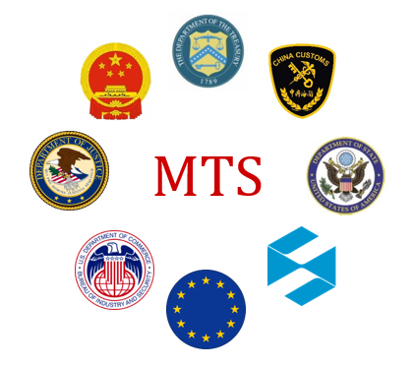
What is Global Trade?
Global Trade is the transfer of goods, services, technology, knowledge, and software across international borders. The transfer could be an import or export.
Imports
Transferred into one country or customs territory from another country
Exports
Transferred out of one country or customs territory to another country
MTS is subject to numerous import and export laws and regulations in all countries to which we do business across the globe. Follow MTS Global Trade policies to support compliance.
Global Trade Policy ORC-008
Supporting ORC-008 Procedures
Laws change frequently and may differ country to country
A violation is illegal
Penalties for violations can be severe
19

Slide 20
Know Your Customer
Companies, and you, have an important role to play to effectively control exports and re-exports, in support of national security and foreign policy interests.
MTS has policies in place to effectively control exports. An example of an MTS policy requirement for employees is to know your customer.
“Know your customer” means verifying the legitimacy of our customers so that MTS does not do business with prohibited parties.
Your Responsibilities
Be Transparent: Be aware of all information that is provided by the parties you are engaging with, and document information learned within our business systems.
Look for Red Flags: Be mindful of abnormal circumstances in a transaction that indicate an export may be planned for an inappropriate end-use, end-user, or destination.
Partner with Global Trade Team: Proactively seek guidance from your Global Trade team with questions by contacting Import-Export-Screening-EP@mts.com or Legal@pcb.com.
The Global Trade team reviews government lists to monitor people or organizations prohibited or restricted from participating in export transactions or requiring licenses to do business.
20

Slide 21
Know Your Customer – Red Flags
Below are examples of red flags to be aware of when working with customers.
Lack of Transparency:
The customer is reluctant to offer information about the end-use of the item.
When questioned, the buyer is evasive and especially unclear about whether the purchased product is for domestic use, for export, or for re-export.
Inconsistencies with Typical Business Activities:
The product's capabilities do not fit the buyer's line of business.
The item ordered is incompatible with the technical level of the country to which it is being shipped.
The customer has little or no business background.
The customer is unfamiliar with the product's performance characteristics but still wants the product.
Routine installation, training, or maintenance services are declined by the customer.
Logistics:
The shipping route is abnormal for the product and destination.
Packaging is inconsistent with the stated method of shipment or destination.
Delivery dates are vague, or deliveries are planned for destinations that are out of the way.
Payment Terms:
The customer is willing to pay cash for a very expensive item when the terms of sale would normally call for financing.
If you identify any of these red flags or activities that are unusual, escalate the request to your supervisor or contact your local Global Trade team for further review, or email Import-Export-Screening-EP@mts.com or Legal@pcb.com.
21

Slide 22
Order Information Accuracy
The accuracy of order information is critical for MTS to make appropriate business decisions, and also to ensure compliance with global trade requirements.
Order information is relied upon by Sales, Finance, Tax, Treasury, Accounts Payable, Accounts Receivable, Engineers, Production, Operations, and the Office of Risk and Compliance, so all information associated with an order needs to be accurate and complete in the system.
What is Accurate and Complete “Order Information”?
Parties: Identification of all parties involved in purchasing, using, moving, sourcing, and paying.
Products and Services: Description of products and services based on standardized language from existing business tools.
Pricing: Pricing of products and services, including types of deductions, discounts, commissions, and other pricing details.
Key Reminders:
Use company preferred contracting terms and conditions.
Use the most current version of business tools, templates, and worksheets available.
22

Slide 23
Key Highlight
Anti-Bribery (FCPA)
23

Slide 24
What is Anti-Bribery?
MTS takes a firm stance against corruption and bribery. It is not tolerated, and bribery is illegal. MTS is subject to a variety of anti-corruption and anti-bribery laws across the globe. The U.S. law is the Foreign Corrupt Practices Act (FCPA).
The FCPA prohibits MTS employees and anyone who conducts business on our behalf from offering corrupt payments or anything of value to a government official in order to obtain/retain business or gain an undue business advantage.
WHAT:
TO:
WHY:
Cannot offer or pay anything of value, either directly or through a third party.
Any government official, employee of a government-owned business, or family member of a government official.
To win business or to obtain an unfair business advantage.
24

Slide 25
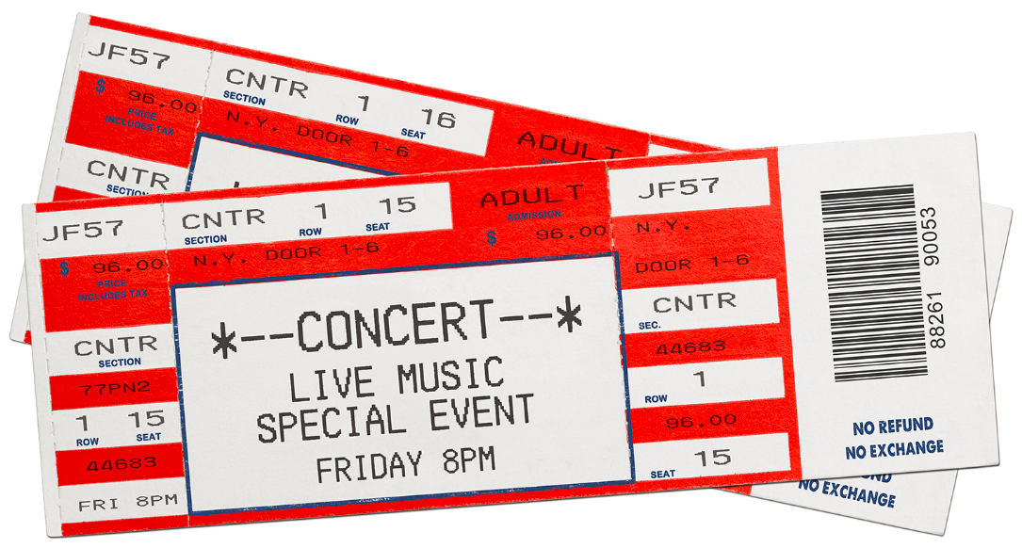
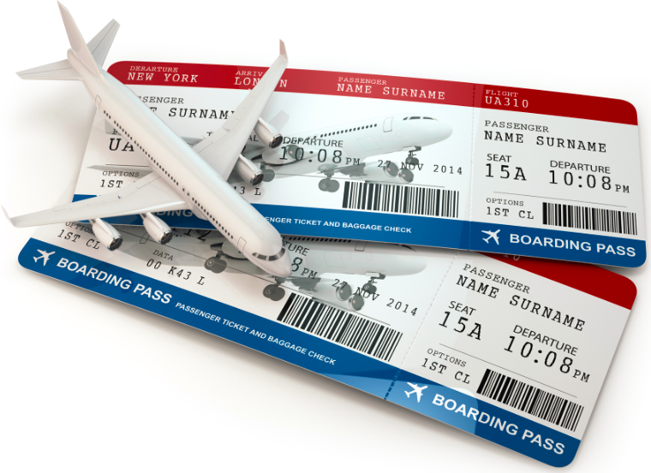
What is a Bribe?
A bribe is illegal, no matter how small
Offering ‘anything of value’ is a bribe.
A bribe has a broader definition than just a cash payment.
Cash
A Pricing Discount
A Bonus
Kickback
Offered indirectly
Such as a scholarship to a family member of a government official
Gifts
Gift Certificate
Gift Cards
Charity Contributions
Political Contributions
Entertainment, such as:
Concert tickets
Sporting event tickets
A trip
Anything used to gain an unfair business advantage is considered a bribe.
Hospitality that is unreasonable, excessive or does not support a legitimate business purpose. Hospitality includes items such as meals, drinks, travel, lodging, or transportation.
A Favor, such as the use of materials, or equipment, use of facilities, a loan, or promise of a job.
25

Slide 26
Our Responsibilities
MTS takes a firm stance against corruption and bribery, regardless of impact on business performance.
This applies to all of us, regardless of where we work and regardless of local customs.
Read and understand anti-bribery MTS policies and procedures.
Consistently execute your work in alignment with these MTS policies and procedures.
Report concerns using the reporting options listed on slide 10.
FCPA Policy ORC-010
Supporting ORC-010 Procedures
26

Slide 27
In Summary
The confidence in our business reputation rests on the honesty, integrity and
good common sense within each of us.
Our responsibility to follow legal, compliance and ethical obligations cannot be fully defined by one set of written rules.
Use the Code to:
Understand what is expected of you as an MTS employee
Help answer your questions
Know where to report a concern
Do the right thing
Base decisions on ethical principles + MTS Values
Use your good sense to:
27

