Slide 1
Q1 FY18 Ethics Committee Key Reminders - Conflict of Interest

Slide 2
Agenda
After reviewing these key reminders, you should have an understanding of the following:
What is a conflict of interest
What are MTS policy requirements
What are some common examples of conflicts of interest
How to report a concern

Slide 3
Conflict of Interest – What is it?
A conflict of interest occurs when an individual’s outside activities or personal interests conflict, or appear to conflict, with his or her responsibilities to MTS, compromising judgment or the ability to conduct business in the best interest of MTS.
An outside activity would be considered a conflict of interest if it:
Has a negative impact on MTS business interests
Negatively affects MTS’ reputation or relations with others
Interferes with an individual’s judgment in carrying out his or her job duties
MTS expectations and requirements can be found here:
OGC.001 MTS Global Code of Ethical Business Conduct
OGC.010 MTS Conflict of Interest Policy
OGC.009 MTS Gifts, Business Courtesies and Sponsorships Policy

Slide 4
Conflict of Interest – Policy Requirements
As an MTS employees, you must:
Act in the best interest of MTS
Make business decisions free from any conflict of interest – do not engage in outside interests that interfere with or impact your ability to do so
Make business decisions based on reasoning that is objective and impartial
Inform the Office of Risk and Compliance when serving on the board of directors of a registered 501(c)3 entity such as a charitable, educational, or other nonprofit board, other than a religious organization
Seek approval from your VP and the Office of Risk and Compliance to take part in legitimate outside activities by completing and submitting the OGC-010.01 disclosure form
OGC-010.01 Outside Interest and Activities Disclosure Form

Slide 5
Conflict of Interest Examples
Outside Financial Interest: Having a financial interest or relationship with an MTS competitor, supplier or customer
Outside Competing Business: Owning your own business or providing consulting services where your business is a competitor, supplier or customer to MTS
MTS Non-Public Information: Using MTS proprietary information, trade secrets, or other non-public information for personal gain or improper benefit of others
Engaging in a Personal Relationship: Engaging in a personal relationship with another MTS employee that is inconsistent with MTS policy
Gifts / Gratuity: Accepting and giving a business gratuity or gift to/from a competitor, supplier, or customer that is inconsistent with MTS policy

Slide 6
Conflict of Interest - Gifts & Gratuities
What is meant by gift?
Includes any gratuity, favor, discount, entertainment, hospitality, loan, forbearance, gifts of services (i.e. training, transportation, local travel)
When is it okay to give/accept a gift to/from a supplier, customer, or competitor?
It is consistent with customary business practices (i.e. holiday, cultural, a business event) and the industry
Does not exceed monetary limits set in OGC-009 policy
Does not create the appearance of preferential treatment
Would not embarrass MTS or the gift giver if disclosed publicly
Does not create a real or potential conflict of interest
Is accurately recorded on MTS’ books and records
Promotes, demonstrates or explains MTS products/services
Enhances knowledge of MTS’ industry
Gifts Allowed
Modest items of food (snacks, coffee, soft drinks)
Greeting cards
Other items of limited intrinsic value used for presentation purposes
Gifts NOT Allowed
Gifts of cash or equivalent
Gifts that violate FCPA standards
Gifts given as a bribe / kickback
Tickets to events (i.e. sports, concerts)
Gifts to/from government officials Gifts to / from organizations where MTS has agreed to gift restrictions

Slide 7
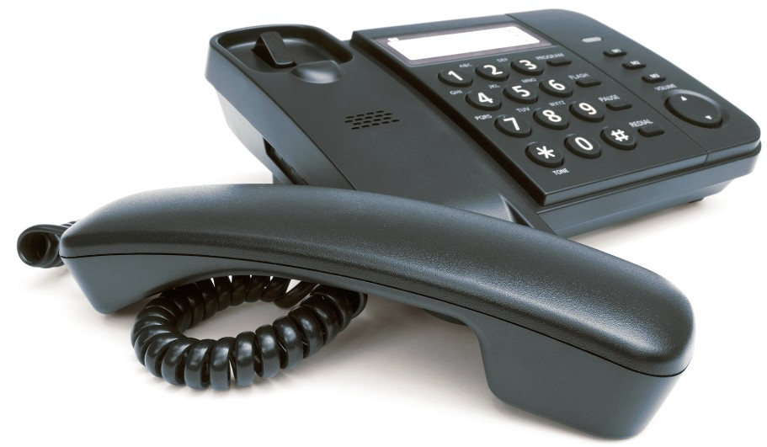
How to Report a Concern - Do the Right Thing!
To your Supervisor, HR, Local Ethics Committee member or other member of management
Office of Risk and Compliance
MTS_Risk_&_Compliance@mts.com
MTS Alert Line
https://alertline.com
SPEAK UP! If you have concerns about adherence to the Conflict of Interest Policy
TALK
EMAIL
VISIT
CALL
Country | Direct Access Number | Alert Line Number
North America |  | 888-321-5562
China, PRC (Northern Region) | 108-888 | 888-321-5562
China, PRC (Southern Region) | 108-11 | 888-321-5562
Japan (KOOI) | 00 539-111 | 888-321-5562
Japan (NTT) | 0034-811-001 | 888-321-5562
Korea (Korea Telecom) | 0072-911 | 888-321-5562
France | 0800-99-0011 or 085-701-288 | 888-321-5562
Germany | 0-800-2255-288 | 888-321-5562
Italy | 800-172-444 | 888-321-5562
Sweden | 020-799-111 | 888-321-5562
United Kingdom (BT) | 0800-89-0011 | 888-321-5562
United Kingdom (C&W) | 0800-89-0011 | 888-321-5562

