Slide 1
US Dept. of Commerce - Bureau of Industry and Security (BIS) Export Controls
Revised 11/26/2018

Slide 2
BIS EAR Export Controls
The Export Administration Regulations (EAR) are administered by the Bureau of Industry of Security within the US Dept. of Commerce
The EAR can apply to both domestic and international work, products, & technology
MTS ITAR internal process controls are somewhat similar for EAR
The scope can include:
Specially designed products and test equipment for use by military and not regulated by ITAR
Commercial orders that have dual use or restricted end use/user
MTS Global Trade Compliance team is responsible for making a determination taking into account a number of factors related to opportunity:
Customer input | Presence of new part numbers
Customer’s test specimen | Presence of engineering hours
Vendor input | Presence of a controlled item in BOM
Engineering input | End use/End user
Notes:
Test equipment for vending machines, not customization done, this would not apply
US Army orders depending on specific products and end use and why GT needs to review
When there are additional controls these are requirements
Link to website: https://www.bis.doc.gov/index.php/regulations/export-administration-regulations-ear

Slide 3
MTS Legal
Any US Govt. or Federal contracts (Example FARS)
Any Defense contracts (Example DFARS)
Any customer contract requirements must be routed to MTS legal for guidance and not MTS Global Trade compliance
Examples include:
Any documents and agreements requested by any parties to the agreement
Project documents
Technical contractual agreements
IP/contract

Slide 4
Pre-Sale Process
If subject to EAR controls the following steps are taken:
Ensure all individuals involved on project are US Persons:
MTS coworkers, business partners, non-US Person customers (in and outside of US)
Verify with Global Trade Compliance
Non-US Persons may need an export license to be involved
Do not share “technical data” that is licensable. Stick with a simple quote outlining basic descriptions and prices. You can share information that’s already in the public domain (e.g., product brochures).
Restrict your discussions (“technical assistance”) to information already in the public domain and not derived from your experience or knowledge of work on systems built for the military

Slide 5
Pre-Sale Process
Export license may be required for non-US Person involvement on transaction
A non-US Person can be located inside or outside the US (IE Engineer)
Considered deemed export while in US
License applications are submitted by Global Trade Compliance personnel to the U.S. Department of Commerce
No fee to MTS to submit individual license applications
Expect 2 weeks to prepare the application and 6-8 weeks on average to obtain a response
Government response may be Return Without Action, License approval, or License denial
Licenses expire once the quantity (or value) shipped reaches that authorized by the license, or when the license reaches its expiration date (4 years)

Slide 6
Pre-sale Data Storage Requirements Through Shipment
Okay storing technical data on MTS network drives
Must be access controlled
Okay storing technical data on MTS desktop or laptop computers
Must be accessed controlled
Must have windows 10 if travelling outside United States

Slide 7
Post-sale through Shipment
Drawings and other technical data derived from EAR data received from the customer are themselves EAR and need protection
When creating technical data for projects:
A text block has been provided for each CAD package
Add text block near title block of drawing
EXPORT CONTROLLED. This document contains technical data controlled by the Export Administration Regulations (EAR) or International Traffic in Arms Regulations (ITAR) and is subject to export control laws of the U.S. Government. Transfer of this data by any means to a foreign person, whether in the U.S. or abroad, without an export license or other approval from the appropriate jurisdictional agency, is prohibited. Contact Global Trade Compliance for more information.
“EAR Technical Data Marking Guidelines” available from the Global Trade Compliance upon request

Slide 8
Post-sale through Shipment
When you create a new part number for a licensed EAR product or project, flag that item as Military checked controlled unless:
Part number is an off-the-shelf purchased part not controlled
Part number is created solely as a result of the way we run our projects
Part number is created for some reason unrelated to the current project, could be different length or size unrelated to enhanced performance
Do not mix commercial goods and licensed EAR or ITAR products on the same engineering drawing. Must be separated for tabulated drawings
Do not make a copy of a Military checked item, and call it commercial, just to avoid having to deal with the controls
Be careful when using an existing material master to create a new material master

Slide 9
Post-sale through Shipment
How does Engineering flag a specific part number as controlled?

Slide 10
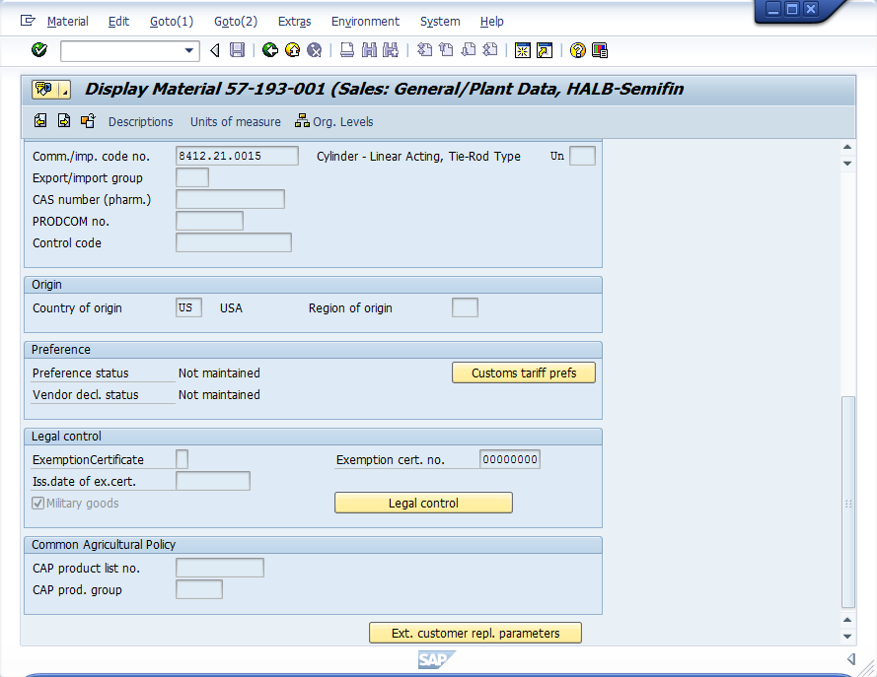
Post-sale through Shipment
Once drawing is released by engineering, how does MTS flag a specific part number as controlled?
Currently done by Connie Norman and team

Slide 11
Post-sale through Shipment
By checking the “Military Goods” checkbox within a material master record, the engineering drawing associated with that material is directed to a secured storage location
Access to the secured storage location is controlled by Global Trade Compliance
To gain access, e-mail:
Name, country of birth, country of citizenship, proof of citizenship and SAP User ID to GlobalTrade@mts.com
Once access is provided, you will be able to access all controlled drawings via DOD, but not Finder
Okay storing technical data on MTS network drives
Okay storing technical data on MTS desktop or laptop computers

Slide 12
Summary
Protect electronic data and hard copies
Restrict involvement to US Persons unless authorization is received
Keep Global Trade Compliance informed
If you have questions or concerns on topics we have not covered, please ask us!

