Slide 1
International Traffic in Arms Regulations (ITAR)
Revised 05/31/2018

Slide 2
Definitions
ITAR
International Traffic in Arms Regulations
Defense and military related technologies
US Person
US Citizen, Permanent Resident Alien (Green Card holder), Political Asylee
Technical data
Drawings, plans, diagrams, models, formulae, tables, engineering designs and specifications, manuals, and other instructions
Technical assistance
Instruction, skills, training, working knowledge, and consulting services

Slide 3
When ITAR applies
ITAR can apply to both domestic and international work
MTS Global Trade Compliance team is responsible for making a determination taking into account a number of factors:
Customer input | Presence of new part numbers
Customer’s test specimen | Presence of engineering hours
Vendor input | Presence of a controlled item in BOM
Engineering input | Commodity Jurisdiction Request

Slide 4
Pre-sale
Ask the customer if project is subject to ITAR
Ensure all individuals involved are US Persons:
MTS coworkers, business partners, non-US Person customers (in and outside of US)
Verify with Global Trade Compliance
Non-US Persons may need an export license to be involved
Do not share “technical data” that is military specific. Stick with a simple quote outlining basic descriptions and prices. You can share information that’s already in the public domain (e.g., product brochures).
Restrict your discussions (“technical assistance”) to information already in the public domain and not derived from your experience or knowledge of work on systems built for the military.
Advise Global Trade Compliance that project is ITAR

Slide 5
Pre-sale
Export license may be required for shipment and/or non-US Person involvement
A non-US Person can be located inside or outside the US
License applications are submitted by Global Trade Compliance personnel to the U.S. Department of State
No fee to MTS to submit individual license applications
Expect 2 weeks to prepare the application and 6-8 weeks on average to obtain a response
Government response may be Return Without Action, License approval, or License denial
Licenses expire once the quantity (or value) shipped reaches that authorized by the license, or when the license reaches its expiration date (4 years)

Slide 6
Pre-sale
If you receive technical data from customer, ask if it is controlled. If yes, it must be encrypted or secured:
Storing on network drives?
Company servers are encrypted but access must be controlled
Company SharePoint sites are encrypted but access must be controlled
Storing on desktop or laptop computers?
Windows 7 systems are not encrypted and do not meet requirements
Windows 10 meets encryption requirements
Transmitting technical data outside MTS?
Ask IT Security to ensure your e-mail encryption meets requirements
Storing hard copy (printed) files?
Ask Facilities to get keys for cabinets/offices

Slide 7
Post-sale through Shipment
Drawings and other technical data derived from ITAR data received from the customer are themselves ITAR and need protection
When creating technical data for projects:
A text block has been provided for each CAD package
Add text block near title block of drawing
“ITAR Technical Data Marking Guidelines,” available from the Global Trade Compliance upon request

Slide 8
Post-sale through Shipment
When you create a new part number for an ITAR product or project, flag that item as ITAR controlled unless:
Part number is an off-the-shelf purchased part not ITAR controlled.
Part number is created solely as a result of the way we run our projects.
Part number is created for some reason unrelated to the current project.
Do not mix commercial goods and ITAR controlled goods on the same engineering drawing
Do not make a copy of an ITAR controlled item, and call it commercial, just to avoid having to deal with the ITAR
Be careful when using an existing material master to create a new material master

Slide 9
Post-sale through Shipment
How does Engineering flag a specific part number as controlled?

Slide 10
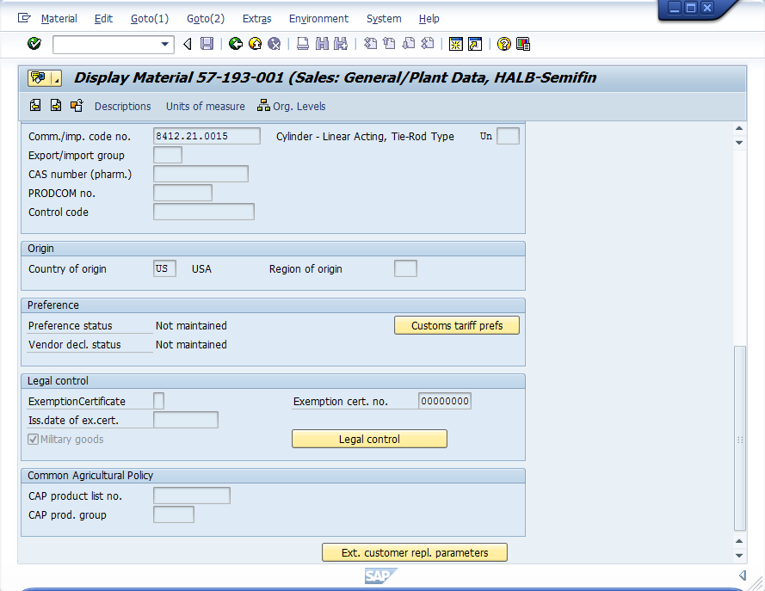
Post-sale through Shipment
Once drawing is released by engineering, how does MTS flag a specific part number as controlled?
Currently done by Connie Norman and team

Slide 11
Post-sale through Shipment
By checking the “Military Goods” checkbox within a material master record, the engineering drawing associated with that material is directed to a secured storage location
Access to the secured storage location is controlled by Global Trade Compliance
To gain access, e-mail:
Name, country of birth, country of citizenship, proof of citizenship and SAP User ID to GlobalTrade@mts.com
Once access is provided, you will be able to access all controlled drawings via DOD, but not Finder

Slide 12
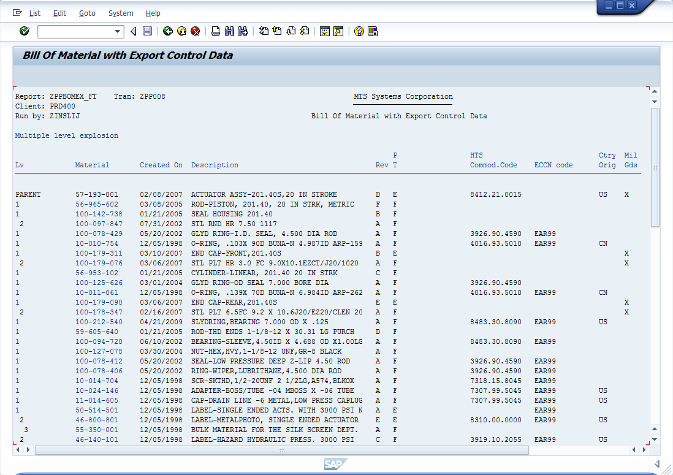
Post-sale through Shipment
Transaction code ZPP008:

Slide 13
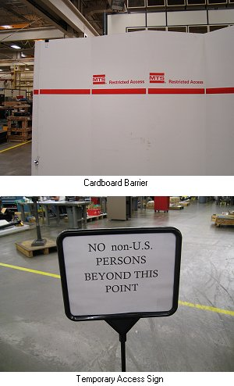
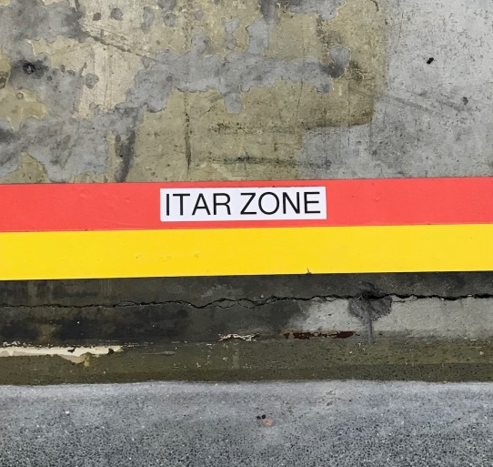
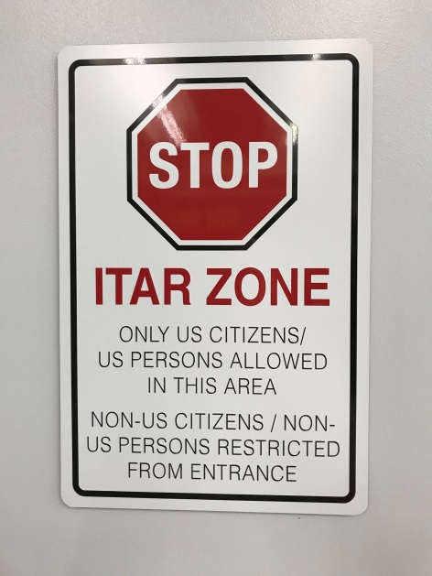
Post-sale through Shipment
Plant floor physical restrictions:
Floor markings
Signs

Slide 14
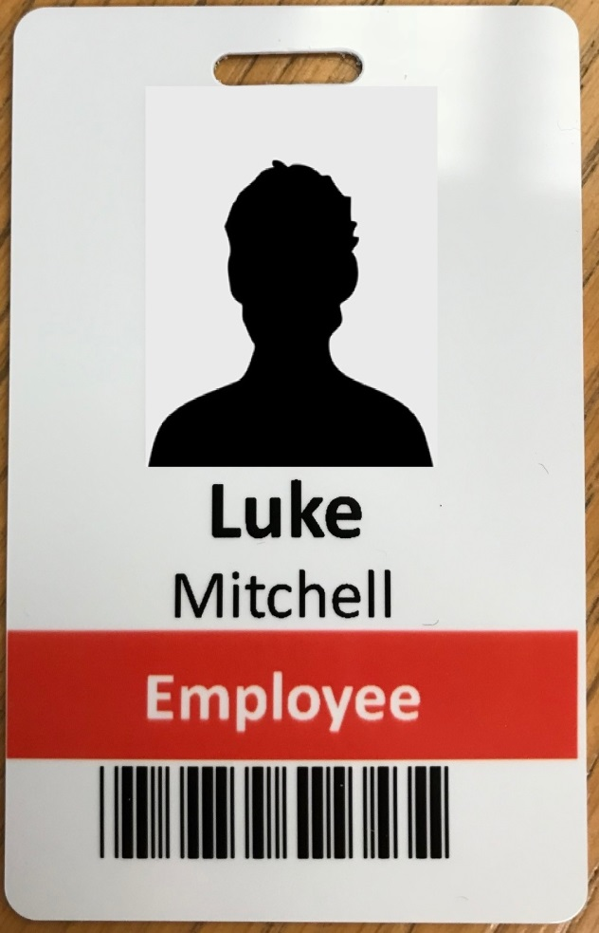
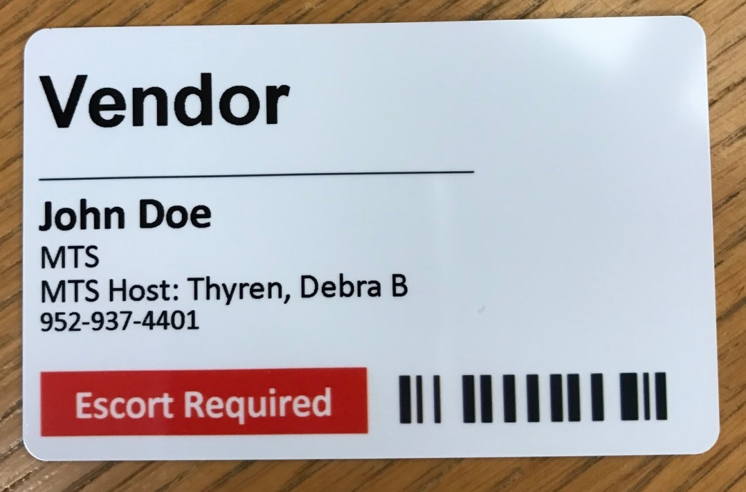
Post-sale through Shipment
Red stripe on badge indicates non-US Person

Slide 15
Post-sale through Shipment
If subcontracting manufacturing, our vendor/supplier must be ITAR registered (if project is subject to ITAR)
Coordinate all international shipments with Global Trade Compliance and Logistics/Shipping
All ITAR international shipments require an export license
Best practice is to ship complete and not partial shipments
Forgotten items may require a separate export license

Slide 16
Post-shipment
Coordinate all technical support and/or service calls with Global Trade Compliance
Post-installation support calls may require an export license if providing service outside of US
Coordinate all service parts orders with Global Trade Compliance
Parts orders may require an export license if shipping outside of US

Slide 17
Summary
Protect electronic data and hard copies.
Protect data transmissions.
Restrict involvement to US Persons unless authorization is received.
Restrict access on plant floor.
Ensure all international shipments are licensed.
Be careful with post-installation activities.
Keep Global Trade Compliance informed.
If you have questions or concerns on topics we have not covered, please ask us!

