Slide 1
Privacy and Data Protection Training Human Resources Responsibilities
May 2021

Slide 2
Privacy and Data Protection Compliance Program Structure
MTS has a formal Privacy and Data Protection Compliance Program, with related practices and standards managed and executed across different business areas.
Business Area Roles
Office of Risk and Compliance sets organizational compliance expectations through policies and trainings.
Human Resources adheres to compliance requirements to safeguard personal data as they manage daily HR practices.
Information Technology and Security owns security measures to protect MTS networks and systems and safeguard data from loss, misuse, unauthorized access, disclosure, alteration or destruction.
This training will focus on the role of Human Resources regarding privacy related practices and standards.
2

Slide 3
Privacy and Data Protection
Privacy Principles
As HR employees, you are responsible for protecting the personal data you have access to as you execute HR business activities. Follow the key principles outlined below.
Key Privacy Principles
These key principles apply to the full lifecycle of personal data:
Only use and share personal data for its intended business purpose
Create / Collect
Store
Use
Share
Retain / Destroy
Follow operational and technical safeguards to avoid unauthorized access
Use the minimum amount of personal information necessary for your work
3

Slide 4
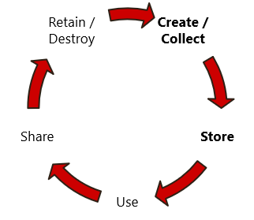
Privacy and Data Protection
Requirements
Creating, Collecting, and Storing Personal Data
Create / Collect
Only create or collect the personal data needed to specifically perform an operational task or business-related project.
Store
Store information on approved devices and locations only.
Ensure that documents that contain personal data are kept in secure locations with access only to those employees that need it to perform their job function.
Regularly review access rights on HR shared drives that include personal data.
For sensitive personal data, safeguard data through file-level security controls (e.g., password protecting files) and dispose of immediately after business use.
4

Slide 5
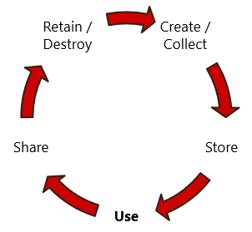
Privacy and Data Protection
Requirements
Using Personal Data
Use
Further protect sensitive* personal information by adding additional security controls on documents (such as password protection, email encryption, etc.).
Avoid duplicating personal data, including saving personal data in multiple locations or unnecessarily printing copies.
Avoid downloading or saving personal data that is not needed for a specific operational task or project.
Lock your screen and secure personal data when you are away from your desk.
* Sensitive personal data requires additional protection, as processing of this kind of data is heavily regulated by country-specific privacy laws and regulations. Some examples include social security or national identification number, personal health information, religious beliefs, race, ethnicity.
5

Slide 6
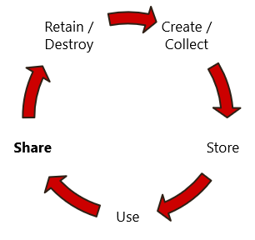
Privacy and Data Protection
Requirements
Sharing Personal Data
Share:
Only share personal data with those who need it to fulfill their job responsibilities.
If sharing personal data via email as part of an HR process, use MTS’s email system; Do not use personal email accounts.
Prior to sending an email that contains personal data, review the distribution list to ensure only those who need data have been included on the email.
Include a note on the subject line or within the email stating that personal data is included.
When transferring personal data internally between MTS employees, it is best practice to secure with an email encryption feature.
When transferring personal data between an MTS employee and a third party, it is required to use a secure method such as an email encryption feature.
6

Slide 7
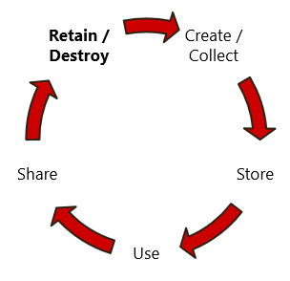
Privacy and Data Protection
Requirements
Retaining and Destroying Personal Data
Retain / Destroy:
Strictly follow document retention policy and related guidelines – review, archive and delete electronic and paper documents when no longer needed or retention timeframe has been met.
Take caution with disposal method of sensitive data on hard drives and network drives, when no longer needed.
Take caution with disposal method of sensitive data in paper files, ensuring disposal is handled using currently approved secure handling methods (e.g., shred).
Delete any documents with personal data that are saved on personal drives and no longer serve a business or legal need.
If you have questions on retention or destruction of data, please consult with your legal or compliance partners.
7

Slide 8
Privacy and Data Protection
Reporting a Privacy Incident
Because of your day-to-day responsibilities and access to employee personal data, you may be the first to identify a privacy incident related to personal data.
Report a potential incident immediately to privacy@mts.com
ORC, Legal, IT, and HR teams work together and follow the Privacy Incident Response Policy to address a reported incident.
Europe Privacy Policy ORC-012
Incident Response Policy ORC-013
Global Privacy Policy ORC-014
North America Privacy Policy ORC-015
8

Slide 9
Privacy and Data Protection
Lessons Learned
In summary, MTS had many key takeaways from the recent cyber event. Lessons learned related to HR data include:
Use Minimum Personal Data: Only download what you need for a specific task or project.
Safeguard Personal Data: While the personal data is in your possession, secure it (e.g., password protect project files).
Destroy Personal Data: When you no longer need the data for its business purpose, destroy files following record retention guidelines.
HR is partnering with IT to evaluate solutions to identify sensitive personal data in our network folders, to support ongoing file clean up and monitoring efforts.
9

