Slide 1
Global Trade Education & Training

Slide 2
Agenda
After completing this training, you should have an understanding of the following:
MTS Legal History and Issues due to non-compliance with Trade Requirements
Sales’ Role and Responsibilities in supporting Global Trade:
    Know your customer, product, and delivery
Improvement Opportunities
Resources

Slide 3
MTS History
2000 – Multiple Violations of Export Administration Regulations
2003 - 2004 – Multiple Violations of Export Administration Regulations
2008 - 2011 – Multiple Violations of Government Contracting Requirements
  Exporting product to a listed entity without a license
  Mis-representing material facts in obtaining export licenses
  Failing to disclosure prior regulatory violations on certifications
Impacts: Fines & Penalties, Negative Company Reputation, Banned from Business Opportunities - Federal & State Contracts

Slide 4
Your Responsibilities

Slide 5

Know your customer - Companies
MTS must verify the legitimacy of its customer so that it does not transact with prohibited companies or individuals under export control and/or sanctions rules.
Typical customer “red flags”
“This new customer is great, he is willing to pay all cash without our typical financing agreement.”
“That’s odd, no one is familiar with our new customer’s business and we can’t find any background on its operations.”
  WHAT TO DO IF THIS APPLIES TO YOUR SITUATION:
  Before doing business:
  Identify and document the legal names and addresses of all parties involved in the sale/shipment. Understand each party’s role in the transaction.
  Verify who the customer is, including what they do and are known for, where they operate and which customers and business partners they are affiliated with.
  Ensure that the customer is a legitimate business in the jurisdiction(s) it operates. Do not proceed with unverified persons/entities.

Slide 6

Know your customer – Research & Teaching Institutes
MTS must verify the legitimacy of its customer so that it does not transact with prohibited companies or individuals under export control and/or sanctions rules.
Typical customer “red flags”
“This new customer is great, he is willing to pay all cash without our typical financing agreement.”
“That’s odd, no one is familiar with our new customer’s business and we can’t find any background on its operations.”
  WHAT TO DO IF THIS APPLIES TO YOUR SITUATION:
  Before doing business:
  Identify and document the legal names and addresses of all parties directly involved in the sale/shipment. Understand each party’s role in the transaction.
  Identify and document the legal names and addresses of all parties indirectly involved in the sale/shipment. Understand each party’s role in the transaction. For example, parties overseeing, advising, benefitting, and/ or funding the Research or Teaching.
  Verify who the customer is, including what they do and are known for, where they operate and which customers and business partners they are affiliated with.
  Ensure that the customer is a legitimate business in the jurisdiction(s) it operates. Do not proceed with unverified persons/entities.

Slide 7
End User / Use Letter – USER SECTION ONLY

Slide 8

Know your product and use - Companies
MTS must understand how our products will be used by our customers and how our products can be used to minimize the chance of unlawful misuse
  WHAT TO DO IF THIS APPLIES TO YOUR SITUATION:
  Before doing business:
  Understand what we are selling, including customizations, non-standard configurations, usage in rugged environments (extreme temperatures, radiation exposure, etc.), and the dollar value of the transaction.
  Verify how the product will be used including any intended transfer or reexport.
  Is the requested product common/appropriate for the customer based on business, facility/location, etc.? If customer declines typical accessories/options, training and/or in-person FAT, ask why and document the customer’s rationale.
  Determine how the product could be used.
Typical end use “red flags”
“Our customer requested a product configuration that’s inconsistent with the destination country’s standards (e.g., wrong voltage) or technology level.”
“The product ordered seems inappropriate for the customer’s line of business and/or for its facility.”

Slide 9

Know your product and use - Research & Teaching Institutes
MTS must understand how our products will be used by our customers and how our products can be used to minimize the chance of unlawful misuse
Typical end use “red flags”
“Our customer requested a product configuration that’s inconsistent with the destination country’s standards (e.g., wrong voltage) or technology level.”
“The product ordered seems inappropriate for the customer’s line of business and/or for its facility.”
  WHAT TO DO IF THIS APPLIES TO YOUR SITUATION:
  Before doing business:
  Understand what we are selling, including customizations, non-standard configurations, usage in rugged environments (extreme temperatures, radiation exposure, etc.), and the dollar value of the transaction.
  Verify how the product will be used by direct and indirect users, including any intended transfer or reexport, shared direction, shared specimens, shared use, shared testing, etc.
  Identify and document the legal names and addresses of all parties indirectly involved in the sale/shipment. Understand each party’s role in the transaction. For example, parties overseeing, advising, benefitting, and/ or funding the Research or Teaching.
  Is the requested product common/appropriate for the customer based on business, facility/location, etc.? If customer declines typical accessories/options, training and/or in-person FAT, ask why and document the customer’s rationale.
  Determine how the product could be used.

Slide 10
End User / Use Letter – USE SECTION ONLY

Slide 11
End User / Use Letter – USE SECTION ONLY (Continued)

Slide 12
Know your delivery
MTS must minimize opportunities for our products to be diverted from lawful end uses, users and destinations to unauthorized ones contrary to export control and/or sanctions rules.
Typical diversion “red flags”
“ Our customer requested delivery to an unusual destination or via a seemingly inconvenient shipping route.”
“The customer listed its freight forwarder or a P.O. Box (except for UAE) as the final destination.”
  WHAT TO DO IF THIS APPLIES TO YOUR SITUATION:
  Before shipping the items:
  Verify that MTS preferred incoterms are utilized.
  Communicate to the Global Trade team any customer requests to change parties to the transaction (e.g., end user, consignee, etc.) and/or end destinations (e.g., delivery address).
  Communicate to the Global Trade team any customer requests to an unusual location or a shipping route that seems unusual based on your sales experience.
2

Slide 13

Recap of Know Your Customer, Product, and Delivery
You are critical to MTS’ Global Trade Business and are MTS’ first line of protection and defense!
  Proactively consult with the Global Trade team as needed.
  Ask open-ended questions and make sure you receive clear and complete answers from Customers.
  Include detailed and updated information about end user and end use in all communications and documentation throughout the lifecycle of the transaction.
  Always report any suspicious or evasive responses to the Global Trade team.
  Read and understand ORC-008 Global Trade Policy.
MTS must clearly understand and confirm:
Who our customers are
How our customers will be using our products
Our products reach our customers
Our products are used by our customers for the stated purpose

Slide 14
Improvement Opportunities

Slide 15
#1 Opportunity
# 1 Enhance the quality of the End User / End Use Letters
  Ensure that the letters are complete and accurate
NOTE –
  You MUST review the letter completed by the End User prior to returning the letter to the Global Trade team
    When you return the end user / end use statement
      You are accountable for the completeness and accuracy of the information.
      You are responsible for telling us if there is additional information that should be provided to allow us to complete our compliance review

Slide 16
#2 Opportunity
#2 Use optimal transaction structure
Reduce use of resellers, import agents, and/ or buying agents
Use the Buy / Sell Business Model
  Customer places order on MTS India
  MTS India places order on MTS U.S. for goods only
  MTS India delivers “one line” solution
Sell goods and services under separate contracts
  Customer places order on MTS India for local content
  Customer places order on MTS U.S. for U.S. content
Sell goods and services under one contract with itemization: foreign goods, foreign services, local goods, local services

Slide 17
#3 Opportunity
#3 Enhance books and records
  Include direct and indirect parties involved in the transaction
  Include complete names, addresses, and role of all direct and indirect parties
  Use Legal & Compliance review to communicate information to Trade team
    NOTE - Continued on next 4 slides

Slide 18
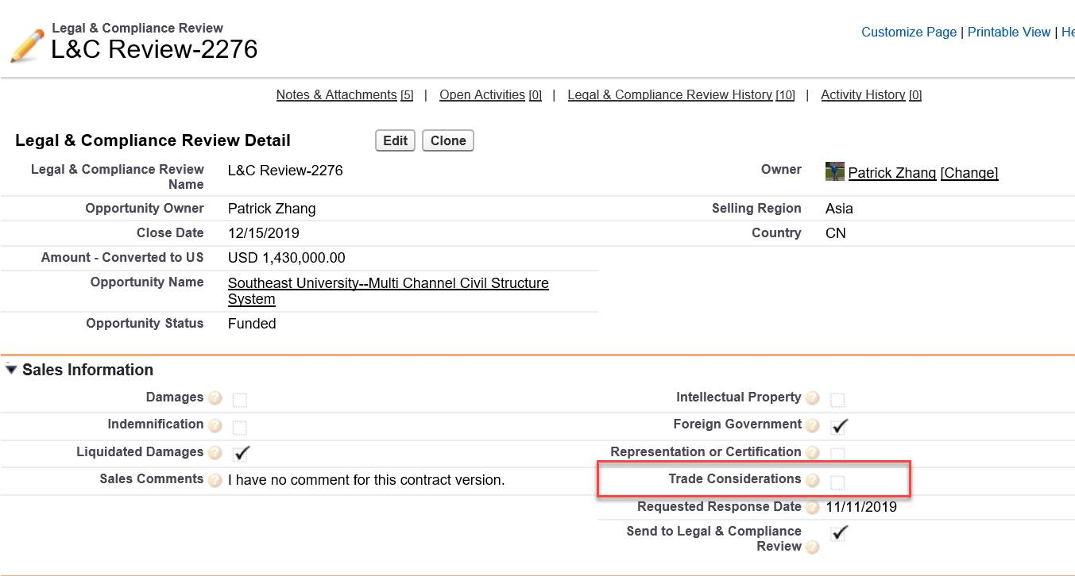
#3 Continued

Slide 19
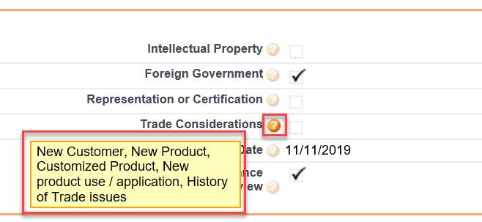
#3 Continued

Slide 20
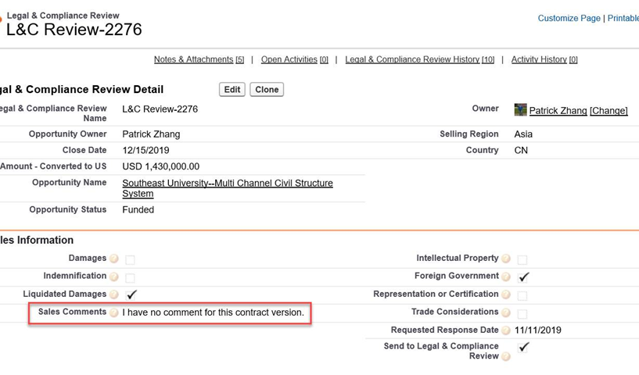
#3 Continued

Slide 21
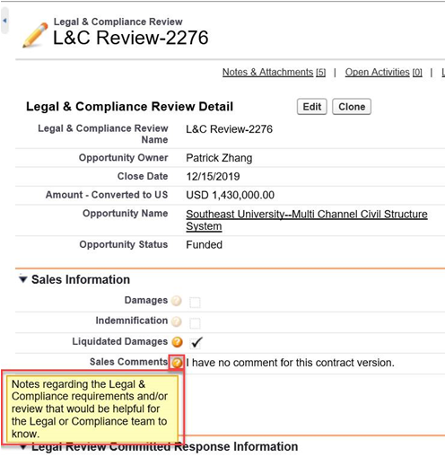
#3 Continued

Slide 22

#4 Opportunity
#4 Enhance and Retain Documentation
From Potential Customer (RFQ)
  Copy of Procurement Announcement
From Customer
  Award Letter
From Customer
  Copy of PO to MTS or Copy of PO to 3rd party and copy of 3rd party PO to MTS
From Potential Customer
  Copy of Tender Offer
From MTS
  Tender Response Submitted
From Potential / Actual Customer
  Copy of any / all terms and conditions for procurement and tender processes
This Photo by Unknown Author is licensed under CC BY-SA

Slide 23
Resources

Slide 24
Global Trade Team
Office of Risk and Compliance
Phyllis Nordstrom
Chief Risk and Compliance Officer
Business Ethics, Investigations and Monitoring
Corporate Compliance Programs
Global Trade Team
Order and Contract Administration
Kim Johnson
Director, Global Trade
Test
Sensors
Page 6

Slide 25
Global Trade Written Policies, Procedures, Tools
Office of Risk & Compliance Global Trade Policy
Website (Intranet > Quality Mgmt System > Materials Management)
Global Trade - Red Flags Checklist
Global Trade - End User Statement & End Use Statement
Global Trade - Site Visit

Slide 26
Global Trade - Red Flags Checklist
The customer or its address is similar to one of the parties found on the Commerce Department's [BIS'] list of denied persons.
The customer or purchasing agent is reluctant to offer information about the end-use of the item.
The product's capabilities do not fit the buyer's line of business, such as an order for sophisticated computers for a small bakery.
The item ordered is incompatible with the technical level of the country to which it is being shipped, such as semiconductor manufacturing equipment being shipped to a country that has no electronics industry.
The customer is willing to pay cash for a very expensive item when the terms of sale would normally call for financing.
The customer has little or no business background.
The customer is unfamiliar with the product's performance characteristics but still wants the product.
Routine installation, training, or maintenance services are declined by the customer.
Delivery dates are vague, or deliveries are planned for out of the way destinations.
A freight forwarding firm is listed as the product's final destination.
The shipping route is abnormal for the product and destination.
Packaging is inconsistent with the stated method of shipment or destination.
When questioned, the buyer is evasive and especially unclear about whether the purchased product is for domestic use, for export, or for reexport.

Slide 27




Report Global Trade Concerns
    To your Supervisor, HR, Local Ethics Committee or other members of management
    Office of Risk and Compliance MTS_Risk_&_Compliance@mts.com
    MTS Alert Line https://alertline.com
TALK
EMAIL
VISIT
CALL
Page 11
Page 10

