Slide 1
MTS System GmbH introduces environmental management system until 10/2018.
What does environmental management system mean and why is it important?

Slide 2
What does environmental management mean?
The environmental management system is a tool for the definition, documentation and control of those activities in a company which have a significant influence on its environmental impact.

Slide 3
Why is environmental management important?
Reasons for legal compliance
Benefits for the environment
Increased transparency
Economic reasons

Slide 4
Essential steps for the introduction (1/3)
Designation of the EHS responsible person
For Europe this is Christian Gust
Definition of context & environment
Who/what influences us?
Assessment of environmental impacts / aspects
Who/what do we influence?
Definition of environmental goals (smart)
What do we want to achieve?

Slide 5
Essential steps for the introduction (2/3)
Implementation of measures to improve environmental performance
How do we preserve the environment?
Documentation of the environmental management system: overviews, procedural instructions, work instructions.
Instructing and informing employees
Add environmental check & action to processes
When & how do I make decisions in day-to-day business, taking into account the environmental impact?

Slide 6
Essential steps for the introduction (3/3)
Regular assessment and continuous improvement of performance
Measurement, Analysis & Evaluation of Consumption
Measures to minimize consumption
Auditing
Certification audit stage 1 (documents) on 24.07.2018
Internal audit on 11 & 12.09.2018
Certification audit on 04. & 05.10.2018

Slide 7
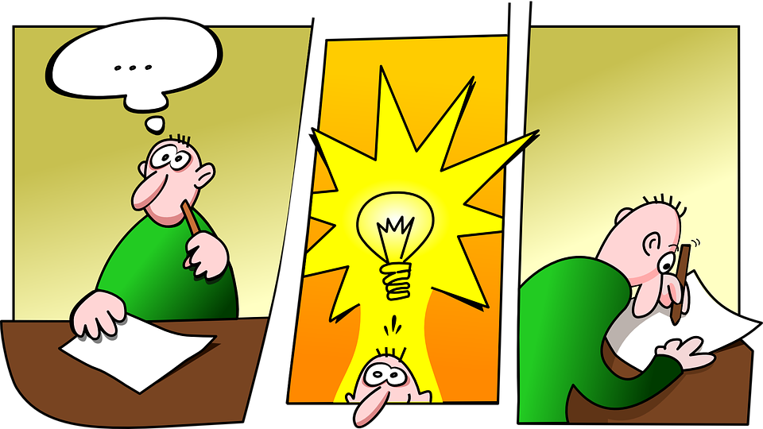
An idea - how We at MTS – can better protect the environment?
Your idea by email
To HealthSafetyEurope@MTS.com
Subjects: Area/Processes & Brief information regarding environmental topic
Description of the improvement potential with actual state and - if possible – optimized or planned state.

