Slide 1
Scaffold Inspection Training - Competent Person Qualification

Slide 2
Agenda
Scaffolding Types
Scaffolding Terminology
Components
Requirements
Types of Scaffolding Classification
Scaffolding Basics
Competent Person Responsibilities (MTS Specific)
Inspection Requirements
Locations within MTS
Knowledge Checks
Conclusion

Slide 3
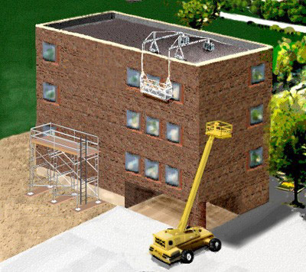
Scaffolding Types
Supported Scaffolds (1) – consists of one or more platforms supported by rigid, load-bearing members, such as poles, legs, frames, outriggers, etc.
Suspended Scaffolds (2) – which are one or more platforms suspended by ropes or other non-rigid, overhead support.
Other types (3) – such as scissor lifts and aerial lift can be regarded as other types of supported scaffolds.
2
1
3

Slide 4
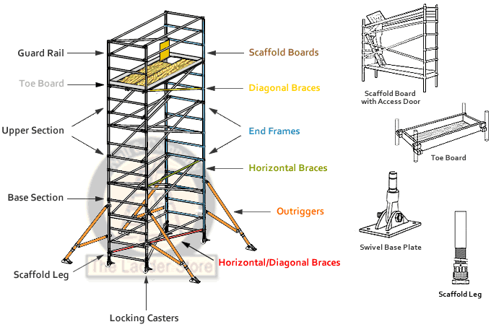
Scaffolding Terminology
Guard Rail – a vertical barrier, consisting of, but not limited to, toprails, midrails, and posts, erected to prevent employees from falling off a scaffold platform or walkway to lower levels.
Toe Boards – a piece of metal that surrounds the working platform to prevent material from falling off the work/walkway onto lower levels. Must be 3.5” tall minimum, per OSHA requirements.

Slide 5
Scaffolding Terminology cont.
Diagonal Braces – a scaffold tube placed diagonally with respect to the vertical and horizontal members of a scaffold and fixed to them to give the scaffold stability.
End Frames – a system of fabricated tubular metal frames (panels) that are connected in the field with bracing members.
Outriggers – The structural member of a supported scaffold used to increase the base width of a scaffold in order to provide support for and increased stability of the scaffold.

Slide 6
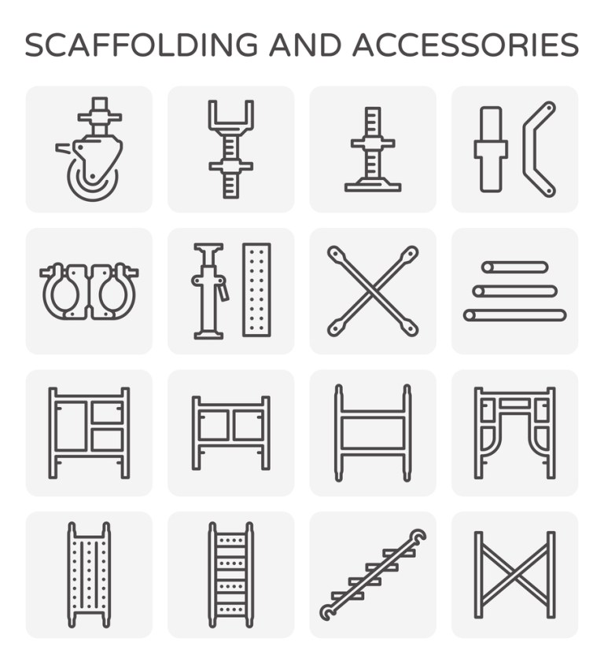
Scaffolding Terminology cont.
Base plate – a flat supporting plate or frame at the base of a column, designed to distribute the column’s weight over a greater area and provide increased stability.
Working Platform – the platform where the majority of foot-traffic is expected to be.
Ladder – must be industry-rated.
Anchor Bolt – The type of approved anchor to secure a wall or anchor tie.

Slide 7
Types of Scaffolding Classification
Light Duty
Not to exceed 25 pounds per square foot
10 foot longitudinal post spacing
6 foot traverse post space
1 work level
8 additional planked levels
125 feet maximum height
2 work levels
4 additional planked levels
125 feet maximum height
3 work levels
0 additional planked levels
91 feet maximum height
Medium Duty
Not to exceed 50 pounds per square foot
8 foot longitudinal post spacing
6 foot traverse post space
1 work level
6 additional planked levels
125 feet maximum height
2 work levels
0 additional planked levels
78 feet maximum height
Heavy Duty
Not to exceed 75 pounds per square foot
6’ 6” foot longitudinal post spacing
6 foot traverse post spacing
1 work level
6 additional planked levels
125 feet maximum height

Slide 8
Scaffolding Basics
Training – Employers must train each employee who works on a scaffold on the procedures to control or minimize the hazards.
Inspections – Before each work shift and after any occurrence that could affect the structural integrity, a competent person must inspect the scaffold and scaffold components for visible defects.
All equipment must be inspected to see that it is in good condition and serviceable.
Damaged or deteriorated equipment must not be used.
Fall Protection – required at a 10ft height above a lower level.
Safe Access – When erecting and dismantling supported scaffolds, a competent person must determine the feasibility of providing a safe means of access and fall protection for these operations.
Level Ground – Inspect job site to determine ground conditions, strength of (if any) supporting structure and any overhead obstructions.
Compensate for uneven ground by using screw jacks and base plates.
Do not use unstable objects such as blocks, loose bricks or similar objects.

Slide 9
Competent Person Responsibilities (MTS Specific)
Construction:
Overall construction is usually conducted through a 3rd party contractor. At the time of generating this training, this training does NOT cover the training requirements needed for MTS employees to build, modify, or dismantle scaffolding structures.
Inspections:
An inspection of the entirety of the scaffold structure must be completed every day there is work being conducted on the structure.
Signatures (Initials) must be present on the inspection tag located at the main entrance of the scaffold structure.
Green Tag – Indicates that the structure is safe and ready to use.
Red Tag – Indicates that the structure is either: Incomplete or Unsafe to use

Slide 10
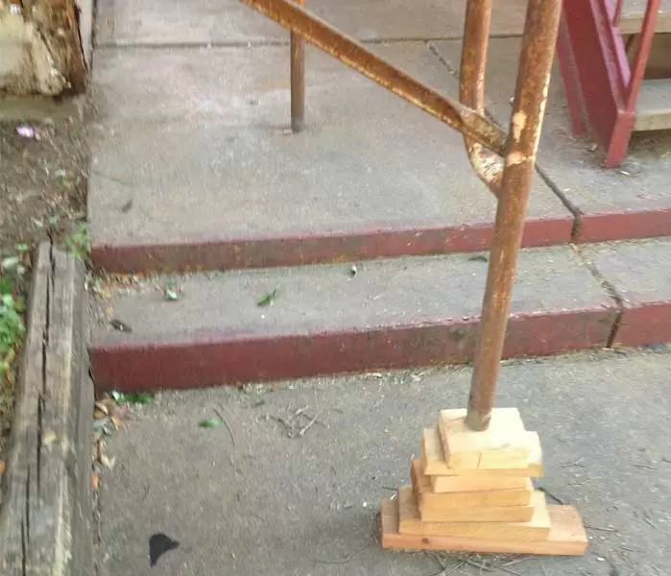
Inspections – Competent Person Training
From the Ground Up – Start your inspection from the ground and work your way up.
Base plate must be secured and flat on the ground.
Base plate must not be propped up on items such as: bricks, wood, stone blocks, machinery, etc.

Slide 11
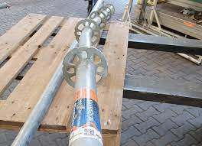
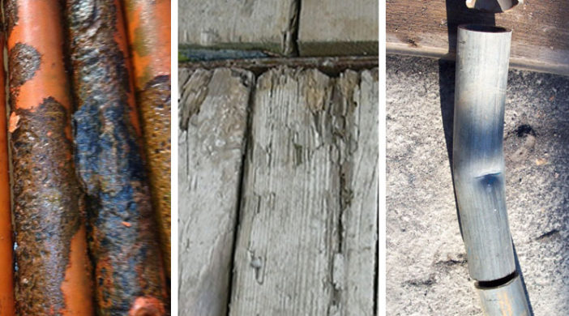
Inspections – Competent Person Training
2. Supports -
Ensure that the supports connecting the base plates to the scaffolding structure are:
Straight.
Undamaged, no signs of corrosion (rust).
No signs of tampering or influence.
Most common causes of damage would be struck by heavy machinery (Cranes or forklifts).

Slide 12
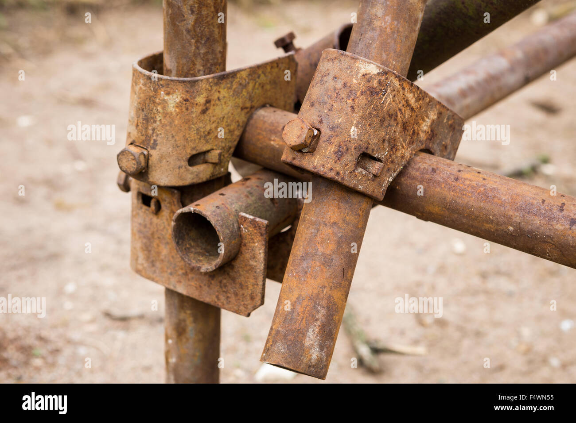
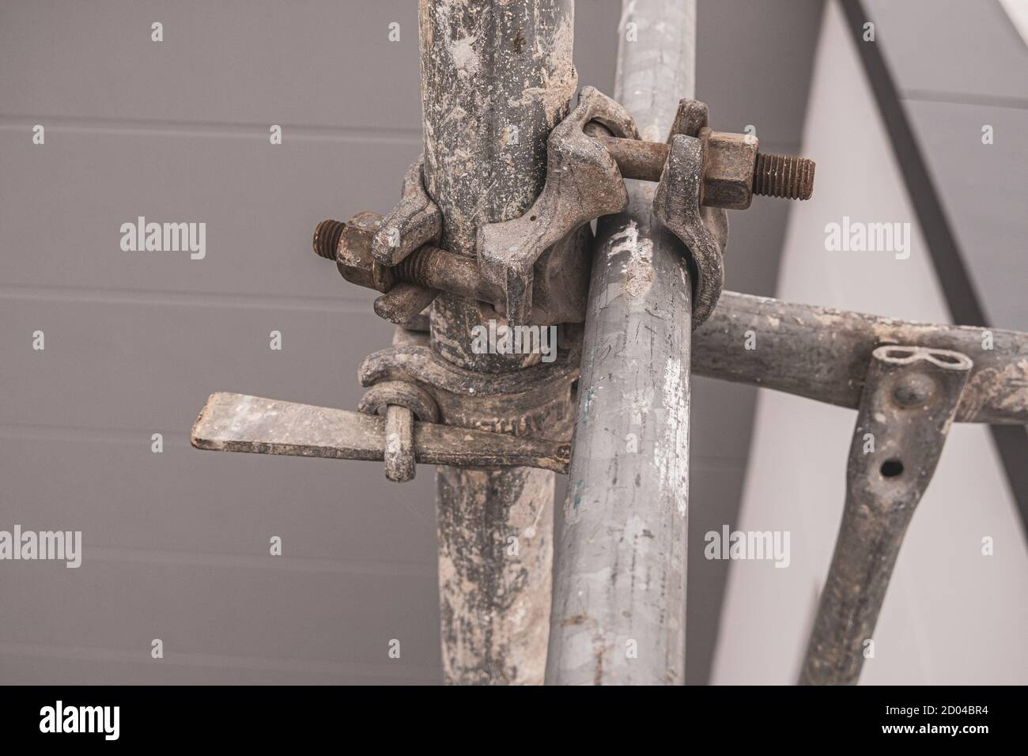
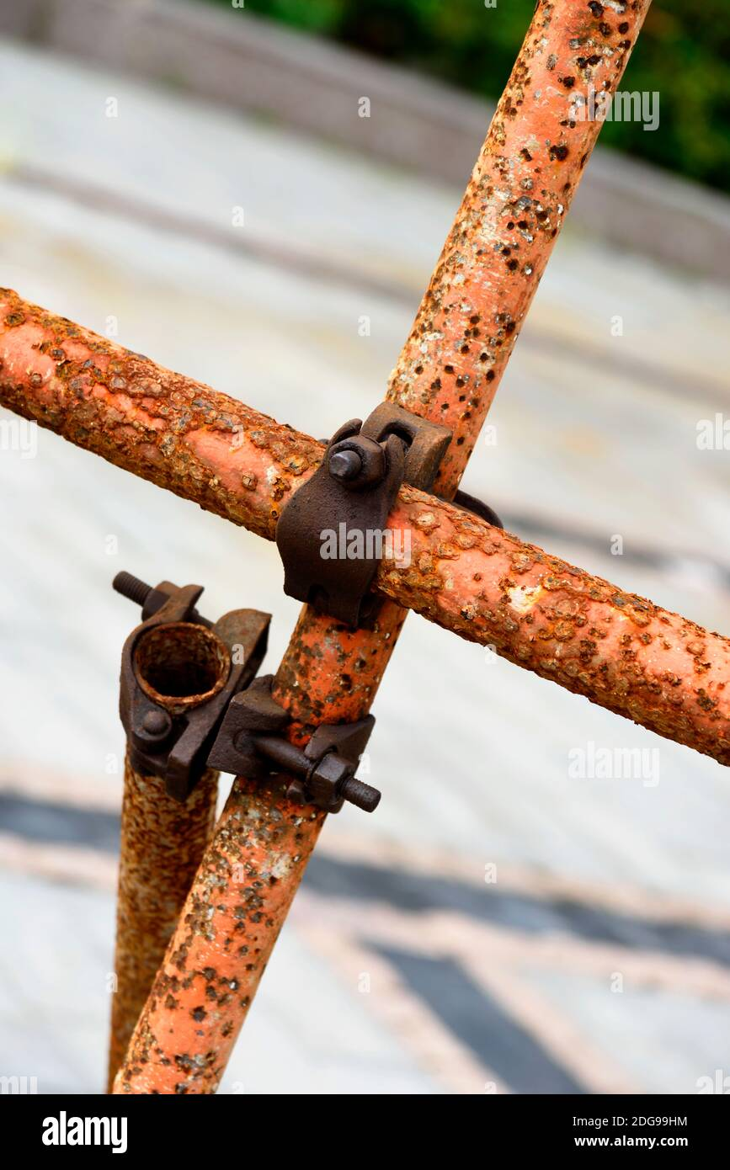
Inspections – Competent Person Training
3. Couplings/Anchors –
Most scaffolds are interconnected through the use of couplings, anchors and brackets. Check for:
Obvious damage.
Missing devices.
Damaged/loose devices.
Inappropriate Materials being used. (Duct Tape and zip ties)

Slide 13
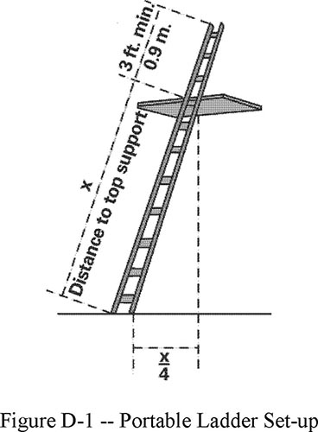
Inspections – Competent Person Training
4. Ladders/Walkways –
Ladders must follow the OSHA Standard 1910.23 which includes:
Rungs must be spaced not more than 18” apart.
Ladder must extend 3ft above the threshold level where ladder leads to.
Rated to support at least 300lbs.
Secured to the structure through proper anchorage.

Slide 14
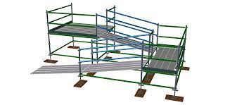
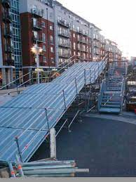
Inspection – Competent Person Training
4. Ladders/Walkways continued
Walkways must follow the OSHA Standard 1926.451 requirements.
Walkways must be at least 18” wide.
If not possible, they shall be as wide as feasible, and employees on those platforms and walkways shall be protected by the use of guardrails and/or personal fall arrest systems.
When scaffold platforms are more than 2ft above/below a point of access, access should be made with use of ladders, stairways, ramps, or walkways. Cross braces shall NOT be used as a means of access.

Slide 15
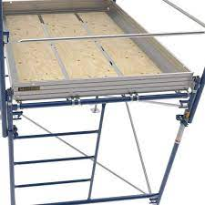
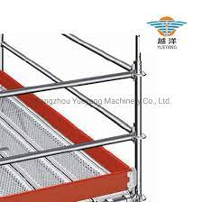
Inspection – Competent Person Training
5. Working Platforms
Ensure that the working platforms are level and clear of debris.
If scaffold is taller than 10’, a 3.5” toe board is required around all edges of the platform to prevent falling material from striking the ground.
Hard hats would be required for all employees working on/around >10’ scaffold platforms.

Slide 16
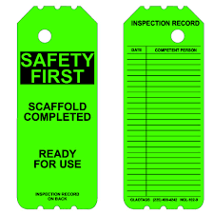
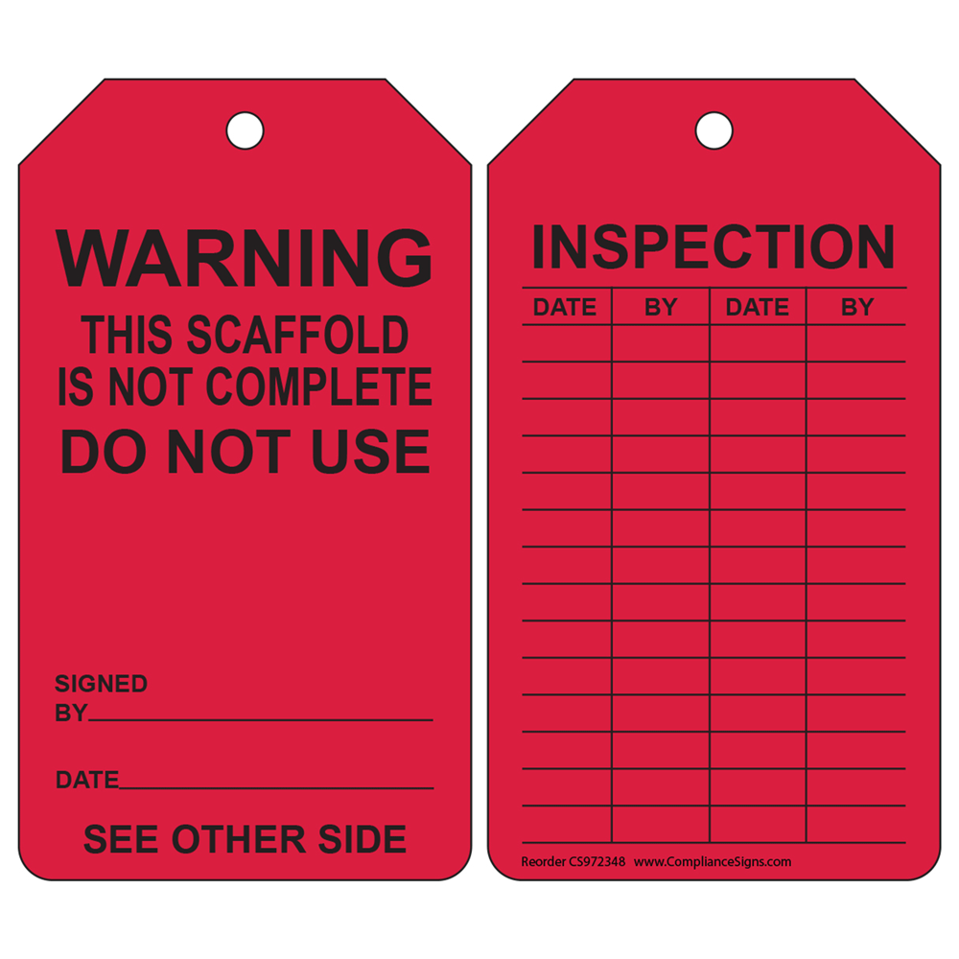
Inspection – Competent Person Training
6. Inspection Tag
Required by OSHA to be present on every scaffold structure at the main entrance for easy visibility.
Tag MUST be present and initialed for every day that work is being conducted on the structure.
Responsibility of the competent person (You) to inspect these structures.
Communicate with management of when structures will be needed and requirements of daily inspections.

