Slide 1
STEP Training Customer
9/25/2018

Slide 2
Agenda
Part 1
What is STEP
High Level Overview
Part 2
How to Use Step: Functional Training
Hands on Training
Appendix: Structured Scenario: Maintain and De-Duplication

Slide 3
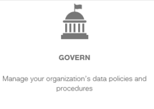
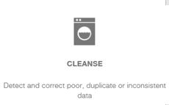
What is STEP – Master Data Management Tool
Today
Limited integration between systems resulting in data re-entry
Unreliable master data & lack of data governance process and policy
Core data not trusted and managed
Inaccurate/out of date data within system
Future
Centralized and standard processes for Master Data Management
Clean up legacy Material, Customer, and Vendor Master Data
Develop Master Data governance policy & oversight
Get Clean/Stay Clean
StiboSystems
Identify Master Data Requirements
Data Cleansing
Develop processes, standards, and best practices for prevention
Establish ongoing metrics and monitors

Slide 4
High Level Overview
User Roles
What data is available
How is the data Structured
How data moves through STEP

Slide 5
User Roles
User Group | Description
Data Steward | Search, View, and Modify master data Can submit a record to DnB to get full legal name and address Perform Clerical Review (potential duplicates)
Power User | Search, View, and Modify master data Can submit a record to DnB to get full legal name and address Perform Clerical Review (potential duplicates) Can approve changes made by Data Stewards triggering the record to be sent back to SAP for updates
Data Viewer | Search and View records. Cannot make any data changes

Slide 6
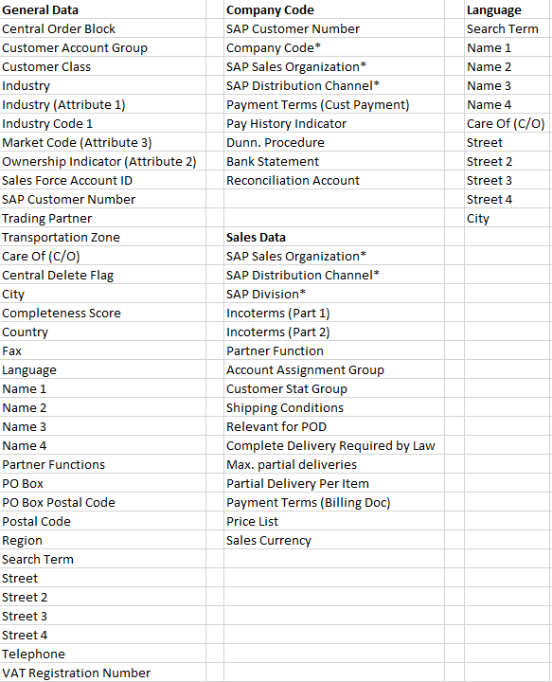
What Data is Available
All SAP Attributes identified as Mater Data from the following areas of SAP
General Data
Company Code Data (DC)
Sales Data (DC)
Partner Functions (DC)
Mandarin or Hangul
translation (DC)
(DC) = your data is stored in
what STEP calls a Data
Container

Slide 7
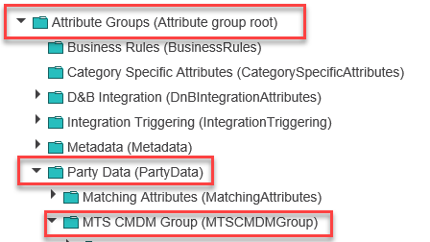
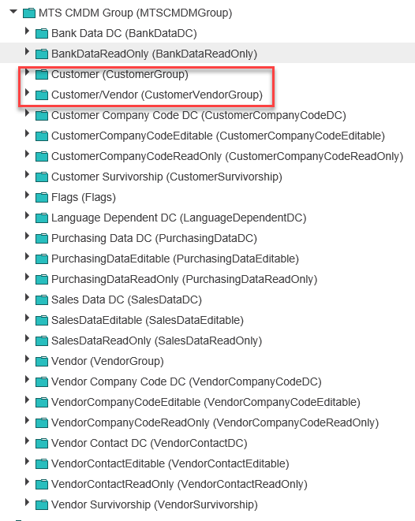
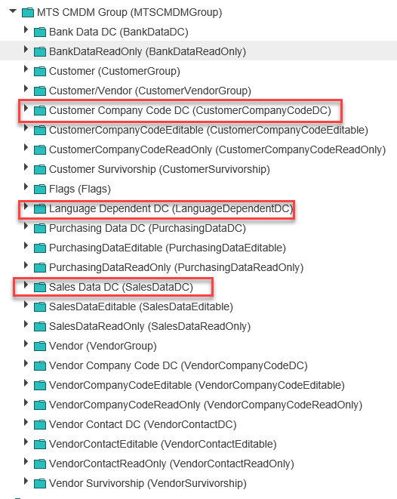
How is the Data Structured
If you are using the Advanced Search, you will need to understand how to find the attributes you want to add as search criteria
You will also need to understand if your data is part of a Data Container (This is called out on the prior slide)
Notes:
You will start by navigating to Attribute Groups then Party Data, and then MTS CMDM Group
The middle screen shot shows you the two folders your General Data attributes will fall under.
The 3rd screen shot shows you your data container folders.

Slide 8
Workflows
In STEP we have 5 workflows:
Customer Clerical Review: Based on a matching algorithm potential duplicate customers are identified. Here the Data Steward will review the potential duplicates and decide on the “surviving” record.
Maintain Customer: The surviving record along with any other records that are not a potential duplicate or marked for delete, will go through a Maintain Customer workflow where the Data Steward can update key master data elements.
DnB Match Candidate: Allows a data steward to submit a matching request to DnB. DnB will then identify any potential matching candidates and the data steward can select which DnB record they feel is the best match.
DnB Detailed Company Profile: Once the DnB candidate is selected another request is sent to DnB to identify and bring back detailed company data from DnB and associate it to our SAP record.
Approved Linked Deletes: This workflow will include any records where the following rule is met: On import, if the Customer object is a Sold-To or Site Account group and Central Delete = X, looks to see if it has any Payer/Bill-To or a Ship-To customer linked to it via Partner Function Reference. If it does, look to see if that customer is a partner to anything else. If it is not a partner to anything else, it is initiated into “Approve Linked Deletes” workflow

Slide 9
Data Flow – SAP to STEP
SAP-ECC
Clerical Review
Potential Duplicate identified
Can be a new set of records
Can be a previously defined survivor that now has a new potential duplicate
Extracts based on the following rules:
Newly created Customer since last run
Change to one of the master data elements since last run
Survivor and Not Marked for Delete
Non Duplicate and not marked for delete
XML File
Maintain Customer - Enrich
Not Marked for delete and no potential duplicate found
Previously defined non duplicate with an attribute update

Slide 10
Match Criteria
How are Potential Duplicates Identified within an Account Group and across
Account Group | Domestic vs International | Duplicate Rule
0002 Ship-To | Domestic | 5 digit Postal Code + Street make each Ship-To Customer unique
0002 Ship-To | International | Postal Code + Name + Country make each international Ship-To Customer Unique
0003 Payer & 0004 Bill to | Domestic | 5 digit Postal Code + Street make each Payer and Bill to unique for customers that do not use a PO Box
0003 Payer & 0004 Bill to | Domestic | 5 digit Postal Code + PO Box make each Payer and Bill to unique for customers that use a PO Box
0003 Payer & 0004 Bill to | International | Postal Code + Name + Country make each international Payer and Bill to Unique
0001 Sold To | Domestic | 5 digit Postal Code + Street make each Sold To unique for customers that do not use a PO Box
0001 Sold To | Domestic | 5 digit Postal Code + PO Box make each Sold To unique for customers that use a PO Box
0001 Sold To | International | Postal Code + Name + Country make each international Payer and Bill to Unique
Z001 Site | Domestic | 5 digit Postal Code + Street + Industry make each Site Customer unique
Z001 Site | International | Postal Code + Name + Country + Industry make each international Site Customer Unique
ZNOT, ZINT, ZRET | Domestic | 5 Digit Postal Code + Street
ZNOT, ZINT, ZRET | International | County + Postal Code + Street
Acct Grp 1 | Acct Grp 2 | Domestic vs International | Duplicate Rule
Sold To | Payer | Domestic | 5 digit Postal Code + Street
Sold To | Payer | International | Postal Code + Name + Country
Site | Ship To | Domestic | 5 digit Postal Code + Street
Site | Ship To | International | Postal Code + Name + Country

Slide 11
Data Flow – STEP to SAP
Maintain Customer – Approval State
Any record marked as deactivated in in Clerical Review, and the identified survivor record approved by power user
Sends SAP Customer Number of deactivated record. SAP marks the record for delete and applies an Order Block
Any Site that has been identified as a duplicate during Clerical Review and the Survivor approved by the Power User
Sends Survivor SAP Customer Number and Duplicate SAP Customer Number
Any change to an SAP sources attribute in STEP
Record must be reviewed and approved by a power user
XML File
CSV File
Excel File
Email
SAP-ECC
SFDC

Slide 12
How to Use STEP
How to Log In
How to read your home screen
How to Search and View Accounts
How to Resolve Potential Duplicates
How to Maintain and Enrich an Account record
Cleanse, Complete, Send to DnB
How to Approve changes to go back to SAP

Slide 13
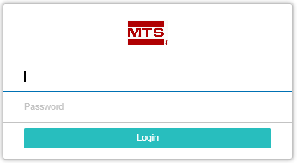
How to Log In
QA: http://msp02-stibo-q/
PROD: http://msp02-stibo-p/
Windows ID and Password
Notes:
To log in you can choose from either the Quality Assurance Environment or from Production. To do so please follow the appropriate link below:
QA: http://msp02-stibo-q/
PROD: http://msp02-stibo-p/
Once you have navigated to the appropriate link, you will see the following screen. The screen will indicate which environment you are logged into.
The Area of this login screen that end users will be using is the Launch Web UI area. The end user will pick the appropriate Web UI – Customer or Vendor. Permissions are set so that you can only log into the Master Data Area you have permissions to maintain.
Once you have selected the Web UI you would like to log into, you will be prompted with a log in box. Your user name and password are the same as your windows log in credentials
NOTE: The first time you log in you may get a pop up. Once you click OK it takes you to the release notes. To avoid this, click the do not show this screen button before clicking ok.

Slide 14
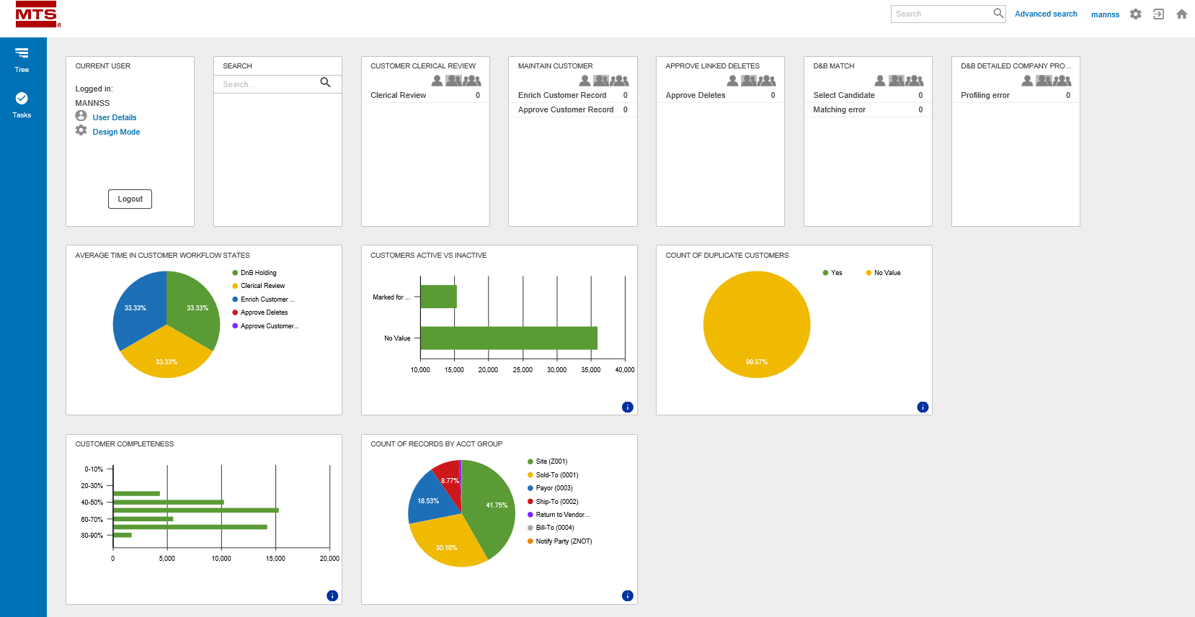
How to Read your Home Screen

Slide 15
How to Read your Home Screen - Continued
Corner Bar
Advanced Search
Log Out
Home Page
Notes:
Your top right corner bar will allow you to perform your basic functions such as:
Perform a basic Search or an Advanced Search
*Please note. Search will need to be done using the name not the SAP number. Use *<name>* to help with the search.
Log out
Navigate back to Home page

Slide 16
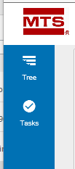
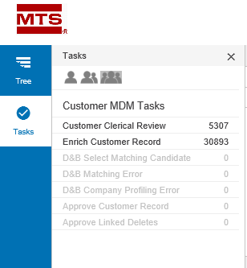
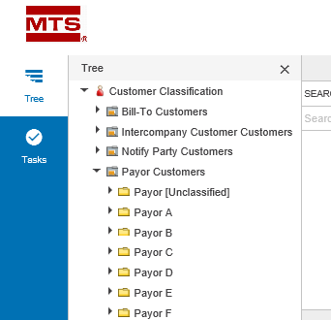
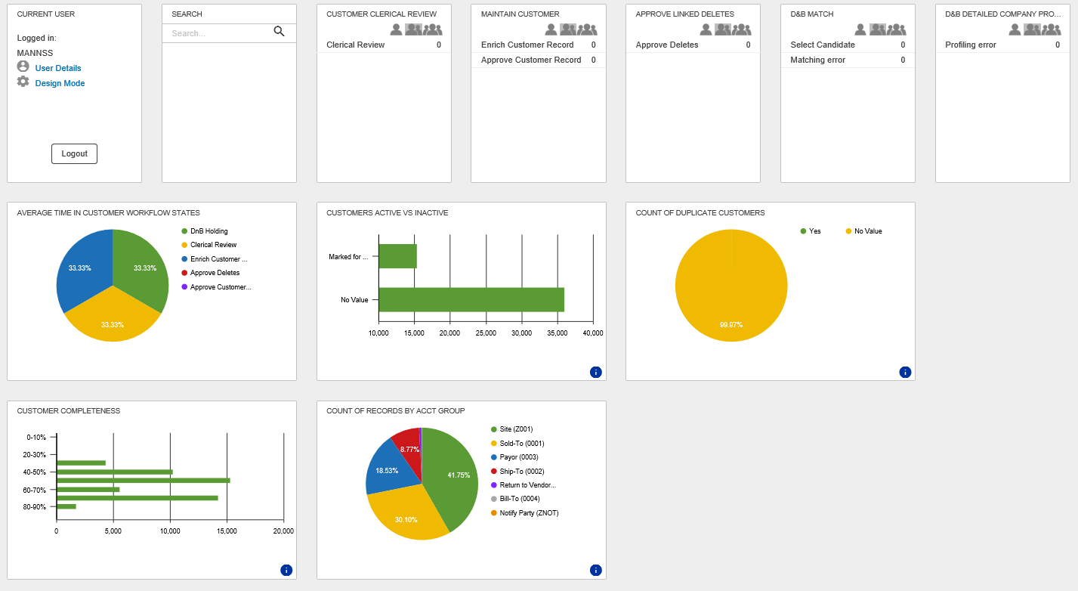
How to Read your Home Screen - Continued
Navigation Pane
Dashboard
Notes:
Navigation Pane
On the left-hand side, you will see your Navigation Pane. This is used for searching for a Customer or Vendor via a tree structure if you do not know the vendor name or number. From here you can also navigate to workflow tasks.
Dashboard
The middle section of your main page is your dashboard. Here you will have application widgets help guide you through your workflow as well as provide some metrics about your Data.

Slide 17
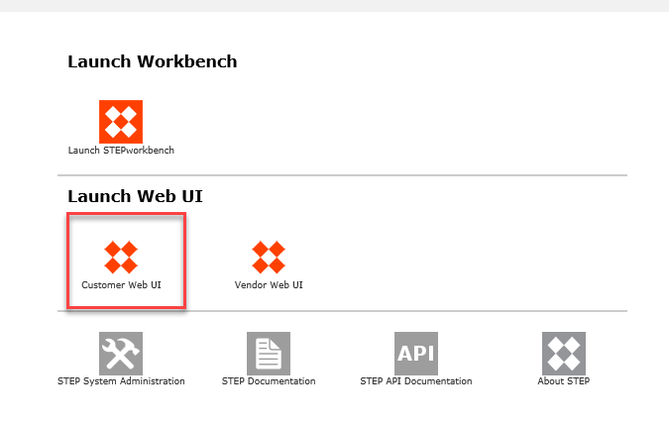
Activity
http://msp02-stibo-q/
Select Customer Web UI
Enter your Windows User ID and Password
Familiarize yourself with the Corner Bar, Navigation Pane, and Dashboard

Slide 18
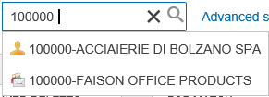
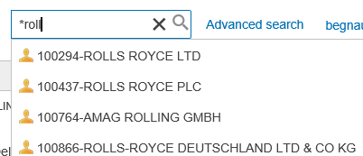
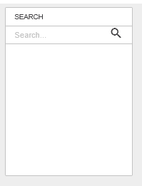
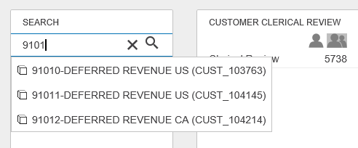
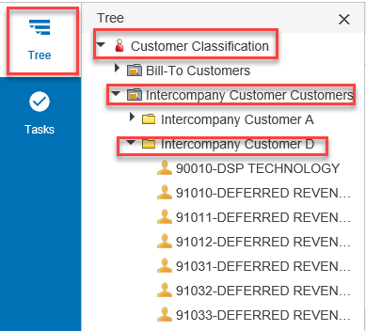
How to Search and View Accounts
4 ways to search
Corner Bar
Advanced Search
Search Widget
Navigation Pane
Notes:
Search Wild Cards
When performing searches, it is useful to understand STEPS search Options:
Asterisk (*) means select all or is used as a wild card for multiple characters
!= means not equal to
? is a wild card to represent 1 character
Advanced search has additional search values that are found by using the drop-down selector.
Corner Bar Search and Search Widget
Place your cursor in the search box on the corner bar and begin to type the Customer number. A drop down of options will begin to appear. You may see customers here as well depending on your access level.
If you type in the full customer number and do not see the customer in the drop down type a dash “-” after the number. This is how the names are formatted.

Slide 19
Activity
Tips:
Only the corner bar allows * as a wild card
On corner bar if you don’t see the customer you are looking for after typing the number add a “-”
Search Widget you must start with the Customer Number
Click in the Search Box on the corner bar
Type in *Rolls
Click in the Search Box on the corner bar
Type in 100000-
Click on the Search Widget and type
Type in 9101
Click on the Navigation Pane
Navigate to find Rolls Royce LTD

Slide 20
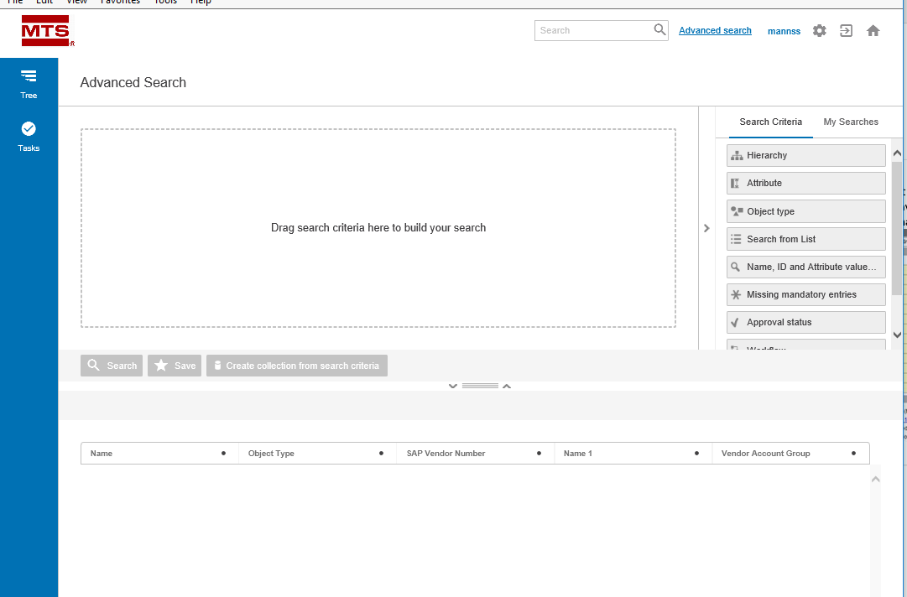
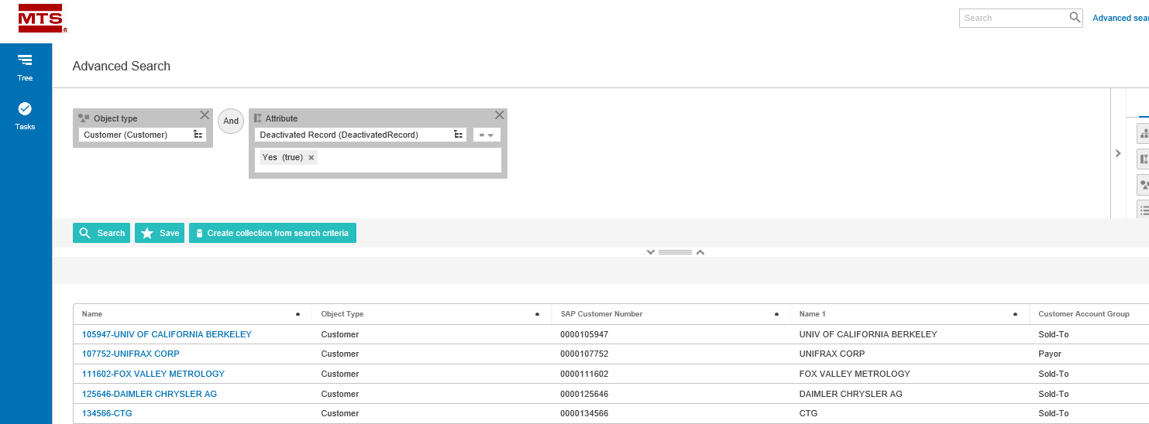
How to Search and View Accounts – Advanced Search
Notes:
When you click on the Advanced Search in the Corner Bar, you are directed to the advanced search page. Here you can build your own customized searches. You can also save our searches for future use.
Here are detailed instructions on how to build an advanced search: http://ibmtb-app.stibo.com/help/#web_user_interfaces/advancedsearch/using_advanced_search.html?Highlight=Advanced Search
The second screenshot is an example of an Advanced search for all Customers that have been deactivated (duplicates)

Slide 21
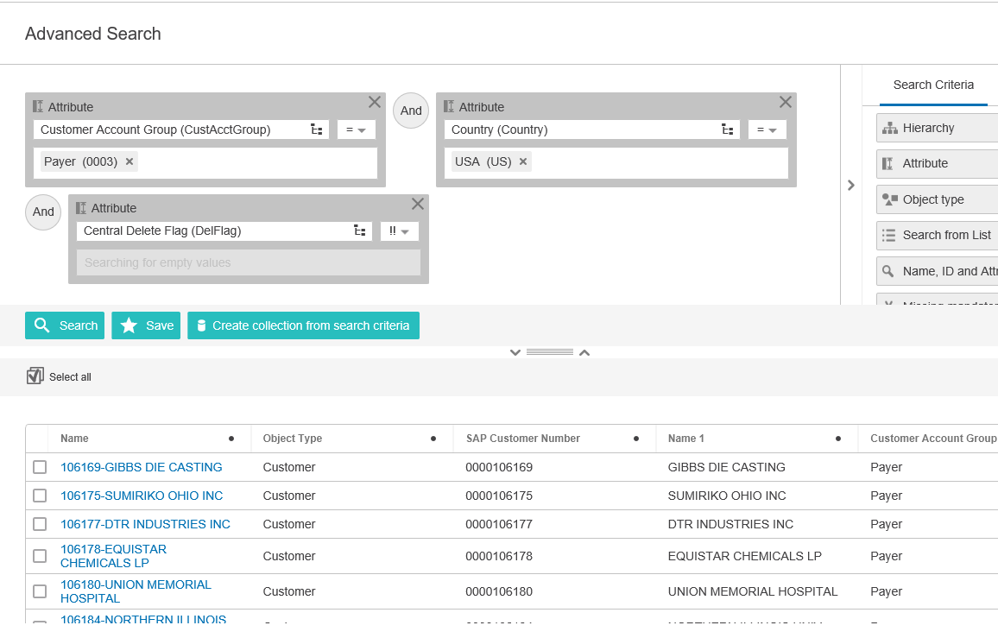
Activity
From your home page, click on Advanced Search in the corner bar
Build a Query to bring back the following Customers:
Payer (0003)
Country is USA
Active Customer

Slide 22
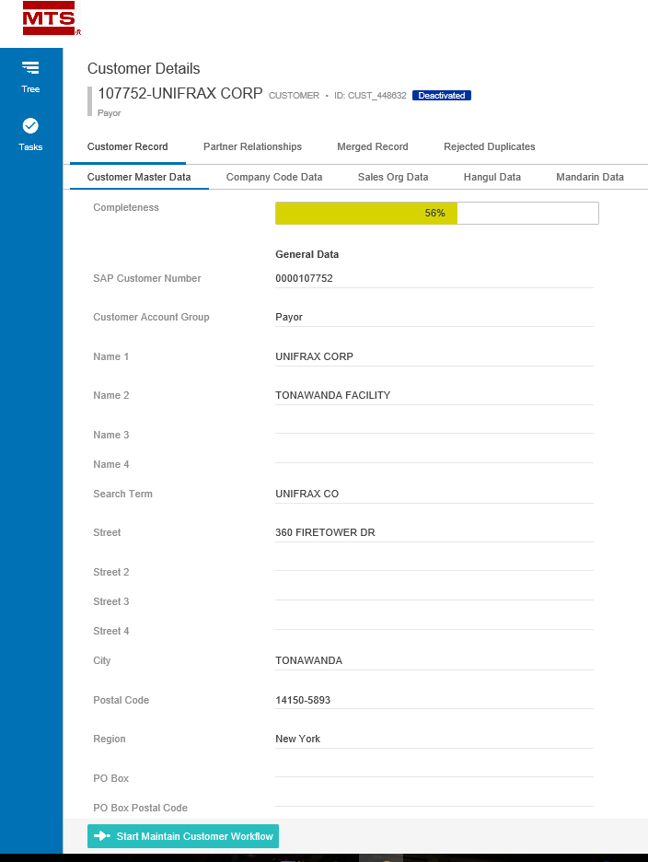
How to Search and View Accounts
After you have found the Customer you are looking for in your search. You can open the Customer Details screen and view all information about that Customer.
Customer Master Data
Company Code Data
Sales Data
Hangul
Mandarin
*On the Customer Details
screen you should only
“view” your data. Do not
edit it.
Notes:
Customer detail page is organized into several tabs which separate data elements related to specific business functions. Each tab is explained below:
Customer Record
The Customer Record tab allows you to see subpages of:
Customer Master Data – all master data attributes that are globally shared
Company Code Data – All master data attributes that are unique for different company codes
Sales Org Data – All master data attributes that are unique for different sales organizations
Hangul – Korean translation of name and address fields
Mandarin – Chinese translation of name and address fields
When clicking on any one of the tabs you may need to switch from Single Edit View to Multi Edit View to be able to better see your data.

Slide 23
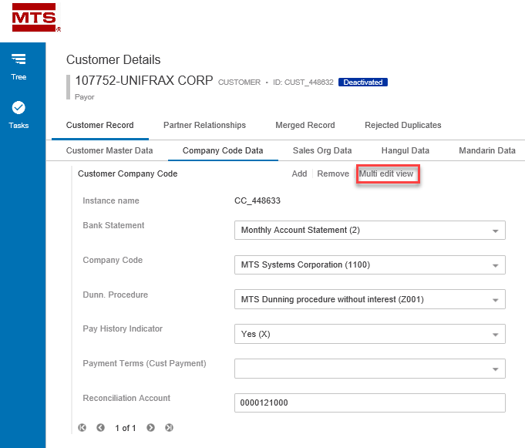
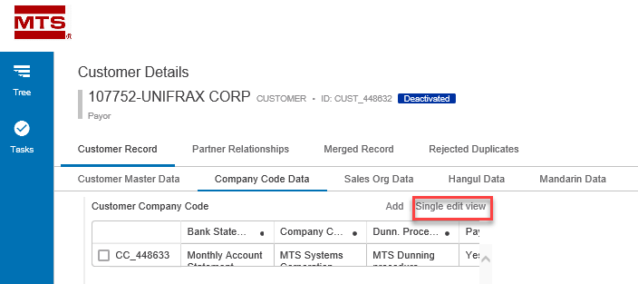
How to Search and View Accounts
The Data in the following tabs are organized by what is called Data Containers. A data container is a way of organizing the data to allow for one Customer to have multiple instances of the associated data.
Company Code Data
Sales Data
Hangul & Mandarin
When Viewing this data you may need to switch from a Single Edit view to a Multi Edit view

Slide 24
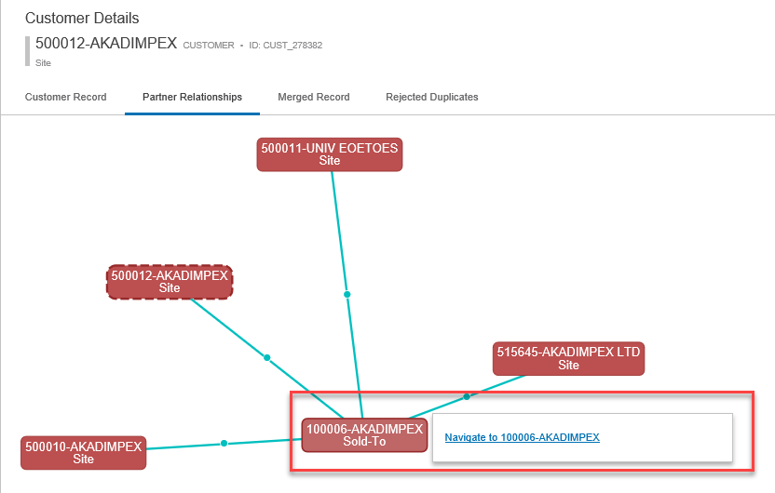
How to Search and View Accounts – Partner Relationships
From the Partner relationships tab, you can see all partner functions of the record you are viewing. By hovering over the Partner function box, you can get an additional popup that will allow you to navigate to that partner function record.

Slide 25
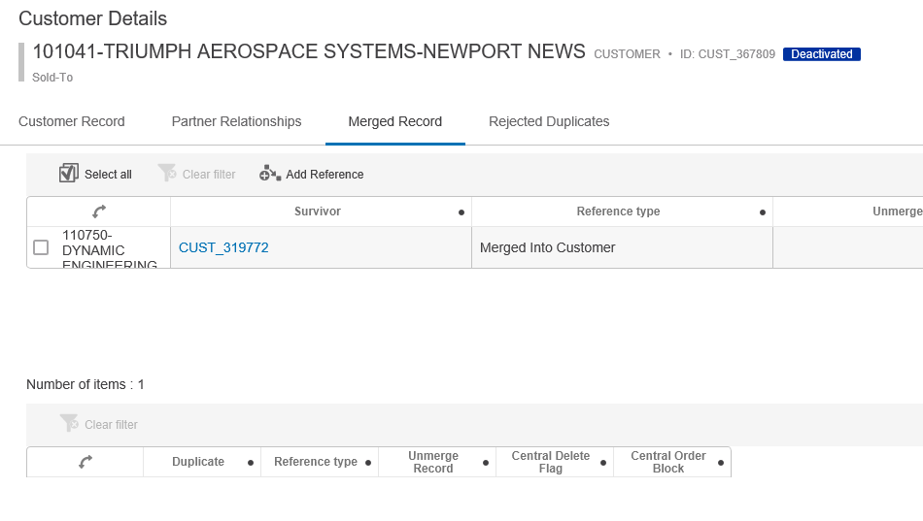
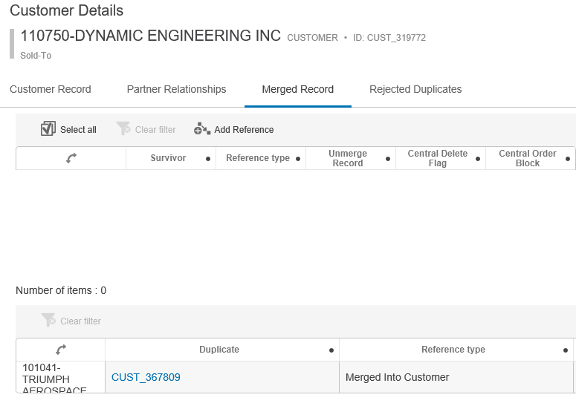
How to Search and View Accounts – Merged Record
Merged: A record that is an identified duplicate. The Merged Record can either be the “deactivated” record or the “survivor” record.
On the “Deactivated” record the Survivor will be displayed on the top section. On the “Survivor” record the duplicate will be displayed on the bottom section.
Notes:
Merged Record and Rejected Duplicates
Merged Record = A record that is an identified duplicate. The Merged Record can either be the “deactivated” record or the “survivor” record.
Rejected Duplicates = Any record(s) that you said during clerical review were NOT duplicates of each other.
On the merged record or Rejected Duplicates tab, you will see two sections on the pages. This is because in STEP a record can be Referenced or Referenced By.
Reference = Where you can see references from the selected entity to other objects. Here the entity is the Source and it references other Targets (Referenced By)
Referenced By = Where all references of which the selected object is the target (e.g., all the objects that the selected object is referenced by) can be viewed

Slide 26
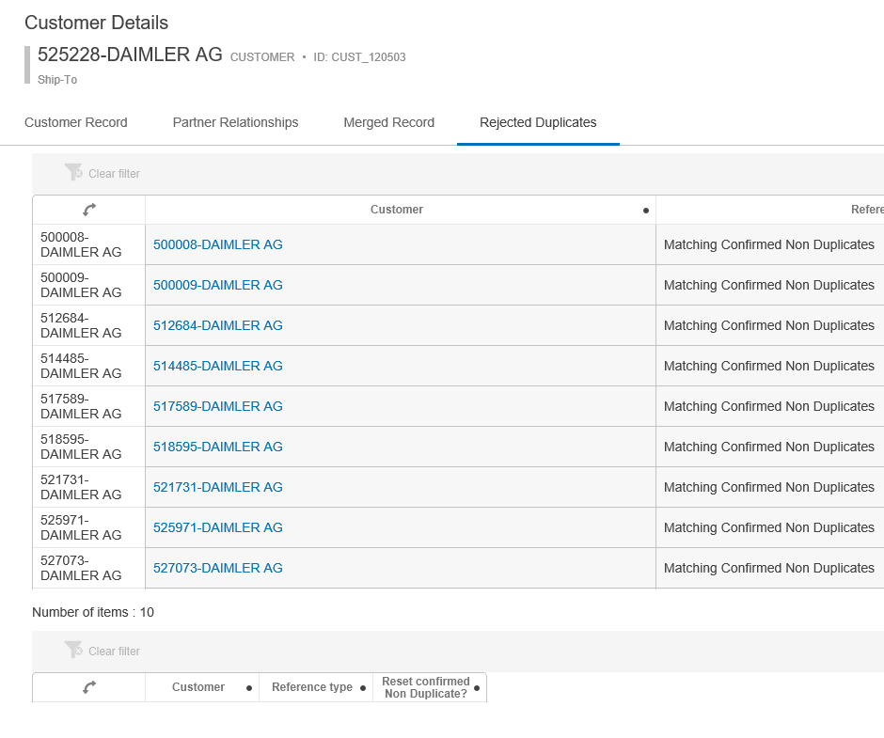
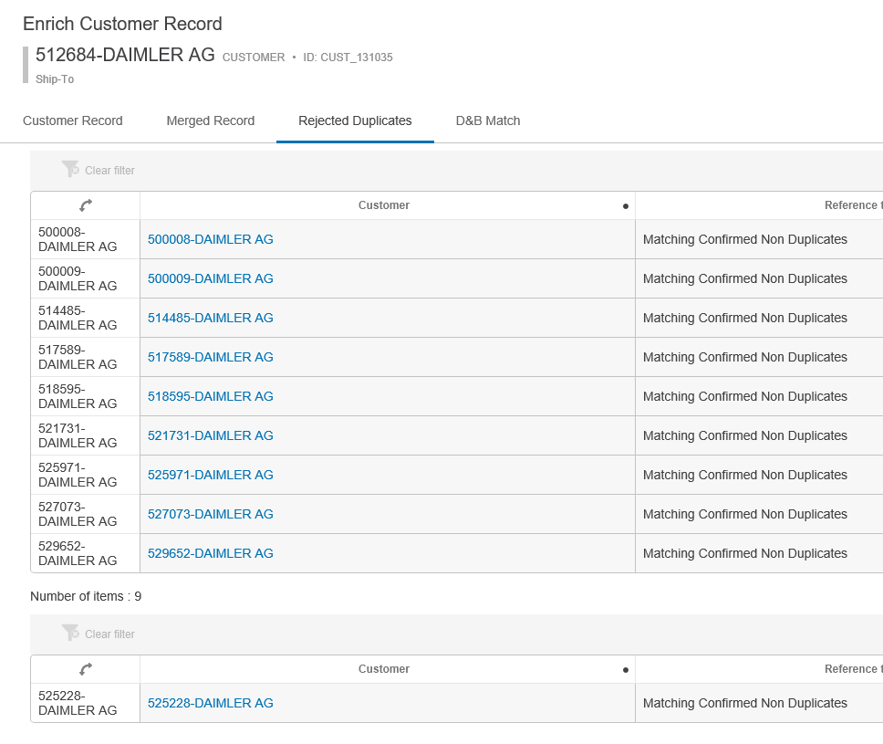
How to Search and View Accounts – Rejected Duplicate
Rejected Duplicates are any record(s) that you said during clerical review were NOT duplicates of each other.
Notes:
525228 is the survivor

Slide 27
How to Search and View Accounts
From any tab you can submit a record into the Maintain Workflow by clicking the Start Maintain Customer Workflow button
Notes:
From any of these tabs you can also submit a record into the maintenance workflow by selecting the action button at the bottom of the screen. If the action button is grayed out, this means your record is already in the maintain state and waiting to be cleansed.

Slide 28
Activity
Search and Select any Customer
Practice navigating the different tabs and understanding how the data is displayed and organized.

Slide 29
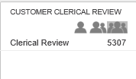
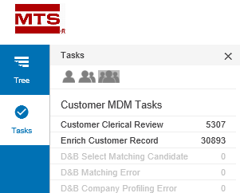
Clerical Review (Potential Duplicates)
Clerical Review Workflow is where the user reviews and resolves potential duplicate records.
How do you see your assigned tasks?
Lone Ranger: Shows items assigned directly to your user id
Twins: Shows all items assigned to your user id or anyone in your same user group
Three Amigos: Show all items assigned to any user in that workflow. Note: depending on access level you may not see this option.
Notes:
All records when loaded into STEP will be assessed and sent through clerical review. If a Customer is new to STEP it will be compared against all other existing Customer records to determine if it is a duplicate. If it has no matches it will move to Maintain Customer. If it has a match it will go into Clerical Review.
If a Customer that has previously been loaded to STEP comes in again, it will be compared against all records and if any new potential duplicates are found it will go to Clerical Review. If it is only matched with already identified duplicates or non-duplicate records, it will go directly to the Maintain Customer workflow.
To access the potential duplicate review task, list the user will click on Clerical Review state from Customer Clerical Review widget from their homepage. Or use the Side Panel Tasks

Slide 30
Clerical Review (Potential Duplicates)
Golden Record Clerical Review Task List
Lists all potential duplicate groupings
Notes:
Duplicate Review Task List
On this screen, you will see a high-level task list that allows you to select your potential duplicate grouping to begin to review.
This initial task list displays STEP ID, STEP Name, Source Information, Customer Acct Group, Name 1, Street, Postal Code, Country, and if the record is marked for delete.
From this screen you have 3 options:
Advanced Merge: Open the selected grouping and review additional columns in detail to determine if the records are duplicates
Reassign: Reassign the task list item to another user
Reject: Reject all items of the grouping resulting in them being set as non-duplicates
Clear all simply clears any check box selections you have made

Slide 31
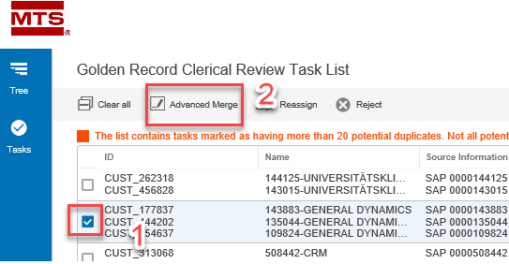
Clerical Review (Potential Duplicates) – Advanced Merge
To enter advanced merge, select the grouping you want to review and then select the advanced merge button
Notes:
This takes you to the Advanced Merge Screen. On this screen, you can review key master data columns as well as some high-level information related to company code and sales organization to aid in selecting the appropriate survivor record.

Slide 32
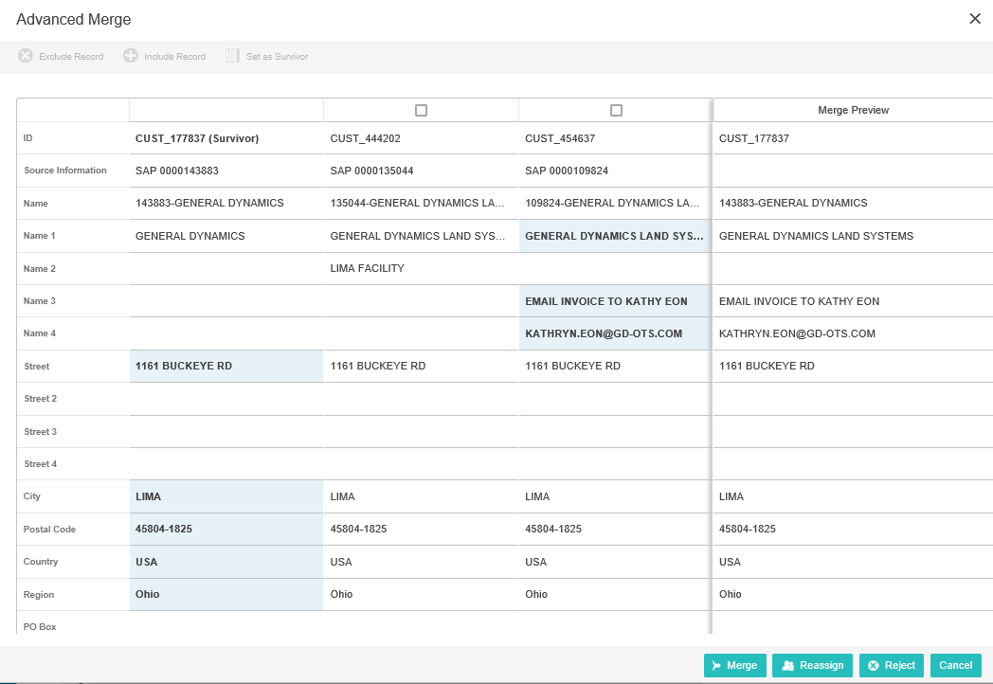
Clerical Review (Potential Duplicates) – Advanced Merge
Notes:
On this screen, STEP has pre-selected which record it wants to make as the survivor as well as what attributes to use to build the Merge Preview. You can however during your review determine if you want to:
Exclude a Record: Consider it a non- duplicate
Include a Record: Add back in a record if you Excluded it
Set as Survivor: Change which record is considered the survivor.
Merge Preview: pick and choose what attributes from the potential duplicates you want to keep.

Slide 33
Clerical Review (Potential Duplicates) – Advanced Merge
To exclude a record, you simply check the record you want to exclude from being a potential duplicate and click the exclude button’
To include an excluded record, you select the record you want to include back in as a potential duplicate and click the include record button

Slide 34
Clerical Review (Potential Duplicates) – Advanced Merge
To change which record is set as the survivor you select the record you want to become the new survivor and click set survivor

Slide 35
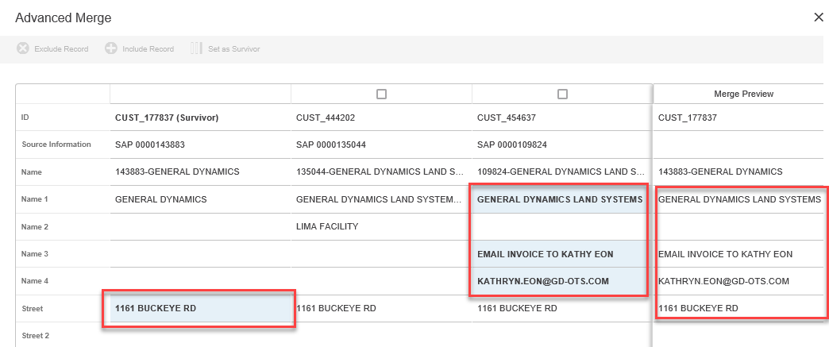
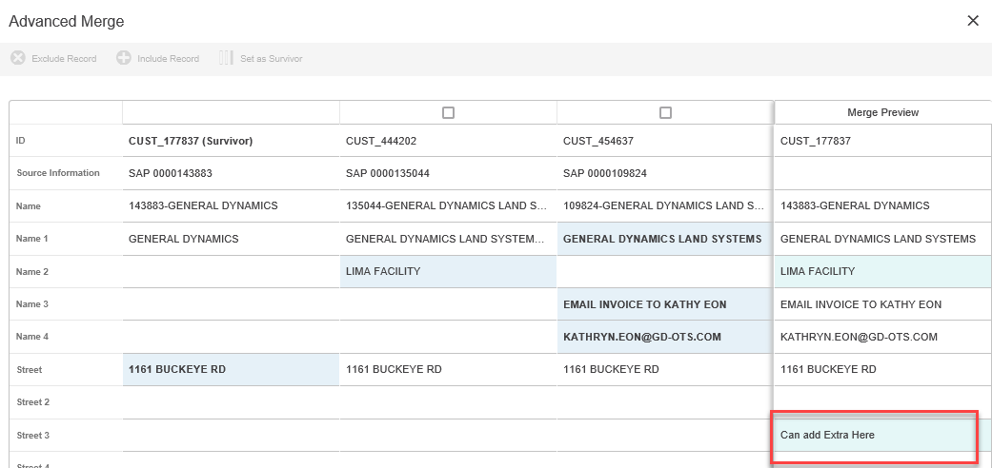
Clerical Review (Potential Duplicates) – Advanced Merge
Build your surviving record and Merge
Notes:
After you have excluded any non-duplicates as well as selected your survivor you can begin to build you merged record.
To do so you can select values from either record. The value you have selected will show in Blue and it will also show in the Merge Preview.
From here you will select merge at the bottom of your screen and the potential duplicate records will be identified as a duplicate of the survivor. This will then systematically mark all potential duplicate records with a Marked for Delete, a Block Function of 98, and a Purchasing Block of Yes. All survivor records (if not already marked for delete) will go to the Maintain Customer workflow for further editing and approval.
Merge: Once you are complete with building your Merged record you will click Merge.
Reassign: Here you can choose again to reassign to another user
Reject: you can reject all the records here and they become confirmed non-duplicates
Cancel: You can cancel what you have done and the grouping remains in clerical review

Slide 36
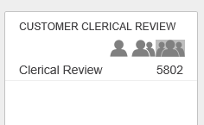
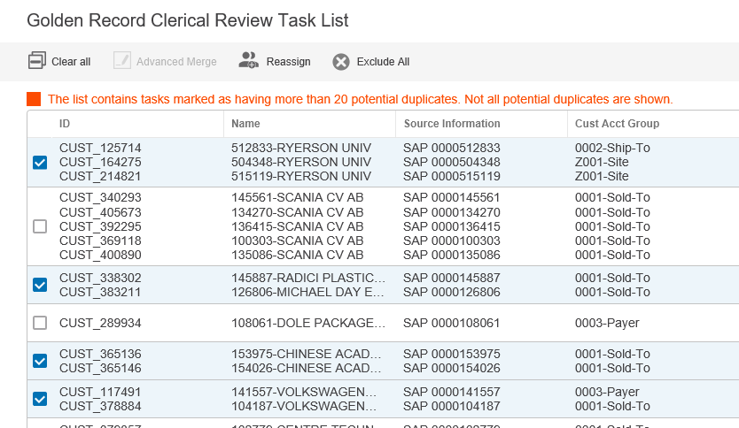
Activity
From Home Page locate your Clerical Review Widget
Click on the “Twins” to find potential duplicates assigned to your user group
Select a handful of potential duplicate groupings by selecting the checkbox
Try to get ones with more than 2 potential duplicates
Pick at least 5 groupings
Reassign those potential duplicates to your user id.

Slide 37
Activity
From Home Page locate your Clerical Review Widget
Click on the “Lone Ranger” to find potential duplicates assigned to your user id
Select 1 potential duplicate grouping and perform an Advanced Merge
Change the Survivor
Complete your Merge Preview
Merge your records

Slide 38
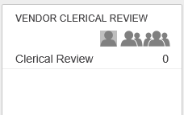
Activity
From Home Page locate your Clerical Review Widget
Click on the “Lone Ranger” to find potential duplicates assigned to your user id
Select 1 potential duplicate grouping and perform an Advanced Merge
Exclude 1 or more records as “non duplicate”
Complete your Merge Preview
Merge your records

Slide 39
Activity
From Home Page locate your Clerical Review Widget
Click on the “Lone Ranger” to find potential duplicates assigned to your user id
Select 1 potential duplicate grouping and perform an Advanced Merge
Exclude more than 1 record as “non duplicate”
Select one excluded and re-include it
Complete your Merge Preview
Merge your records

Slide 40
Activity
From Home Page locate your Clerical Review Widget
Click on the “Lone Ranger” to find potential duplicates assigned to your user id
Select 1 potential duplicate grouping and reject it (make them all a non duplicate of each other)

Slide 41
Activity
From Home Page locate your Clerical Review Widget
Click on the “Lone Ranger” to find potential duplicates assigned to your user id
Select 1 potential duplicate grouping and perform an Advanced Merge
Review the contents
Select Reject at the bottom of the screen

Slide 42
Activity
From Home Page locate your Clerical Review Widget
Continue to play with resolving duplicates as time allows

Slide 43
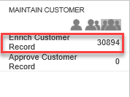
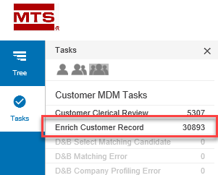
Maintain Customer
The Maintain Customer workflow contains only records that have met the following criteria:
Survivor and not marked for delete
No identified potential duplicate and are not marked for delete
Submitted manually from the Start Maintain Customer Workflow action button
How do you see your assigned tasks?
Lone Ranger: Shows items assigned directly to your user id
Twins: Shows all items assigned to your user id or anyone in your same user group
Three Amigos: Show all items assigned to any user in that workflow. Note: depending on access level you may not see this option.
Notes:
The Maintain Customer workflow contains only records that have met the following criteria:
They are a survivor and not marked for delete from the Clerical Review workflow
They have no identified potential duplicate and are not marked for delete
They were submitted manually from the Start Maintain Customer Workflow action button on a Customer Detail screen
To enter the Maintain Customer workflow, using the Maintain Customer Widget click on the Enrich Customer Record state or use the Side Panel and click the Tasks
NOTE: Remember to select the appropriate “person” icon to get the appropriate list of Customer.

Slide 44
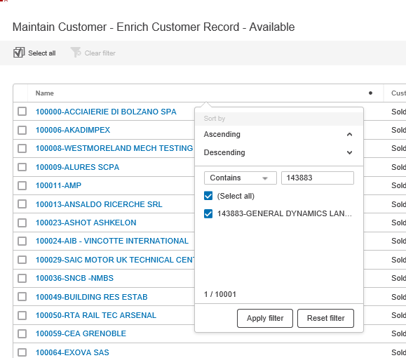
Maintain Customer
Maintain Customer – Enrich Customer Record – Available
Select the Customer you would like to Enrich
You can select multiple and reassign to you
Or you can click and work one at a time
To further limit what you see in the task list, you can filter on the headers
Notes:
Maintain Customer Task List
Once you click on the Enrich Customer Record state, you will be taken to the Maintain Customer – Enrich Customer Record Task List. This task list allows you to:
Check the Customer you would like to maintain and assign it to yourself or the Customer Stewards user group
You can click directly on the name link and enter the Enrich Customer Details screen
NOTE: If you select multiple customer at one time you also have a clear all button to clear your selection
To make it easier to find the records you would like to maintain, you can use a sort or filter the task list. This is accessed by clicking on the header of the column you want to filter on. Be sure to click Apply Filter

Slide 45
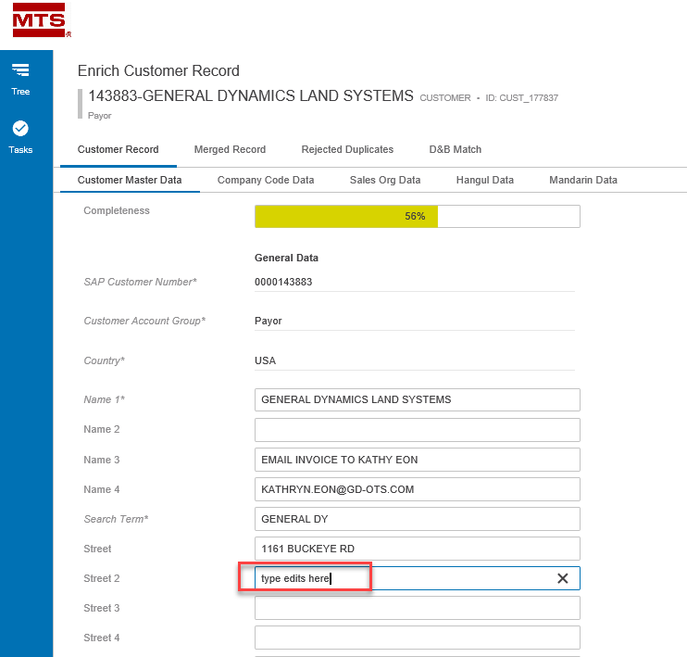
Maintain Customer
To begin to Enrich a customer record, click on the name from the task list. This will bring you to the Enrich Customer Record screen
Looks just like Customer Details screen
If you did not reassign it to you on the
previous screen, click Assign to Me
button at the bottom
Always Save before Submit
Notes:
Enrich Customer Record
To enter the Enrich Customer Record screen you click on the Name of the customer you want to maintain and that will take you into the Enrich Customer Screen. This screen looks and behaves just like the Details Screen

Slide 46
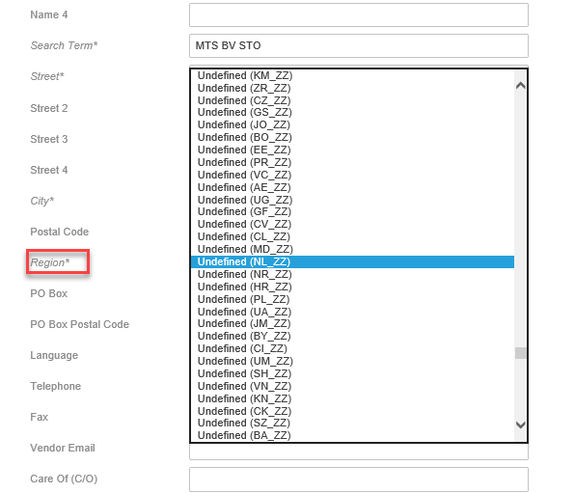
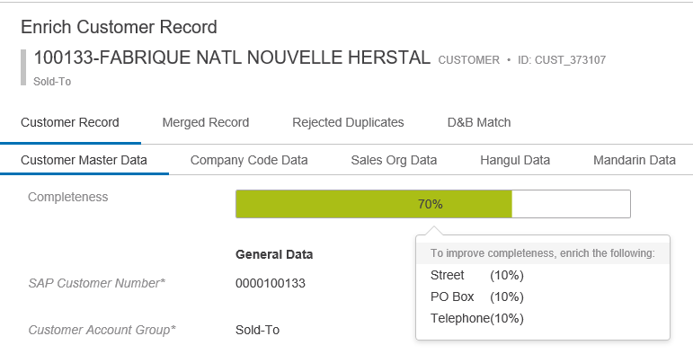
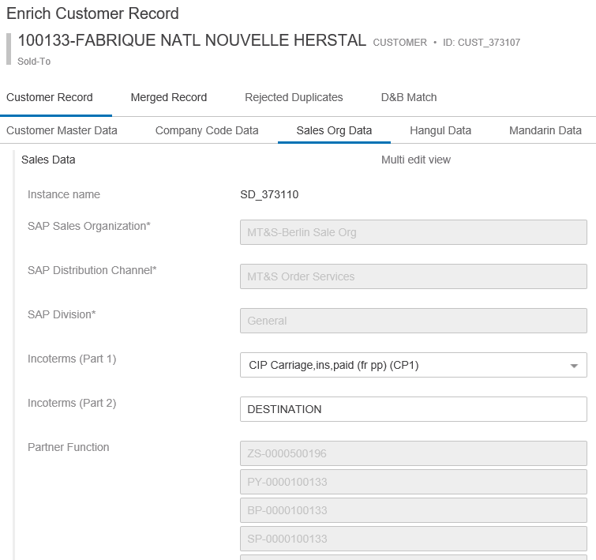
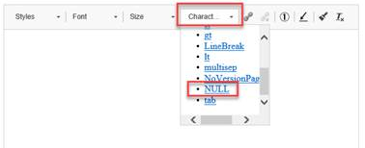
Maintain Customer
Things to keep in mind when maintaining data:
* Means mandatory
Use drop downs
Use Completeness Meter
Non Editable fields are grayed out
Apply a Null Tag if you remove a value
1
2
3
5
4

Slide 47
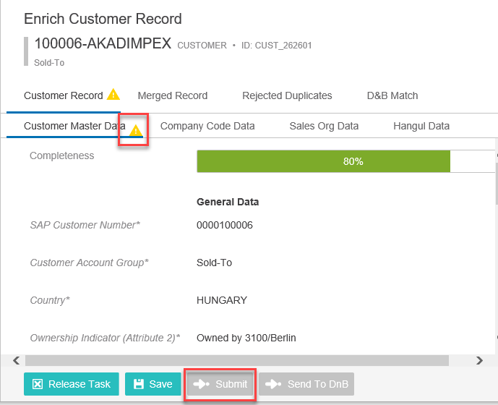
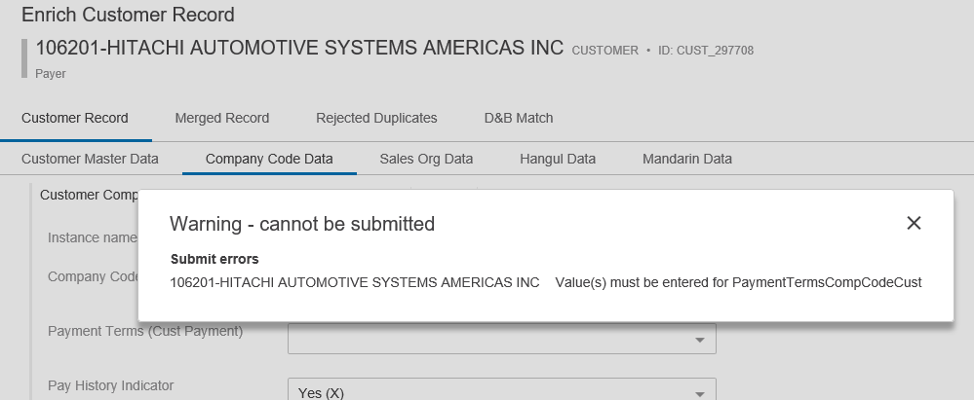
Maintain Customer
Submitting Changes
Save your changes
If there is missing mandatory data you will see a Warning Sign and your Submit button will be grayed out.
Click the submit button
If there are any required data container fields missing you will get a pop up error and will not be able to submit
Notes:
Submitting your Changes
To submit the changes, you have made to the customer record, click submit at the bottom of the page. If a required field does not have data, a warning message will come up letting you know what was missed or you will see a warning symbol and the submit button will be grayed out.

Slide 48
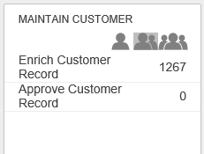
Activity
Select a record from the Maintain Customer Workflow: Enrich Customer Record task.
Practice Filtering Data
Select a record and click on the Name
Can you identify what is missing and would drive up completeness?
Look through the various tabs, can you identify mandatory fields and Editable/Not Editable fields

Slide 49
Activity
Select a record from the Maintain Customer Workflow: Enrich Customer Record task.
Select a record and click on the Name
Assign the work to you
Practice editing data on various tables.
Save and Submit
Repeat this for multiple customers
At this time do not send to DnB
Notes:
You can also do a bulk assign by selecting multiple customers on the task list screen and running the bulk update action

Slide 50
Maintain Customer – Reject Merges
User can determine a “merge” that took place in Clerical Review was done by mistake
On Merge Record Tab, in Unmerge Record column, select yes
The unmerged record will then enter the Maintain Workflow
Notes:
In the Maintain Workflow, the user has the opportunity to “undo” a merge if they determine the records were merged mistakenly in Clerical Review. To do this, double click on the Merged Records tab and select yes in the Unmerged Record column. Upon submit and approval of this record, the merge will be removed and the central delete and order block function code reset. The “unmerged” record will then enter the Maintain Workflow.

Slide 51
Maintain Customer – Reject Rejected Duplicates
User can determine that records that were set as Non Duplicate in Clerical Review were set by mistake and remove them as a non duplicate
Reject Duplicates tab and in Reset Confirmed Non-Duplicate column select Yes
The “rejected non duplicate” will remain in the maintain workflow and available to Enrich
The reference between the two is removed
Notes:
In the maintain workflow the end user can Reset an identified non-duplicate if they feel it was marked as a non-duplicate by mistake. This is done from the Rejected Duplicates tab by double clicking the Reset Confirmed Non-Duplicate cell and selecting yes. Once the record is submitted and approved, the rejected duplicate will be approved as a standalone account and the survivor will go back through the maintenance review without the rejected duplicate reference.
Both the Record you are Maintaining AND the Confirmed non duplicate (Rejected Duplicates) are in the Maintain workflow as separate records

Slide 52
Activity
Instructor will walk through examples as supporting data is difficult to find in Test Environment

Slide 53
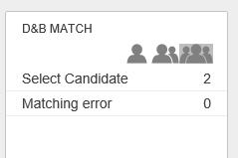
Maintain Customer - How to Send to DnB
At any point during Enrichment you can send a record to DnB
Click the Send to DnB button
When your record “returns” from DnB it will be in the DnB Workflow. From this workflow you will select the candidate
Returns a list of potential matches.
Can remove those that you know are not a match
Can click each and see more detail. Here is where you Select the candidate
You will then return to the Enrich Customer screens on the DnB tab and complete your enrichment
Notes:
DnB Match Select Candidate
The task list D&B Match will display a list of customer records. Upon selecting one or more customer records, the “Remove from DnB due to No Candidate” we be made available so the user can remove from the workflow state if they choose
The customer Name column displayed with will take you to the D&B Match candidates screen. There number of D&B attributes are listed as header on top.
Select Candidate
After drilling into the customer record, you can see all the potential candidates that were returned from DnB. The Select candidate on top of the screen will be active once a Customer record is selected.
To narrow down the big list the Modify search can be used to narrow down the records in display.

Slide 54
Maintain Customer - How to Send to DnB
The Enrich Record, D&B Match tab is where you will see the selected candidate from the DnB workflow
Data to Send to D&B is what was sent to D&B to match on
Left side is the Selected Candidate from the D&B workflow
Customer Record Enrichment is where you can copy data from the Selected Candidate and paste into the Enrichment fields. This data is what will be saved on your Customer Record.
Notes:
On the left-hand side is the Data to send to DnB. The DnB customer record enrichment attributes are displayed and on the right-hand side.
After filling out this information on the right side, you will click the send to DnB button on the bottom of the screen.

Slide 55
Activity
Select a record from Maintain Workflow: Enrich Customer State
Select DnB Match Tab
Review what you are sending to DnB to match on
Click Send to DnB action button
When record returns review and select a candidate
Go back to your Enrich Record D&B match screen and review the results.
From here you can take data from your candidate and edit your Enrich Record.

Slide 56
How to Approve changes to go back to SAP
After a user submits a record from the Enrich Customer record state, it enters the approval workflow.
Exception: if the user performing the Enrich is a Power User, the Submit will auto approve the record and the approval workflow is bypassed
The Approval state of the Maintain Workflow is only available to Power Users
How do you see your assigned tasks?
Lone Ranger: Shows items assigned directly to your user id
Twins: Shows all items assigned to your user id or anyone in your same user group
Three Amigos: Show all items assigned to any user in that workflow. Note: depending on access level you may not see this option.
Notes:
Approve Customer Record
Once the Data Steward has completed the maintenance of the record and submitted it, it will be sent to the Approve Customer Record state of the maintain workflow.
NOTE: Only Power Users can approve the changes.
Power users will enter this state by clicking on the Approve Customer Record state in the Maintain Customer workflow widget or from the Task list on the side panel

Slide 57
How to Approve changes to go back to SAP
Two ways to approve/reject:
Straight from Task List screen without reviewing record in detail
From Detailed Review screens
If Reject is choose you can put in a reject reason and this will show when the record is sent back to the user who performed the “Enrich”
Notes:
Maintain Customer Approval
After clicking into the Approve Customer Record state, the power user will be taken to a task list screen. Here the power user can approve the record without reviewing all the details or they can click on the name and view the details of the record.
The detail screens look exactly like the Maintain details screens and give a power user all the same opportunities to edit the record..
After reviewing the changes, the Power user has the ability to either submit or reject the changes.
If submit is chosen the record will go into an approved state and:
All Merged Records will be auto approved
All Rejected Duplicates will flow into the maintain workflow (unless marked for delete)
Survivor Records will be approved
If Reject is chosen, the power user will have an opportunity to apply a reject reason and the record will go back to the maintain workflow and the data steward who originally made the edits.

Slide 58
How to Approve changes to go back to SAP
Revision screen to make changes made to the record easy to see
Detailed Review Screen
Revisions Screen

Slide 59
Activity
Navigate to your list of records that are ready to approve using your Maintain Customer Widget
Select a Customer and Approve Directly from the task list
Select a Customer and Reject directly from the task list
Select a customer and open to see the details. Review and approve
Select a customer and open to see the details. Review and Reject

Slide 60
Approve Linked Deletes
Identifies Parent/Child relationships between records. If the “parent” has been marked for delete and the child has not, it calls it out as a possibility for the child to also be marked for delete
The Approve Linked Deletes workflow is only available to power users. To access it you can use the widget or use the task list from the side panel
Notes:
The Approve Linked Deletes workflow is only available to power users. To access it you can use the widget or use the task list from the side panel

Slide 61
Approve Linked Deletes
Available customer records in a task list screen and it contains Name and Customer Account Group.
Links to a Partner Function tab so that you can see what accounts are related to the record you are going to delete
Notes:
Approve deletes state show available customer records in a task list screen and it contains Name and Customer Account Group.
Once a user selects a customer record it will then take to Partner Function tab with Reference type, Name, Customer Account Group and Partner Functions as header on top so that you can see what accounts are related to the record you are going to delete

Slide 62
Approve Linked Deletes
The Set Delete tab and set the central delete flag and order block. Once you have set the confirmation that you have finished reviewing the record the Submit button is activated
Notes:
If you have you finished reviewing the record for delete, you go to the Set Delete tab and set the central delete flag and order block. Once you have set the confirmation that you have finished reviewing the record the Submit button is activated otherwise Set Delete tab will show with yellow triangle to flag the user.
The Customer Master Data tab shows read only General data on left hand side. Other side Data set of sales data and customer company code.
The Customer Master Data tab shows read only General data on left hand side. Other side Data set of sales data and customer company code.

Slide 63
Things to Keep in Mind
If all you are doing is Clerical Review and resolving potential duplicates you MUST still review and approve the Surviving record in the Maintain Workflow or the duplicate will not be marked for delete in SAP
Any record that is “Deactivated” (duplicate) or “Marked for Delete” will NOT be in the Maintain Workflow
If a previously reviewed and approved record has one of its master data attributes updated in SAP, the SAP change will be pushed to STEP and the record will be re-initiated into the Maintain Workflow

Slide 64
Appendix: Common Terminology
Term | Description
Entity | A group of master data that has a specific business meaning. Entities typically store product-neutral data in STEP according to client-specific groupings of information, such as customers, employees, suppliers, and addresses. Entities are also often used to store reference data that is utilized within the system.
Attribute | A characteristic or detailed piece of information related to a particular object. Attributes for Entities can only be of type Description. Description attributes hold characteristics which are typically used for internal or search purposes and often store metadata (e.g. file size, loading date, and image type). Entities do not support hierarchical value inheritance of attributes. Entity attributes cannot be category specific.
Data Container | By using Data Container Types, one is able to model a composite entity (e.g., customer record) containing Data Containers (addresses - e.g., main / physical, shipping- contact names, contact information, email addresses, phone numbers, etc.) with relevant attributes
Merged Record (Golden Record) | Collection of data from a variety of sources, based on matching, linking, and survivorship rules. The Golden Record is considered the trusted data record, compiled from the various source objects.
Workflow | Business process(es) modeled as a series of states and tasks that can be executed by users and/or automatic processes within the STEP system. Workflows prompt the next step of a process to be started, by either creating a task for a user, or sending an alert. Workflows may contain a number of process steps or tasks, as well as business logic.
LOV | List of Values; a validation base type for an attribute that only allows a value to be considered valid if it belongs to a respective list of pre-configured values assigned to the attribute
Reference | Relationship between objects in the STEP systems

Slide 65
Appendix: Detailed Example

