Slide 1
This slideshow is animated and must be viewed in Presentation mode
Each slide displays content that appears, moves and disappears
User input is required to advance to the next slide
This is a visual display only (no sound)
Click to continue

Slide 2
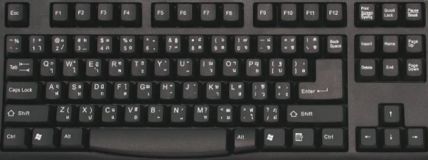
How to view this presentation
Each slide plays animation and effects
< This icon appears in the corner during playback
After each slide displays, this icon >
prompts you to advance to the next page
Space bar key
Mouse click
Page Down key
Down Arrow key
Enter key
Click one to continue

Slide 3
ENGR099_OLT: 2020 Incoterms™ Service Pack Training
By Doug Stuyvenberg
June 1, 2021
Click to continue…

Slide 4
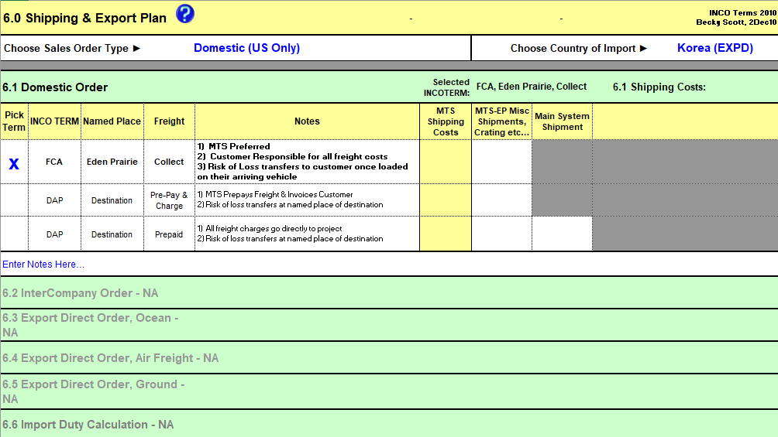
Required Service Pack for the v4.04 Cost Tool
In June 2021, a new Service Pack for the Cost Tool was released
Service Pack name: “2020 Incoterms”
This service pack overwrites tables 6.1 – 6.5 in the Cost Tool’s “Shipping” page
Click to continue

Slide 5
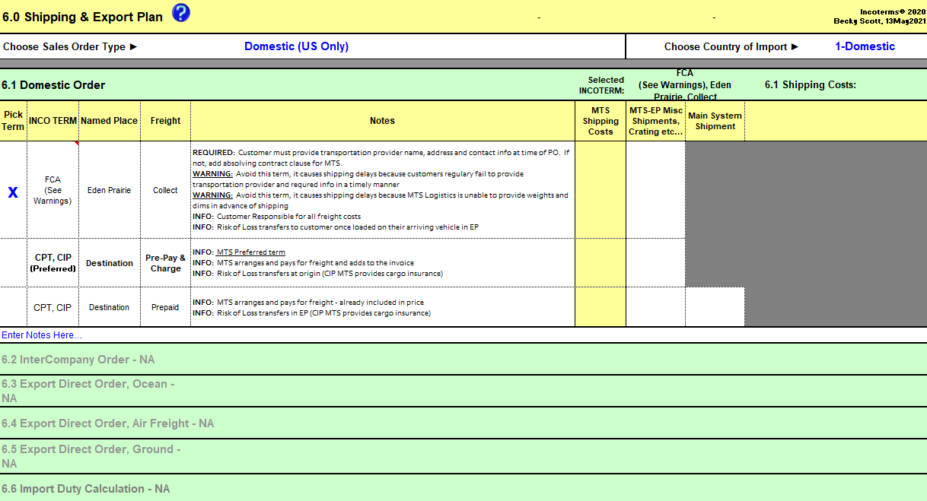
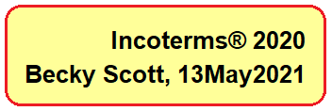
Required Service Pack for the v4.04 Cost Tool
2020 Incoterms in the “Shipping” page:
MTS Approved Incoterms™ for each Sales Order type
New terms: DAP, CPT, CFR & DPU
DDU no longer used
Click to continue

Slide 6
Required Service Pack for the v4.04 Cost Tool
All Cost Tools (CT) require this service pack
CT revision changes from v4.04 to v4.05
Starting July 5, 2021, CT-based sales order submittals require this Service Pack
Order Administration will reject order submittals not meeting criteria
Cost Tool must be v4.05!
Thank you for your order!
* PO & Contract
* Cost Tool v4.04
* Specifications
* Order Submittal Form
On my way…
Congratulations!
Please submit the order
MTS
Customer
Order Admin
Click to continue

Slide 7
2020 Incoterms™ Service Pack
Service Pack “2020 Incoterms” is a stand-alone Excel File
Let’s take a
Closer Look
This service pack features one page view and control
Click to continue

Slide 8
2020 Incoterms™ Service Pack
Click to continue

Slide 9
2020 Incoterms™ Service Pack
Contracts Administration provides greater detail and guidance for each Incoterm™
Cost Tool version changes to v4.05
Click to continue

Slide 10
2020 Incoterms™ Service Pack
Click to continue

Slide 11
2020 Incoterms™ Service Pack
Click to continue

Slide 12
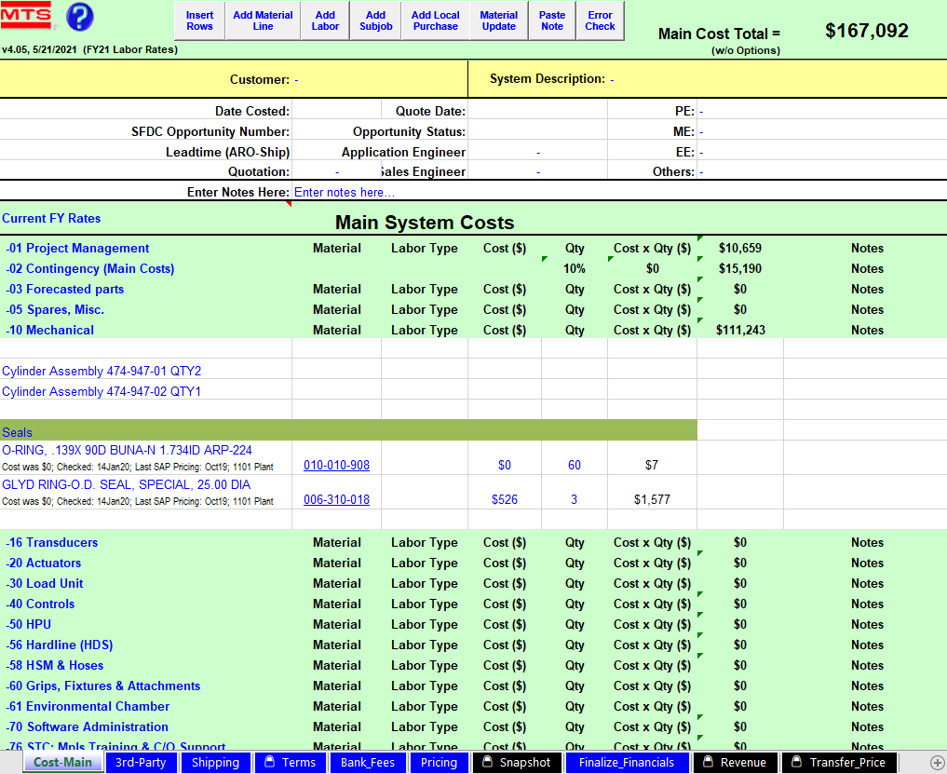
Install in 5 easy steps
1) Close all Excel files
2) Open 2020 Incoterms™ Service Pack
(Ensure Macros are enabled)
3) Open a v4.04 Cost Tool
(Wait for automated programs at file>open)
4) Return to the Service Pack
5) Click “Run Service Pack”
Click to continue

Slide 13
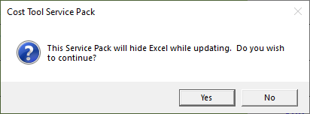
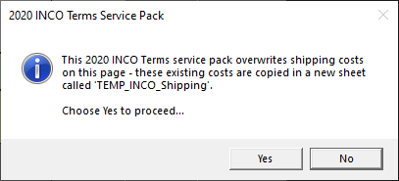
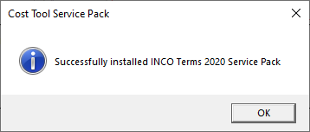
Info messages while installing
New feature
Run time = ~1 min
Important!
Remember
Shipping costs require re-entry
Click one to continue

Slide 14
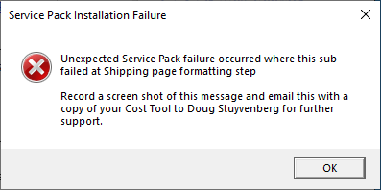
Error Messages encountered during installation
Initial conditions checks
Cost Tool protections and integrity checks
The Service Pack conducts a series of verification, compatibility and Cost Tool readiness checks. Error messages define what the error is and how to fix it.
Potential error messages:
Please take a moment to read through these errors before advancing to the next slide
Missing, past and required Service Packs
The “Everything Else” error result
Click to continue

Slide 15
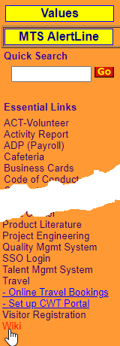
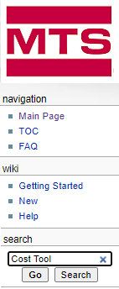
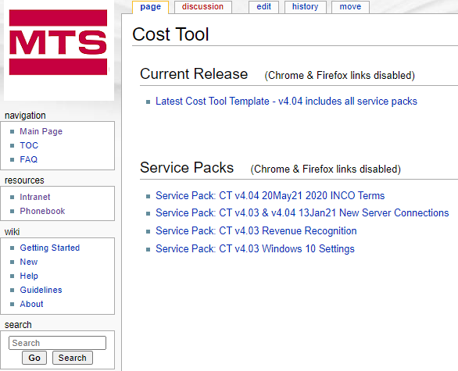
Ready, Set and Go!
To access this “2020 Incoterms” service pack and earlier Cost Tool service packs, navigate to the Cost Tool Wiki home page
Intranet Home Page > Quick Links > Wiki > Search on “Cost Tool” > Choose a Service Pack
Click to continue

Slide 16
Finish line! You completed this training
Thank you!

