Slide 1
ENGR108_OLT “Engineering Communication Expectations”
January 11, 2024
Doug Stuyvenberg

Slide 2
Background
MTS and ITW’s workplace culture offers an environment for engineering personnel to enjoy empowerment, a spirit of independence, responsibility, and accountability. For decades, engineering personnel have mostly been assigned to matrixed project teams where work direction, schedules, and collaboration were established. Within these matrixed teams, communication is more fluent and open. Company-wide, maintaining good communication is an essential requirement for success. As with MTS and now with ITW, the “Trust” value is exemplified in our leadership. We act professionally and we trust our staff. MTS leadership focuses on execution of company strategy through recruiting, developing top talent, and supporting career growth for engineers and designers. Our leadership ethos does not and should not micro-manage direct reports.
As the engineering staff engages and strengthens working relationships with product and project teams, the communication becomes pervasive and ubiquitous amongst these matrixed teams as expected. Conversely, communication with people leaders in our work culture at times produces unintended situations where managers and supervisors are not getting informed or engaged when they should be. This guide provides instructions and expectations to improve communication between engineering staff and their leaders.

Slide 3
Communication Instructions for Engineering Staff
Please notify your supervisor of the following:
Safety
Any safety incident witnessed in-plant or off-site; observed unsafe conditions
“Good catches”, “near misses”, and accidents involving injuries and/or death
Accidents that cause significant system or facility damage.
Customers
A “Customer-down” situation, customer visit(s) or unplanned service request(s) requiring 1 day or more of engineering labor
Work Schedule
Remote work plans (WFH)
PTO email notification when taking more than 1 day consecutively
Culture
Disrespectful behavior or hostile attitudes
Poor compliance with ITW’s Values
Travel
Unplanned and/or short notice travel requests
Travel approvals per latest guidelines

Slide 4
Communication Matrix
Category | Details | Colleagues | Supervisor / Mgr | +1 Manager | Sr. Leader / Director | EHS Manager(s) | HRBP | Product Safety & Compliance Engineer
Safety | Any safety incident or observed unsafe conditions; “Good catch”, “near miss” | ○ | ● | ● | ○ | ● | ○ | ○
Safety | Accidents involving injuries and/or death or accidents that cause significant system or facility damage. |  | ● | ● | ● | ● | ● | ○
Customers | A “Customer-down” situation, customer visit(s) or unplanned service request(s) requiring 1 day or more of engineering labor |  | ● | ● | ○ | ○
Work Schedule | Remote work plans (WFH) or PTO email notification when taking more than 1 day consecutively | ● | ● | ○
Culture | Disrespectful behavior, hostile attitudes, or poor compliance with ITW’s Values |  | ● | ○ | ○ |  | ○
Travel | Unplanned and/or short notice travel requests Travel approvals per latest guidelines |  | ● | ○
● Required ○ Optional

Slide 5
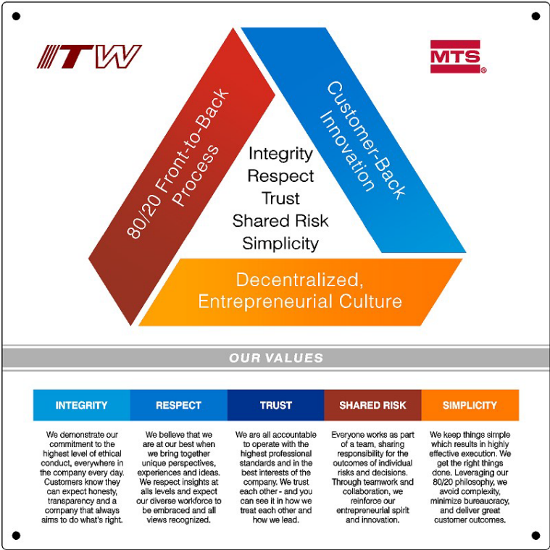
MTS/ITW Values

