Slide 1
ENGR111_OLT “GRV QN-ECN Goal 2024”
Goal Review & Process Training
May 31, 2024

Slide 2
2024 QN-ECN Goal
Background
This training material was originally prepared and presented for an instructor-led training session held in April 2024.
Understand, this QN-ECN goal raises awareness of two different information systems used by two separate organizations. SAP’s Quality Notification (QN) system is how the Operations teams flags production problems and the Engineering Change Notification (ECN) is how the Engineering team processes drawing and BOM changes. This 2024 goal’s purpose is to encourage responsive and diligent actions to react to QN’s and drive engineering change activities to correct and close the QN. Creating awareness, priority, and measuring response times for various process steps is engineering’s contribution to improving MTS’s On-time Delivery (OTD) performance.
The slides begin with a detailed description of the group level goal that was established for the GRV Mechanical Engineering team’s 2024 goal plans.
The “Process” section of the slides explain how to search for your QN’s and what steps are necessary to “own” the actions to address the open QN’s and process a respective ECN.

Slide 3
2024 QN-ECN Goal
Goal Description
Measure the duration and completion to resolve all CY24 GRV mechanical engineering QN’s in Q2, Q3, and Q4.
MTS’s Operations team employs SAP’s Quality Notification (QN) system as a formal communication method of a production problem and QN’s that are designated as “Engineering” as a cause or expected resolution require the GRV Engineering team to react promptly. Engineering personnel are expected to “own” all aspects of a QN and to use the ECM and ECN process and tools to formally resolve the noted problem. Active and effective communications and urgency are expected and will be measured.
Definitions
Start Time: QN creation date.
General: Any project with an order value less than $2M.
Large ETO/Custom Project: An engineered-to-order (ETO) project valued greater than $2M.
ECN Closed: ECN tasks are complete and closed out.
ECN/QN Linked: Linkage occurs when an ECN value is entered and saved in the respective QN.
Resolved: ECN/QN Linked and ECN Closed as defined above.
500000003: A proxy ECN number used in a QN for a material that does not require an ECN. As an example, a QN gets written for a BOM or drawing error for an obsolete material. When this number is linked in the QN, the status is considered resolved.

Slide 4
2024 QN-ECN Goal
T
→ Time Start
T
→ Measurement Taken
ENGINEERING
OPS
QN CREATE
QN REVIEW
ECN
QN/ECN LINKED
T
T
T
Successful
General: Close ECN in < 25 calendar days.
Large ETO: Close ECN in < 30 calendar days.
Exceeding
General: Close ECN in < 20 calendar days.
Large ETO: Close ECN in < 25 calendar days.
*Timer begins the day QN is created
Successful
General:
  100% Resolved within 90 calendar days.
  >=95% Resolved in < 30 calendar days.
Large ETO:
  100% resolved within 120 calendar days.
  >=95% Resolved in < 60 calendar days.
Exceeding
General:
  100% Resolved within 60 calendar days.
  >=95% Resolved in < 25 calendar days.
Large ETO:
  100% resolved within 90 calendar days.
  >=95% Resolved in < 40 calendar days.
*Timer begins the day QN is created

Slide 5
The Process
STEP 1: FIND AND REVIEW YOUR QN’S
STEP 2: ECN UPDATED DOCUMENTATION
STEP 3: LINK ECN WITH QN AND CLOSE

Slide 6
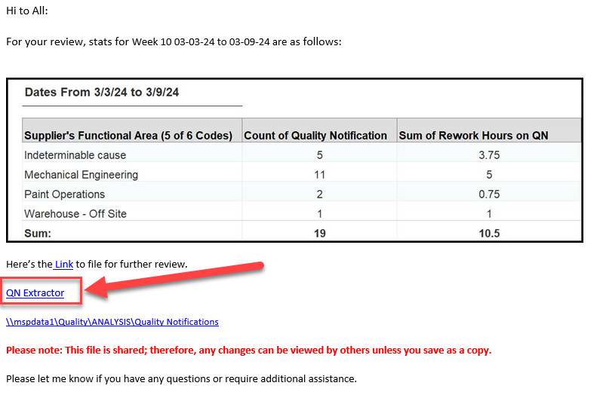
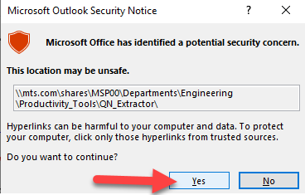

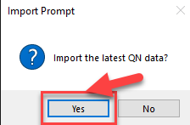
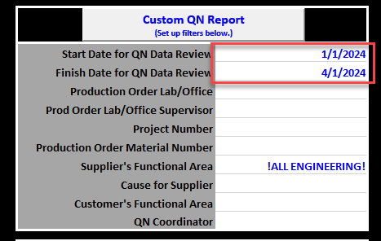
STEP 1: Find Your Quality Notifications
HOW you will know about your QNs…
Manufacturing Engineer or Technician.
Weekly QN report.
  Open QN Report Email and click AN Extractor.
  Say “Yes” to security prompt.
  Open the extractor worksheet in the presented explorer.
  Inside workbook, click “yes” to import latest data.
  Set dates to filter on
  Click “Custom QN Report”
  Go to next slide →
1
2
3
4
6
5
Verify
“!ALL ENGINEERING!

Slide 7
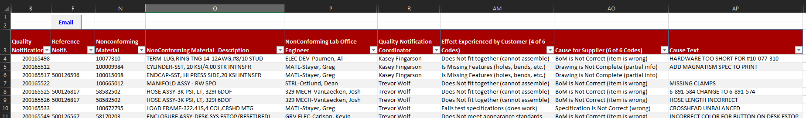
STEP 1: Find Your Quality Notifications Continued…
ECN number associated with QN – this will auto populate once linked in SAP
1
Nonconforming Lab Office
Filter on this column to find your name/QNs
2
Review cause codes
QN ID Number
Nonconforming Material # and Description
FYI – QN Coordinator/ Manufacturing Engineer
*SOME COLUMNS HIDDEN OR NOT SHOWN FOR CLARITY
Expectations
You regularly check the QN Extractor and QNs assigned to you.
    If the QN is not assigned correctly, contact the QN coordinator/manufacturing engineer to have updated.
You review and confirm the cause codes and text for your QNs.
    If the issue is unclear, engage with your coordinator/manufacturing engineer/Ops team to clarify.
    If the QN is not coded correctly, contact the QN coordinator/manufacturing engineer to have updated.

Slide 8

Check Point 1
ENGINEERING
OPS
QN CREATE
QN REVIEW
ECN
QN/ECN LINKED
T
T
T
Definitions
ECN Closed: ECN tasks are complete and closed out.
ECN/QN Linked: Linkage occurs when an ECN value is entered and saved in the respective QN.
Resolved: ECN/QN Linked and ECN Closed as defined above.

Slide 9
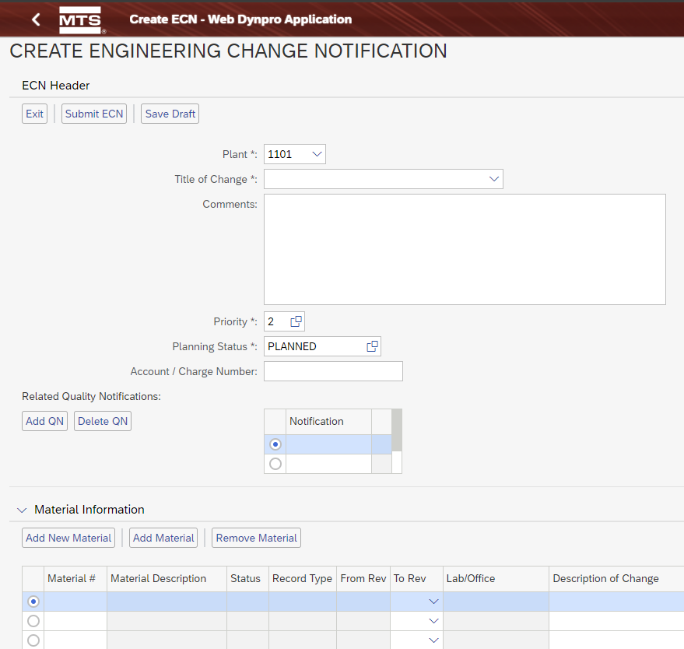
STEP 2: ECN
Revise documentation via the standard ECN process
  ECNs may be written for one OR many non-conforming materials
Notification not available at this time

Slide 10
Check Point 2
ENGINEERING
OPS
QN CREATE
QN REVIEW
ECN
QN/ECN LINKED
T
T
T
Definitions
ECN Closed: ECN tasks are complete and closed out.
ECN/QN Linked: Linkage occurs when an ECN value is entered and saved in the respective QN.
Resolved: ECN/QN Linked and ECN Closed as defined above.

Slide 11
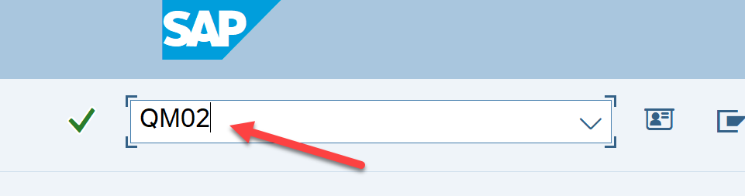
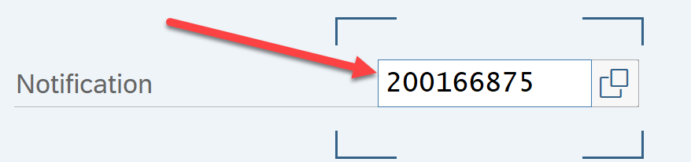
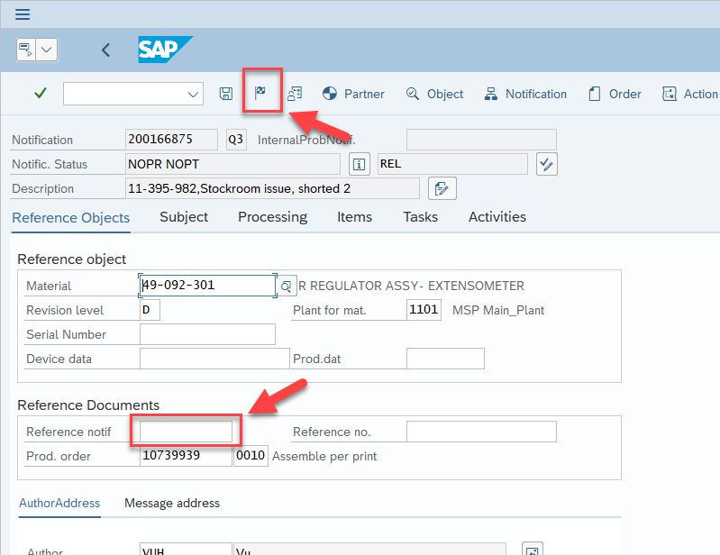
STEP 3: QN/ECN Tie Out
HOW to tie-out…
Open SAP and use code “QM02”
Enter the QN number
Enter the ECN number in “Reference Notif” field.
Click the little flag to close the QN.
Click green check mark in pop-up window or press <ENTER> key.
1
2
RULE: ECN# 500000003…
May already be entered in field by manufacturing engineer – need to verify.
Generic ECN number to indicate the material does not require an ECN but is confirmed an engineering BOM/Drawing issue.
Example use may be an obsolete part that has an error in the BOM/Drawing but we will never build or service it again.
4
If the “Reference Notif” is grayed out and you cannot enter your ECN number, the QN was closed. See next slide to reopen the QN
3

Slide 12
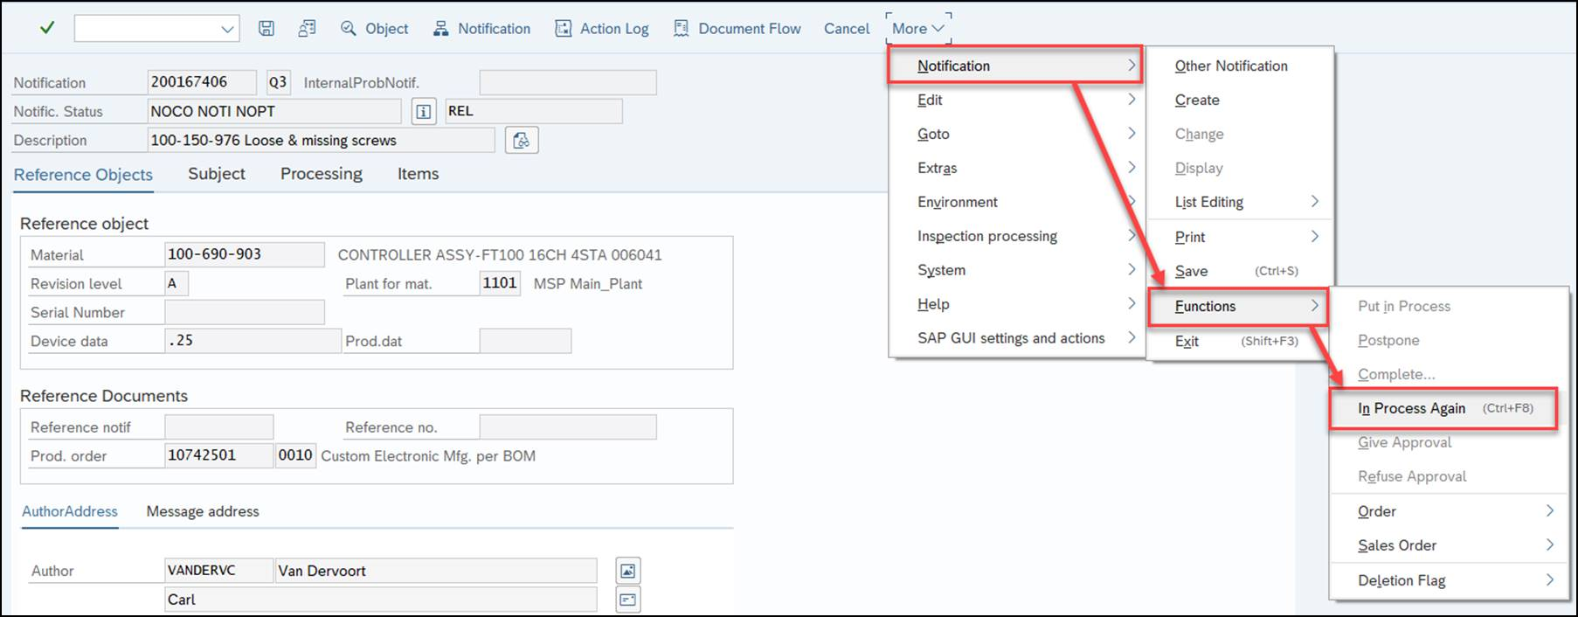
STEP 3: Re Open Closed QNs
If the QN was closed before you could enter your ECN number,
Press Ctrl+F8 to reopen the QN
Or do the following steps to reopen the QN…
Navigate to “More” dropdown
Navigate to “Notification” dropdown
Navigate to “Functions” dropdown
Select “In Process Again”
After you have reopened the QN, go to the previous slide to complete the QN/ECN tie out process.
1
2
3
4

Slide 13
Check Point 3
ENGINEERING
OPS
QN CREATE
QN REVIEW
ECN
QN/ECN LINKED
T
T
T
Definitions
ECN Closed: ECN tasks are complete and closed out.
ECN/QN Linked: Linkage occurs when an ECN value is entered and saved in the respective QN.
Resolved: ECN/QN Linked and ECN Closed as defined above.

Slide 14
CONTACT
If you need any assistance with this process or have any questions, PLEASE CONTACT MATT SCHON
Matthew.schon@mts.com

