Slide 1
STEP Training
Vendor
11/21/2018

Slide 2
Agenda
  Part 1
  What is STEP
  High Level Overview
  Part 2
  How to Use Step: Functional Training
    Hands on Training
Notes:
Part 1
What is STEP
STEP and how it relates to My Role
High Level Overview
Part 2
How to Use Step: Functional Training
Hands on Training
Appendix: Structured Scenario: Maintain and De-Duplication

Slide 3
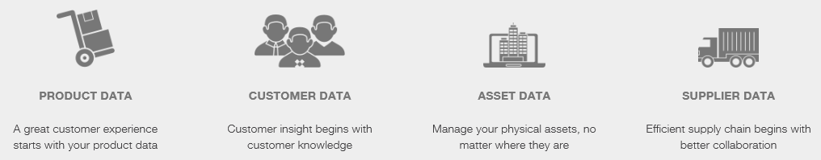
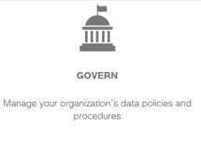
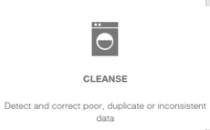
What is STEP – Master Data Management Tool
Today
Limited integration between systems resulting in data re-entry
Unreliable master data & lack of data governance process and policy
Core data not trusted and managed
Inaccurate/out of date data within system
Future
Centralized and standard processes for Master Data Management
Clean up legacy Material, Customer, and Vendor Master Data
Develop Master Data governance policy & oversight
Get Clean/Stay Clean
StiboSystems
Identify Master Data Requirements
Data Cleansing
Develop processes, standards, and best practices for prevention
Establish ongoing metrics and monitors

Slide 4
STEP and My Role
This section is to be written by a SME and outline the use cases for which a Data Steward will use STEP within their day to day role.
  Validate if exists prior to creation
  Identify potential duplicates and evaluate which record should be deleted
  Maintain record accuracy and completeness

Slide 6
High Level Overview
User Roles
What data is available
How is the data Structured
How data moves through STEP

Slide 7
User Roles
User Group | Description
Data Steward | Search, View, and Modify master data Can submit a record to DnB to get full legal name and address Perform Clerical Review (potential duplicates)
Power User | Search, View, and Modify master data Can submit a record to DnB to get full legal name and address Perform Clerical Review (potential duplicates) Can approve changes made by Data Stewards triggering the record to be sent back to SAP for updates
Data Viewer | Search and View records. Cannot make any data changes

Slide 8
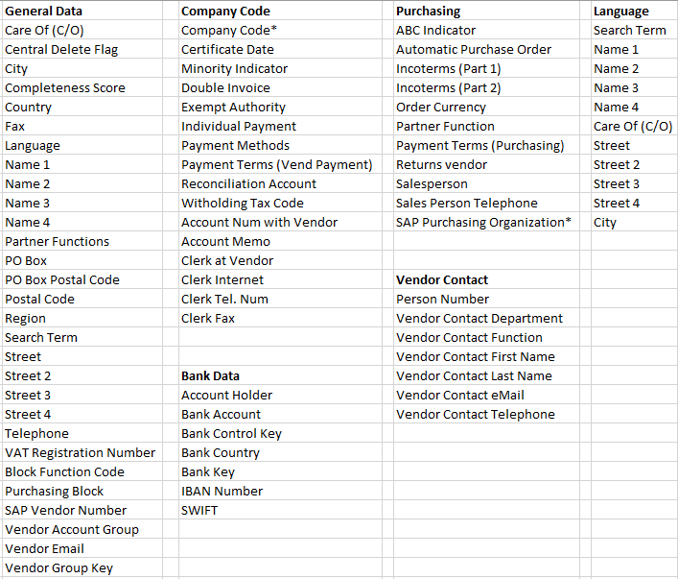
What Data is Available
All SAP Attributes identified as Mater Data from the following areas of SAP
  General Data
  Company Code Data (DC)
  Purchasing Data (DC)
  Vendor Contact Data (DC)
  Partner Functions (DC)
  Mandarin or Hangul
  translation (DC)
(DC) = your data is stored in
what STEP calls a Data
Container

Slide 9
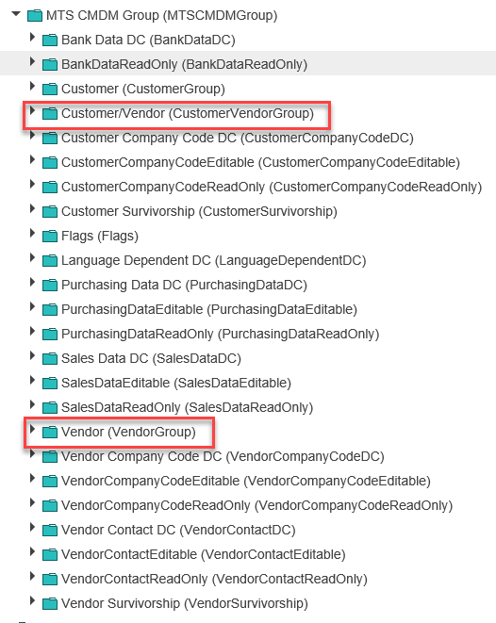
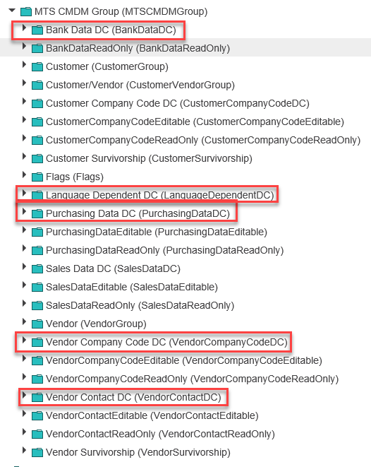
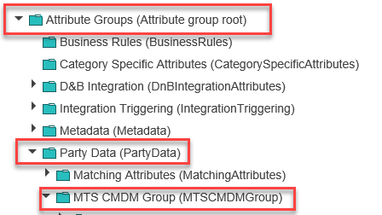
How is the Data Structured
If you are using the Advanced Search, you will need to understand how to find the attributes you want to add as search criteria
You will also need to understand if your data is part of a Data Container (This is called out on the prior slide)
Notes:
You will start by navigating to Attribute Groups then Party Data, and then MTS CMDM Group
The middle screen shot shows you the two folders your General Data attributes will fall under.
The 3rd screen shot shows you your data container folders.

Slide 10
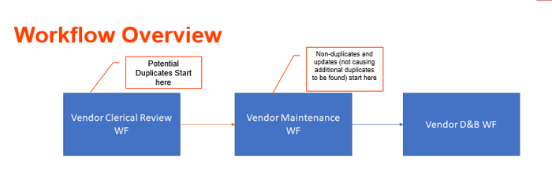
Workflows
In STEP we have 4 workflows:
  Vendor Clerical Review: Based on a matching algorithm potential duplicate vendors are identified. Here the Data Steward will review the potential duplicates and decide on the “surviving” record.
  Maintain Vendor: The surviving record along with any other records that are not a potential duplicate or marked for delete, will go through a Maintain Vendor workflow where the Data Steward can update key master data elements.
  DnB Match Candidate: Allows a data steward to submit a matching request to DnB. DnB will then identify any potential matching candidates and the data steward can select which DnB record is the best match.
  DnB Detailed Company Profile: Once the DnB candidate is selected another request is sent to DnB to identify and bring back detailed company data from DnB and associate it with our SAP record.

Slide 11


Data Flow – SAP to STEP
SAP-ECC
Clerical Review
Potential Duplicate identified
  Can be a new set of records
  Can be a previously defined survivor that now has a new potential duplicate
Extracts based on the following rules:
Newly created Vendor since last run
Change to one of the master data elements since last run
Survivor and Not Marked for Delete
Non Duplicate and not marked for delete
XML File
Maintain Vendor - Enrich
Not Marked for delete and no potential duplicate found
Previously defined non duplicate with an attribute update

Slide 12
Match Criteria
How are Potential Duplicates Identified
Account Group | Domestic vs International | Duplicate Rule
All | Domestic | 5 Digit Postal Code + Street
All | International | County + Postal Code + Street

Slide 13
Data Flow – STEP to SAP
Maintain Vendor – Approval State
Any record marked as deactivated in in Clerical Review, and the identified survivor record approved by power user
Sends SAP Vendor Number of deactivated record. SAP marks the record for delete and applies a Purchasing Block
Any change to an SAP sources attribute in STEP
Record must be reviewed and approved by a power user
XML File
CSV File
SAP-ECC

Slide 14
How to Use STEP
How to Log In
How to read your home screen
How to Search and View Accounts
How to Resolve Potential Duplicates
How to Maintain and Enrich an Account record
  Cleanse, Complete, Send to DnB
How to Approve changes to go back to SAP

Slide 15
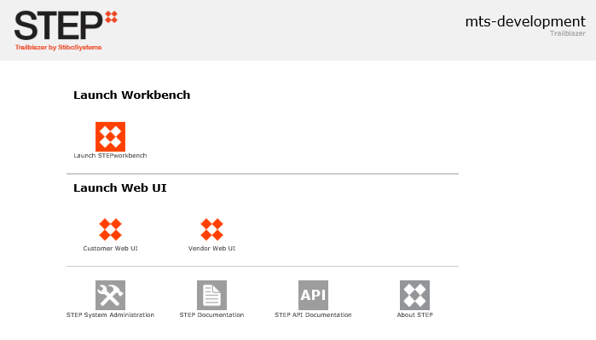
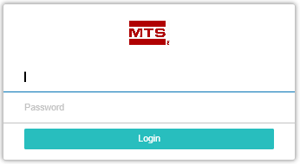
How to Log In
QA: http://msp02-stibo-q/
Notes:
To log in you can choose from either the Quality Assurance Environment or from Production. To do so please follow the appropriate link below:
QA: http://msp02-stibo-q/
PROD: http://msp02-stibo-p/
Once you have navigated to the appropriate link, you will see the following screen. The screen will indicate which environment you are logged into.
The Area of this login screen that end users will be using is the Launch Web UI area. The end user will pick the appropriate Web UI – Customer or Vendor. Permissions are set so that you can only log into the Master Data Area you have permissions to maintain.
Once you have selected the Web UI you would like to log into, you will be prompted with a log in box. Your user name and password are the same as your windows log in credentials
NOTE: The first time you log in you may get a pop up. Once you click OK it takes you to the release notes. To avoid this, click the do not show this screen button before clicking ok.

Slide 16
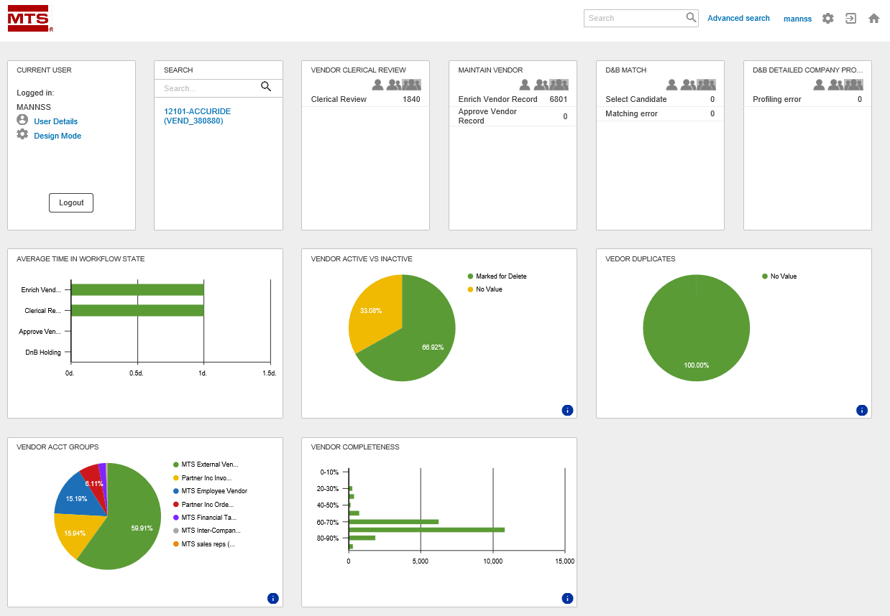
How to Read your Home Screen

Slide 17



How to Read your Home Screen - Continued
Corner Bar
  Advanced Search
  Log Out
  Home Page
Notes:
Your top right corner bar will allow you to perform your basic functions such as:
Perform a basic Search or an Advanced Search
*Please note. Search will need to be done using the name not the SAP number. Use *<name>* to help with the search.
Log out
Navigate back to Home page

Slide 18
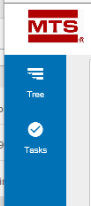
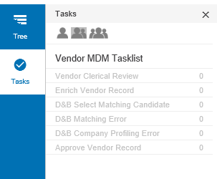
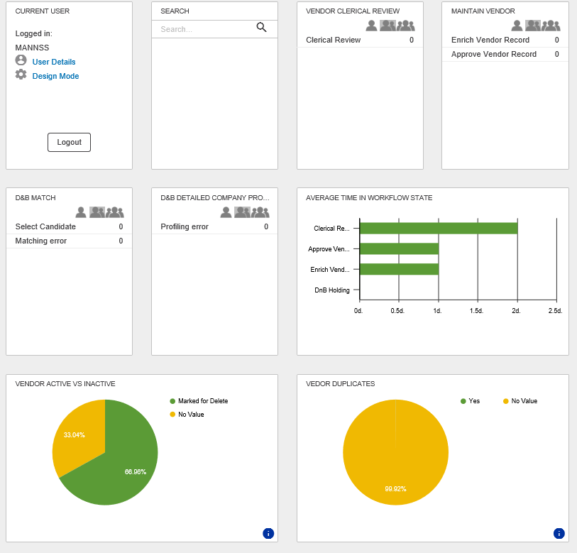
How to Read your Home Screen - Continued
Navigation Pane
Dashboard
Notes:
Navigation Pane
On the left-hand side, you will see your Navigation Pane. This is used for searching for a Customer or Vendor via a tree structure if you do not know the vendor name or number. From here you can also navigate to workflow tasks.
Dashboard
The middle section of your main page is your dashboard. Here you will have application widgets help guide you through your workflow as well as provide some metrics about your Data.

Slide 19
Activity
http://msp02-stibo-q/
Select Vendor Web UI
Enter your Windows User ID and Password
Familiarize yourself with the Corner Bar, Navigation Pane, and Dashboard

Slide 20
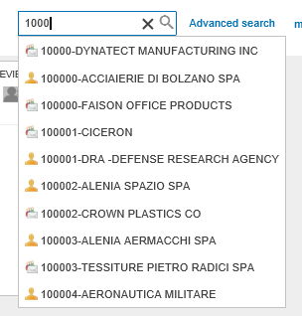


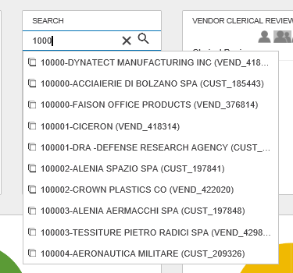
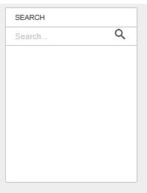
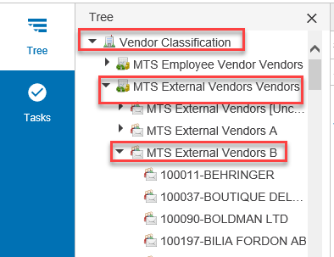

How to Search and View Accounts
4 ways to search
  Corner Bar
  Advanced Search
  Search Widget
  Navigation Pane
Notes:
Search Wild Cards
When performing searches, it is useful to understand STEPS search Options:
Asterisk (*) means select all or is used as a wild card for multiple characters
!= means not equal to
? is a wild card to represent 1 character
Advanced search has additional search values that are found by using the drop-down selector.
Corner Bar Search and Search Widget
Place your cursor in the search box on the corner bar and begin to type the Vendor number. A drop down of options will begin to appear. You may see customers here as well depending on your access level.
If you type in the full vendor number and do not see the vendor in the drop down type a dash “-” after the number. This is how the names are formatted.

Slide 21
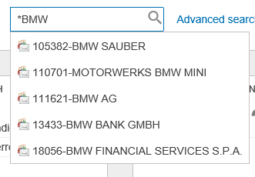
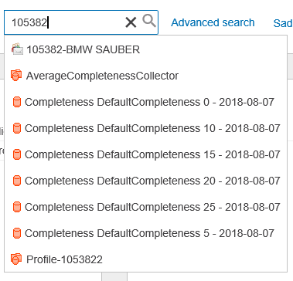
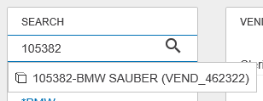
Activity
Tips:
Only the corner bar allows * as a wild card
On corner bar if you don’t see the vendor you are looking for after typing the number add a “-”
Search Widget you must start with the Vendor Number
Click in the Search Box on the corner bar
Type in *BMW
Click in the Search Box on the corner bar
Type in 105382
Click on the Search Widget and type
Type in 105382
Click on the Navigation Pane
Navigate to find BMW

Slide 22
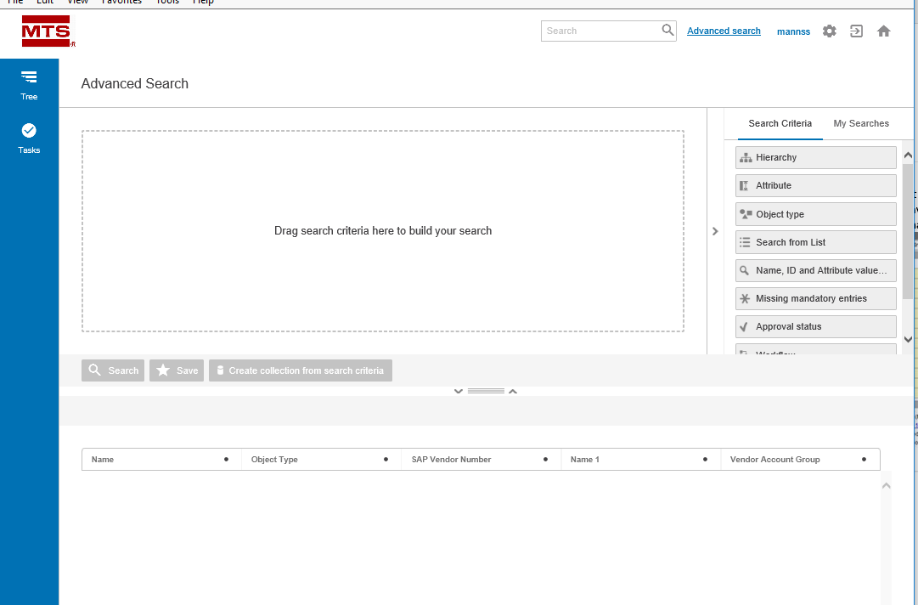
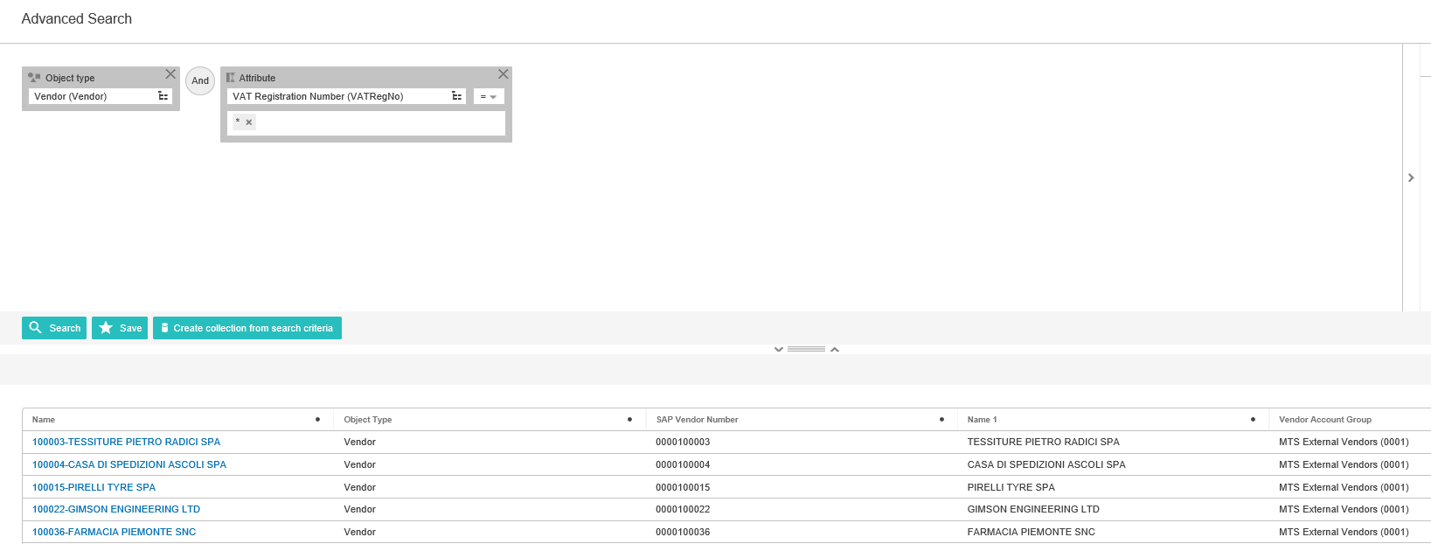
How to Search and View Accounts – Advanced Search
Notes:
When you click on the Advanced Search in the Corner Bar, you are directed to the advanced search page. Here you can build your own customized searches. You can also save our searches for future use.
Here are detailed instructions on how to build an advanced search: http://ibmtb-app.stibo.com/help/#web_user_interfaces/advancedsearch/using_advanced_search.html?Highlight=Advanced Search
The second screenshot is an example of an Advanced search for all Vendors that have a VAT

Slide 23
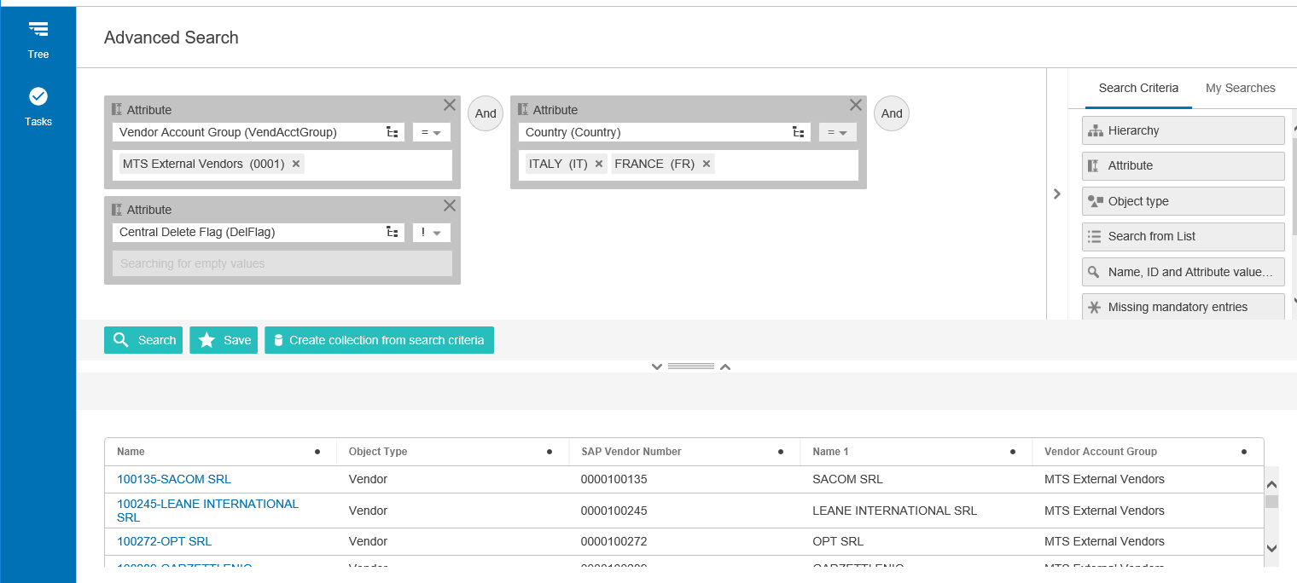
Activity
From your home page, click on Advanced Search in the corner bar
Build a Query to bring back the following Vendors:
  External Vendor (0001)
  Country is Italy or France
  Active Vendor

Slide 24
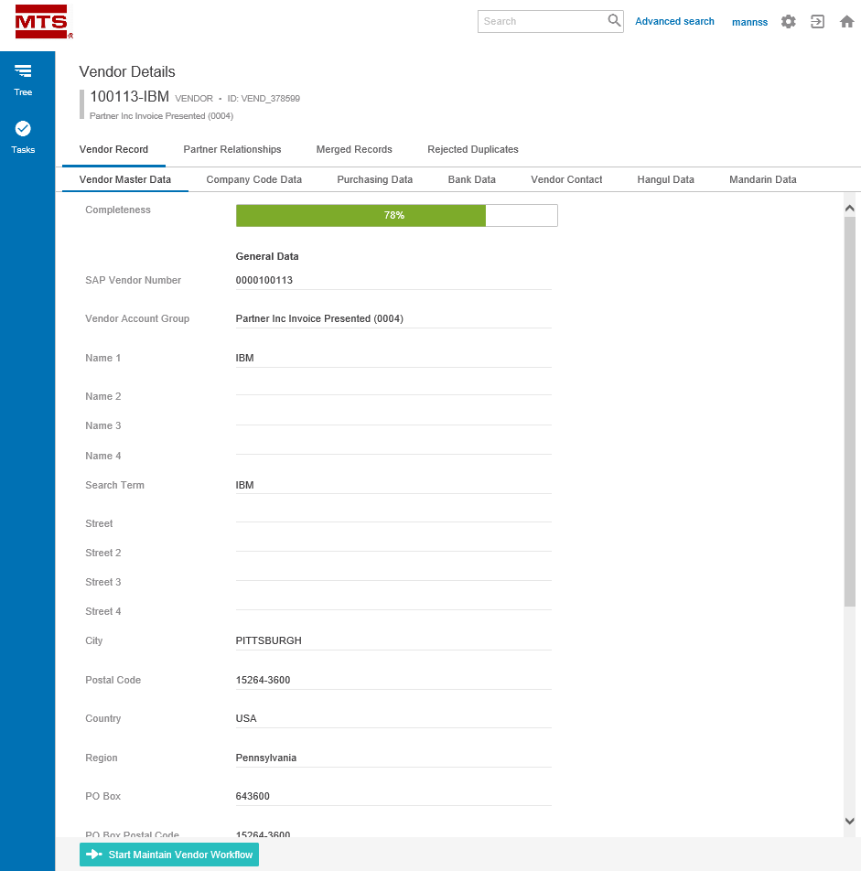
How to Search and View Accounts
After you have found the vendor you are looking for in your search. You can open the Vendor Details screen and view all information about that vendor.
  Vendor Master Data
  Company Code Data
  Purchasing Data
  Bank Data
  Vendor Contact
  Hangul
  Mandarin
*On the Vendor Details
screen you should only
“view” your data. Do not
edit it.
Notes:
Your vendor details page is organized into several tabs which separate data elements related to specific business functions.
The Vendor Record tab allows you to see subpages of:
Vendor Master Data – all master data attributes that are globally shared
Company Code Data – All master data attributes that unique for different company codes
Purchasing Data – All master data attributes that are unique to different purchasing organizations
Bank Data – All master data attributes that are bank specific
Vendor Contact – All master data attributes that are at the Vendor Contact specific
Hangul – Korean translation of name and address fields
Mandarin – Chinese translation of name and address fields

Slide 25
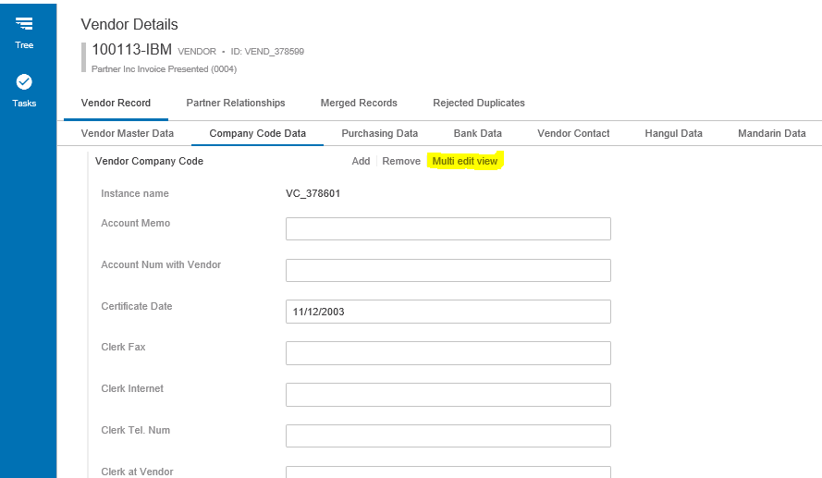
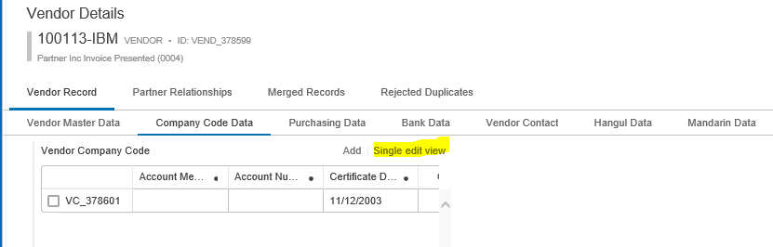
How to Search and View Accounts
The Data in the following tabs is organized by what is called Data Containers. A data container is a way of organizing the data to allow for one vendor to have multiple instances of the associated data.
  Company Code Data
  Purchasing Data
  Bank Data
  Vendor Contact
  Hangul & Mandarin
When Viewing this data you may need to switch from a Single Edit view to a Multi Edit view

Slide 26
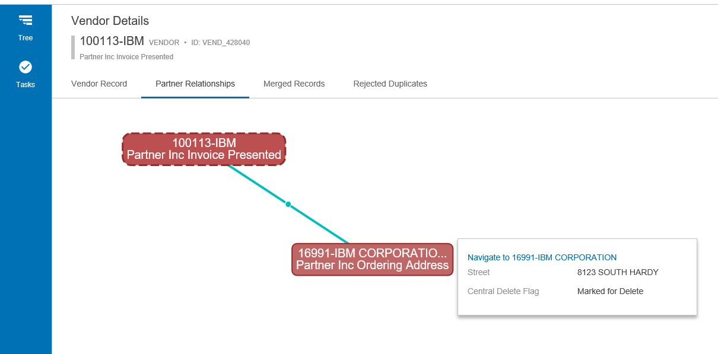
How to Search and View Accounts – Partner Relationships
From the Partner relationships tab, you can see all partner functions of the record you are viewing. By hovering over the Partner function box, you can get an additional popup that will allow you to navigate to that partner function record.

Slide 27
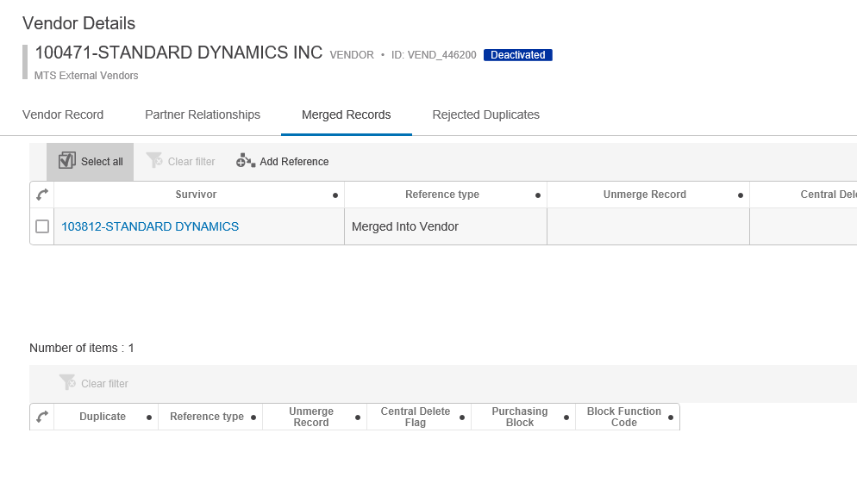
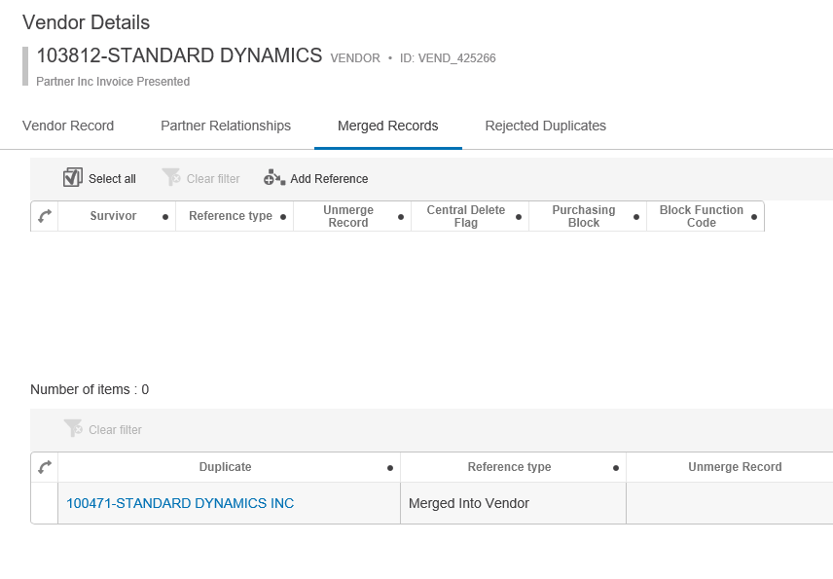
How to Search and View Accounts – Merged Record
Merged: A record that is an identified duplicate. The Merged Record can either be the “deactivated” record or the “survivor” record.
On the “Deactivated” record the Survivor will be displayed on the top section. On the “Survivor” record the duplicate will be displayed on the bottom section.
Notes:
Merged Record and Rejected Duplicates
Merged Record = A record that is an identified duplicate. The Merged Record can either be the “deactivated” record or the “survivor” record.
Rejected Duplicates = Any record(s) that you said during clerical review were NOT duplicates of each other.
On the merged record or Rejected Duplicates tab, you will see two sections on the pages. This is because in STEP a record can be Referenced or Referenced By.
Reference = Where you can see references from the selected entity to other objects. Here the entity is the Source and it references other Targets (Referenced By)
Referenced By = Where all references of which the selected object is the target (e.g., all the objects that the selected object is referenced by) can be viewed

Slide 28
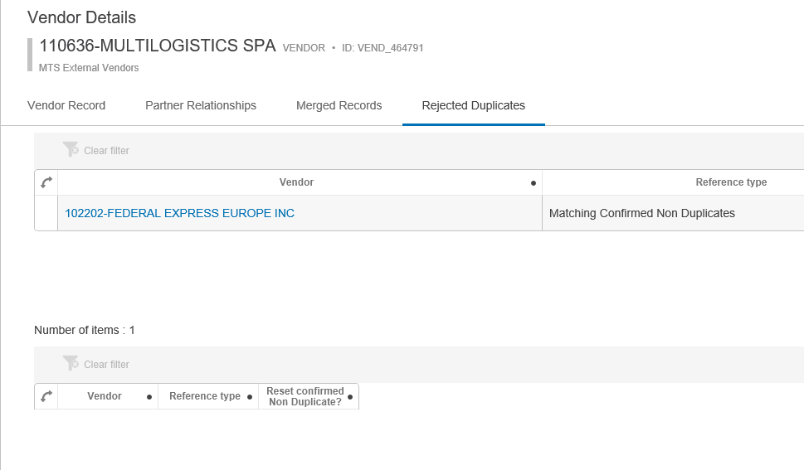
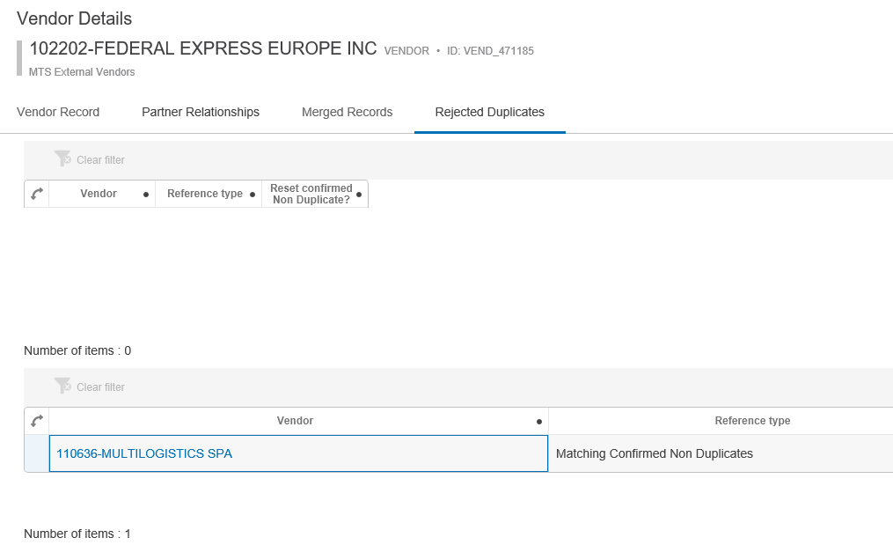
How to Search and View Accounts – Rejected Duplicate
Rejected Duplicates are any record(s) that you said during clerical review were NOT duplicates of each other.

Slide 29

How to Search and View Accounts
From any tab you can submit a record into the Maintain Workflow by clicking the Start Maintain Vendor Workflow button
Notes:
From any of these tabs you can also submit a record into the maintenance workflow by selecting the action button at the bottom of the screen. If the action button is grayed out, this means your record is already in the maintain state and waiting to be cleansed.

Slide 30
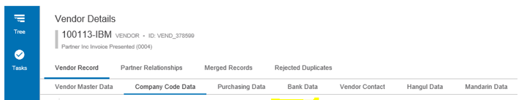
Activity
Search and Select any Vendor
Practice navigating the different tabs and understanding how the data is displayed and organized.

Slide 31
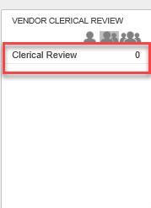
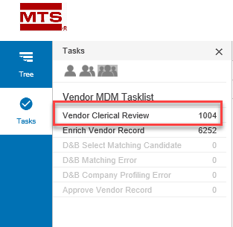
Clerical Review (Potential Duplicates)
Clerical Review Workflow is where the user reviews and resolves potential duplicate records.
How do you see your assigned tasks?
  Lone Ranger: Shows items assigned directly to your user id
  Twins: Shows all items assigned to your user id or anyone in your same user group
  Three Amigos: Show all items assigned to any user in that workflow. Note: depending on access level you may not see this option.
Notes:
Vendor Clerical Review
All records when loaded into STEP will be assessed and sent through clerical review. If a Vendor is new to STEP it will be compared against all other existing vendor records to determine if it is a duplicate. If it has no matches it will move to Maintain Vendor. If it has a match it will go into Clerical Review.
If a vendor that has previously been loaded to STEP comes in again, it will be compared against all records and if any new potential duplicates are found it will go to Clerical Review. If it is only matched with already identified duplicates or non-duplicate records, it will go directly to the Maintain Vendor workflow.
To access the potential duplicate review task, list the user will click on Clerical Review state from Vendor Clerical Review widget from their homepage. Or use the Side Panel Tasks

Slide 32

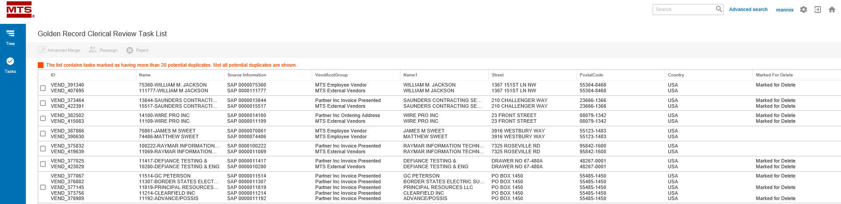
Clerical Review (Potential Duplicates)
Golden Record Clerical Review Task List
  Lists all potential duplicate groupings
Notes:
Duplicate Review Task List
On this screen, you will see a high-level task list that allows you to select your potential duplicate grouping to begin to review.
This initial task list displays STEP ID, STEP Name, Source Information, Vendor Acct Group, Name 1, Street, Postal Code, Country, and if the record is marked for delete.
From this screen you have 3 options:
Advanced Merge: Open the selected grouping and review additional columns in detail to determine if the records are duplicates
Reassign: Reassign the task list item to another user
Reject: Reject all items of the grouping resulting in them being set as non-duplicates
Clear all simply clears any check box selections you have made

Slide 33
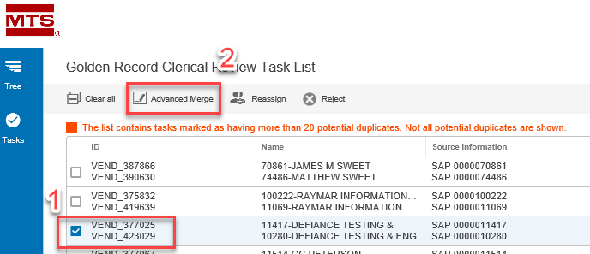
Clerical Review (Potential Duplicates) – Advanced Merge
To enter advanced merge, select the grouping you want to review and then select the advanced merge button
Notes:
This takes you to the Advanced Merge Screen. On this screen, you can review key master data columns as well as some high-level information related to company code, purchase organization, banking data, and vendor contacts to aid in selecting the appropriate survivor record.

Slide 34
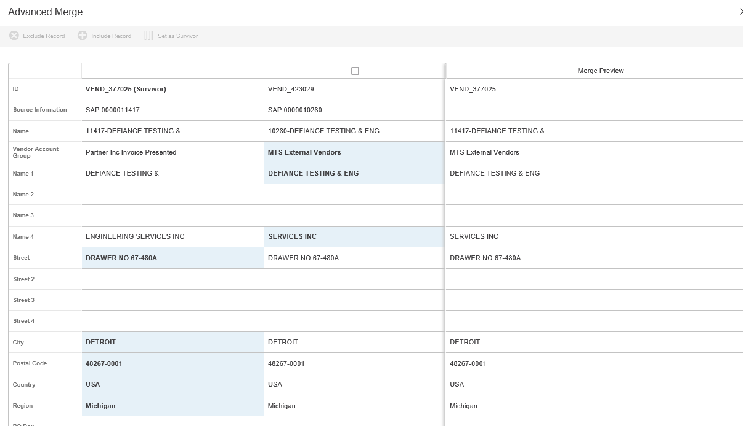
Clerical Review (Potential Duplicates) – Advanced Merge
Notes:
On this screen, STEP has pre-selected which record it wants to make as the survivor as well as what attributes to use to build the Merge Preview. You can however during your review determine if you want to:
Exclude a Record: Consider it a non- duplicate
Include a Record: Add back in a record if you Excluded it
Set as Survivor: Change which record is considered the survivor.
Merge Preview: pick and choose what attributes from the potential duplicates you want to keep.

Slide 35
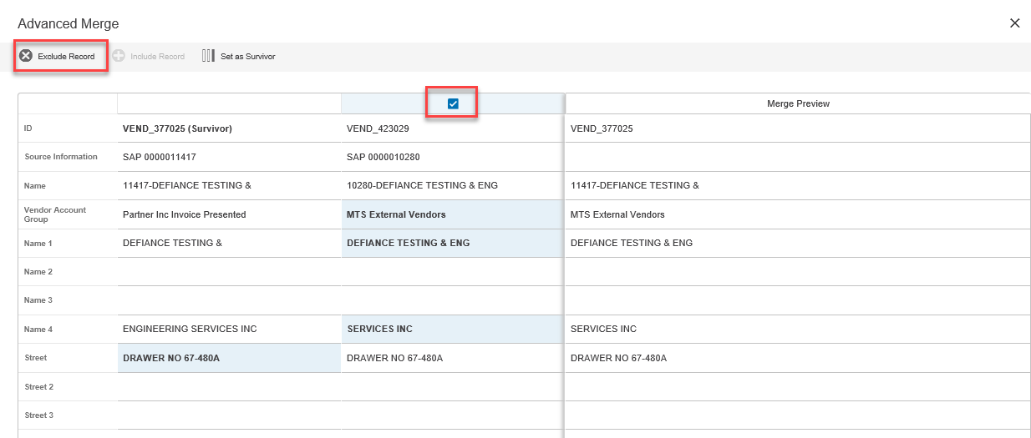
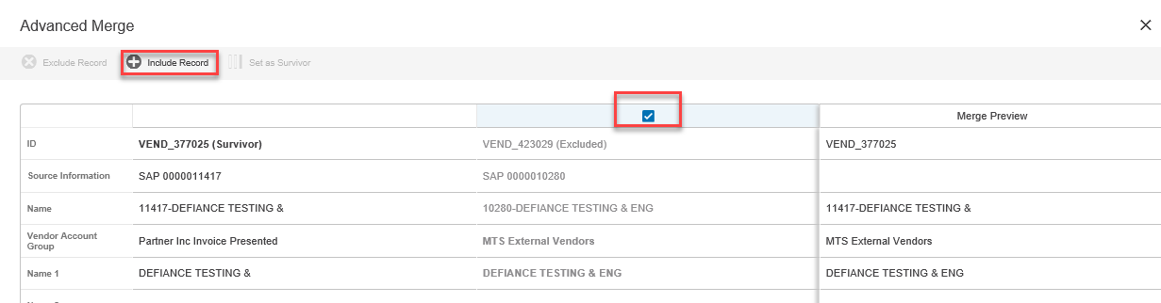
Clerical Review (Potential Duplicates) – Advanced Merge
To exclude a record, you simply check the record you want to exclude from being a potential duplicate and click the exclude button’
To include an excluded record, you select the record you want to include back in as a potential duplicate and click the include record button

Slide 36
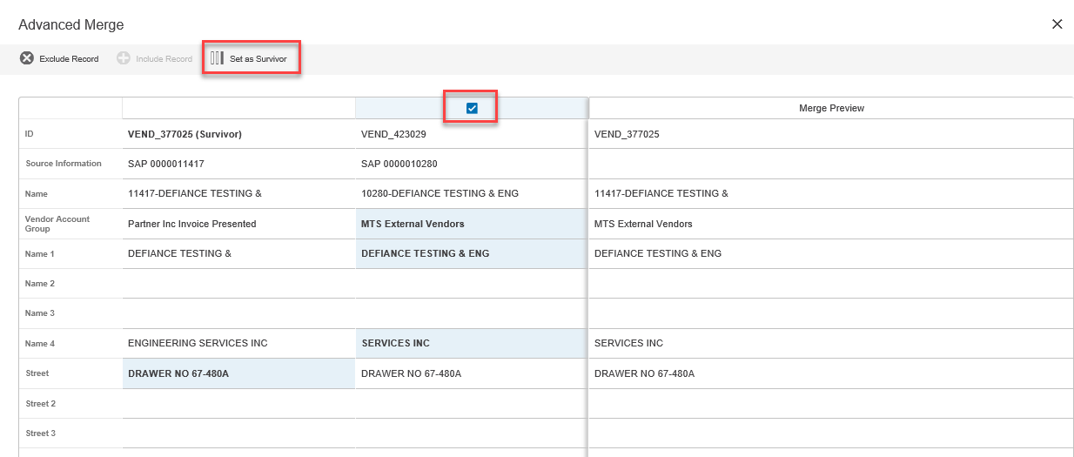
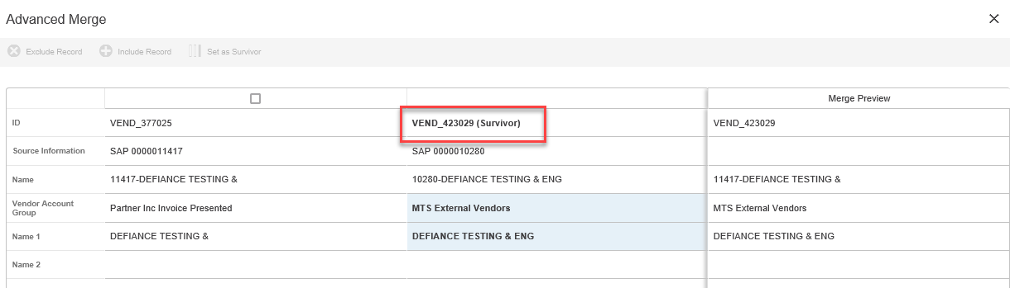
Clerical Review (Potential Duplicates) – Advanced Merge
To change which record is set as the survivor you select the record you want to become the new survivor and click set survivor

Slide 37
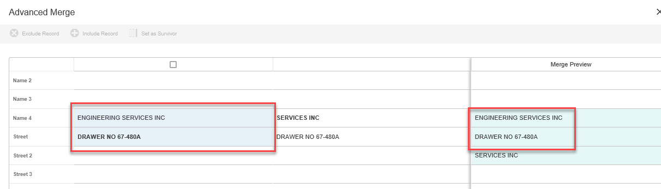
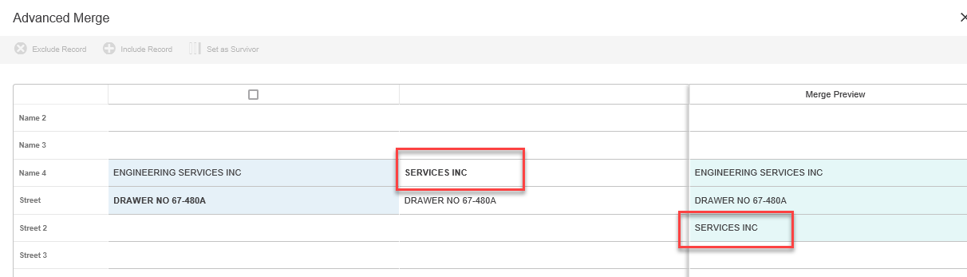

Clerical Review (Potential Duplicates) – Advanced Merge
Build your surviving record and Merge
Notes:
After you have excluded any non-duplicates as well as selected your survivor you can begin to build you merged record.
To do so you can select values from either record. The value you have selected will show in Blue and it will also show in the Merge Preview.
From here you will select merge at the bottom of your screen and the potential duplicate records will be identified as a duplicate of the survivor. This will then systematically mark all potential duplicate records with a Marked for Delete, a Block Function of 98, and a Purchasing Block of Yes. All survivor records (if not already marked for delete) will go to the Maintain Vendor workflow for further editing and approval.
Merge: Once you are complete with building your Merged record you will click Merge.
Reassign: Here you can choose again to reassign to another user
Reject: you can reject all the records here and they become confirmed non-duplicates
Cancel: You can cancel what you have done and the grouping remains in clerical review

Slide 38
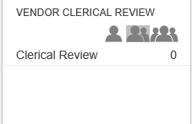
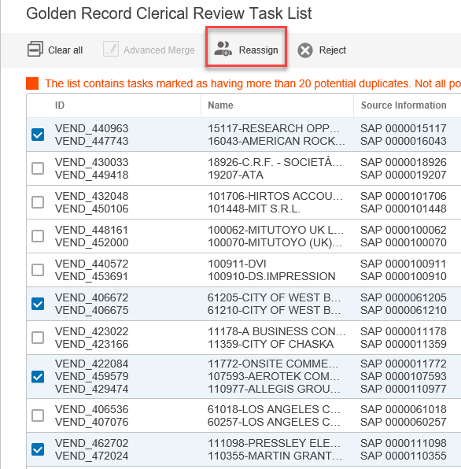
Activity
From Home Page locate your Clerical Review Widget
Click on the “Twins” to find potential duplicates assigned to your user group
Select a handful of potential duplicate groupings by selecting the checkbox
  Try to get ones with more than 2 potential duplicates
  Pick at least 5 groupings
Reassign those potential duplicates to your user id.

Slide 39
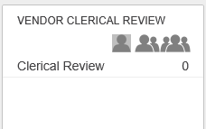
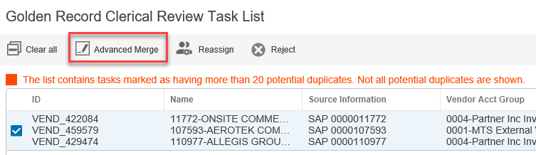
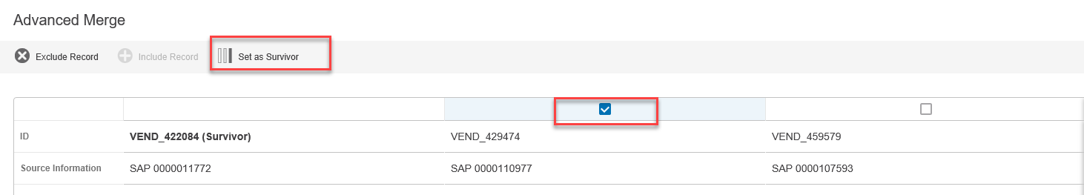
Activity
From Home Page locate your Clerical Review Widget
Click on the “Lone Ranger” to find potential duplicates assigned to your user id
Select 1 potential duplicate grouping and perform an Advanced Merge
Change the Survivor
Complete your Merge Preview
Merge your records

Slide 40
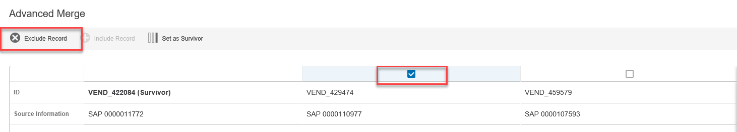
Activity
From Home Page locate your Clerical Review Widget
Click on the “Lone Ranger” to find potential duplicates assigned to your user id
Select 1 potential duplicate grouping and perform an Advanced Merge
Exclude 1 or more records as “non duplicate”
Complete your Merge Preview
Merge your records

Slide 41

Activity
From Home Page locate your Clerical Review Widget
Click on the “Lone Ranger” to find potential duplicates assigned to your user id
Select 1 potential duplicate grouping and perform an Advanced Merge
Exclude more than 1 record as “non duplicate”
Select one excluded and re-include it
Complete your Merge Preview
Merge your records

Slide 42

Activity
From Home Page locate your Clerical Review Widget
Click on the “Lone Ranger” to find potential duplicates assigned to your user id
Select 1 potential duplicate grouping and reject it (make them all a non duplicate of each other)

Slide 43
Activity
From Home Page locate your Clerical Review Widget
Click on the “Lone Ranger” to find potential duplicates assigned to your user id
Select 1 potential duplicate grouping and perform an Advanced Merge
Review the contents
Select Reject at the bottom of the screen

Slide 44
Activity
From Home Page locate your Clerical Review Widget
Continue to play with resolving duplicates as time allows

Slide 45


Maintain Vendor
The Maintain Vendor workflow contains only records that have met the following criteria:
  Survivor and not marked for delete
  No identified potential duplicate and are not marked for delete
  Submitted manually from the Start Maintain Vendor Workflow action button
How do you see your assigned tasks?
  Lone Ranger: Shows items assigned directly to your user id
  Twins: Shows all items assigned to your user id or anyone in your same user group
  Three Amigos: Show all items assigned to any user in that workflow. Note: depending on access level you may not see this option.
Notes:
The Maintain Vendor workflow contains only records that have met the following criteria:
They are a survivor and not marked for delete from the Clerical Review workflow
They have no identified potential duplicate and are not marked for delete
They were submitted manually from the Start Maintain Vendor Workflow action button on a Vendor Detail screen
To enter the Maintain Vendor workflow, using the Maintain Vendor Widget click on the Enrich Vendor Record state or use the Side Panel and click the Tasks

Slide 46


Maintain Vendor
Maintain Vendor – Enrich Vendor Record – Available
  Select the vendor you would like to Enrich
    You can select multiple and reassign to you
    Or you can click and work one at a time
  To further limit what you see in the task list, you can filter on the headers
Notes:
Maintain Vendor Task List
Once you click on the Enrich Vendor Record state, you will be taken to the Maintain Vendor – Enrich Vendor Record Task List. This task list allows you to:
Check the vendor you would like to Maintain and assign it to yourself or the Vendor Stewards user group
You can click directly on the name link and enter the Enrich Vendor Details screen
NOTE: If you select multiple vendors at one time you also have a clear all button to clear your selection
To make it easier to find the records you would like to maintain, you can use a sort or filter the task list. This is accessed by clicking on the header of the column you want to filter on. Be sure to click Apply Filter

Slide 47

Maintain Vendor
To begin to Enrich a vendor record, click on the name from the task list. This will bring you to the Enrich Vendor Record screen
Looks just like Vendor Details screen
If you did not reassign it to you on the
previous screen, click Assign to Me
button at the bottom
Always Save before Submit
Notes:
Enrich Vendor Record
To enter the Enrich Vendor Record screen you click on the Name of the vendor you are wanting to maintain and that will take you into the Enrich Vendor Screen. This screen looks and behaves just like the Details Screen

Slide 48






Maintain Vendor
Things to keep in mind when maintaining data:
  * Means mandatory
  Use drop downs
  Use Completeness Meter
  Non Editable fields are grayed out
  Apply a Null Tag if you remove a value
1
2
3
5
4

Slide 49

Maintain Vendor
Submitting Changes
  Save your changes
  Click the submit button
    If there are any required fields missing you will get a pop up error and will not be able to submit
Notes:
Submitting your Changes
To submit the changes, you have made to the vendor record, click submit at the bottom of the page. If a required field does not have data, a warning message will come up letting you know what was missed

Slide 50


Activity
Select a record from the Maintain Vendor Workflow: Enrich Vendor Record task.
Practice Filtering Data
Select a record and click on the Name
Can you identify what is missing and would drive up completeness?
Look through the various tabs, can you identify mandatory fields and Editable/Not Editable fields

Slide 51

Activity
Select a record from the Maintain Vendor Workflow: Enrich Vendor Record task.
Select a record and click on the Name
Assign the work to you
Practice editing data on various tables.
Save and Submit
Repeat this for multiple vendors
At this time do not send to DnB

Slide 52

Maintain Vendor – Reject Merges
User can determine a “merge” that took place in Clerical Review was done by mistake
  On Merge Record Tab, in Unmerge Record column, select yes
Notes:
In the Maintain Workflow, the user has the opportunity to “undo” a merge if they determine the records were merged mistakenly in Clerical Review. To do this, double click on the Merged Records tab and select yes in the Unmerge Record column. Upon submit and approval of this record, the merge will be removed and the central delete, purchasing block, and block function code reset. The “unmerged” record will then enter the Maintain Workflow.

Slide 53

Maintain Vendor – Reject Rejected Duplicates
User can determine that records that were set as Non Duplicate in Clerical Review were set by mistake and remove them as a non duplicate
  Reject Duplicates tab and in Reset Confirmed Non-Duplicate column select Yes
  The “rejected non duplicate” will remain in the maintain workflow and available to Enrich
  The reference between the two is removed
Notes:
A rejected duplicate is a record that was identified as a possible duplicate in clerical review but then excluded or rejected as a possible duplicate.
In the maintain workflow the end user can reset an identified non- duplicate if they feel it was marked as a non-duplicate by mistake. This is done from the Rejected Duplicates tab by double clicking the Reset Confirmed Non- Duplicate cell and selecting yes. Once the record is submitted and approved, the rejected duplicate will be approved as a standalone account and the survivor will go back through the maintenance review without the rejected duplicate reference.

Slide 54
Activity

Slide 55




Maintain Vendor - How to Send to DnB
At any point during Enrichment you can send a record to DnB
  Click the Send to DnB button
When your record “returns” from DnB it will be in the DnB Workflow. From this workflow you will select the candidate
  Returns a list of potential matches.
    Can remove those that you know are not a match
    Can click each and see more detail. Here is where you Select the candidate
  You will then return to the Enrich Customer screens on the DnB tab and complete your enrichment
Notes:
DnB Match Select Candidate
The task list D&B Match will display a list of vendor records. Upon selecting one or more vendor record, the “Remove from DnB due to No Candidate” we be made available so the user can remove from the workflow state if they choose
The customer Name column displayed with will take you to the D&B Match candidates screen. There number of D&B attributes are listed as header on top.
Select Candidate
After drilling into the vendor record, you can see all the potential candidates that were returned from DnB. The Select candidate on top of the screen will be active once a vendor record is selected.
To narrow down the big list the Modify search can be used to narrow down the records in display.

Slide 56

Maintain Vendor - How to Send to DnB
The Enrich Record, D&B Match tab is where you will see the selected candidate from the DnB workflow
  Data to Send to D&B is what was sent to D&B to match on
  Left side is the Selected Candidate from the D&B workflow
  Customer Record Enrichment is where you can copy data from the Selected Candidate and paste into the Enrichment fields. This data is what will be saved on your Vendor Record.
Notes:
On the left-hand side is the Data to send to DnB. The DnB customer record enrichment attributes are displayed and on the right-hand side.
After filling out this information on the right side, you will click the send to DnB button on the bottom of the screen.

Slide 57


Activity
Select a record from Maintain Workflow: Enrich Vendor State
Select DnB Match Tab
Review what you are sending to DnB to match on
Click Send to DnB action button
When record returns review and select a candidate
Go back to your Enrich Record D&B match screen and review the results.
From here you can take data from your candidate and edit your Enrich Record.

Slide 58


How to Approve changes to go back to SAP
After a user submits a record from the Enrich Vendor record state, it enters the approval workflow.
  Exception: if the user performing the Enrich is a Power User, the Submit will auto approve the record and the approval workflow is bypassed
The Approval state of the Maintain Workflow is only available to Power Users
How do you see your assigned tasks?
  Lone Ranger: Shows items assigned directly to your user id
  Twins: Shows all items assigned to your user id or anyone in your same user group
  Three Amigos: Show all items assigned to any user in that workflow. Note: depending on access level you may not see this option.
Notes:
Approve Vendor Record
Once the Data Steward has completed the maintenance of the record and submitted it, it will be sent to the Approve Vendor Record state of the maintain workflow.
NOTE: Only Power Users have the ability to approve the changes.
Power users will enter this state by clicking on the Approve Vendor Record state in the Maintain vendor workflow widget or from the Task list on the side panel

Slide 59




How to Approve changes to go back to SAP
Two ways to approve/reject:
  Straight from Task List screen without reviewing record in detail
  From Detailed Review screens
  If Reject is choose you can put in a reject reason and this will show when the record is sent back to the user who performed the “Enrich”
Notes:
Maintain Vendor Approval Task List
After clicking into the Approve Vendor Record state, the power user will be taken to a task list screen. Here the power user can approve the record without reviewing all the details or they can click on the name and view the details of the record.
If submit is chosen the record will go into an approved state and:
All Merged Records will be auto approved and the Central Delete Flag and Purchasing Block will be set
All Rejected Duplicates will flow into the maintain workflow (unless marked for delete)
Survivor Records will be approved
If Reject is chosen, the power user will have an opportunity to apply a reject reason and the record will go back to the maintain workflow and the data steward who originally made the edits.

Slide 60


How to Approve changes to go back to SAP
Revision screen to easily see changes made to a record.
  Detailed Review Screen
  Revisions Tab

Slide 61

Activity
Navigate to your list of records that are ready to approve using your Maintain Vendor Widget
Select a Vendor and Approve Directly from the task list
Select a Vendor and Reject directly from the task list
Select a vendor and open to see the details. Review and approve
Select a vendor and open to see the details. Review and Reject

Slide 62
Things to Keep in Mind
If all you are doing is Clerical Review and resolving potential duplicates you MUST still review and approve the Surviving record in the Maintain Workflow or the duplicate will not be marked for delete in SAP
Any record that is “Deactivated” (duplicate) or “Marked for Delete” will NOT be in the Maintain Workflow
If a previously reviewed and approved record has one of its master data attributes updated in SAP, the SAP change will be pushed to STEP and the record will be re-initiated into the Maintain Workflow
If mandatory data is missing use your Create data standards document to identify the value to populate it with.

Slide 63
Appendix: Common Terminology
Term | Description
Entity | A group of master data that has a specific business meaning. Entities typically store product-neutral data in STEP according to client-specific groupings of information, such as customers, employees, suppliers, and addresses. Entities are also often used to store reference data that is utilized within the system.
Attribute | A characteristic or detailed piece of information related to a particular object. Attributes for Entities can only be of type Description. Description attributes hold characteristics which are typically used for internal or search purposes and often store metadata (e.g. file size, loading date, and image type). Entities do not support hierarchical value inheritance of attributes. Entity attributes cannot be category specific.
Data Container | By using Data Container Types, one is able to model a composite entity (e.g., customer record) containing Data Containers (addresses - e.g., main / physical, shipping- contact names, contact information, email addresses, phone numbers, etc.) with relevant attributes
Merged Record (Golden Record) | Collection of data from a variety of sources, based on matching, linking, and survivorship rules. The Golden Record is considered the trusted data record, compiled from the various source objects.
Workflow | Business process(es) modeled as a series of states and tasks that can be executed by users and/or automatic processes within the STEP system. Workflows prompt the next step of a process to be started, by either creating a task for a user, or sending an alert. Workflows may contain a number of process steps or tasks, as well as business logic.
LOV | List of Values; a validation base type for an attribute that only allows a value to be considered valid if it belongs to a respective list of pre-configured values assigned to the attribute
Reference | Relationship between objects in the STEP systems

Slide 64
Appendix: Detailed Example

