Slide 1
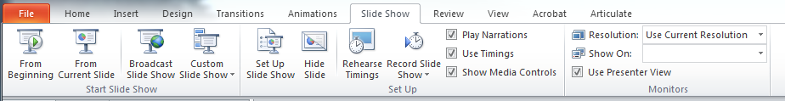

Before you start, read these instructions!
To ensure the best training experience possible, make sure you are viewing this PowerPoint in Presentation Mode.
You can access Presentation Mode in any of the three following ways:
Press the F5 button.
Click “Slide Show” on the ribbon, then “From Beginning”
Click the Presentation Mode icon in the lower right corner of the window.
Enjoy the training!
2.
3.

Slide 2
Traveling To Perform Hands-On Work In Europe
(Immigration and Visa Requirements)
June 2017

Slide 3
Objective & Agenda
Agenda:
  Context: Why is this topic important for MTS and for you?
  Roles and Responsibilities for complying with European work permits and visas.
  Rules and processes for gaining work permits and visas in European countries.
Objective: Identify actions to take when traveling to a customer site in Europe.

Slide 4
Why is this topic, Immigration Permits and Work Visas in Europe, important to MTS and You?
Notes:
Talking points:
Let’s discuss the important steps involved in providing useful feedback.

Slide 5
  Who needs to attend this training
Who needs to attend this training?
New, Current Managers who have employees that travel to Europe for hands-on work.
New, Current Employees who travel to Europe for hands-on work.

Slide 6
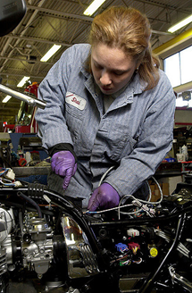
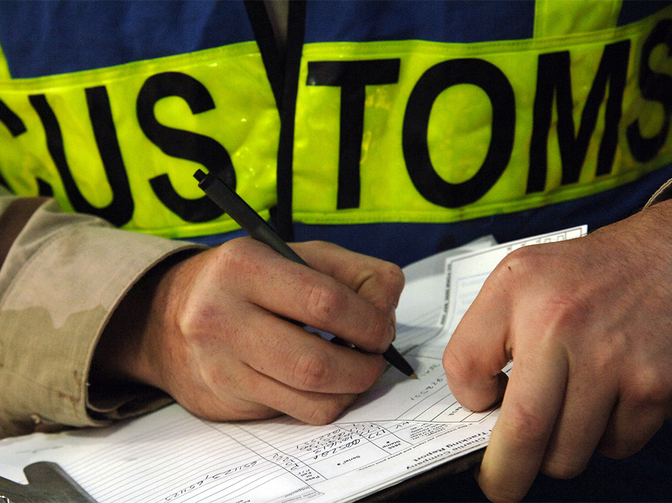
  Introduction
This is Angela, a Field Service Engineer based out of Eden Prairie. Angela does most of her work in the United States, but she has been assigned to work on a project in Germany.
For two weeks, Angela works on various equipment at the customer site.
Why is it important to have necessary paperwork when working in Europe?
Consider Angela’s story about working at a customer site in Germany for insights into the importance of having the right work permits and visas.
She successfully completes the project, and is on her way home. At the airport, German Customs Agents have questions for Angela about her work at the customer site.

Slide 7
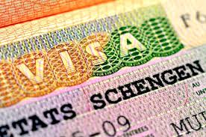

  Introduction
After explaining that she was working on customer equipment, the Customs Agent informs Angela that a work permit is required to do this work.
Angela learns that the work permit is required because of the dangerous nature of her work. If she would have been hurt on the job, MTS would have been assessed a substantial penalty.
“It would have been nice to know about these rules before my trip!“ thought Angela. She makes a note to discuss this with her manager as soon as she returns.

Slide 8
Introduction
What could have Angela done differently?
  Ask questions. When traveling internationally, Angela should check with her supervisor and the travel department to make sure she has the appropriate work visas and permits.
Why is it important for Angela to file this paperwork?
  It’s the law. International law requires, for specific types of work, that employees provide registration or visas to clarify the work they will be engaged in.
If you were Angela’s manager, what could you have done to prevent this problem?
  Follow-up. Ensure Angela has spoken with the travel department to acquire the necessary documentation, and help answer any additional questions to complete the paperwork.

Slide 9
  Why is this topic important to MTS and for you?
It is not uncommon for MTS Employees to travel internationally, doing hands-on work.
Hands-on work in Europe often requires a work permit or visa. It is important to prepare the necessary paperwork when traveling internationally.
Following local laws is an important part of maintaining an ethical and compliant workplace. An understanding of the content and training will help ensure compliance for you and MTS.
You may be prevented from traveling and working in a specific country without the necessary permit or visa. Preventing or limiting your work would negatively impact your performance, and MTS’ ability to meet customer expectations.

Slide 10
  Why is this topic important to MTS and for you?
What are the consequences for not having the appropriate work permit or visa?
You may be required to leave the country immediately.
MTS may be assessed a financial penalty.
You can be detained and/or refused authorization to continue traveling, at any time, by immigration officials, in any Schengen member state (EU).
If the employee would have an accident at customer site, MTS may have to pay medical expenses for all injured personnel (MTS employees and/or the customers employees).

Slide 11

  Why is this topic important to MTS and for you?
What are the permissible business visitor (non-hands-on) activities?
Attending business meetings
Meeting candidates for employment or employees
Supervision meetings
Teaching, attending a course, training
Attending a conference, congress, auctions or exhibition
Completing contracts and/or conducting negotiations
Briefings, staff consulting or partner organizations
Making sales calls to potential European clients
Meetings in relation to product deliveries or production processes
Purchase of goods

Slide 12
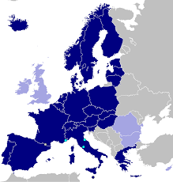
  Why is this topic important to MTS and for you?
The Schengen Visa:
If performing hands-on work for less than 90 days per calendar year in multiple European countries, you can apply a Schengen visa.
  A Schengen visa is valid for all European countries in the EU plus Norway and Switzerland.
  A Schengen visa is valid two years.
  UK is not part of the Schengen area.
Listed in this picture are Schengen visa-eligible countries.

Slide 13
Roles and Responsibilities for complying with European work permits and visas.
Notes:
Talking points:
Let’s discuss the important steps involved in providing useful feedback.

Slide 14
Roles and Responsibilities
Managers
  Confirm the purpose (business meeting or hands-on work) and the length of the trip.
Employees
  Complete neccesary paperwork in a timely manner.
  Coordinate with the HR Specialist/Generalist in Europe, the Travel Department, and your manager to ensure neccessary paperwork is filled in accurately and on time.
HR Specialists/Generalist in Europe
  Support US/EU employees to get a visa/approval.
  Assist with translation needs.
  Assist with any special paperwork needs (i.e. sending information to local governmental offices).
Travel team (US)
  Support the timely and accurate completion of work permit and visa applications.
  Provide timely and accurate guidance to employees traveling to Europe for hands-on work.
Legal
  Create or sign necessary documents (e.g. power of authority).
  Contact Jana.Hecker@mts.com for questions about performing hands-on work in non-European countries.

Slide 15
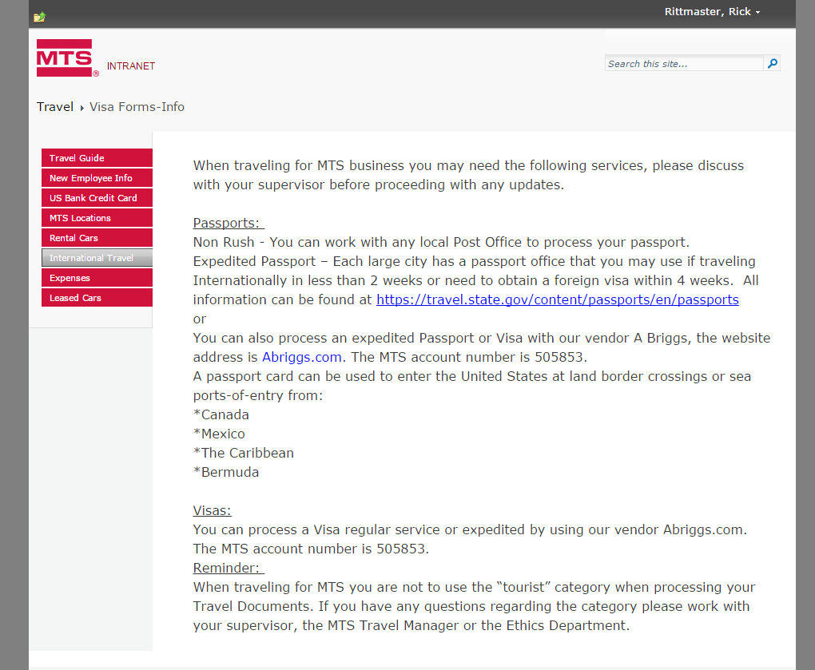
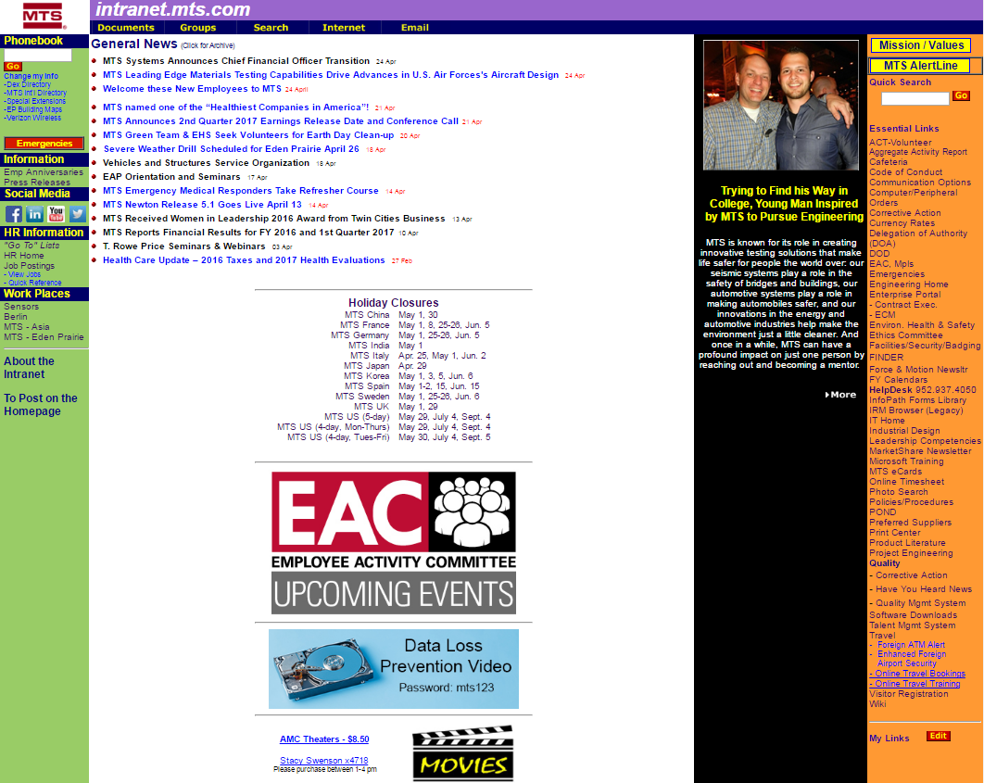
Travel at MTS – Additional Resources
  More travel information is also available on the MTS Intranet Homepage!
  Email: Travel@mts.com,
  Phone: 952-937-4888
  Intranet Information: http://groups.mts.com/travel/

Slide 16
Rules and processes for gaining work permits and visas in European countries.
Notes:
Talking points:
Let’s discuss the important steps involved in providing useful feedback.

Slide 17





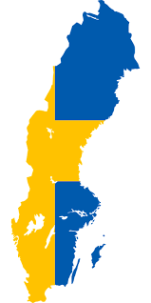

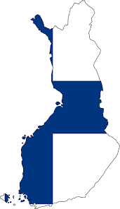






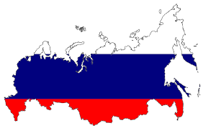

  What rules apply to my staff – rules by nation of origin?
Countries in Europe where we do most times hands-on work:
Austria
Hungary
Italy
Spain
Denmark
Luxembourg
Sweden
Finland
Norway
Switzerland
France
Poland
Turkey
Russia
United Kingdom
Germany
Click on a country name or country image for more information about that country’s local laws.

Slide 18

  What rules apply to my staff – rules by nation of origin?
Austria
Main rule
A work permit is required if the assignee is to work in Austria +
the point of the visit is to create a product, change a product or
contribute to the output of a company in any way. The employee is
allowed to work at client site sponsored by the local entity or overseas company.
It is not possible to work in Austria without a work permit.
Pursuant to Section 3 (1) of the AuslBG, an employer may only employ a foreigner in Austria if he has been granted a Work permit and an advertisement confirmation has been issued. In accordance with the applicable legal situation, visa-necessary and visa-free foreigners are required to be certified according to the Foreigners' Employment Act by the local responsible labor market service for the short-term/temporary employment (pursuant to § 2 para 4 Z 17 FPG).

Slide 19
  What rules apply to my staff – rules by nation of origin?
Austria
For US:
Step 1: Employee's manager to confirm the purpose of the trip.
Step 2: The employee needs to apply for a visa at the embassy (consulate in Chicago).
Step 3: Employee has to register himself online: https://www4.formularservice.gv.at/formularserver/user/formular.aspx?pid=fe66cedb506e495c94b3e826701443e5&pn=B461f73088ab946fe9bd1d1cce573d81a
Step 4: HR generalist applies for A1 certificate for ee at health insurance
Step 5: Employee has to take the documents with him.
Length of time the process takes place: Please calculate min. 2 weeks.

Slide 20
  What rules apply to my staff – rules by nation of origin?
Austria
For European:
Step 1: HR Specialist has to register the employee online: https://www4.formularservice.gv.at/formularserver/user/formular.aspx?pid=fe66cedb506e495c94b3e826701443e5&pn=B461f73088ab946fe9bd1d1cce573d81a
Step 2: HR Specialist applies for A1 certificate for ee
Step 3: Employee has to take the documents with him.

Slide 21
  What rules apply to my staff – rules by nation of origin?
Denmark
Main rule
A work permit is required if the assignee is to work in Denmark +
the point of the visit is to create a product, change a product or
contribute to the output of a company in any way. The employee is
allowed to work at client site sponsored by the local entity or overseas company.
It is not possible to work in Denmark without a work permit unless the activities can be considered under the Fitter-rule.
Fitter-rule (business visa or visa-free stay)
The Fitter rule can only be used when a Danish company has bought a new system from a foreign supplier and a foreign-based technician is needed to install the system due to his specific knowledge on the machinery. The assignee is only allowed to perform maintenance and/or service during the warranty period (only 1 visit).
General maintenance and upgrades do not fall under the fitter rule and requires a work permit. If the foreign nationals are coming to upgrade a system and the activities are not related to installing a NEW system, the fitter rule does not apply and the activities require a work permit.

Slide 22
  What rules apply to my staff – rules by nation of origin?
Denmark
For US:
Step 1: Employee's manager to confirm the purpose of the trip.
Step 2: If installation of a new system or service during warranty period and only the first visit, a business visa applies.
The employee needs:
Invitation letter from the Danish customer incl. their address + dates of the visit.
A certificate from MTS stating/allowing the business travel incl. paying the expenses.
If there were previous trade relations between the two companies, proof of such events must be provided. Employee’s business bank statement of the
latest 3 months. Flight itineraries + hotel reservation
Proof medical health insurance.
Length of time the process takes place: Please calculate min. 2 weeks.
Online visa application at this webpage: https://www.visaselfservice.um.dk/trunk/VisaPortal/default.aspx?epslanguage=EN

Slide 23
  What rules apply to my staff – rules by nation of origin?
Denmark
For European:
If employees need to do hands-on work longer than 8 days in Denmark, employees have to register online at the RUT (Register for Foreign Services) before going to Denmark.
A contact person in Denmark has to be named.
Online registration: www.virk.dk
An A1 certificate has to be loaded into RUT.
Return to Country List

Slide 24
What rules apply to my staff – rules by nation of origin?
Finland
Main rule
Assignees who can be categorized as special experts can conduct the specialist activities.
Specialists include IT experts, experts in a special field who have a university degree, and other persons who have a university degree and whose duties require special expertise. One may be considered to be a specialist if work tasks are demanding and require university studies. Salary above a required level is also an indication of the demanding nature of the duties. The application for a specialist residence permit requires evidence that the applicant meets these criteria.

Slide 25
What rules apply to my staff – rules by nation of origin?
Finland
For US:
Step 1: Employee's manager to confirm the specialist status
(e.g. university degree or minimum of base salary etc.)
Step 2: If below 3 month, specialist residence permit could be applied.
The employee needs:
Work contract from MTS in addition to an invitation letter from the Finnish host entity/customer. Employee travels to local Embassy for submission of biometrics + shows required documentation, from this visitation date about 1.5 months to receiving the permit card for a specialist. Or online via the enterfinland.fi e-service of the Finnish Immigration Service. Visa processing takes about two weeks from the Embassy visit.
Length of time the process takes place: Please calculate up to 6 weeks after visiting the embassy.
For European:
Nothing to do if work is no longer than 90 days.
Return to Country List

Slide 26
What rules apply to my staff – rules by nation of origin?
France
Main rule
A work permit is required for any productive work. This would include visits to install or repair machinery, computer software or equipment, or to perform other technical duties at either an affiliated company or a client site.

Slide 27
What rules apply to my staff – rules by nation of origin?
France
For US:
Step 1: Employee's manager to confirm the length and purpose of the trip.
If work is below 90 days/a, a work permit is required.
Step 2: HR Generalist + employee's manager put together the following information:
job description, salary, name and address of the home and host entities, proof
of the social security certificate of coverage, a copy of the signed service agreement between the home company and the client company in France (if provision of services status applies).
Employee: copy passport, CV, degree, marriage/birth certificates, birth/ marriage certificates, service agreement must be translated into French.
Step 3: HR Generalist: Application for a temporary work permit for the employee. Approved by the French Ministry of Labor, the DIRECCTE, or a convention d’accueil stamped by the local prefecture if you’re a scientist/researcher.
Step 4: This authorization to work has to be sent to the French embassy/consulate in the employees home country.
Step 5: Employee applies for the visa.
Length of time the process takes place: Please calculate around 6 weeks.
Specific: - Concrete, detailed, well-defined, action-oriented,
outcome-oriented:
- What, Why, and How
Measurable: - Trackable with numbers, quantities, comparisons
- Tangible evidence for objective accomplishment
- Support of a fair evaluation of objective attainment
Attainable: - Challenging, stretching and reachable
- You must possess the appropriate knowledge,
skills, abilities, and resources
Relevant: - Related to the person’s job
Time-bound: - Defined time line, due date
- Linked to a time frame that creates a practical
sense of urgency

Slide 28
What’s to do for different countries for US employees, for European employees
France
For European:
Before entering France, for assignees sent on secondment, a declaration should be submitted to the labor inspectorate prior to the assignment and be kept on file.
Step 1: HR Generalist in France has to register the company
https://www.sipsi.travail.gouv.fr
Step 2: HR Generalist in France has to register the employee:
same internet address
Step 3: HR Specialist has to apply for A1 certificate.
Step 4: Employee has to take the document about registration,
the A1 certificate, his contract and a pay slip with him.
Return to Country List

Slide 29
What rules apply to my staff – rules by nation of origin?
Germany
Main rule
MTS Systems Corp. has to list in advance each hands-on work stay of non-EU employees in Germany in a notification form. MTS Systems Corp. needs to authorize MTS Systems Germany to sign and submit the completed form to the FEA.
Besides, the contractual agreement between MTS Systems Corp. and the German MTS entity, a performance specification must be attached to the notification form. Based on verbal information by the FEA, they might also accept a letter whereby MTS Systems Corp. confirms that the equipment to be repaired and maintained was produced and delivered by MTS Systems Corp. (letter of confirmation).
For US:
Step 1: Responsible Manager informs HR Specialist, cc HR Manager Test EU + sends all necessary data (contact data of MTS Systems Corp. (supplier) and of German MTS entity, purpose of hands-on work, place of work in Germany, number of employees, nationalities of employees, list of employees
(full name, birth date, profession/position title, start and end date
of stays in Germany, address of customer, work to do).

Slide 30
What rules apply to my staff – rules by nation of origin?
Germany
Step 2: HR Specialist creates a letter to legal: We in Germany are allowed to sign the form and a letter of confirmation (template) from MTS Corp. that they are the producer/deliver of the equipment and have to do the installation.
Step 3: Legal sends the (two) letters signed back to HR Specialist
Step 4: HR Specialist sends the request and all documents to FEA.
Step 5: If the approval is back HR Specialist sends it to the impacted employee and the responsible manager.
Step 6: Employee should take the printed approval with him.
Length of time the process takes place: Please calculate around 2 weeks.
For European:
Nothing to do if work is no longer than 90 days.
Return to Country List

Slide 31
What rules apply to my staff – rules by nation of origin?
Hungary
Main rule
No work permit is required if the employee provides installation work for up to 15 days within a 30 day period
Period of stay is up to 90 days within a 180-day period
The single work permit can be obtained at the Hungarian Labor Authority. The host company (employer) is required to file an application for workforce need and for the work permit. The US citizen may start working in Hungary only in possession of the valid permits.
For US:
Step 1: Employee's manager to confirm purpose and length of trip.
Step 2: If no work permit is required, the host company (employer) has notification obligation to the Labour Authority that the third-country national who works for it, does not need any work permit.

Slide 32
What rules apply to my staff – rules by nation of origin?
Hungary
Step 3: If it is determined that a work permit is required, employee (or MTS on behalf of the employee) should file an application for workforce need and a work permit application.
Step 4: The "hiring" company must advertise the job at the Hungarian Labor Office for a fixed period of 15 days. This is to give a chance for unemployed Hungarian citizens to apply for the position.
Step 5: Afterwards MTS can apply for the work permit on behalf of the employee.
Length of time the process takes place: Please calculate around 3 weeks.
For European:
Step 1: HR Specialist registers employee at NFSZ (gov. labor agency)
Step 2: Employee registers himself at BAH = Office for Immigration
and Citizenship
Step 3: HR Specialist applies for A1 certificate for employee
Step 4: Employee has to take the documents with him.
Return to Country List

Slide 33
What rules apply to my staff – rules by nation of origin?
Italy
Main rule
Regardless of the duration of stay, if the activities do not fall under the approved business visitor definition then an application must be made for a work permit. The applicable option is the “assignment procedure” which can be followed when a worker is assigned to work at an Italian company for a fixed period of time, though remaining on the payroll of the foreign company. Italian Immigration law provides for different kinds of assignment procedures, depending on the relationship between the foreign and Italian company and the job to be carried out.
Relevant for MTS: Service agreement assignment
This procedure requires that a service agreement is executed between the worker’s foreign company and the Italian company.

Slide 34
What rules apply to my staff – rules by nation of origin?
Italy
For US:
Step 1: Employee's manager should determine the purpose + the length of the trip.
Step 2: If the activities do not fall under the approved business visitor definition then an application must be made for a work permit = assignment agreement.
Length of time the process takes place: Please calculate around 3 weeks.
Step 3: Travel team applies for A1 certificate for employee
Step 4: Employee has to take the A1 certificate with him.
For European:
Step 1: HR Specialist applies for A1 certificate for employee
Step 2: Employee has to take the A1 certificate with him.
Return to Country List

Slide 35
What rules apply to my staff – rules by nation of origin?
Luxembourg
Main rule
No visa is required for US citizen.
An authorization to stay for salaried worker is required for any person who plans to work in Luxembourg for period of time for less or more than 90 days.
If more than 3 month or Non-US/Non-EU:
Requiring a preliminary authorization to stay for salaried worker before entering into the territory of Luxembourg.
After entering
a) declaration of arrival to the municipality of residence within 3 days,
b) Medical check up
c) application for an authorization to stay for salaried worker within 90 days of arrival
Sending firm, hosting firm and posted worker have to provide a lot of documents (see Excel file).

Slide 36
What rules apply to my staff – rules by nation of origin?
Luxembourg
For US:
Step 1: Employee's manager should determine the purpose and length of their trip.
For a stay less than 3 months, authorization is not required.
Step 2: US employees have to register themselves online at the Business Inspection Administration (Inspection du Travail et des Mines - ITM).
For European:
Step 1: EU employees have to register themselves online at the Business Inspection Administration (Inspection du Travail et des Mines - ITM).
Step 2: HR Specialist applies for A1 certificate for employee
Step 3: Employee has to take the A1 certificate with him.
Return to Country List

Slide 37
What rules apply to my staff – rules by nation of origin?
Norway
Main rule
US citizens will need residence permit when working in Norway. Certain groups are exempt from the residence permit if the assignee is temporary (max 3 months)
• technical experts who are to install, repair, perform maintenance etc. on machinery or technical equipment or provide information about the use of such equipment. For work up to 90 days one can, if considered a technical expert, do the following without a permit:
Assignments lasting longer than 3 months are only allowed if one holds "special skills" and a residence permit is granted in advance.
Assignments longer than 3 months:
- online registration with the authorities
- submitting/filing of application/needed documents
- registration with the police after the permit is granted

Slide 38
What rules apply to my staff – rules by nation of origin?
Norway
For US and European:
Step 1: Employee's manager should determine the purpose and length of the trip.
Step 2: US: If less than 3 month and technical expert, the assignee/company must notify the authorities prior to arrival https://selfservice.udi.no/
European: As well all EU/EEA nationals who are going to stay in Norway for >90 days must register https://selfservice.udi.no/
Step 2: HR Specialist has to register the company online (form RF1199) at the Central Office for foreign tax affairs.
Step 3: HR Specialist applies for A1 certificate for employee
Step 4: Employee has to apply for an ID card if work > 90 days, direct if work in Norway starts: 42 local offices: fill form RF1209B, passport, letter from MTS about duties to do in Norway.
Step 5: Employee has to take the A1 certificate + ID card
(valid for two years) with him.
Return to Country List

Slide 39
What rules apply to my staff – rules by nation of origin?
Poland
Main rule
Visa requirement hands-on work longer than 3 month.
For US:
Step 1: Employee's manager should determine the purpose and length of the
trip. Work permit + visa-free stay, if employees are sent to Poland for - at most
- three months a calendar year to do training, assembly of fair expositions, reception or maintenance of machines and equipment ordered by their companies
Step 2: If > 3 month work permit requires submission of application (with additional documents) to the provincial office in Poland competent for the place of work of the assignee in Poland (post or personally, meetings must be booked in advance).
US employees have to register themselves online at the Business Inspection Administration (Inspection du Travail et des Mines - ITM).
For European:
Employees have to register themselves online at the Business Inspection Administration (Inspection du Travail et des Mines - ITM).
Return to Country List

Slide 40
What rules apply to my staff – rules by nation of origin?
Russia
Main rule
Short-Term, Technical Activities - Business visitor status is generally appropriate for visits to install, service, or repair equipment or software that was supplied by a foreign national’s overseas employer, provided it is on a post-sales, contractual basis.
If the hands-on work by US or EU citizens falls in the list of Short-term, technical activities, a work permit is not required.
Only a business technical visa should be obtained.

Slide 41
What rules apply to my staff – rules by nation of origin?
Russia
For US and European:
Step 1: To apply for a letter of invitation (LOI) for a business visa of any type, the company - inviting party, located in the territory of Russia, should be registered with a migration authority. If it is not registered, the documents for registration can be submitted to the authority with the documents for the first LOI application.
Step 2: Prior to application for a business visa, two lists of documents are required - one from the employee and one from a company.
Company: Tax Identification Number, OGRN (Certificate of General Registration of the company), Code of Statistics, Corporate Company card, Appointment of the General Director/Chief Accountant + Charter may be required as well.
Employee: Passport, copies of previous Russian visas if applicable, country of visa application.
Length of time the process takes place: Please calculate
around 4 weeks.
Step 3: On arrival the address registration should be obtained
for a visitor within 7 working days from the date of arrival.
Return to Country List

Slide 42
What rules apply to my staff – rules by nation of origin?
Spain
Main rule
Business Visitor status is not appropriate for visits to install or repair
machinery, computer software or equipment, or to perform other
technical duties at either an affiliated company or a client site. In order
to carry out this type of activities the corresponding permit allowing to
work will be required.
For US:
Step 1: Employer submits an application for a work permit to the provincial office of the Ministry of Labour (Delegación Provincial del Ministerio de Trabajo e Inmigración) on behalf of employee. While this is being processed, you’ll be sent a copy of the application with the stamp from that office and file number.
Step 2: Employee sends it onto the Spanish embassy or consulate as part of the application for a work visa. The embassy will inform the regional labor office that it has your application and the labor office will start to process your application.
Length of time the process takes place: Please calculate up to 8 month. Once the labor office has approved the work permit, the embassy or consulate will issue your work visa.

Slide 43
What rules apply to my staff – rules by nation of origin?
Spain
For European:
Step 1: HR Specialist/Generalist applies for A1 certificate
Step 2: Employee has to take the A1 certificate with him.
Step 3: Online registration if work > 8 days at the Spanish Labor office (Dirección General de Empleo; Consejeria de Economía, Trabajo y Hacienda) which is applicable for the department of Spain.
Return to Country List

Slide 44
What rules apply to my staff – rules by nation of origin?
Sweden
Main rule
For US:
General business visitor status is not appropriate for visits to install or repair machinery, computer software or equipment, or to perform other technical duties at either an affiliated company or a client site. However, some work-related activities are permitted without a visa in connection with urgent installation or repair of machinery for up to two months. The work must be an emergency — in other words, an unexpected event that requires immediate measures. Scheduled or foreseeable work does not qualify for the exemption. It is advisable that there is a existing service agreement or purchase order in place between the sending company and the host company. Assignees must remain on foreign payroll and contract.
Generally, a work and residence permit will be required for US citizens to undertake hands-on work in Sweden.
For European:
After entering Sweden, individual must register in person with the tax authorities (Skatteverket) to obtain the PIN (Personal Identification Number) or coordination number (depending on the circumstances). All assignees posted to Sweden who will be working in Sweden for > 5 days must be registered with the Swedish Work Environment Authority at the latest on the first day of the assignment. The registration may be done online at the Work Environment Authority website.

Slide 45
What rules apply to my staff – rules by nation of origin?
Sweden
For US:
Step 1: Employee' manager should determine purpose and length of stay. Work-related activities are permitted without a visa in connection with urgent installation or repair of machinery (emergency) for up to two month
Step 2: If hands-on work + no emergency, non-European citizens are bound to apply for a short-term Schengen visa under “business” specification -online http://www.schengenvisainfo.com/business-schengen-visa/
Depending on the visa issued they may be allowed to enter once (single entry) or multiple times (multiple entry) and stay for no longer than 90 days per year in between the period of 6 months.
Step 3: Employee who needs to work longer than five days must be registered online with
the Swedish Work Environment Agency. The registration needs to take place through
SWEA’s website (www.av.se), latest on the 6th day from date of arrival in Sweden
For European:
Step 1: If hands-on work > 5 days, employer + employee have to register at the
Office for Labor environment (Arbetsmiljöverket) before start of the work.
Step 2: HR Specialist applies for A1 certificate for employee
Step 3: Employee has to take the A1 certificate + registration document with him.
Return to Country List

Slide 46
What rules apply to my staff – rules by nation of origin?
Switzerland
Main rule
A US or European citizen is allowed to work for up to 8 days per year without permit.
Please note that the 8 days apply per employer and employee.
However if the same employer posts 5 employees at the same day to Switzerland this is only counted as one day.
US employees who are posted on an irregular basis but several times per year to Switzerland may be granted a 120 day-permit allowing them to work rather flexibly in Switzerland (for 120 days within 12 months). This type of permit is not subject to the quota system.

Slide 47
What rules apply to my staff – rules by nation of origin?
Switzerland
For US + European:
Step 1: Employee's manager should determine purpose and length of stay. For a stay less than 8 days, no permit is required.
For US:
Step 2: If above 8 days - requirements for a 120-day permit: Employee needs to submit Employment contract, Contract of assignment (stating the reason for the work in Switzerland and the place of work), Employee's passport, Proof of education, CV, proving employee is qualified for the job. Depending on the type of permit the approval of the two responsible cantonal authorities or additionally the approval of the Federal authority is required. Applying for the entry visa at the Swiss representation in the country of residence. Length of time the process takes place: Please calculate around 4 weeks.
For European:
Step 2: If above 8 days/a and below 90 days, online registration www.bfm.admin.ch
or www.seco.admin.ch
Registration minimum 8 days before start of hands-on work.
Step 3: HR Specialist applies for A1 certificate for employee
Step 4: Employee has to take the A1 certificate, registration document + copy of contract between MTS and the customer with him.
Return to Country List

Slide 48
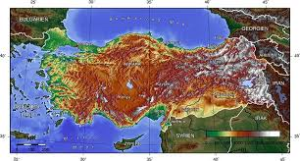
What rules apply to my staff – rules by nation of origin?
Turkey
Main rule
Hands-on work requires a work permit in most circumstances. Some specific work activities are permitted on an Assembly, Maintenance and Service (AMS) Visa for a period of up to 90 days, which can only be issued by a Turkish consulate abroad. This process usually applies where the assignee is being sent to fulfill foreign contractual obligations to a Turkish client company. It will require there be an existing service agreement or purchase order between the sending company and the host company. Assignees must remain on foreign payroll and contract.
AMS visas will require minimally a support letter from both the sending employer and the Turkish host entity. Additionally the application form, passport, photograph, proof of accommodation, onward air ticket.

Slide 49
What rules apply to my staff – rules by nation of origin?
Turkey
For US and European:
Step 1: Employee's manager should determine purpose and length of stay.
Step 2: Employee needs to apply for a AMS visa - the nearest Turkish mission to obtain work permit and visa (with passport, visa application form and a letter from employer and the Turkish company, photo, proof of accommodation, onward air ticket).
Step 3: Employer - documents should be submitted to the Turkish Ministry of Labour and Social Security (MLSS) within ten working days after your application. Find the list of those documents in the MLSS’s website http://www.csgb.gov.tr.
Applications are finalized by the MLSS within thirty days at the latest.
Length of time the process takes place: Please calculate around 6 weeks.
Return to Country List

Slide 50
What rules apply to my staff – rules by nation of origin?
UK
Main rule
An employee of a foreign manufacturer or supplier may install, dismantle, repair, service or advise on equipment, computer software or hardware where it has a contract of purchase or supply or lease with a UK company or organization.
Prior work authorization would be required for any productive work that does not fall under this or other exemptions outlined for business visitors in the Excel file, e.g. work for several month. Most typically this would require the UK company to Sponsor a Tier 2 visa in, either the Tier 2 Intra-Company Transfer or the Tier 2 General category. The role must be skilled to graduate degree level - engineering technicians will not qualify for Tier 2.

Slide 51
What rules apply to my staff – rules by nation of origin?
UK
For US:
Our Sponsor license is a Tier 2 ICT, if MTS employee needs to work in UK for > 90 days within 180-day period.
Step 0: Before our sponsor license expires (2020), UK Admin needs to apply for MTS for extension + immediately apply as well for Tier 2 general sponsorship (to be ready if we want to hire a new employee from outside UK/EU).
Step 1: HR Specialist needs to check if employee is eligible for sponsorship (details of the proposed UK role, salary) - on web page of home office authority.
Step 2: UK Admin with access to the Sponsorship Management System needs to put into the Tier 2 ICT the specific dates from the employee, downloads the certificate. The Certificate of Sponsorship is similar to a work permit and has a unique reference number.
Step 3: The employee takes a copy to submit with their UK visa application.
Part of the visa application will require the applicant to submit their
biometric information (digital fingerprinting and picture) and this must
be completed in person.

Slide 52
What rules apply to my staff – rules by nation of origin?
UK
Step 4: If salary change or diff. JD, UK Admin needs to report this online.
Step 5: Employee travels to UK within the validity of 30 day temp. visa. Upon arrival in the UK attend specific Post Office to collect Biometric Residence Permit (BRP). MTS to ensure right to work checks are carried out and relevant documentation is held.
Step 6: UK Admin needs to collect + file copy of passport, visa, BRP, NI card, wage slip, contact details, contract etc.
Step 7: UK Admin needs to put into the Tier 2 ICT the end date after employee left UK.
For European:
Step 1: HR Specialist applies for A1 certificate for employee
Step 2: Employee has to take the A1 certificate with him.
Attention! Although the Channel Islands and the Isle of Man do not belong to the United Kingdom or to the EU, a work permit is required. Contact local authorities.
Return to Country List

