Slide 1
Before you start, read these instructions!
To ensure the best training experience possible, make sure you are viewing this PowerPoint in Presentation Mode.
You can access Presentation Mode in any of the three following ways:
Press the F5 button.
Click “Slide Show” on the ribbon, then “From Beginning”
Click the Presentation Mode icon in the lower right corner of the window.
Enjoy the training!
2.
3.

Slide 2
Traveling to perform Hands-On Work in another country in Europe (Immigration and Visa Requirements)
January 2019

Slide 3
Objective & Agenda
Objective: Identify actions to take before traveling to a customer site in another country in Europe to perform hands on work.
Agenda:
Context: Why is this topic important for MTS and for you?
Roles and Responsibilities for complying with European work permits and visas.
Rules and processes for gaining work permits and visas in European countries.

Slide 4
Who needs to attend this training
Who needs to attend this training?
Managers who have employees that travel to Europe for hands-on work.
Project Engineers who request on site work to be performed.
Employees who travel to Europe for hands-on work.

Slide 5
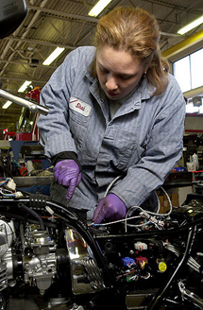
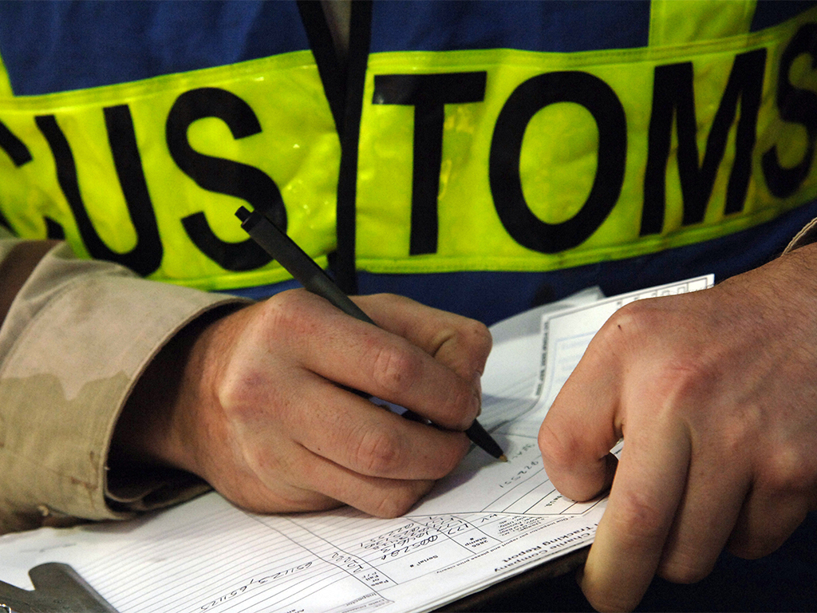
Introduction
This is Angela, a Field Service Engineer based out of Germany. Angela does most of her work in Germany, but she has been assigned to work on a project in France.
For two weeks, Angela works on various equipment at the customer site.
Why is it important to have necessary paperwork when working in another country in Europe?
Consider Angela’s story about working at a customer site in France for insights into the importance of having the right work documents.
She successfully completes the project, and is on her way home. At the airport, French Customs Agents have questions for Angela about her work at the customer site.

Slide 6
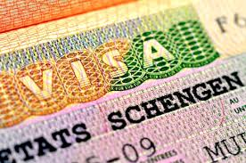
Introduction
After explaining that she was working on customer equipment, the Customs Agent informs Angela that different documents are required to do this work.
Angela learns that these documents are required because of the nature of her work. If she would not have the relevant documents with her or have been hurt on the job, MTS would have been assessed a substantial penalty.
“It would have been nice to know about these rules before my trip!“ thought Angela. She makes a note to discuss this with her manager as soon as she returns.

Slide 7
Introduction
What could have Angela done differently?
Ask questions. When traveling internationally, Angela should check with her supervisor and HR to make sure she has the appropriate work visas and permits.
Why is it important for Angela to file this paperwork?
It’s the law. International law requires, for specific types of work, that employees provide registration or visas to clarify the work they will be engaged in.
If you were Angela’s manager, what could you have done to prevent this problem?
Follow-up. Ensure Angela has had this training and applied for and received the necessary documentation, and help answer any additional questions to complete the paperwork.

Slide 8
Why is this topic important to MTS and for you?
It is not uncommon for MTS Employees to travel internationally, doing hands-on work.
Hands-on work in Europe often requires an online registration, work permit or visa. It is important to prepare the necessary paperwork when traveling internationally.
Following local laws is an important part of maintaining an ethical and compliant workplace. An understanding of the content and training will help ensure compliance for you and MTS.
You may be prevented from traveling and working in a specific country without the necessary online registration, permit or visa. Preventing or limiting your work would negatively impact your performance, and MTS’ ability to meet customer expectations.

Slide 9
Why is this topic important to MTS and for you?
What are the consequences for not having the appropriate online registration, work permit or visa?
You may be required to leave the country immediately.
MTS may be assessed a financial penalty.
You can be detained and/or refused authorization to continue traveling, at any time, by immigration officials, in any Schengen member state (EU).
If the employee would have an accident at customer site, MTS may have to pay medical expenses for all injured personnel (MTS employees and/or the customers employees).

Slide 10
Why is this topic important to MTS and for you?
What are the permissible business visitor (non-hands-on) activities for a lot, but not all EU member states?
Attending business meetings
Meeting candidates for employment or employees
Supervision meetings
Teaching, attending a course, training
Attending a conference, congress, auctions or exhibition
Completing contracts and/or conducting negotiations
Briefings, staff consulting or partner organizations
Making sales calls to potential European clients
Meetings in relation to product deliveries or production processes
Purchase of goods

Slide 11
Roles and Responsibilities for complying with European registration, work permits and visas.

Slide 12
Roles and Responsibilities
Manager
Confirm the purpose (business meeting or hands-on work) and the length of the trip.
PE/TSC
Informs respective parties about necessary hands-on work in a EU country (manager, employees, travel department).
Employees
Complete neccesary paperwork in a timely manner.
Coordinate with the HR Specialist/Generalist in Europe, and your manager to ensure neccessary paperwork is filled in accurately and on time.
HR Specialists/Generalist in Europe
Support EU employees to get an approval were possible, to register etc..
Assist with any special paperwork needs (i.e. sending information to local governmental offices).

Slide 13
Rules and processes for online registration, gaining work permits and visas in European countries.

Slide 14
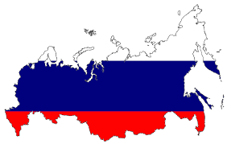
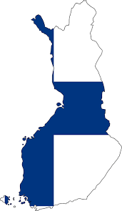
What rules apply to my staff – rules by nation of origin?
Countries in Europe where we do most times hands-on work:
Austria
Hungary
Russia
Czech Republic
Italy
Spain
Denmark
Luxembourg
Sweden
Finland
Norway
Switzerland
France
Poland
Turkey
Germany
Romania
United Kingdom
Click on a country name or country image for more information about that country’s local laws.

Slide 15
What rules apply to my staff – rules by nation of origin?
Austria
Main rule
A registration (ZKO3) is required if the assignee is to work short term in
Austria and the point of the visit is to create a product, change a product or
contribute to the output of a company in any way. The employee is
allowed to work at client site sponsored by the local entity or overseas company.
It is not possible to work in Austria without this registration.
Pursuant to §21 LSD – BG the assignee has to carry the registration as well as an A1 Certificate during the stay in Austria.

Slide 16
What rules apply to my staff – rules by nation of origin?
Austria
Step 1: HR Specialist has to register the employee with a ZKO3 notification online: https://www4.formularservice.gv.at/formularserver/user/formular.aspx?pid=fe66cedb506e495c94b3e826701443e5&pn=B461f73088ab946fe9bd1d1cce573d81a
Step 2: HR Specialist applies for A1 certificate for ee
Step 3: Employee has to take the documents with him.
Accompanying documents: A1 certificate, posting notification, work contract, payment slip, age recording, wage classification
Return to Country List

Slide 17
What rules apply to my staff – rules by nation of origin?
Czech Republic
Main rule
The Czech Republic has opened its labor market for nationals from the EU
member states. A work permit is therefore not required. An obligation of the employer to report has arisen. A registration has to be done by the employer.
Step 1: HR Specialist has to register the employee incl. naming a contact person in posting country and residence of contact person in posting country
Obtaining the documents, documents in Czech and sending to Czech employer, forwarding of signed documents to Ministery of Labour in Prague
http://www.businessinfo.cz/en/psc/start-your-business/posting-of-workers.html
Step 2: HR Specialist applies for A1 certificate for ee
Step 3: Employee has to take the documents with him: Proof of qualification, passport, A1 certificate, posting notification, work contract.
Return to Country List

Slide 18
What rules apply to my staff – rules by nation of origin?
Denmark
Main rule
A registration is required if the assignee is to work in Denmark for more
than 9 days, the point of the visit is to create a product, change a product
or contribute to the output of a company in any way. The employee is
allowed to work at client site sponsored by the local entity or overseas company.
Fitter-rule (business visa or visa-free stay)
The Fitter rule can only be used when a Danish company has bought a new system from a foreign supplier and a foreign-based technician is needed to install the system due to his specific knowledge on the machinery. The assignee is only allowed to perform maintenance and/or service during the warranty period (only 1 visit).
General maintenance and upgrades do not fall under the fitter rule and requires a work permit. If the foreign nationals are coming to upgrade a system and the activities are not related to installing a NEW system, the fitter rule does not apply and the activities require a work permit.

Slide 19
What rules apply to my staff – rules by nation of origin?
Denmark
If employees need to do hands-on work longer than 9 days in Denmark, employees have to register online at the RUT (Register for Foreign Services) before going to Denmark.
A contact person in Denmark has to be named.
Step 1: Online registration: https://danishbusinessauthority.dk/register-foreign-service-providers-rut-0, incl. naming a contact person in posting country and residence of contact person in posting country
Step 2: HR Specialist applies for A1 certificate for ee
Step 3: Employee has to take the documents with him: A1 certificate, RUT notification
Return to Country List

Slide 20
What rules apply to my staff – rules by nation of origin?
Finland
Main rule
Assignees who can be categorized as special experts can conduct the specialist activities.
Specialists include IT experts, experts in a special field who have a university degree, and other persons who have a university degree and whose duties require special expertise. One may be considered to be a specialist if work tasks are demanding and require university studies. Salary above a required level is also an indication of the demanding nature of the duties. The application for a specialist residence permit requires evidence that the applicant meets these criteria.

Slide 21
What rules apply to my staff – rules by nation of origin?
Finland
Step 1: Online registration necessary.
The report must be submitted to the workplace safety authority before
the beginning of the assignment https://www.tyosuojelu.fi/
incl. naming a contact person in posting country and residence of contact person in posting country
Step 2: HR Specialist applies for A1 certificate for ee
Step 3: Employee has to take the documents with him: A1 certificate, identification document of posted worker and posting company, statement
of attention to Finnish law, statement of posting, time sheet, payment confirmation, pay slip
Return to Country List

Slide 22
What rules apply to my staff – rules by nation of origin?
France
Main rule
A work permit or online registration (EU) is required for any type
of work.
Before entering France a SIPSI notification - online – is necessary
Step 1: HR Generalist in France has to register the company
https://www.sipsi.travail.gouv.fr

Slide 23
What’s to do for different countries for US employees, for European employees
France
Step 2: HR Generalist in France has to register the employee: same internet address incl. naming a contact person in posting country and
residence of contact person in posting country, company and contact person
in France
Step 3: HR Specialist has to apply for A1 certificate.
Step 4: Employee has to take the document with him.
Accompanying documents: A1 certificate, SIPSI notification, work contract, pay slip
Return to Country List

Slide 24
What rules apply to my staff – rules by nation of origin?
Germany
Main rule
MTS Systems Corp. has to list in advance each hands-on work stay of non-EU employees in Germany in a notification form. MTS Systems Corp. needs to authorize MTS Systems Germany to sign and submit the completed form to the FEA.
Besides, the contractual agreement between MTS Systems Corp. and the German MTS entity, a performance specification must be attached to the notification form. Based on verbal information by the FEA, they might also accept a letter whereby MTS Systems Corp. confirms that the equipment to be repaired and maintained was produced and delivered by MTS Systems Corp. (letter of confirmation).

Slide 25
What rules apply to my staff – rules by nation of origin?
Germany
Step 1: HR Specialist has to register the employee online:
www.meldeportal-mindestlohn.de
Step 2: Employee has to apply for A1 certificate.
Step 3: Employee has to take the documents with him.
Accompanying documents: A1 certificate, posting notification, work contract, payment slip, age recording, wage classification
Return to Country List

Slide 26
What rules apply to my staff – rules by nation of origin?
Hungary
Main rule
No work permit is required if the employee provides installation work for up to
15 days within a 30 day period, but an online registration
Period of stay is up to 90 days within a 180-day period
The single work permit can be obtained at the Hungarian Labor Authority. The host company (employer) is required to file an application for workforce need and for the work permit. The US citizen may start working in Hungary only in possession of the valid permits.

Slide 27
What rules apply to my staff – rules by nation of origin?
Hungary
Step 1: HR Specialist registers employee at http://www.ommf.gov.hu/index.html?akt_menu=123&set_lang=123
incl. naming a contact person in posting country
Step 2: HR Specialist applies for A1 certificate for employee
Step 3: Employee has to take the document with him.
Accompanying documents: A1 certificate, notification, work contract,
Time sheet, payment confirmation
Return to Country List

Slide 28
What rules apply to my staff – rules by nation of origin?
Italy
Main rule
Regardless of the duration of stay, if the activities do not fall under the approved business visitor definition then an application must be made for a work permit. The applicable option is the “assignment procedure” which can be followed when a worker is assigned to work at an Italian company for a fixed period of time, though remaining on the payroll of the foreign company. Italian Immigration law provides for different kinds of assignment procedures, depending on the relationship between the foreign and Italian company and the job to be carried out.
Relevant for MTS: Service agreement assignment
This procedure requires that a service agreement is executed between the worker’s foreign company and the Italian company.

Slide 29
What rules apply to my staff – rules by nation of origin?
Italy
Step 1: HR Specialist registers employee at
https://www.cliclavoro.gov.it/Pagine/Registrazione.aspx
(only in Italian) incl. naming a contact person in posting country + company
address in posting country. This contact person has to be a lawful person (i.e. Attorney,
Tax Advisor or Notary).
Step 2: HR Specialist applies for A1 certificate for employee
Step 3: Employee has to take the document with him: A1 certificate, notification, work contract in Italian language, Time sheet, payment confirmation, pay slip
Return to Country List

Slide 30
What rules apply to my staff – rules by nation of origin?
Luxembourg
Main rule
An authorization to stay for salaried worker is required for any person who plans to work in Luxembourg for any period of time.
If more than 3 month or Non-US/Non-EU:
Requiring a preliminary authorization to stay for salaried worker before entering into the territory of Luxembourg.
After entering
a) declaration of arrival to the municipality of residence within 3 days,
b) Medical check up
c) application for an authorization to stay for salaried worker within 90 days of arrival
Sending firm, hosting firm and posted worker have to provide a lot of documents (see Excel file).

Slide 31
What rules apply to my staff – rules by nation of origin?
Luxembourg
Step 1: HR Specialist registers
a. Notification to Ministry of Economic Affairs: https://guichet.public.lu/de/entreprises/marche-international/intra-ue/prestation-luxembourg/notification.html
Notification an registry and Domain Administration because of VAT:
https://guichet.public.lu/de/entreprises/creation-developpement/declarations-initiales/tva-impots/inscription-tva.html
c. employee online registration https://guichet.itm.lu/edetach/
incl. naming a contact person in posting country and residence of contact person in posting country
Step 2: HR Specialist applies for A1 certificate for employee
Step 3: Employee has to take the document with him.
Accompanying documents: A1 certificate, work contract, Qualification,
Time sheet, payment confirmation, pay slip, passport
Return to Country List

Slide 32
What rules apply to my staff – rules by nation of origin?
Norway
Main rule
A registration has to be done within 14 days after arrival.
Exeptions:
Installers for initial installation work: up to 8 days at a time

Slide 33
What rules apply to my staff – rules by nation of origin?
Norway
Step 1: Employee's manager should determine the purpose and length of the trip.
Step 2: Registration process US/European: a. Finance EU has to register the company online (form RF1199) at the Central Office for foreign tax affairs and has to apply for an organization number
b. Online application at least latest 14 days after commencement with form RF1199 for D number https://www.altinn.no/ui/Authentication/SelfIdentified
c. Personal presentation on ID control at the local authority, form RF1209
Step 3: HR Specialist applies for A1 certificate for Employee at the relevant health insurance.
Step 4: Employee has to apply for an ID card if work > 90 days, direct if work in Norway starts: 42 local offices: fill form RF1209B, passport, letter from MTS about duties to do in Norway.
Step 5: Employee has to take the document with him: A1 certificate, details of posted worker incl. D-number, monthly payment confirmation, allowance, reimbursements
Attention: Company tax obligation in the following year of posting in Norway
Return to Country List

Slide 34
What rules apply to my staff – rules by nation of origin?
Poland
Main rule
Registration necessary latest on the 4th day after arrival in Poland
Step 1: An employer’s statement on the posting of a worker to Poland – on the day of commencement of the services at the latest. HR Specialist registers employee incl. naming a contact person in posting country and residence of contact person in posting country: https://ewnioski.biznes.gov.pl/suppliant/upage/general/unauth_step0.page?eservice=1328&type=procedura,wniosek&referer=external
Online registration only possible with qualified electronic signature
Step 2: HR Specialist applies for A1 certificate for employee
Step 3: Employee has to take the document with him: A1 certificate, Time sheet,
contract, statement of certification
Return to Country List

Slide 35
What rules apply to my staff – rules by nation of origin?
Romania
Main rule
Registration according to the posted worker law is necessary.
Step 1: HR Specialist has to send a notice in Romanian of the posting of workers to the attention of the local chamber of labor, which is responsible for the job in question, 5 days before the start of the employment contract, but no later than the first working day, incl. naming a contact person in posting country.
Step 2: HR Specialist applies for A1 certificate for ee
Step 3: Employee has to take the document with him: A1 certificate,
List of all posted workers, work contracts of all posted workers, payment
slip and payment confirmation, time sheet – in Romanian language
Return to Country List

Slide 36
What rules apply to my staff – rules by nation of origin?
Russia
Main rule
Short-Term, Technical Activities - Business visitor status is generally appropriate for visits to install, service, or repair equipment or software that was supplied by a foreign national’s overseas employer, provided it is on a post-sales, contractual basis.
If the hands-on work by US or EU citizens falls in the list of Short-term, technical activities, a work permit is not required.
Only a business technical visa should be obtained.

Slide 37
What rules apply to my staff – rules by nation of origin?
Russia
Step 1: To apply for a letter of invitation (LOI) for a business visa of any type, the company - inviting party, located in the territory of Russia, should be registered with a migration authority. If it is not registered, the documents for registration can be submitted to the authority with the documents for the first LOI application.
Step 2: Prior to application for a business visa, two lists of documents are required - one from the employee and one from a company.
Company: Tax Identification Number, OGRN (Certificate of General Registration of the company), Code of Statistics, Corporate Company card, Appointment of the General Director/Chief Accountant + Charter may be required as well.
Employee: Passport, copies of previous Russian visas if applicable, country of visa application.
Length of time the process takes place: Please calculate
around 4 weeks.
Step 3: HR Specialist applies for A1 certificate
for ee at the relevant health insurance. Employee has to take the
documents with him.
Step 3: On arrival the address registration should be obtained
for a visitor within 7 working days from the date of arrival.
Return to Country List

Slide 38
What rules apply to my staff – rules by nation of origin?
Spain
Main rule
If the hands-on work exceeds 8 days, a registration has to be
done, prior to the first working day.
Step 1: HR Specialist registers employee incl. naming a contact
person in posting country and residence of contact person in posting
country at the specific Communidad Autónoma: http://www.empleo.gob.es/es/enlaces/enlaces-comunidades.htm
The notification must be submitted to the regional authority in person.
The requirements may vary.
Step 2: HR Specialist applies for A1 certificate for ee
Step 3: Employee has to take the document with him: A1 certificate,
work contract (in Spanish or bilingual), payment confirmation, time sheet
Return to Country List

Slide 39
What rules apply to my staff – rules by nation of origin?
Sweden
Main rule
After entering Sweden, individual must register in person with the tax authorities (Skatteverket) to obtain the PIN (Personal Identification Number) or coordination number (depending on the circumstances). All assignees posted to Sweden who will be working in Sweden for > 5 days must be registered with the Swedish Work Environment Authority at the latest on the first day of the assignment. The registration may be done online at the Work Environment Authority website.
Step 1: HR Specialist registers at the Office of work environment (Arbetsmiljöverket) before start of the work incl. naming a contact person in posting country: http://posting.av.se/Default.aspx?lang=en-GB
Contact person could be a posted worker.
Step 2: HR Specialist applies for A1 certificate for employee
Step 3: Employee has to take with him: A1 certificate + registration document.
Return to Country List

Slide 40
What rules apply to my staff – rules by nation of origin?
Switzerland
Main rule
The electronic registration procedure is used for job applications of up to 90 days at a company in Switzerland. For EU citizen there is only a reporting obligation.
A registration of EU employees is necessary in all cases.
However if the same employer posts 5 employees at the same day to Switzerland this is only counted as one day.

Slide 41
What rules apply to my staff – rules by nation of origin?
Switzerland
Step 1: Employee's manager should determine purpose and length of stay. For each hands-on work stay a registration at the Switzerland authority is necessary at least 8 days before the start of employment in the notification procedure.
Step 2: If below 90 days, online registration locally in canton incl. naming a contact person in posting country and residence of contact person in posting country minimum 8 days before start or work: https://www.sem.admin.ch/sem/de/home/themen/fza_schweiz-eu-efta/meldeverfahren.html
In case of emergency, the 8-day deadline can be shortened (confirmation of emergency situation from customer). Emergency situation only accepted if start of work in max. 3 days.
Step 3: HR Specialist applies for A1 certificate for employee
Step 4: Employee has to take the documents with him: A1 certificate, copy of notification or copy of granted authorization, work contract.
Return to Country List

Slide 42
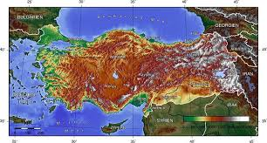
What rules apply to my staff – rules by nation of origin?
Turkey
Main rule
Hands-on work requires a work permit in most circumstances. Some specific work activities are permitted on an Assembly, Maintenance and Service (AMS) Visa for a period of up to 90 days, which can only be issued by a Turkish consulate abroad. This process usually applies where the assignee is being sent to fulfill foreign contractual obligations to a Turkish client company. It will require there be an existing service agreement or purchase order between the sending company and the host company. Assignees must remain on foreign payroll and contract.
AMS visas will require minimally a support letter from both the sending employer and the Turkish host entity. Additionally the application form, passport, photograph, proof of accommodation, onward air ticket.

Slide 43
What rules apply to my staff – rules by nation of origin?
Turkey
Step 1: Employee's manager should determine purpose and length of stay.
Step 2: Employee needs to apply for a AMS visa - the nearest Turkish mission to obtain work permit and visa (with passport, visa application form and a letter from employer and the Turkish company, photo, proof of accommodation, onward air ticket).
Step 3: Employer - documents should be submitted to the Turkish Ministry of Labour and Social Security (MLSS) within ten working days after your application. Find the list of those documents in the MLSS’s website http://www.csgb.gov.tr.
Applications are finalized by the MLSS within thirty days at the latest.
Length of time the process takes place: Please calculate around 6 weeks.
Step 4: HR Specialist applies for A1 certificate for
ee at the relevant health insurance.
Step 5: Employee has to take the documents with him.
Return to Country List

Slide 44
What rules apply to my staff – rules by nation of origin?
UK
Main rule
An employee of a foreign manufacturer or supplier may install, dismantle, repair, service or advise on equipment, computer software or hardware where it has a contract of purchase or supply or lease with a UK company or organization.
Prior work authorization would be required for any productive work that does not fall under this or other exemptions outlined for business visitors in the Excel file, e.g. work for several month. Most typically this would require the UK company to Sponsor a Tier 2 visa in, either the Tier 2 Intra-Company Transfer or the Tier 2 General category. The role must be skilled to graduate degree level - engineering technicians will not qualify for Tier 2.

Slide 45
What rules apply to my staff – rules by nation of origin?
UK
Step 1: HR Specialist applies for A1 certificate for employee
Step 2: Employee has to take the A1 certificate with him.
Attention! Although the Channel Islands and the Isle of Man do not belong to the United Kingdom or to the EU, a work permit is required. Contact local authorities.
Return to Country List

