Slide 1
Data Privacy, Data Protection and Data Security
Why HR is Rethinking its Role
Notes:
So, today, I’m here to talk you about a hot topic in the current business world: Data Privacy, Protection and Security. This used to be something relegated to the IT world, but today it’s an issue that affects us all.

Slide 2
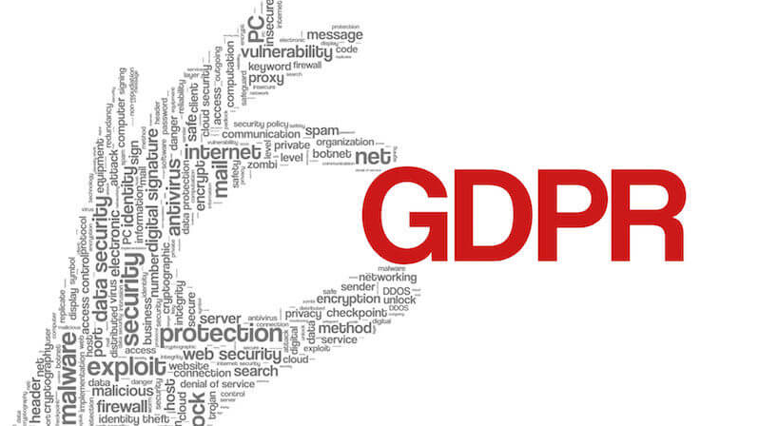
Privacy, Data Protection and Data Security
Learning Objectives
Definitions
Data Security Today
Why HR is Rethinking its Role
What is GDPR
Your Responsibility
Best Practices
Resources
Q and A
Notes:
The topics we’ll be covering today include some basic terminology or definitions, the current state of data security, and why HR is rethinking it’s role. We’ll talk about what GDPR is, review your responsibilities, discuss best practices, and identify resources you can use going forward.

Slide 3
Definitions
Key MTS Terminology:
Data Privacy: A person's right to control access to their personal information. This is relevant when Personally Identifiable Information (PII) is collected, stored, or used (processed).
Data Protection: Appropriate use and control of data gathered. Governed by the Office of Risk and Compliance (ORC).
Type of data processed
Location of data storage
Data Security: Confidentiality, availability and integrity of data. Governed by IT.
Protection of networks and systems
Physical Security
Personally Identifiable Information (PII): Information that, when used alone or with other sensitive data, can be used to identify an individual and, if lost or misused, could result in harm to that person.
Notes:
Let’s start with some key MTS terminology. These definitions were provided by the Office of Risk and Compliance (ORC) , so I expect you will see them again in future training and policy documents.

Slide 4
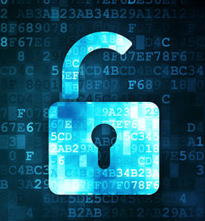
Data Security Today
“In today’s digital world, cyberattacks are becoming increasingly prevalent. By 2021, annual damage from security breaches is projected to reach $6 trillion, and over the next five years, global spending on cybersecurity products and services is expected to exceed $1 trillion.” - Information Management
Cyberattacks include Social Engineering Tactics, which target people:
Phishing
Spear Phishing
Impersonations
Tailgating
Notes:
Let’s talk about the current state of data security. You’ve all likely seen the headlines announcing data breaches at Target, Yahoo, eBay, etc. Here’s quote from Information Management to give us some perspective.
There are many kinds of Cyber attacks – the most common of which involves Social Engineering: Phishing, Spear Phishing, impersonations, and tailgating. Phishing involves trying to trick someone into clicking on a link or opening a file that will cause harm or steal data. Spear phishing is similar, but more sophisticated. These attacks are targeted – they may use your company’s name, names of leaders in your company or connections you have on social media. And they will request sensitive employee information. Impersonations are when criminals contact you posing as a government official or company executive requesting or even demanding sensitive information – these frequently involve some kind of imminent deadline or negative consequence for not providing the data quickly. Don’t be fooled. Bad spelling and grammar are signs the request might not be legit. Always check with IT if the email looks suspect. And always verify unusual data requests.
Tailgating involves physical security – someone coming in the door behind you that may not have an access badge. Never let a stranger in. If someone sneaks in behind you, remind them to swipe their badge. If they don’t have a badge or if they object, call security.

Slide 5
Data Security Today
The People Factor
“The biggest risk is always human error. People are often unclear about the true danger of HR data loss.” - HRMS World
People are a company’s greatest resource – they make the business run. People are also the greatest risk to data security. Why? We’re human. We get so focused on the task of gathering or sharing data that we forget to ask how we should share the data we’ve gathered and whether we should share it at all, or with whom.
Example from Forbes.com: A well-meaning Boeing employee sent a spreadsheet to his spouse to get help with formatting. Because he sent the spreadsheet unprotected outside the company, he exposed the personal data of 36,000 Boeing employees. We know about it because they had to report the breach.
Notes:
People are a favorite target of cyber criminals. Why? We have access. And we’re human. That’s why it’s so important to remember to stop and ask Why, What, Who and How before we share sensitive information. Sometimes we get so caught up in the work or the deadline that we don’t use our best judgment. Here’s an example.

Slide 6
Data Security Today
The People Factor
“Our number one defense against information theft and loss is you. Everyone is responsible for knowing and following our organization's security policies and procedures. By doing so, you ensure our information and resources remain secure, protect our reputation, and help us avoid costly penalties for violating the law.” – MTS Systems Corporation, Inc.
What You Can Do:
Be alert and aware of potential security risks.
Ask questions. If something doesn’t feel right, don’t do it.
Lock your computer screen when you walk away from your desk.
Never turn off the security software running on your computer.
Always verify unusual data requests before providing information.
Notes:
As users and owners of employee data, we have a responsibility to protect our employees’ sensitive information. Here’s a quote from the MTS Data Security policy.
So what can you do? Be alert. Ask questions. Lock your computer screen when you walk away. Don’t turn off your security software, even if it’s driving you crazy. And always verify unusual data requests.

Slide 7
Why HR is Rethinking its Role
One of the new trends in data privacy is that HR is rethinking its role, due to current legislation and the overall potential impact on businesses. Data privacy used to belong solely to IT. Today, data security is governed by IT, and data protection is governed by ORC (Office of Risk and Compliance). HR falls somewhere in between. As owners of employee data and administrators of our cloud based systems, HR is taking a more proactive role in data privacy, security and protection, and in addressing the human aspect of data management.
Drivers of this trend include:
Increased value of HR data to cyber criminals
Targeting benefits data is a newer trend
Payroll and compensation data are always at risk
Increased business risks, due to:
Cyber criminal attacks
Stiffer fines and penalties (ex: GDPR)
Increased public awareness due to public data breaches
Notes:
As a result of all this, HR is rethinking it’s role. Data privacy used to be relegated to the IT world. Today, data security is governed by IT, and data protection is governed by ORC (Office of Risk and Compliance). HR falls somewhere in between. As owners of employee data and administrators of our cloud based systems, HR is taking a more proactive role in data privacy, security and protection, and in addressing the human aspect of data management.
Why? HR data has value to cyber criminals. Benefits data is one of the newer areas of interest – and payroll and comp data are always at risk. Our Business is at great risk because of this increased criminal activity and because of new laws like GDPR governing data privacy. We’ll talk more about GDPR in a minute. Last but not least, there is an increased public awareness of data breaches and a public outcry to hold the offending companies responsible.
The bottom line is that HR has a vested stake in data privacy and in keeping employee data secure.

Slide 8
What is GDPR?
Stands for ‘General Data Protection Regulation’
New law applies to the 28 countries in the European Union
Strict new rules on controlling and protecting Personally Identifiable Information (PII)
Replaces 1995 EU Data Protection Directive
New Objective:
Give control over their own data to EU residents (transparency)
‘The Right to be Forgotten’
Notes:
GDPR. This is a new law in the European Union that is changing everything. GDPR stands for ‘General Data Protection Regulation’. It applies to the European Union and includes strict rules on Personally Identifiable Information or PII. The two big game changers in how GDPR affects businesses are data transparency and the ‘right to be forgotten’. This means that citizens of the European Union have the legal right to know why their data is being collected and exactly what it is being used for. This data cannot be used for any other purpose than what was communicated. The right to be forgotten means that citizens of the European Union have the legal right to have their data deleted from businesses databases. There are some restrictions on this – for example, a unsuccessful candidate applying for a position has the right to request that their data be deleted from the company database. An employee does not have that same right – GDPR takes into account the fact that companies need employee information to run their business. However, that information must be used as expressly indicated.

Slide 9
What is GDPR?
Impact of GDPR on Businesses
“. . . the impact to businesses is huge and will permanently change the way customer data is collected, stored, and used.’ – Forbes.com
Stiff Penalties:
€ 20 Million or 4% of global revenue, whichever is higher, for serious violations
2% of global revenue for lessor violations
Consent: Personal data can only be used for the expressed purpose given
Business Purpose: Must have a valid business purpose for collecting, using and storing data
Data Breaches: 72 hour notification window to regulatory agency
Data Deletion: Must delete personal data upon request (ex: candidate data, not employee data)
Compliance: MTS self-audit activities will include process reviews to mitigate risk
Notes:
This slide gives a quick look at the business impact of GDPR. You can see why companies are concerned.

Slide 10
Your Responsibility
As HR professionals, we are entrusted with employee data that is every bit as sensitive as customer data. It is our responsibility to collect, use, and store employee data wisely. We are responsible for safeguarding the employee data we have access to, and for protecting any Personally Identifiable Information (PII) we use or share.
What does this mean?
Use, share and store employee data securely
Be thoughtful about what data is shared and stored – is it necessary?
Ask ‘Who, What, Why and How’ before sharing information
Use PERNRs instead of names whenever possible, especially in email text
Comply with all MTS data security and protection policies
Office of Risk and Compliance (OCR): Partner with the ORC as requested. ORC GDPR process analyses are beginning. These will help identify how GDPR and data protection activities will be integrated into HR work activities and creates an opportunity to discuss possible modifications to HR systems and processes. One example is that we are working through an ‘opt-in’ versus ‘opt-out’ option for EU data privacy consent in our SuccessFactors recruiting application. Another example is the new GDPR data declaration we all signed.
Notes:
In light of all this, we must each take our responsibility seriously to keep employee data secure. How does that translate into your everyday work life? (See ‘What does this mean?’)
Remember, anything you share in an email can be accessed by IT employees with access to the email server, and can be saved or forwarded without your knowledge.
A note about ORC: ORC has begun reviewing various processes to determine what changes we need to make to comply with GDPR. Be aware that they may be reaching out to you and that we must have a valid business reason for any of the data we use, store, collect or share.

Slide 11
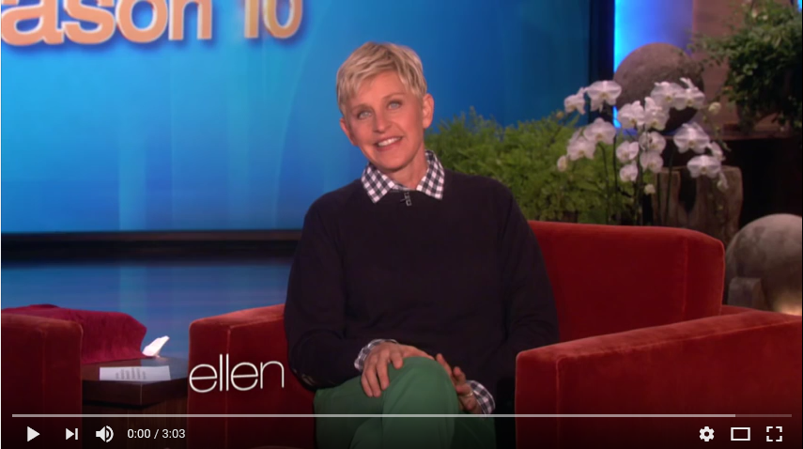
Best Practices
Data Privacy Awareness
Out of Your Password Minder
Notes:
As we move into Best Practices, I’d like to share a video with you. I just love this clip from Ellen DeGeneres on Data Privacy. I hope you will, too.

Slide 12
Best Practices
Passwords and Pass Phrases
Never share your password, even with IT
Pass phrases are better than passwords
Use unique pass phrases; do not use the same pass phrases over and over again
Make your pass phrases complex, using upper and lower case letters, numbers and special characters
Choose something that is not easy to guess
Good Example: VisitBigSky@2018
Bad Example: Password, Winter2018, Password123, etc.
Keep your pass phrases in a secure place
Password protected spreadsheet on secure drive
Locked drawer or office
Not under keyboard or taped to monitors
Best practice is not to write them down anywhere
Notes:
Passwords. I know they can be painful, but they are also really important. Here are the Do’s and Don’ts (Review slide)

Slide 13
Best Practices
Passwords
Manually change your pass phrases periodically, if not prompted to do so
Separate the lock from the key
Communicate passwords separately from data shared
Phone or Jabber is best
Send second email, if phone or Jabber is not possible
Do not use the Password Minder in the infomercial ☺
See MTS Password Policy: IT - 010
Notes:
A few more notes on passwords (Review slide)

Slide 14
Best Practices
Secure Shared Drives: Sharing Data Internally
Use shared drives or SharePoint to share data whenever possible
Only authorized users have access to shared drives and SP sites
Data on shared drives is protected by encryption behind the scenes until opened
Never store PII (Personally Identifiable Information) on your local hard drive
Common source of data breaches if laptop is stolen
Be aware of who has access to your shared drives when saving data files
Provide the link to the file instead of attaching it in an email whenever possible
No control over who email is forwarded to or where it is saved, if attached
If providing a link to a shared file is not possible:
Internal: Password protect attached files with any PII
External: Encrypt external emails with file attachments containing PII (more to come on this)
Less is more; exclude unnecessary data from files and emails
Notes:
When it comes to sharing data, there’s difference between sharing internally and externally. Internally, the best option hands down is to use shared drives or SharePoint. Don’t’ attach the file. Provide a link to the file instead. Part of the beauty of this is that the data while at rest, or stored, is encrypted behind the scenes. The only time it’s not protected is when you open it. Security is a very different story when you email the file itself – you have no way of knowing who the information might be shared with or where it may be stored.
NEVER store sensitive data on your local C drive. Don’t do it. If that is what you are doing now, please stop. Transfer the information to your personal U drive for safekeeping. Exposed sensitive data stored on the hard drive of a stolen laptop is an all too common source of data breaches. Don’t do it.
Review what information you are sharing before you send it. Remove any unnecessary information.
And if you are sharing sensitive data outside the company, best practice is to encrypt the file using the encryption feature in Outlook.

Slide 15
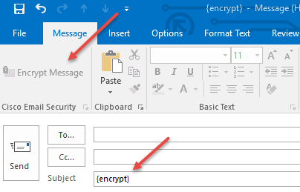
Best Practices
Encryption: Sharing Data Externally
“Encrypting an email message in Outlook means it's converted from readable plain text into scrambled cipher text. Only the recipient who has the private key that matches the public key used to encrypt the message can decipher the message for reading.” – Microsoft Office Support
When to Use: Encryption should be used when sending a file containing PII (personally Identifiable Information) to an external recipient. Used in lieu of a password.
How it works:
Use Outlook add-in
Or, type {encrypt} in the subject line
External recipient receives an email with prompts
Once verified, file can be open and read
See job aide from IT
You may also use a vendor’s secure email service in lieu of encryption
Notes:
So here’s how the encryption feature works: Open a new email message and click the encryption option in the upper left hand corner. The recipient will get an email prompting them to verify their identity and register with Outlook encryption. Then they will be able to open the file securely. There is also a job aide linked to this presentation, which I will be sharing with you. Note – if the encryption feature is not enabled on your machine, you can type encrypt in brackets and the functionality will be enabled in that email.
An even better option may be to use the vendor’s secure email. You can ask your vendor if they have this functionality and how it works. Typically, they just need to send you a secure email that you then respond to and attach your data file.
If these options aren’t workable, protect the file with a password until a more secure option is available.

Slide 16
Best Practices
Miscellaneous
Never share SSNs, DOB, etc. in an email message or an unprotected file
Always protect files shared externally that contain Personally Identifiable Information (PII)
SSN, DOB, Benefits information, etc.
Home address, EEO information, etc.
Compensation, payroll, etc.
Don’t leave confidential data lying on your desk or workstation
Use your best judgement; better safe than sorry
Notes:
Last but not least, never share SSNs, DOBs, etc. in the text of an email message or an unprotected file. Always protect sensitive data. Remember not to leave printed documents with sensitive data lying where others can see and always use your best judgement. If something doesn’t feel right, don’t do it. Reach out for assistance.

Slide 17
Resources
MTS IT Service Desk (Help Desk)
HRIS Team
Google
Job Aides
Password protection in Word, Excel, or PowerPoint
Create a hyperlink
Using Encryption in Outlook
Privacy and Data Protection Training (FY 2019)
privacy@mts.com
Notes:
Speaking of assistance, that brings us to resources. (Review Slide).

Slide 18
Q and A
Questions?
Notes:
Any questions?

