Slide 1
MTS New Manager Guide

Slide 2
New Manager Guide: Table of Contents
Leadership Expectations, pg. 3
Values
Leadership Competencies/Expectations
Talent Acquisition, pg. 8
Job Descriptions
Hiring Needs
Interviewing, Offers & Onboarding new team members
Compensation and Benefits, pg. 14
Compensation philosophy
LOAs
EAP
Retirement
HIPAA
Recognition
Employee Relations, pg. 28
Employee Data
Employee Promotion/Change of Status
Performance Documentation
Voluntary and Involuntary Terms
Learning and Development, pg. 33
Training Timeline
Learning and Development Activities
Performance Management
Managerial Financial Responsibilities, 40
AOP/Budgeting process
Expenses Reimbursement, Corp. Credit Card
Payroll – Online Time Entry (OLE)
Accounts payable/general ledger codes
Tools and Resources, pg. 45
SuccessFactors
HR page/resources
HR Policies
Communication tools

Slide 3
Leadership Expectations
Page: 3

Slide 4
New Manager Guide
MTS’ Expectations of Management
Promote the MTS Values
Demonstrate the MTS Leadership Competencies

Slide 5
MTS Values

Slide 6
MTS Leadership Competencies
Leadership Competencies
These Leadership Competencies apply to all people leaders.
They are the foundation of leadership development programs.
As a leader you are evaluated on this set of competencies as part of our performance management process.
http://intranet.mts.com/files/2014/Leadership_Compentencies.pdf

Slide 7
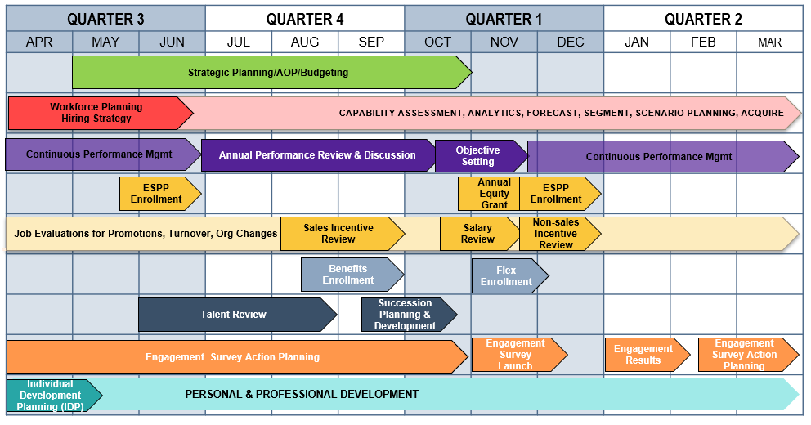
MTS LEADERSHIP CALENDAR:
EXECUTE & DELIVER RESULTS THROUGH SELF & OTHERS
Continuous Performance
Management

Slide 8
Talent Acquisition
Page: 8

Slide 9
Job Descriptions
As a manager it is important to know where to find your employee’s job descriptions and work with your HRBP to update them as needed.
http://spintranet.mts.com/sites/hr/Pages/JobDesc/topjd.aspx

Slide 10
Hiring Needs
When you have identified a hiring need, whether it is for a direct hire or contractor, please reach out to your HR Business Partner (HRBP) to discuss.
Your HRBP will create a req and start the approval process.
Once the position is approved, your designated Talent Acquisition Specialist, or Recruiter, will schedule a Recruiting Strategy Meeting (RSM) with you before posting.
Your Recruiter will walk you through Success Factors on how to use the system.

Slide 11
Hiring Needs (Continued)
Working with 3rd party Agencies:
MTS has agreements with over 70 staffing vendors that cover various functional areas within the organization.
If you have had success with a particular agency at a previous employer, and would like to see if MTS has an agreement in place with them, please discuss with your recruiter during the RSM.
Unsolicited requests can be redirected to recruitingteam@mts.com
MTS’ Agency Practices as stated on our website:
MTS only uses recruitment agencies with whom we have signed Professional Service Agreements. All unsolicited CVs / resumes from approved or unapproved recruitment agencies will be considered MTS property and MTS will not be obligated to pay a referral fee. This includes CVs / resumes submitted directly to hiring managers outside our Applicant Tracking System. Any agency interested in doing business with MTS should contact human resources at recruitingteam@mts.com

Slide 12
Interviewing & Offers
MTS uses Success Factors as our Applicant Tracking System (ATS)
The system will notify you if a candidate has been moved to the Hiring Manager status in the system via email and from your system home page, in the To-do list.
Your Talent Acquisition Specialist will provide a brief overview of the interview process at the Recruiting Strategy Meeting
Once a candidate has been identified for an offer, your HR Business Partner will work with you to determine the offer amount and initiate the offer approval.
After the offer is accepted, you’ll receive the Manager’s New Hire Checklist

Slide 13
Onboarding New Hires
HR Responsibilities:
I-9 form
First day orientation class covering benefits, history of MTS, health and safety, and covering different programs MTS offers
Information on new hires first day can be found: http://spintranet.mts.com/sites/HR/Pages/OnBoarding.aspx
Manager Responsibilities:
Follow the New Hire Checklist to ensure that you have everything set for the new hire to start such as ordering a computer and network access
Introduce employee to the team and others to establish new relationships
Clarify job requirements, & expectations of their role and set goals
Orientate the person to organizational norms of behaviors, ‘ways of working’ and ethics.

Slide 14
Compensation and Benefits
Page: 14

Slide 15
Global Compensation Philosophy
We intend variable compensation for all employees to fluctuate based on performance and results of established objectives
Total compensation is meaningfully influenced by an individual’s role, performance, and learning agility.
We intend total compensation to be competitive in the job markets in which we compete for talent.
Compensation Philosophy

Slide 16
Global Compensation Program Objectives
Establish and maintain a systematic compensation program whereby employees are compensated in relation to their level of responsibilities and work performance
Deliver a program which will enable MTS to attract and retain qualified and competent employees aligned to our culture
Provide agility within the program to meet changing competitive and economic conditions
Maintain equitable and consistent relationships between positions within MTS
Ensure that compensation policies and practices are consistent with effective risk management
Deliver a mixture of market competitive base, incentive, and equity pay

Slide 17
Responsibilities of a Manager/Supervisor
Manager & Supervisor
Utilize compensation philosophy, objectives, and components to optimize business needs
Understand individual components of our compensation program and what that means for each of their employees
Partner with HR Manager/HR Business Partner to identify organizational issues supported by a business need related to compensation
Answer employee questions and communicate changes in compensation programs
Plan merit increases that are fair and equitable using the salary planning process
Manage merit budget

Slide 18
Components of Pay
Fixed Pay
Total Compensation
Variable Pay
Benefits

Slide 19
Fixed Pay
Base Pay
Salary paid to employees for a job performed
Driven by individual performance
Reviewed on an annual basis in the Talent Management System/SuccessFactors
Merit increase effective date: late November (may change at company discretion)
Differentials
Applicable to nonexempt employees who are assigned to a qualifying lead position or work shift (lead, evening, night, weekend)
Types of Adjustments to Base Pay
Merit increase
Promotion
Out-of-Guidelines
Lead or shift differential added or removed
Change in job function

Slide 20
Salary Structures
Salary Structure
Tool that reflects the collection and organization of internal and external compensation data to support job values
Consist of a series of pay ranges that represent jobs of similar internal and external worth
US Structures
ANX: Administrative Nonexempt
SNX: Inside Sales Nonexempt
TNX: Technical Nonexempt
MNX: Manufacturing Nonexempt
SAM: Supervisory, Administrative, Management
TE: Technical Engineering
STE: Software Engineering
FAM & SM: Field Account Management and Sales Management
Minimum
Midpoint
Maximum
Zone 1
Zone 2
Zone 3

Slide 21
Variable Pay
Variable Pay
Contingent on discretion, performance, or results achieved
“Pay at risk”
Short Term Incentives
Rewards short term performance (<1 year)
Non-sales (annual variable compensation plan)
Sales (FAM, RSM, or SNX sales incentive plan)
Long Term Incentives
Reward long term performance (1 – 3 years)
Equity Awards
Align employee compensation to the long-term financial interests of the company and its shareholders
Pool 1: SAM18+, TE8+, SM6, FSM7
50% Stock Options, 50% Restricted Stock Units
Pool 2: SAM15-17, STE/TE5-7, SM5, FSM6
100% Restricted Stock Units

Slide 22
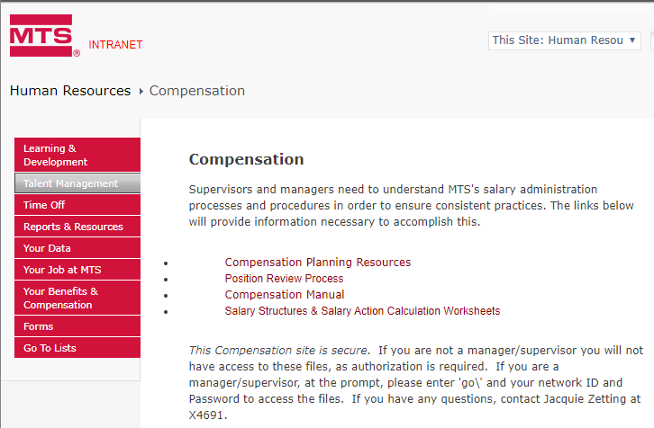
Resources
Intranet Navigation: Talent Management > Compensation
Questions
Contact your HR Business Partner
Email questions to compensation@mts.com

Slide 23
Leave of Absences
When an employee advises that they need to be off work for a medical illness, to care for a family member with a serious illness, Military Leave, Jury Duty, Bereavement to name some Leave types, have them reach out to the HR Coordinator.
The HR Coordinator will email the employee with instructions on paperwork needed to request Leave of Absence and if needed to request Short Term Disability for a medical LOA.
In the employee’s absence, the HR Coordinator will submit Timesheet Instructions to the Manager. The Manager will submit a manual Timesheet to Payroll until the employee returns.
When the employee is permitted to return to work after a Medical LOA. The employee will need a release to work authorization noting any physical restrictions.
Review the Leaves of Absence (HR-004.01) Procedure for more details.

Slide 24
Employee Assistance Program
Refer employees to our CIGNA EAP program (877) 622-4327 24 hours a day for confidential help:
When an employee has problems that interfere with performance or they disclose that they are experiencing physical illness, emotional stress, relationships, marriage, divorce, or issues with children to name a few.
The EAP also provides resources for childcare, senior care, financial & legal assistance, and discounts on a variety of services & supplies, e.g. hearing care and fitness club discounts.
Contact HR Benefits for any additional information.

Slide 25
Retirement
Once employee shares their plans with you, request employee provide a letter of termination with a minimum of a 2-week notice. Once you receive this document, share with HR/Benefits. Note: While there’s no requirement, a 2-week notice is typically the minimum notification period. The more advance notice allows you to create a transition plan and do workforce planning.
Look for instructions from HR/Benefits on: (1) off-boarding checklist and (2) completing a Notice of Termination.
Share the document “What Happens When You Leave MTS?” Note: Employee will also be sent a hard copy to their home address.
Review the Retirement Recognition Guidelines (HR-021.02) procedure to plan and prepare for recognition.
Retirement recognition is defined as regular employees leaving MTS who are: (1) at least 65 years old with a minimum of 5 years of service, or (2) at least 55 years old with a minimum of 10 years of service.
Take action to complete on or before the employee’s last day worked. Since the process takes up to a week to complete, make your request a week before the employee’s last day worked.

Slide 26
HIPAA
An employee may choose to disclose information about their own medical condition to individuals that is otherwise covered under the Health Insurance Portability and Accountability Act. Such disclosure is not a violation of the rules.
However, disclosing medical information of an employee to individuals who are not designated as a Covered Individual by MTS under the regulations is a violation.
Overall, privacy in the workplace in the employment context refers to employee’s information that they regard as personal or private. This can include medical information, work activities, off-duty behavior and the employee’s right to not have such information shared with others

Slide 27
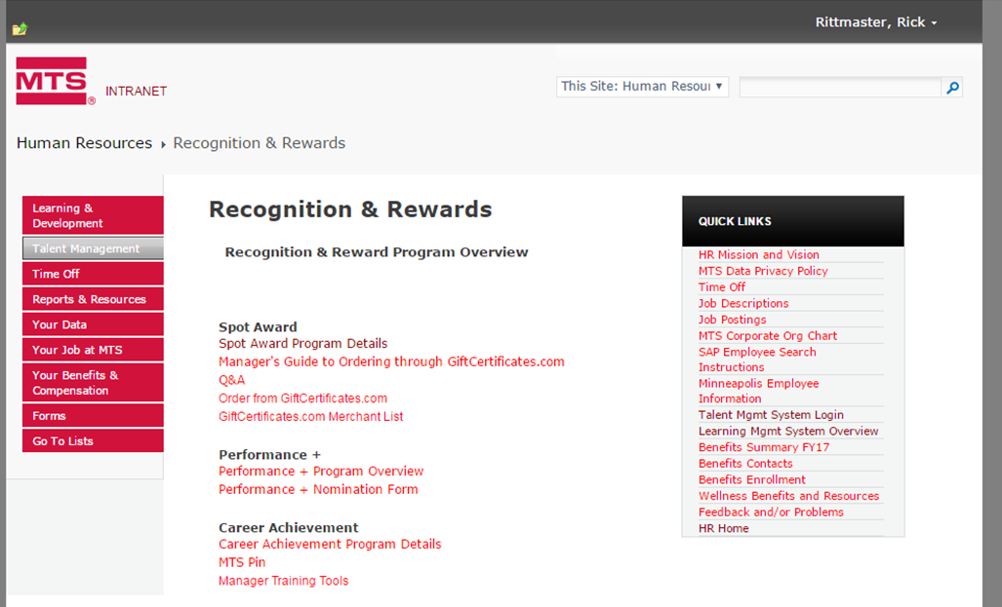
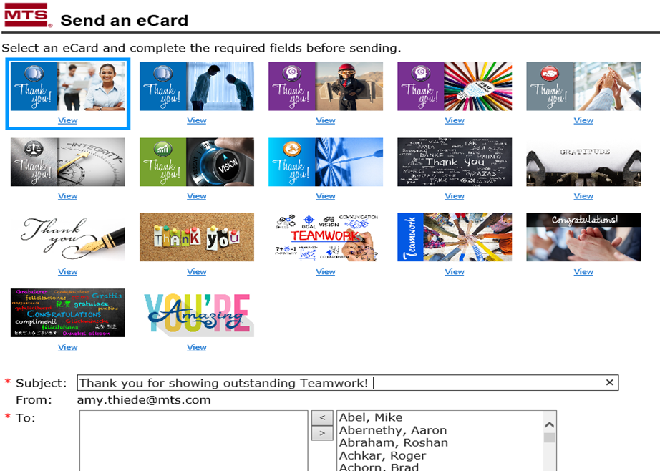
Recognition
Spot Award Program:
Provide a means for managers to recognize employees for contribution to a specific project or going above and beyond job duties.
Gift certificate in amounts of $100 or less.
Performance +
Recognize employees who exceed the company’s expectations
Cash award
Recognition Time Off
Recognize employees with additional PTO days
Send an eCard
Located on the Intranet Homepage
http://spintranet.mts.com/sites/HR/Pages/Recognitions.aspx

Slide 28
Employee Relations
Page: 28

Slide 29
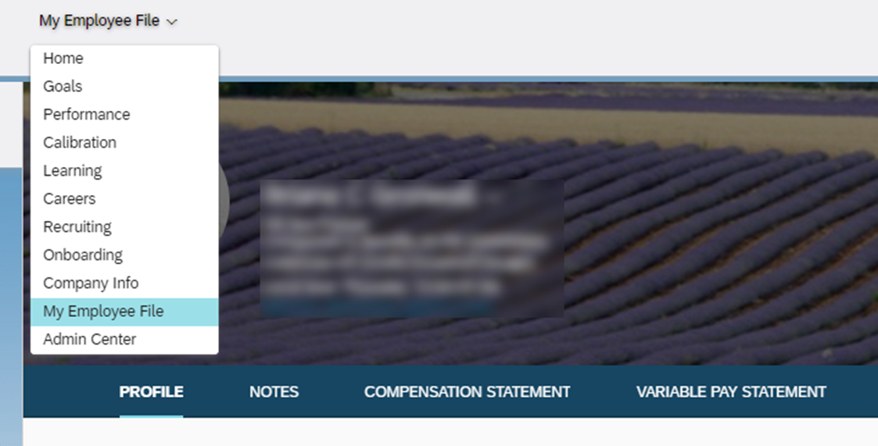
Employee Data
You employee data and team information can be access within Success Factors.
This includes:
Organizational Chart
Performance Review
Compensation Statement
Variable Pay Statement
For more detailed pay information, contact your HRBP

Slide 30
Employee Changes
Promotions: If there is an employee you wish to promote; you’ll provide the business case justification to your leader and then partner with your HRBP to review options and complete the promotion.
Change of Status Form: When changes are made to an employee the HRBP will complete a change of status that the manager and one up manager will sign off on.
Examples, Change in:
Hours, full-time to part-time
Pay
Salary grade
Manager
Cost center
Title
Business Unit

Slide 31
Performance Documentation
As a manager, documentation and consistency are key.
Documentation:
Keep documentation of coaching and counseling sessions with employees. Good documentation includes facts not opinions of who, what, where, and when.
These can be hand-written or typed notes, or emails. Save these in an easy to access place.
Document right away while it’s fresh.
Written comments include specific examples and disciplinary actions, such as verbal warnings with specific examples and consequences.
Why is this important?
Establishes a record
Informs employees of what is expected of them
Serves as evidence
Be prepared to discuss your documentation when consulting with HR on how to proceed with a performance plan.

Slide 32
Terminations
Voluntary Terminations
Once employee shares their plans with you, request employee provide a letter of termination with a minimum of a 2-week notice. Once you receive this document, share with your HRBP. Note: While there’s no requirement, a 2-week notice is typically the minimum notification period. The more advance notice allows you to create a transition plan and do workforce planning.
Look for instructions from HR/Benefits on: (1) Notice of Termination (2) Off-boarding checklist and (3) IT Offboarding.
Employees will receive a hard copy of “What Happens When You Leave MTS?” sent to their home address.
HRBP will schedule an exit interview with the employee.
On the employee’s last day make sure to collect all company property. (phone, laptop, badge, ipad, etc.)
Involuntary Terminations
Work with your HRBP on any performance related concerns or issues that might lead to an involuntary termination.

Slide 33
Learning and Development
Page: 33

Slide 34
Learning and Development Timeline

Slide 35
Offerings
New Manager Resource Guide (In-person delivered by HRBP)
Content: Manager expectations, core processes, resources and accountabilities.
Intended Audience: New Managers within their first week.
First 90-Days Microlearning (LMS)
Content: Key principles to accelerate success as a new manager.
Intended Audience: New Managers, assigned their second week.
Manager Essentials (Half-day workshop delivered by OD)
Content: Four core conversations (goal setting, praising, redirecting, and wrapping up) and the skills that support them.
Intended Audience: Managers that have been here for 30+ days.
Prerequisite: New Manager Resource Guide
Fundamentals of Leadership (Two-day workshop delivered by OD)
Core: Building competence on a variety of leadership skills (eg conflict, change, EQ, trust, etc.)
Intended Audience: Managers that have been here for 6 months or more
Prerequisites: New Manager Resource Guide & Manager Essentials

Slide 36
Learning and Development
Four main areas of Learning and Development:
Leadership Development
Coaching
External Development
Team Building
Managers can request team building activities.
Employee Development
Learning and Development Page: http://spintranet.mts.com/sites/HR/Pages/Learning_Development_Pages/Learning-Development.aspx

Slide 37
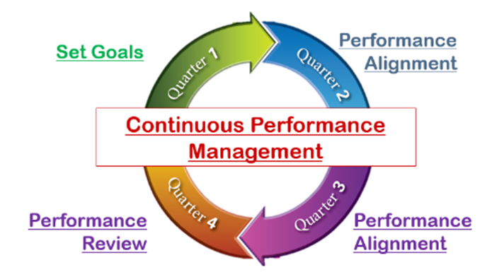
Learning and Development
Performance Management is a combination of:
A clear and consistent process for establishing expectations (goal setting)
Continuous Performance Management in Q2 and Q3:
Developing employees and having check-ins.
Providing feedback on goals.
Performance Review: Reviewing and rating employee’s performance for the Fiscal Year.
As a New Manager
Check in with your employees to ensure everyone has goals in the system and discuss their progress with their goals.
Performance and Goals Page: http://spintranet.mts.com/sites/HR/Pages/Performance-and-Goals.aspx

Slide 38
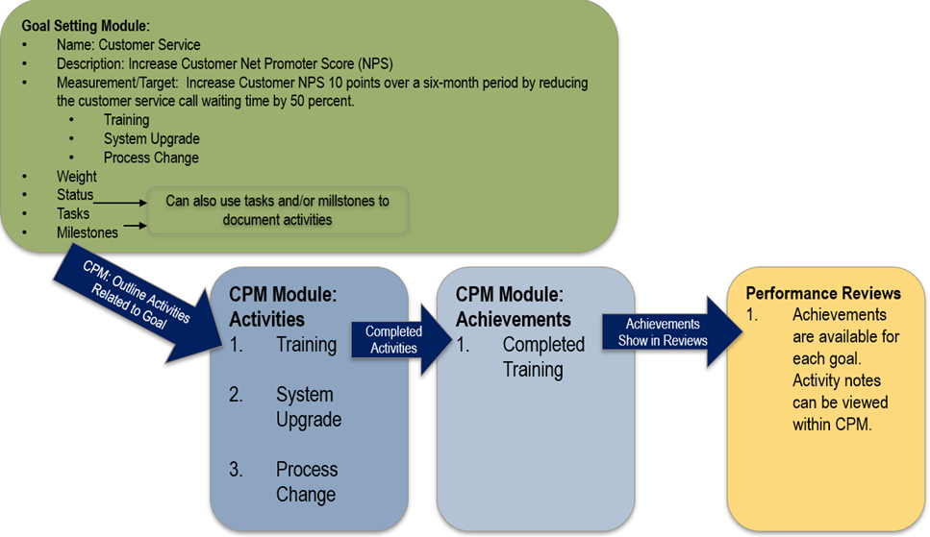
Continuous Performance Management (CPM)
Located in SuccessFactors
A process that encourages managers and employees to engage in more frequent performance (feedback and coaching) discussions
CPM is a way to document those performance discussions throughout the year using SuccessFactors.
CPM Quick Start Guide:
http://spintranet.mts.com/sites/HR/Documents/Files/training/CPM%20Quick%20Start%20Guide.docx

Slide 39
Performance Management Timeline

Slide 40
Managerial Financial Responsibilities
Page: 40

Slide 41
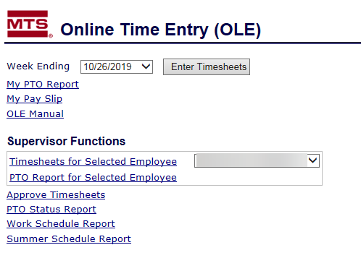
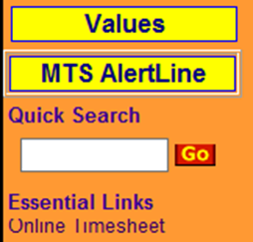
Payroll – Online Time Entry (OLE)
Time reporting is used as the source documentation to track both Direct and Indirect Labor.
Managers with direct reports, whether contract or full time employees, will need to review and approve in OLE (On-Line Time Entry) weekly for any of the following:
Contract and Non-Exempt employees, who must report their hours weekly.
Exempt employees who have taken time off during the week
The OLE Submission deadline is 11:59pm Saturday, the week of the reported time.
All Direct Labor time needs to be submitted daily, using the daily submit button, to comply with federal regulations.
To Access OLE, go to Online Timesheet on the MTS Intranet Quick Search section:

Slide 42
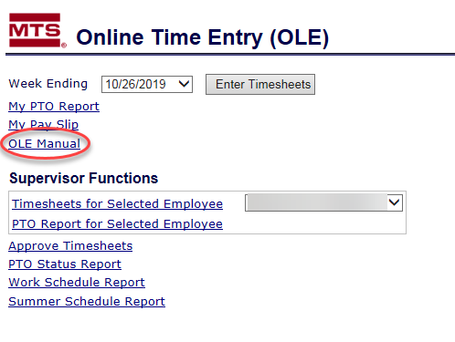
Payroll – Online Time Entry (OLE) continued
Email notifications are sent to you and your direct reports if you did not approve by the deadline
For additional information on Time Reporting, please refer to the OLE Manual which can be viewed here:

Slide 43
Manager Expectations – Cost Centers
Annually
The Annual Operating Plan (AOP) serves to lay out planned activities and corresponding monetary resources for the fiscal year, including recurring annual expenses and non-recurring investments in special projects
AOP occurs in Q4 (July-September)
Partner with functional leadership and finance business partner on departmental needs for next fiscal year
Justify headcount changes and expense investments
Quarterly
BOQ (Beginning of Quarter) Forecast updates occur by 2nd week of each fiscal quarter
Partner with functional leadership and finance business partner to determine if there are new/different needs for the fiscal year compared to AOP
Monthly
Cost center review with finance business partner to analyze monthly activity and validate estimate for the current quarter

Slide 44
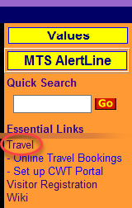
Expense Reimbursement – Corp. Credit Card
As a manager you should have an MTS corporate credit card and be setup in Expense Anywhere to submit your expense and to approve your employee's expenses.
Go to the MTS intranet, on the right side in orange go to Travel.
Under new employee info you can get the form for a corporate card and read any applicable policies. If you go to Expenses the will give you links to Expense Anywhere.
Expense Anywhere is our reimbursement tool. It is designed to pay the credit card for charges and only pay the employee for out of pocket charges.
When you request your card, you will get added to expense anywhere as an approver.
Contacts are on the home page of travel, or you can contact Accounts Payable.

Slide 45
Tools and Resources
Page: 45

Slide 46
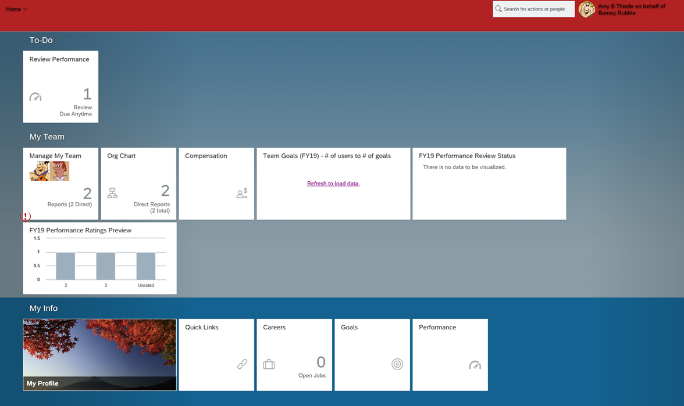
SuccessFactors
As a new manager, the SuccessFactors Homepage is the best way to view information and access information on your team.

Slide 47
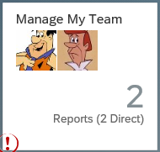
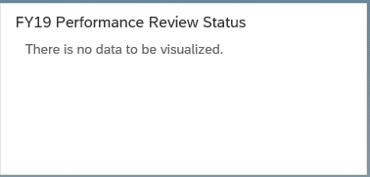
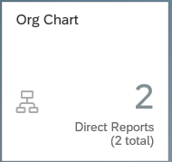
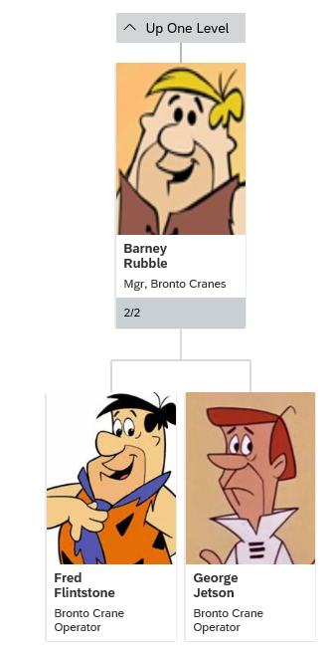
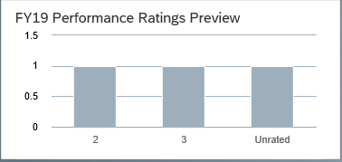
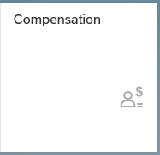
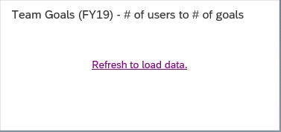
SuccessFactors: My Team
Below are “tiles” that allow you to access information on your direct reports.
This allows you to view your direct reports. You can select an employee and view their profile, notes compensation statement, variable pay, review and goal plan.
During review times, you can view where your team is at in the review process.
Allows you to view your team in an org chart. You can also search for people and view other org charts in the organization.
Once the review is complete you can see your direct report ratings.
This tile will take you to a location where you can access planning forms to enter annual merit and equity recommendations for your team. In subsequent years, you will also be able to access planning forms from previous fiscal years that you have completed.
Helps managers track who in their organization, has created goals and who hasn’t. It also helps them monitor if employees have too few or too many goals.

Slide 48
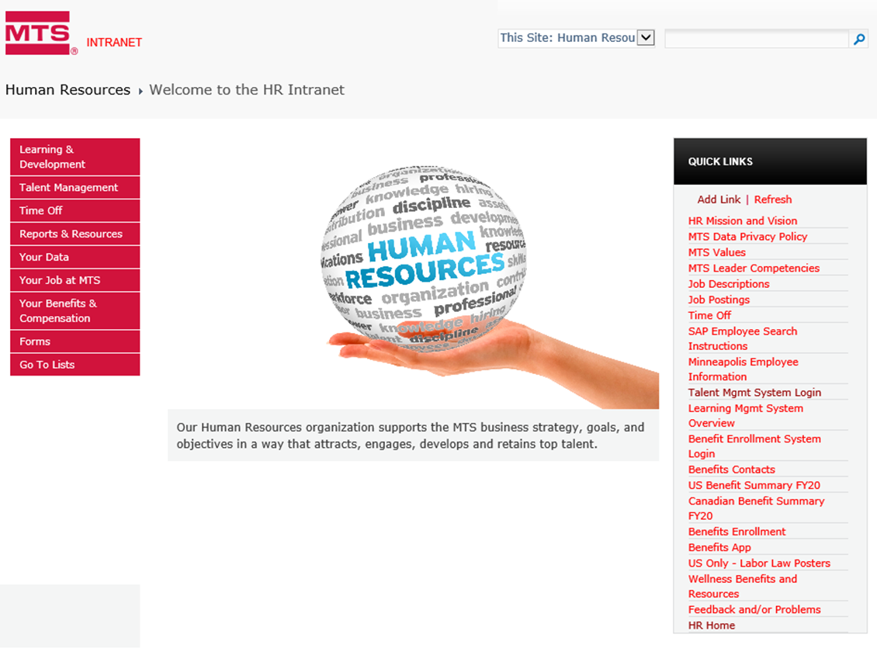
HR Home Page
The HR Home Page on the intranet site is a great spot for managers and employees to obtain helpful information and resources.
For new managers there is helpful information and resources in the performance management, compensation, learning and development, and talent acquisition sections.

Slide 49
HR Policies

Slide 50
Communication Tools
Importance of Communication for Managers
Town Hall Meetings
Intranet
Share point
Communication with your Team
Staff Meetings
One-on-one discussions
E-mail updates

Slide 51
Additional Support
Additional Support and Resources
Online
HR Intranet
http://spintranet.mts.com/sites/hr/Pages/default.aspx
Learning Management System (LMS)
Within SuccessFactors, navigate to the “Learning” page
HR Business Partner/ HR Centers of Excellence
Your HRBP: __________
Total Rewards Manager: Dale Bjerke
HR Information Systems Manager: Tara Klatt
EP Go To List
http://spintranet.mts.com/sites/HR/Documents/Files/contacts/Go%20To_Eden%20Prairie%20May20.pdf
Your Leader

