Slide 1
Before you start, read these instructions!
To ensure the best training experience possible, make sure you are viewing this PowerPoint in Presentation Mode.
You can access Presentation Mode in any of the three following ways:
Press the F5 button.
Click “Slide Show” on the ribbon, then “From Beginning”
Click the Presentation Mode icon in the lower right corner of the window.
Enjoy the training!
2.
3.

Slide 2
Performance Management Q2: Coaching & Giving Feedback
FY19 – Q2

Slide 3
Quarterly Focus & Agenda
Agenda:
Performance Management Overview
What You Need To Know: Effective Coaching and Feedback
Getting Started: Coaching and Feedback Tools and Resources
Performance Management Quarter 2:
Coaching and Giving Feedback

Slide 4
Performance Management Overview
Use for Coaching
Will be a part of FY19 reviews
Great information on the Values Intranet Site

Slide 6
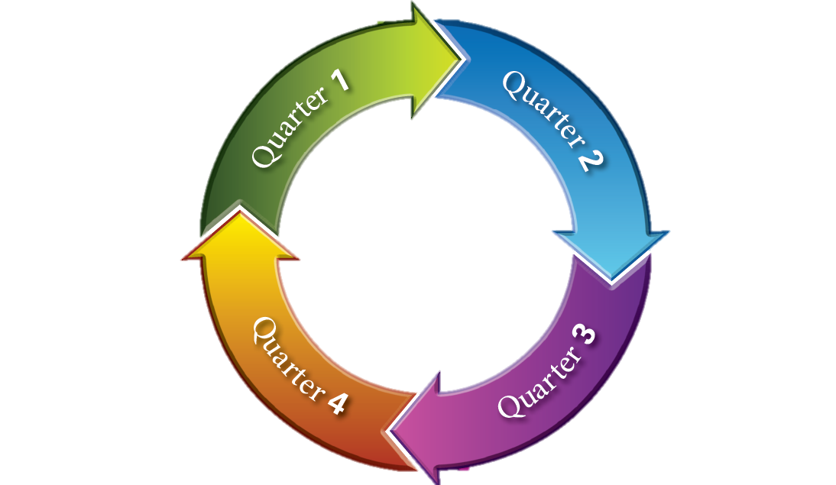
Performance Management Overview
Performance Alignment
Set Goals
Performance Alignment = Coaching & Giving Feedback
Performance Review
Performance Alignment

Slide 7
Performance Management Overview
Great Performance Goals
SMART Criteria
Well Understood
Frequently Discussed
Great Performance Goals

Slide 8
Performance Management Overview-
FY19 Performance Management Timeline
Optional, Best Practice
FY19 Performance Management Kick Off
Manager & Employee Finalize Goals*
Goal Check-In Conversation #1
Mid-Year Review
Goal Check-In Conversation #2
FY19 Final Review Process**
Nov
Dec
March
June
August
Sept- Dec
*Manager may set more aggressive timeline, if they choose.
**Additional information about the Final Review process to be communicated later in 2019

Slide 9
Performance Management Overview
Overall Performance = What + How
What: performance goals
How: MTS values, competencies

Slide 10
Providing Feedback: Key Principles
As a people leader, you are in the best position to provide feedback.
Feedback is about awareness; and helping the employee connect past actions to future opportunities.

Slide 11
Providing Feedback: Situation-Behavior-Impact
Effective feedback has three elements:
Situation:
What was the situation or task, in question?
Behavior:
What did the employee do in this situation or task?
Impact:
What was the outcome of the employee’s actions?
SBI feedback for improvement: SBI/BI
Situation: What was the situation, or task in question?
Behavior: What did the employee do in the situation or task?
Impact: What was the impact of the employee’s actions?
Alternative Behavior: What else could the employee have done?
Alternative Impact: How would the situation have been different?

Slide 12
Providing Coaching: Key Principles
As a people leader, you are in the best position to provide coaching.
Coaching is about drawing out insights, and guiding the employee to solutions without explicit instructions.
Coaching is a two-way conversation, and should adjust based on employee input.

Slide 13
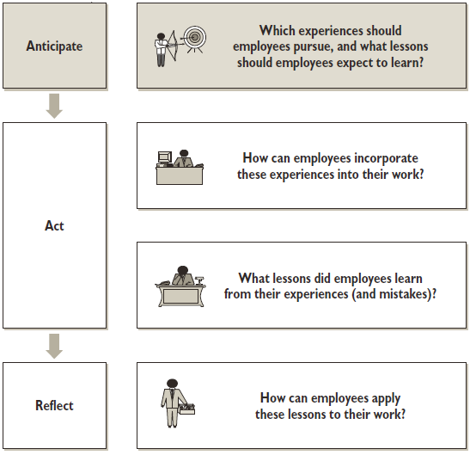
Planned Coaching Conversations
Successful Planned Coaching:
Identify the lessons one wants to learn (Anticipate).
Draw out learnings during the experience (Act).
Connect learnings to future performance improvements (Reflect).

Slide 14
Providing Coaching
Coaching is the most meaningful tool a leader has to drive improvements in employee performance.

Slide 15
Getting Started: Providing Feedback
Effective feedback has three elements:
Situation:
What was the situation or task, in question?
Behavior:
What did the employee do in this situation or task?
Impact:
What was the outcome of the employee’s actions?
SBI feedback for improvement: SBI/BI
Situation: What was the situation, or task in question?
Behavior: What did the employee do in the situation or task?
Impact: What was the impact of the employee’s actions?
Alternative Behavior: What else could the employee have done?
Alternative Impact: How would the situation have been different?

Slide 16
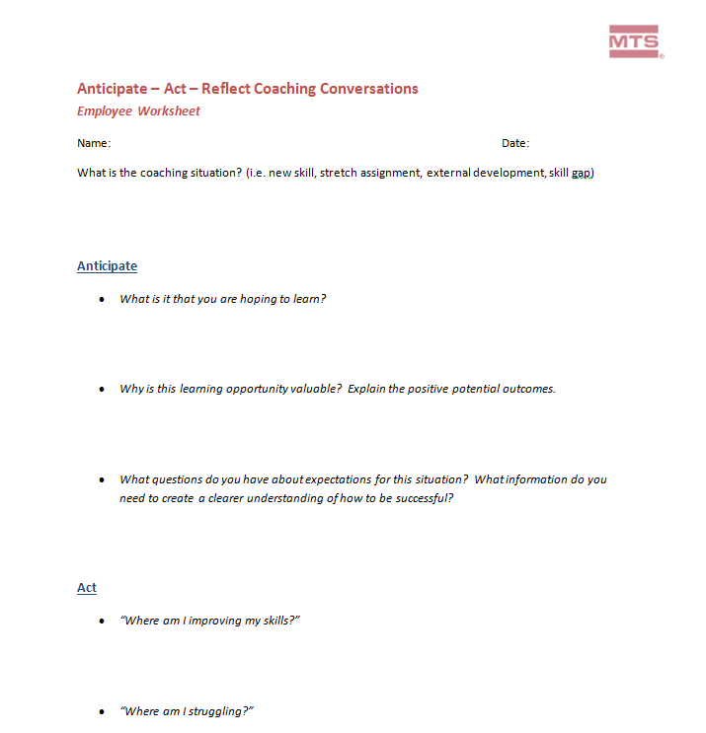
Getting Started: Planned Coaching Discussions

Slide 17
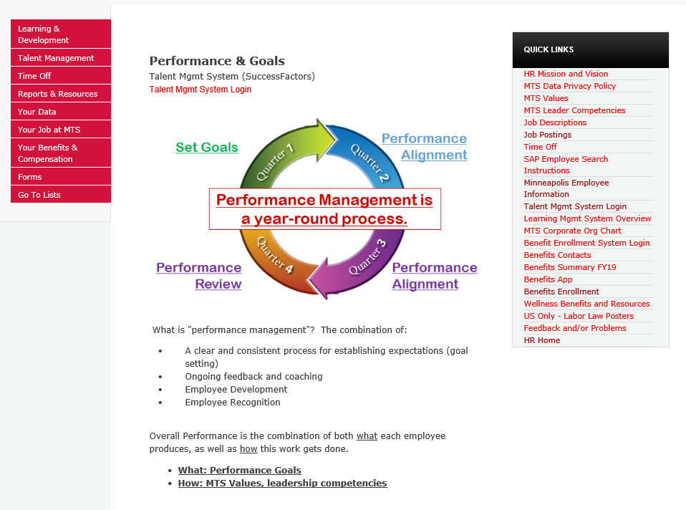
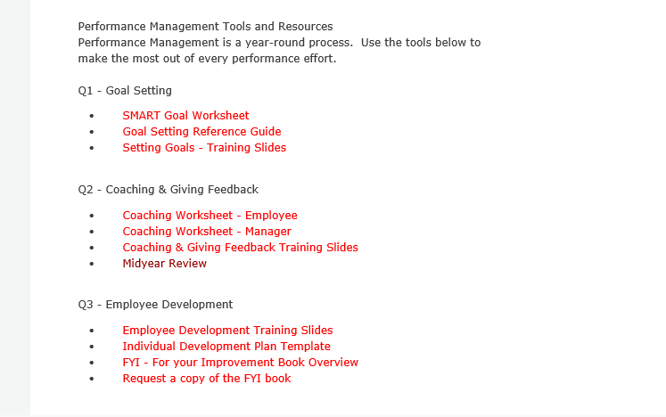

Slide 18
Getting Started: Coaching in the Moment
Ask questions to transform daily interactions into coaching moments.
What went well?
What didn’t go as well as expected?
If you had a do-over – what would you do differently?

Slide 19
Getting Started: Coaching and Giving Feedback
Use your resources:
Recorded Online Training
30 minute on-demand training
Search “coaching and giving feedback” on the LMS home page
Performance and Goals HR Intranet Site
Coaching Worksheets (employee and manager)
Coaching and Giving Feedback training slides

Slide 20
Getting Started: Coaching and Giving Feedback
Goal Check-In
Discussion: March

Slide 21
Thank You!

