Slide 1
Information Security – Data Loss Prevention Boldon James Classifiers
8/24/2021
.

Slide 2
What is Boldon James?
Boldon James is a group of tools that will allow users to classify data as it is used.
Boldon James provides two tools for classifying data from your workstation.
File Classifier.
Office Classifier.
Each of these tools will allow a user to classify data as it is handled, one file at a time.

Slide 3
Why do we need to use Boldon James?
Classification of all of MTS’ data is required to ensure the DLP tool ForcePoint can control where data can be sent according to the written policy (IT-017).
The DLP tool can read some types of content in a file and compare it to known standards like Social Security Numbers or Credit Card numbers and from that match the control rules are applied according to the above policy.
Unfortunately, much of our data isn’t readable in this manner, as it may be diagrams and technical descriptions that are unique in each document. This means we need a way to place a tag in the file meta data to identify the level of classification that applies to a file - MTS Restricted, MTS Export Controlled or MTS Secret.

Slide 4
How do I choose the classification?
Handling requirements for all of MTS’ data are in Information Classification and Handling policy (IT-017).
The policy provides examples of each level of data classification.
There are three levels of classification in scope for the DLP program - MTS Restricted, MTS Export Controlled and MTS Secret. Internal Use and Public do not need be classified.
The policy should be used to provide guidance on which classification tag is appropriate for files as they are handled.
Information users are normally aware of the sensitivity of the documents they handle, so they are the best qualified to apply a classification tag.

Slide 5
MTS Restricted Data
Unauthorized access to information may considerably damage the business and/or the organization's reputation.
Examples
Customer or vendor portals requiring authentication.
Product details, costs, manufacturing details, drawings, etc.
Customer contact info, customer billing summary information.
Information that we are contractually required to protect.
Employee records such as salary, government issued identification number, health/benefit related information.
Passwords, encryption keys.
Security incident or vulnerability details.
This classification has one subclassification level:
Restricted – Personal Information (including information protected under local privacy regulations).
Information is available only to a specific group of employees and authorized third parties (under Non-Disclosure Agreements).

Slide 6
MTS Export Controlled (ITAR)
Unauthorized access to information may result in a violation of US or international regulations including exports of technical data.
Export Controlled – ITAR or EAR.
Required under applicable regulation such as DFARS 252.204-7012.
Examples:
Engineering drawings and Bills of Materials.
Information required for design, development, production, manufacture, assembly, operation, repair, testing, maintenance or modification of defense articles.
Information covered under DFARS 252.204-7012.
Information is available only to authorized individuals.

Slide 7
MTS Secret
Unauthorized access to information may cause catastrophic (irreparable) damage to business and/or to the organization's reputation.
Examples:
Mergers and acquisitions information.
Unreleased information that would be considered a material release by the SEC or other government agencies.
Information related to products that are not patented and that require protection beyond Restricted.
Information is available only to a limited number of individuals in the organization.

Slide 8
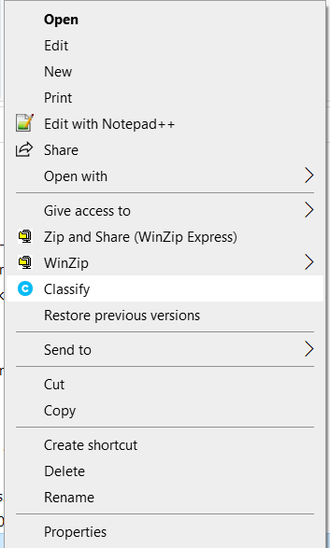
File Classifier
Right click on the file, select classify and then choose the classification you wish to be placed on the file and click OK.
Once a file has been classified, you will notice the lower left corner will be coloured the same as the classification.

Slide 9
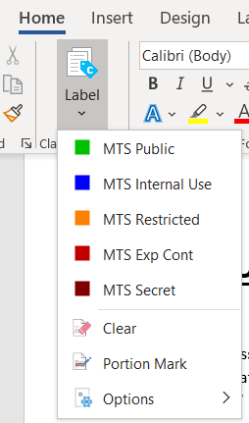
Office Classifier
The Office classifier is easy to use. In an open document (Excel, PowerPoint or Word) you will see a banner at the bottom of the document showing the Classifier Label, the default state is “No Classification”.
In the upper Left Corner of the Document, you will find the Label Icon on the ribbon.
Click on “Label” and select the classification for the document.
Once labeled the “Classifier Label will turn the color of the classification and show the label name.
There will also be a header and footer watermark with the classification.

Slide 10
Outlook Classifier
The Outlook classifier is almost identical to use as the Office classifier. In a new or reply Email you will see a banner at the bottom of the document showing the Classifier Label, the default state is “No Classification”.
In the upper Left Corner of the Email Ribbon, you will find the Label Icon on the ribbon.
Click on “Label” and select the classification for the document.
Once labeled the “Classifier Label will turn the color of the classification and show the label name.
Continued on the next slide.

Slide 11
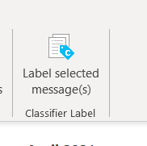
Outlook Classifier
When classifying a reply within your Inbox, there are currently two differences, the Label Icon is on the right end of the ribbon, and the text is slightly different.

Slide 12
File Classifier
File Classifier Video - Select play icon below to play

Slide 13
Office Classifier
Office Classifier Video – Select play icon below to play

Slide 14
Outlook Classifier
Outlook Classifier Video – Select play icon below to play

