Slide 1
East High Bay Pit: Permit Required Confined Space Training

Slide 2
East High Bay Pit: Permit Required Confined Space Training Requirements
Entrants (employees, contractors, visitors) must complete both of the following MTS Confined Space Training programs prior to entering the pit:
EHS027_OLT: Permit Required Confined Space Entry
AND
EHS027A_OLT: East High Bay Pit: Permit Required Confined Space Training (i.e., this training)

Slide 3
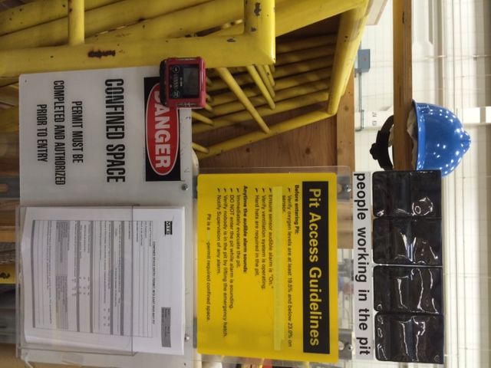
East High Bay Pit: Permit Required Confined Space Training
The content of this training session is based on MTS Work Instruction:
EHS-300-144 - Permit Required Confined Space: East High Bay Pit

Slide 4
What Makes A Confined Space “Permit Required”
Large enough for person to bodily enter
Limited or restricted means for entry or exit
Is not designed for continuous occupancy
Contains or has potential to contain hazards capable of causing death or serious physical harm.
East High Bay Pit:
Is not designed for continuous occupancy
Limited or restricted means for exit due to potential hazards in the pit
Contains potential hazards capable of causing serious physical harm

Slide 5
East High Bay Pit Potential Hazards (Partial List)
Falls/Slips/Trips
Spills
Releases of compressed gases (e.g., nitrogen)
Hydraulic line rupture
Pinched or trapped between equipment
Electrical
Drop of materials from above
Flammable material vapors
Equipment tip-over

Slide 6
Definitions
Attendant: The member or members of the entry team who remain outside the confined space and monitor the entrant’s activities and condition. A member of MTS Security shall serve as the attendant for all pit entries.
Entrant: The member or members of the entry team who enter the confined space.
Job Supervisor (Supervisor): The member of the entry team who is responsible for planning the entry, issuing the entry permit and supervising the overall safety of the entry.

Slide 7
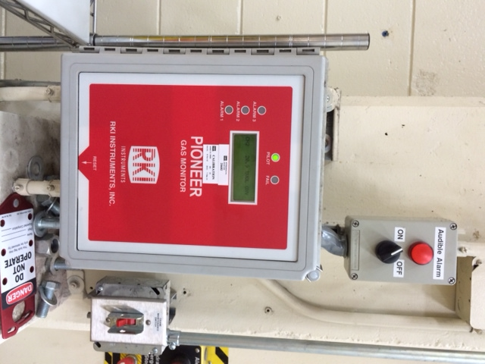
East High Bay Pit: Permit Required Procedures
Pre-Entry
Supervisor: responsible for completing Confined Space Entry Permit.
Supervisor (or designate): contacting MTS Security to arrange for a Security member to serve as attendant.
Review Permit with all entrants and attendants.
Special attention paid to specific hazards associated with work to be performed.
Verify fixed air monitoring system (RKI 35-3000) is functioning.
Verify fixed in-wall ventilation system is turned on and operating.
Turns on when pit lights are turned on.
Keep Permit available near pit area.

Slide 8
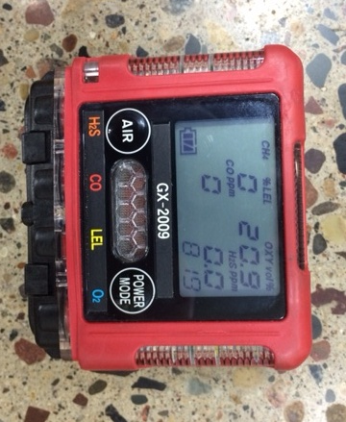
East High Bay Pit: Permit Required Procedures
Entry Action Items
Ensure portable gas meter is functioning.
Locate and put on required PPE (e.g., hard hat).
Ensure attendant is located outside the pit and is present at all times entrants are in the pit.
All entrants shall place their MTS Employee badge or Confined Space Entry badge on the designated board at the pit entrance. The badge shall remain on the board until the entrants work in the pit is complete.
A minimum of one entrant and the attendant shall use the designated radios located at the pit entrance to aid in communication in the event of an emergency in or outside the pit.
Portable gas meter readings recorded upon pit entry and then every two hours until exiting the pit: oxygen %, lower explosive limit (LEL) %, carbon monoxide ppm and hydrogen sulfide %

Slide 9
East High Bay Pit: Permit Required Procedures
Supervisor Duties
Completing the Confined Space Entry Permit and reviewing with all Entrants and Attendants
Assessing potential hazards that may be encountered in the pit while the work is being performed
Ensuring all Attendants and Entrants listed on the Confined Space Permit have received East High Bay Pit Confined Space Training.
Maintaining all completed Confined Space Entry Permits for a minimum of (3) years

Slide 10
East High Bay Pit: Permit Required Procedures
Attendant Duties
Monitor entrants at all times while they are working in the pit
Be in a position to communicate (verbally, nonverbally, radio) with entrants at all times
Be on alert for potential hazards that could harm the entrants, and inform entrants if a hazard is identified
Keep unauthorized persons from entering the space
Know how to operate portable air monitor
Calling for rescue and other emergency services if entrants need assistance to escape
Use radio or dial 6000 for emergency assistance

Slide 11
East High Bay Pit: Permit Required Procedures
Entrant Duties
Knowing the hazards (e.g., review of Risk Assessment) that may be encountered in the pit, and how to minimize the potential for an incident
Conducting air monitoring with the portable meter and documenting the results
Placing MTS Employee badge or Confined Space Entry badge on the designated board at pit entrance
Maintaining communication with the attendant via radio, verbal or non verbal communications; alert the attendant if a concern arises as to the safety of those working in the pit
Exiting the pit immediately if a concern arises that compromises the safety of those working in the pit, or if told to do so by the attendant
Returning Confined Space Entry Permit to Supervisor upon completion of the work

Slide 12
East High Bay Pit: Permit Required Procedures
Nitrogen Accumulators
Accumulator vessels larger than (5) gallons are not allowed in the pit unless:
EHS Department approves in writing; and
Contract rescue service personnel are on-site to serve as attendant throughout duration of time that nitrogen accumulator is located in pit and personnel are in the pit, unless studies indicate accumulator vessels larger than (5) gallons will not result in a reduction of oxygen levels in the pit that will cause a health concern.

Slide 13
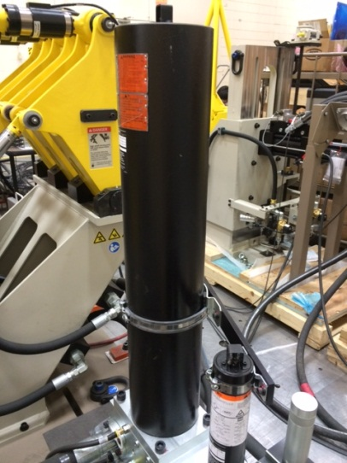
Nitrogen Accumulator
Example of (5) gallon nitrogen accumulator

Slide 15
Please contact the EHS Department with any questions regarding this training. THANK YOU!

