Slide 1
Criterion Test Systems - Interim Calibration requirements and ACS issues.
Gary Dahlberg Dec 2011

Slide 2
Scope
This training is for experienced NAFS engineers only.
The training applies to calibration of Criterion Testing Systems.
The training is meant to supplement the existing ACS calibration processes.
This training is interim, until ACS and our written procedures can be modified to address the new Criterion calibration tolerances.
This training allows for the departure from standard practices under our accreditation.
All Criterion Testing Systems will be calibrated upon installation for Force, Displacement and Crosshead Speed in compliance with the following information.
At the time of installation, adjust Criterion systems to meet ±0.5% for Force, Displacement and Crosshead Speed.
Additional guidance on requirements for re-calibration will be presented at a later date.
This information does not provide for force calibrations in compliance with ISO 7500-1, Class 0.5.

Slide 3
The following information is relevant to all Criterion Testing Systems with the exception of model C42.
The C42 retains the same tolerances as our previous E/M Testing Machine calibrations for Force of ±1%.
The C42 testing machine comes standard with a “S” Beam type force transducer. It is very difficult to achieve the higher accuracy of ±0.5% with these cells.
Perform calibrations for Displacement and Crosshead Speed to ±0.5% per the information in this training.

Slide 4
Criterion Testing Systems Force: +/-0.5% of applied Force
±0.5% is the maximum allowable tolerance for errors presented on the calibration reports for Criterion Testing Systems.
The tolerance of +/-1% of applied force stated on the calibration report and certificate of calibration will not change. The calibration is still stated as in compliance with ASTM E4 which requires the +/- 1% tolerance.
A normal calibration will start at 10% of capacity and follow the standard complement of data points in ACS. (See next slide)
The customer may request a calibration with lower force data points. If this is the case you must start at the allowable lower limit or a higher low force based on resolution, and follow the full range conditioner complement selected in ACS. Modify the schedule as required.

Slide 5
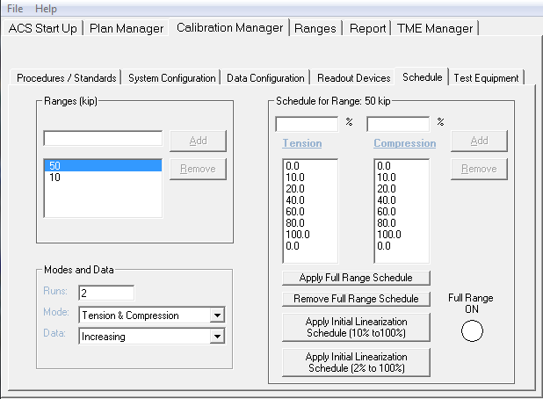
Criterion Testing Systems Force: +/-0.5% of applied Force
Standard complement of data points:

Slide 6
Criterion Testing Systems Force: +/-0.5% of applied Force
The Lower Force Limit of your reference cells need to be doubled
Until ACS is modified you will need to do this manually
When starting a 0.5% Criterion Force Calibration and before loading any standards in ACS, go to the T&ME tab in ACS and double the lower load limit of the force reference standards you are going to use for the calibration.
Make sure to go back into the T&ME tab and half the numbers when done with Criterion Calibrations

Slide 7
Criterion Testing Systems Force: +/-0.5% of applied Force
The lowest data point relative to resolution is now 400 times ½ the noise instead of 200 times.
When you determine the resolution in ACS, you must multiply the number you enter by 400 and this is the lowest data point you may calibrate.
In most cases if you only calibrate down to 10% of capacity you will not have a problem.
Example: 100kN system calibration. The determined resolution (1/2 the noise) is 0.01kN. This number is entered into ACS. ACS will allow you to have a 2% FS value specified in the schedule because 200 times 0.01kN is 2kN. However, for calibrating to 0.5%, this number must be multiplied by 400 so the lowest data point that can be in the schedule needs to be 4%, not 2% for this example. You must readjust the schedule to adhere to this requirement.

Slide 8
Criterion Testing Systems Force: +/-0.5% of applied Force
The Uncertainty statement on the calibration report needs to be changed manually. So you will have to select “No” to the print question when it asks you if you want to “Print the report now”.
Go to the bottom of the calibration report and change +/-0.25% to +/-0.125%. Do this for all ranges that contain calibration data.
A copy of the calibration report in Excel or PDF must be uploaded to the server.
From the Calibration Report:
Errors at Zero are computed in % of Range.
Uncertainty of the data supplied is equal to or less than ±0.125% of reading for a confidence level of 95%.
This report shall not be reproduced except in full, without the written approval of the laboratory.
Calibrations are performed with standards whose values and measurements are traceable to the National Institute of Standards and Technology.
American Association of Laboratory Accreditation Certificate Number: 1145.01

Slide 9
Criterion Testing Systems Force: +/-0.5% of applied Force
Review
Double the lower load limit of the force reference standards to be used for the calibration
Determine the lowest data point possible by multiplying the determined resolution by 400
Make sure all errors for the calibration are equal to or less than ±0.5%
Modify the uncertainty on the calibration report from 0.25% to 0.125%
Upload an excel or pdf copy of the calibration report to the server
Change the lower load limit of the force reference standards back to the metrology certified values.

Slide 10
Criterion Testing Systems Displacement: +/-0.5% of applied displacement
±0.5% is the maximum allowable tolerance for errors presented on the calibration report for Criterion Testing Systems.
ASTM E2309 will be selected in ACS and followed for calibration of displacement for Criterion Testing Systems
The normal calibration will start at 25mm or 1 inch and will follow the normal complement of data points provided in ACS.
The calibration must meet ASTM E2309 Class A to meet the required tolerance.
ACS will determine if the testing system has adequate resolution to achieve the required Class A (±0.5%)

Slide 11
Criterion Testing Systems Displacement: +/-0.5% of applied displacement
The lowest calibration data point needs to be at least ….. 25 mm or 1”
Unless you use the CT6002 high accuracy length device
The CT6002 will let you go down to 2.5 mm or 0.1”
The uncertainty statement on the calibration report must be changed from +/-0.25% to +/-0.125%
A copy of the calibration report in Excel or PDF must be uploaded to the server.
From the Calibration Report:
Errors at Zero are computed in % of Range.
Uncertainty of the calibration data supplied is equal to or less than the greater of, ±0.125% of reading or ±50μ inches, for a confidence level of 95%.
This report shall not be reproduced except in full, without the written approval of the laboratory.
Calibrations are performed with standards whose values and measurements are traceable to the National Institute of Standards and Technology.
American Association of Laboratory Accreditation Certificate Number: 1145.01

Slide 12
Criterion Testing Systems Displacement: +/-0.5% of applied displacement
Review
Select method ASTM E2309 in ACS. ASTM E2309 requires two runs of data.
Set the first non-zero calibration data point at 25mm or 1” unless otherwise requested by the customer.
Make sure all errors for the calibration are equal to or less than ±0.5%
Modify the uncertainty on the calibration report from 0.25% to 0.125%
Upload an excel or pdf copy of the calibration report to the server.

Slide 13
Criterion Testing Systems Crosshead Speed: +/-0.5% of selected speed setting
Recommended calibration data points may remain the same as suggested in FS-CA 2109. Customers may request different data points and less or more data points. The Xspeed program will accept up to 15 data points. Per FS-CA 2109, the listed allowable tolerance on the calibration report and certificate of calibration, will remain ±1%.
Metric or approximate English equivalent
250 mm/min 10 in/min
125 mm/min 5 in/min
50 mm/min 2 in/min
25 mm/min 1 in/min
12 mm/min .5 in/min
5 mm/min .1 in/min
1 mm/min .05 in/min

Slide 14
Criterion Testing Systems Crosshead Speed: +/-0.5% of selected speed setting
The uncertainty statement on the calibration report must be changed from +/-0.25% to +/-0.125%
A copy of the calibration report in Excel or PDF must be uploaded to the server
From the Calibration Report:
Uncertainty of the data supplied is equal to or less than ±0.125% of reading for a confidence level of 95%.
This report shall not be reproduced except in full, without the written approval of the laboratory.
Calibrations are performed with standards whose values and measurements are traceable to the National Institute of Standards and Technology.
American Association of Laboratory Accreditation Certificate Number: 1145.01

Slide 15
Criterion Testing Systems Crosshead Speed: +/-0.5% of selected speed setting
Review
The complement of data points listed in FS-CA 2109 may be used (Metric or approximate English equivalent). If the customer has a specific set of speeds they intend to use for testing, you may perform the calibration for those settings only.
Make sure all errors for the calibration are equal to or less than ±0.5%
Modify the uncertainty on the calibration report from 0.25% to 0.125%
Upload an excel or pdf copy of the calibration report to the server.

Slide 16
Criterion Testing Systems Calibration – Interim Calibration Requirements and ACS Issues - Final
For questions, contact the NA Service Quality Manager or NA Service Metrologist
Complete the Quiz
Training is concluded

