Slide 1
Larson Davis Intrinsic Safety Training Agenda
Larson Davis Intrinsic Safety Products
Hazardous Location Overview training
Part 1 – Hazardous Location Definition
Part 2 – Basic Combustion Theory
Part 3 – Area Classification
Part 4 – Ignition Hazards
Part 5 – Intrinsic Safety Protection Technique
Other Resources

Slide 2
Larson Davis Intrinsic Safety Products
Currently Larson Davis has two families of products that have hazardous location (explosive atmosphere) safety ratings:
Spartan 730IS Noise Dosimeter (ETL [UL,CSA], ATEX, IECEx)
Spark noise dosimeters:
703+, 705+, and 706RC; (UL, CSA, FM, and MSHA approvals)
703+ATEX, 705+ATEX, and 706RC+ATEX (ATEX approvals).
Any questions regarding our I.S. products (Spark / Spartan), ask before making changes or when other issues arise
Intrinsic Safety Product (ISP) Manager – Alex Blodgett
Backup ISP Manager – James Higley
D0001.0014 Quality Addendum for I.S. Product details quality requirements for I.S. products, please review the latest version
D0001.0014-1 Intrinsic Safety Listings and Approvals details approvals and certificates for our I.S. products, please review the latest version

Slide 3
PART 1 Hazardous Location Definition
Hazardous Location usually refers to an environment where an explosion may occur
Any industry that processes, uses or manufactures materials that may give rise to a flammable atmosphere (gas, mist, liquid, dusts or even small fibers) may have a Hazardous Location. Such industries/processes include:
Oil and Gas Drilling
Petrochemical Refining and Processing
Fuel Storage
Chemical manufacturing
Car Manufacturing
Water Treatment
Power Generation
Products used in these locations required extra approvals to ensure they do not cause an ignition of the flammable atmosphere
Pharmaceutical
Distilleries
Food manufacturers
Aviation
Military
Painting

Slide 4
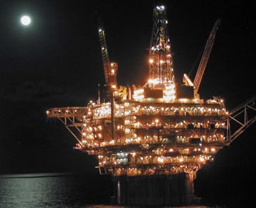
PART 2 Basic Combustion Theory

Slide 5
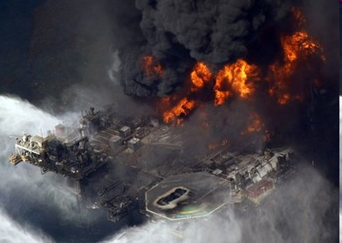
What is an explosion?
An explosion is any uncontrolled combustion wave . (For our purposes)

Slide 6
Explosion Properties
In order to create an explosion there has to be fuel (for example an explosive gas such as hydrogen or methane), an oxidizer (such as the oxygen in air) and a source of ignition energy (for example, a hot surface or an electrical spark).
These three items are commonly referred to as ‘the fire triangle’

Slide 7
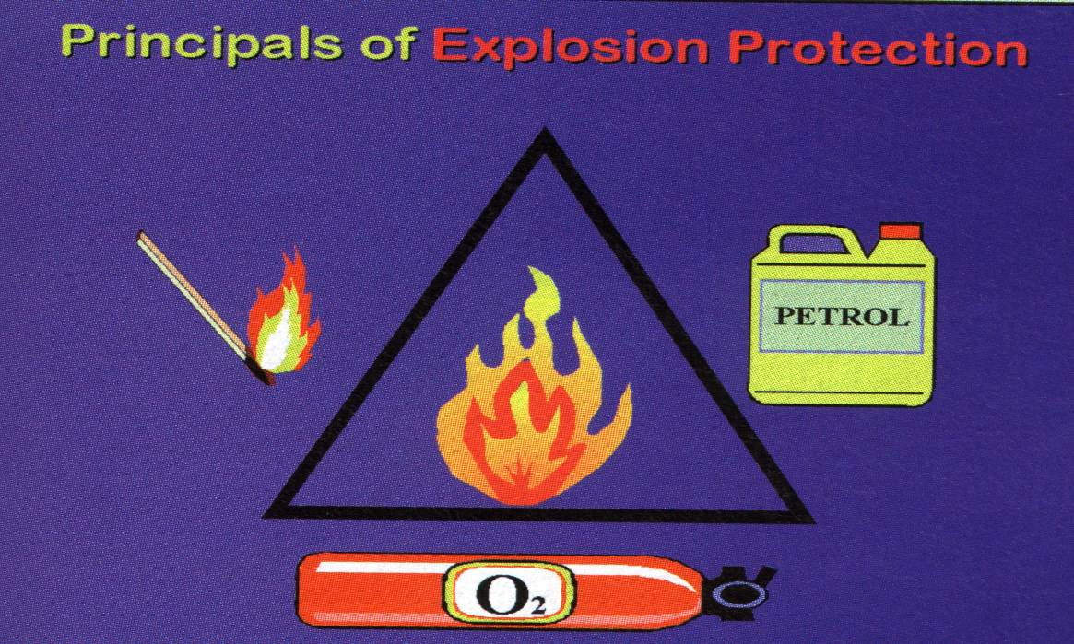
Explosion Properties
Where fuel and oxygen (normally the oxygen in air) are present in the workplace, potential ignition sources must be rendered safe to an acceptable level for the risk.

Slide 8
PART 3 Area Classification
Hazardous Area Classifications
IEC
Zone System
Mining applications
Group I
Gases Mists & Vapors
Group II, Zone 0,1 or 2
Combustible Dusts
Group III, Zone 20, 21 or 22
North America
Class & Division System
Gases Mists & Vapors
Class I Div 1 or 2
Combustible Dusts
Class II Div 1 or 2
Fiber & Flyings
Class III Div 1 & 2
Zone System
Gases, Mists & Vapors Only
Zone 0, 1 or 2
Note: Majority of Areas Classified in NA are Class and Division

Slide 9
Classification System for North America
The North American class designations are:
Class I - Flammable gases, vapors or mists
Class II – Combustible dusts
Class III - Easily ignitable fibers or flyings
In North America, the most widely used system is the “Division” system.
Division I - There is a high probability of an explosive atmosphere in normal operation. This can be for part of the time, up to all the time.
Division 2 - There is a low probability of an explosive atmosphere being present during normal operation.
Group designations further define the types of gases (A, B, C, D), and dusts (E, F, G)

Slide 10
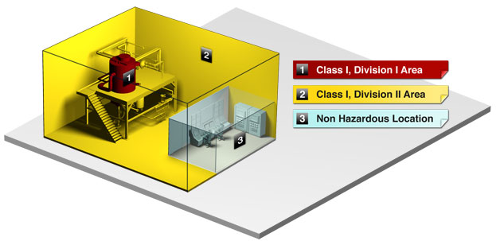
Class / Division example

Slide 11
IEC Classification System
The IEC approach uses three Zones instead of two Divisions.
The Zones are based on how often (frequency and duration) the hazard is present instead of whether the hazard is present "normally“.
The definitions of zones are as follows:
Zone 0 (Zone 20) location is "...an area in which an explosive gas (dust) atmosphere is present continuously or for long periods."
Zone 1 location is "...an area in which an explosive gas atmosphere is likely to occur in normal operation."
Zone 2 location is "...an area in which an explosive gas atmosphere is not likely to occur in normal operation, and if it does occur, is likely to do so only infrequently and will exist for a short period only."

Slide 12
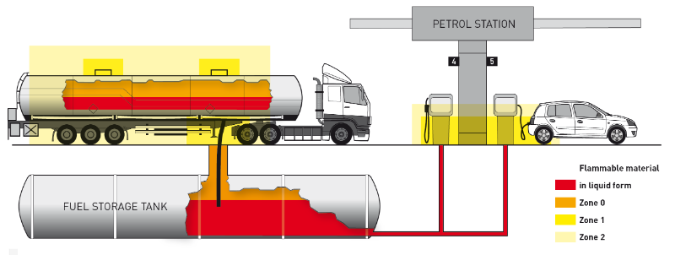
Zones example

Slide 13
Larson Davis Product Area Classifications / Markings
Spartan 730IS Dosimeter:
Class I, Zone 0, AEx ia IIC T165°C Ga
II 1 G Ex ia IIC T165°C Ga
I 1 M Ex ia I Ma
Class I, Division 1, Groups A, B, C & D, T165°C
Spark Noise Dosimeters:
Zone 1, II 2G Ex ib IIB T4…T3 Gb
Class I,II,III Division 1 Groups C,D,E,F,G T4
MSHA (Has its own approval)

Slide 14
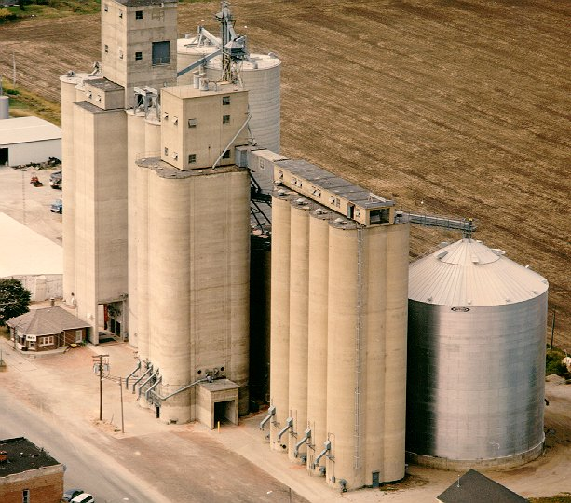
PART 4 Ignition Hazards

Slide 15
Ignition Hazards
If after conducting a risk analysis and area classification a potentially explosive atmosphere is found to exist, efforts shall be made to remove all sources of ignition from the hazardous area.
If this is not possible, protective measures shall be implemented.

Slide 16
Hot Surfaces
If an explosive atmosphere comes into contact with a heated surface, ignition can occur.
The capability of a heated surface to cause ignition depends on the type and concentration of the particular substance in the mixture with air.
This capability becomes greater with increasing temperature and increasing surface area
Ignition also depends on the size and shape of the heated body.

Slide 17
Flames
Flames, even very small ones, are among the most effective sources of ignition.
No open flames are permitted in Zone 0 and gases from flames and other heated gases are not permissible unless special preventive measures are taken
In other Zones devices with flames are only permissible if the flames are safely enclosed and the temperatures generated are not ignition capable for the area of use.

Slide 18
Mechanically generated
sparks
As a result of friction, impact or abrasion processes (such as grinding), particles can become separated from solid materials and become hot due to the energy used in the separation process.
Friction, even between similar ferrous metals and between certain ceramics, can generate hot spots and sparks similar to grinding sparks.

Slide 19
Stray electric currents
Stray currents can flow in electrically conductive systems or parts of systems:
- as return currents in power generating systems, especially in the vicinity of electric railways and large welding systems.
- as a result of a short-circuit or of a short-circuit to earth due to faults in the electrical installations, or
- as a result of magnetic induction (e.g. near electrical installations with high currents or radio frequencies)

Slide 20
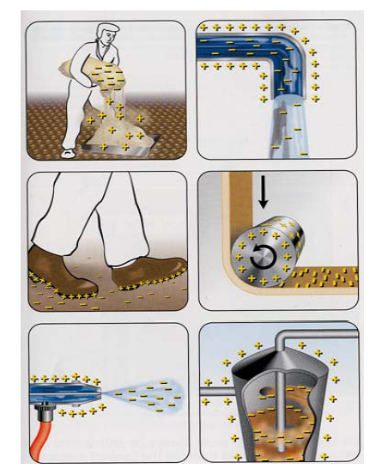
Static electricity
The discharge of charged, insulated conductive parts can easily lead to incendive sparks.

Slide 21
Lightning
If lightning strikes in an explosive atmosphere, ignition will always occur. Even in the absence of lightning strikes, thunderstorms can cause high-induced voltages in equipment, protective systems and components.
The affect of lighting strikes outside the hazardous area needs to be considered.

Slide 22
Radio frequency (RF) energy
(10⁴ to 10¹²Hz)
Electromagnetic waves are emitted by all systems that generate and use radio-frequency electrical energy (radio-frequency systems), e.g. radio transmitters.
All conductive parts located in the radiation field function as receiving aerials. If the field is powerful enough and if the receiving aerial is sufficiently large, these conductive parts can cause ignition in explosive atmospheres.

Slide 23
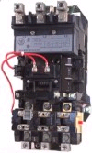
Electrical equipment
In the case of electrical equipment, electric sparks and hot surfaces can occur as sources of ignition.
Electric sparks can be generated:
- when electric circuits are opened and closed;
- by loose connections;
- by stray currents.

Slide 24
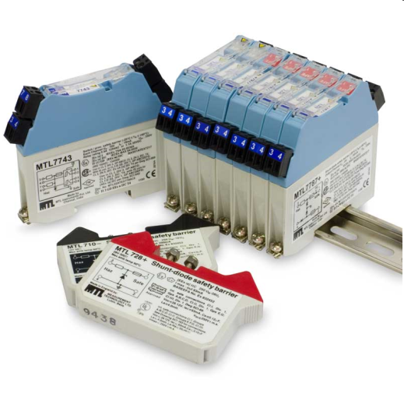
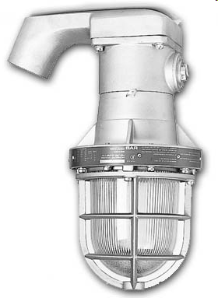
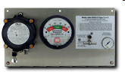
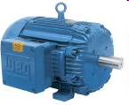
PART 5 Intrinsic Safety Protection Technique

Slide 25
INTRINSIC SAFETY
IEC Type of Protection ‘i’
IEC 60079-11
UL 60079-11 or UL 913
CSA 60079-11 or CSA C22.2 No. 157
(Other Protection schemes can be used, but Larson Davis Products only use I.S.)

Slide 26
INTRINSIC SAFETY
The basic principles of Intrinsic Safety include limiting stored energy in such components as capacitors and inductors, and limiting surface temperatures on components through power limitation.
Permitted in Zone 0, 1 and 2 locations depending on level of protection (i.e., ia, ib and ic respectively).
Only level of protection ia is permitted in Division 1 locations in North America.

Slide 27
INTRINSIC SAFETY
In electrical circuits the mechanism for the release of this ignition energy is one or more of the following:
Open circuit or short circuit components or interconnections in a resistive circuit
Short circuit of components or interconnections in a capacitive circuit
Open circuit components or interconnections in an inductive circuit
Ignition by hot surfaces.

Slide 28
INTRINSIC SAFETY
Evaluation of Intrinsically Safe circuits requires circuit analysis taking into account a variety of fault conditions, including:
Up to two ‘countable’ faults, and
Any combination of ‘non-countable’ faults resulting in the worst-case condition.
Faults considered during evaluation may not seem logical during circuit design.
Additional Safety Factors may be applied as specified by the standards.

Slide 29
Intrinsic Safety
Stored energy values are compared to ignition curves or tested for compliance. Values below and to the left of the curves will not cause ignition.

Slide 30
More Resources
D0001.0014 Quality Addendum for Intrinsic Safety Product
D0001.0014-1 Intrinsic Safety Listing and Approvals
More in depth Hazardous Location training available on the network
R:\Provo\Shared\ATEX - Explosive Atmospheres\ATEX Training\
PC Basic Hazloc Testing and Evaluation - Self Study Training
Intertek Guide to Hazardous Location Equipment Marking
Hazardous Location Explosion Videos on network:
R:\Provo\Shared\ATEX - Explosive Atmospheres\ATEX Training\Hazardous Location Explosion Videos
Ask ISP Manager if you have any questions

