Slide 1
Safe Tire Testing Operator Training
Operating a Tire Testing System safely during checkout requires a few preventative measures.
Safeguarding around system
Access control
Tests performed within capacity of tire
Manual operation within capacity of tire

Slide 2
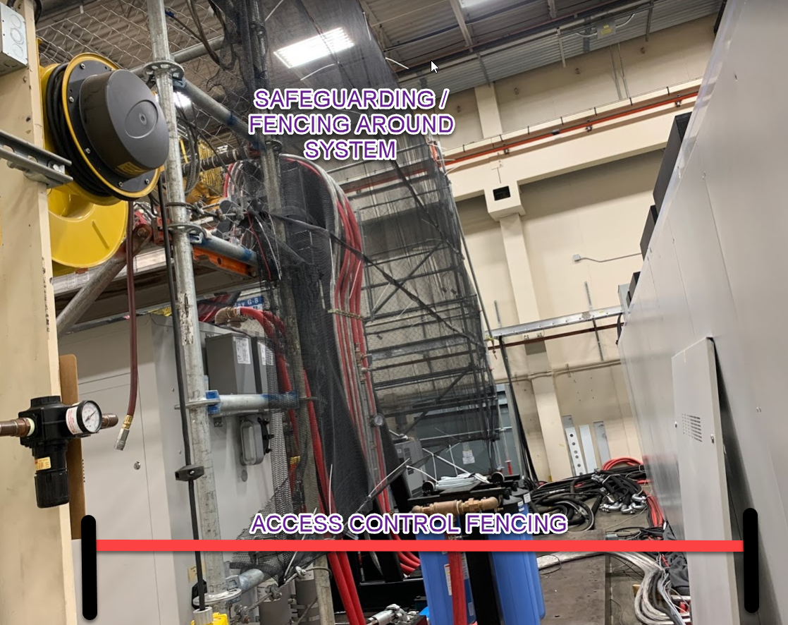
1. Safeguarding around system
Communicate with engineering and facilities safety representative to review plan for safeguarding around system.
Operator requires protection from potentially ejected tire/belt/parts
Surrounding workers require protection from potentially ejected tire/belts/materials.

Slide 3
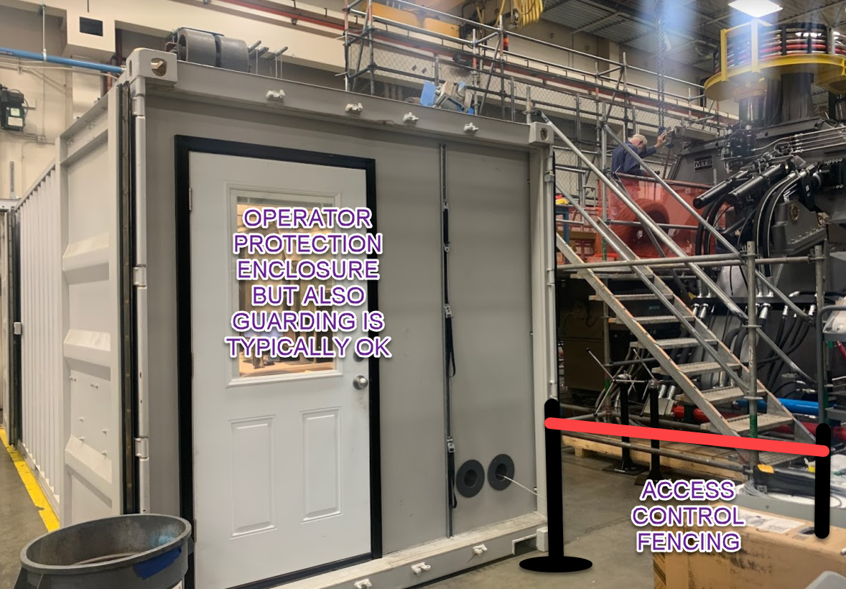
2. Access control
Communicate with engineering and facilities safety representative to review plan for access control around system.
If there are openings for people to walk near operating system, a barrier is required to prevent inerrant movement.
Severe testing may require aisle to be blocked for a short time. Remove barriers immediately after testing is finished.

Slide 4
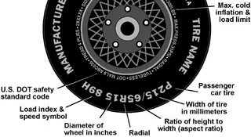
3. Tests designed within capacity of tire
Enter proper information into Tire Description database in Test Definition
Check that specimen limits are enabled and persistence matches checkout plan.
Load Tire before operating AutoTest.
Ensure Tire Description in software matches Tire Description mounted on system.
Run AutoTest, maintain awareness that system initially responds appropriately
Inflates tire before landing
Tire operates at proper speed
Tire isn’t overloaded or underinflated (severely squashed)

Slide 5
4. Manual operation within capacity of tire
Enter proper information into Tire Description database in Test Definition
Load Tire before operating in manual mode.
Check that specimen limits are enabled and persistence matches checkout plan.
Inflate tire before landing
After landing confirm:
Tire operates at proper speed
Tire isn’t overloaded or underinflated (severely squashed)

Slide 6
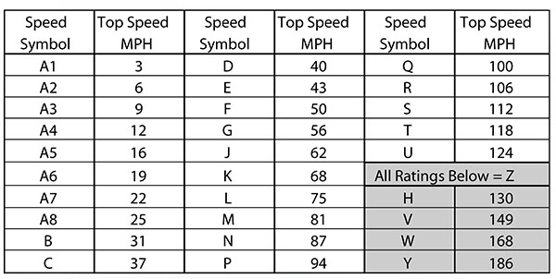
3 & 4 Information: Understanding Tire Ratings
Extremely Important:
speed rating letter code (wrong rating can lead to immediate and sudden tire failure)
rim diameter (wrong size can lead to belt and rim damage)
Important:
Maximum load (may be set by tire supplier higher than sidewall information)
Overload failures typically take a long time and sidewall will fail with burst but not generally many ejected parts.
Pressure limits (may be set by tire supplier higher/lower than sidewall information)
Overpressure failures can lead to tire burst and ejected parts but generally MTS house pressure isn’t high enough to fail a tire
Underpressure failure will be similar to a tire overloaded failure.

Slide 7
3 & 4 Entering Tire Information
For Test Definition -> Tire Description Library:
Enter the maximum load from the tire supplier or tire sidewall converted into N. Tire sidewall in lbf or kg.
Kg *9.81 = N lbf * 4.45 = N
Enter Maximum speed or verify proper rating after entering tire size. Letter code on the right will match tire sidewall.
Enter rim diameter, typically right after the R on tire size.
Enter minimum and maximum inflation from the tire supplier (7 kPa = 1 psi) or use general settings:
Maximum can be 25% above sidewall
Minimum can be 50% below sidewall

Slide 8
3 & 4 Checking Tire Information Before Operation
From TestSuite Tire:
First check (or load) the Tire, Then Apply to load these values into the system
Then double check
Rim Diameter
Max Speed
Max Load
Max Inflation
All match the tire sidewall (or tire supplier) information.

