Slide 1
Core Competency Training – Document Control
Revised 3/24/2021
CC-Doc Cntrl
Rev. 3-24-2021

Slide 2
Applicable Procedures
The following procedures provide guidance on records and document control:
QAM7.5
QA1044
QA1038
TA1039

Slide 3
Personal Stamp
It is preferred that Technicians use their personal stamp to sign off Router steps and other documents since this provides the best means of traceability.
Make sure that your stamp always leaves a completely legible image when used. Notify your Supervisor if the stamp imprint begins to fade or become illegible.
Also remember that you are the only one who may ever use your stamp and that you must maintain control of it at all times. Stamps must not be left unattended and must be secured at the end of the shift”. If you must leave your workstation for any reason, never leave your stamp on your bench. Place it in your bench drawer or take it with you. At the end of the day, make sure that you return the stamp to your drawer, or better yet, lock it in your locker.

Slide 4
Router Sign Offs
If the employee’s stamp is not available, the following employee identification is also acceptable:
Print employee’s full name
Print employee’s initials and clock number

Slide 5
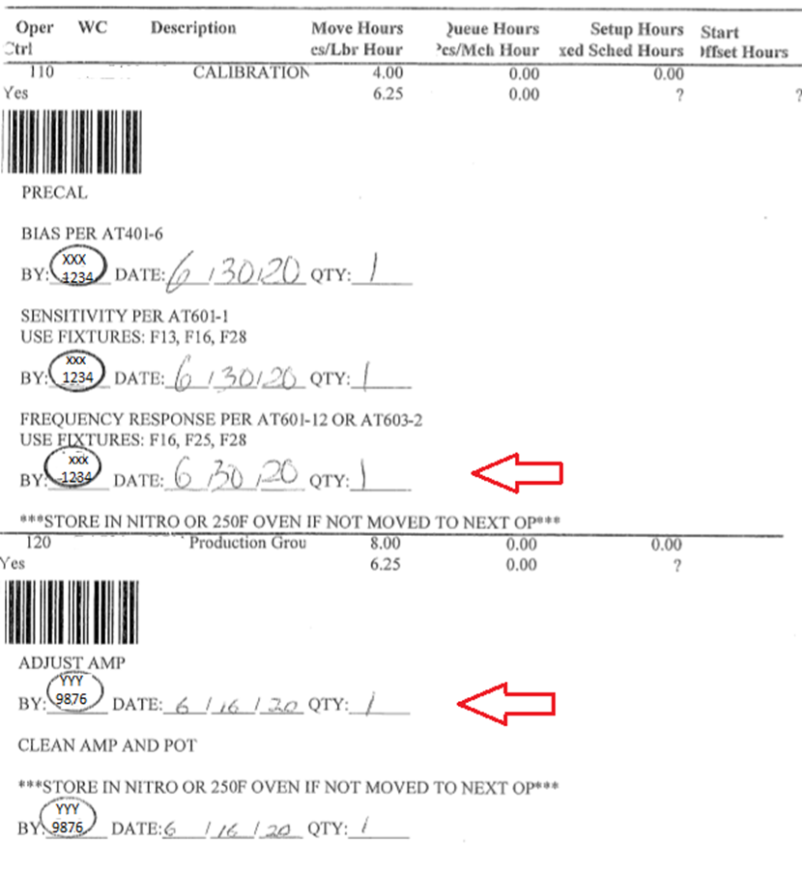
Router Sign Offs
Job operations must be signed off only after the operation is totally finished. An operation is not completed until all of the parts are ready to go to the next production step.
Make sure that operations are completed in sequential order. Dates cannot be out of order. See example below of an unacceptable Router sign-off:

Slide 6
Router Sign Offs
Numbers, dates and other recorded information must be legible
When making a change to a record, a single-line cross-out is required along with one of the following four methods of employee identification.
Printed name, and the date the cross-out was made,
A controlled stamp that contains both the employee’s number and initials, and the date the cross-out was made (e.g CTP),
Any controlled stamp that is traceable to the employee (e.g. assigned stamps controlled through processes QA14 and MS02), and the date the cross-out was made.
Employee number and also their initials, and the date the cross-out was made.
No erasable (i.e.: pencil) or water soluble (i.e.: non-permanent marker) medium is allowed on records. Also, no white-out, correction tape, or similar cover-up material is allowed. Ink is the only acceptable form, preferably black or blue.
When entering a date onto a record, it must include month, day and year.

Slide 7
Router Sign Offs
When a portion of a record is not required to be completed (ie. router step that is no longer applicable due to a documented deviation), it is the intent to show that the step is allowed to be skipped by recording the following:
identification of the individual (employee stamp, full name, printed initials and clock number)
date when information was recorded
an “N/A” to indicate the step is no longer applicable.
An acceptable practice is to record N/A, accompanied by a line running through the portion of the document illustrating the no-longer-required step(s), along with name and date as shown in the example below.

Slide 8
Router Sign Offs
If two Technicians are working on the same job operation, the technician who assists must place their stamp to the side of that operation. The technician finishing all pieces and moving on to the next operation shall complete the operation in accordance with QA1044 Records Control Policy User Guide in the blank provided. See example below

Slide 9
Document Control
NOTE: Assembly procedures are to be reviewed thru
Shop-Trak info tab
TCS special processes, workmanship and some build procedures.
G:\Drafting – Scanned Originals\Original_By_Dwg_Number
Electronic copies cannot not be saved on the workstation computer (PC’s) unless the copy is saved as a “Shortcut” link to the network folder where the current revision of the document is stored.
No paper copies can be saved at your work station.

