Slide 1

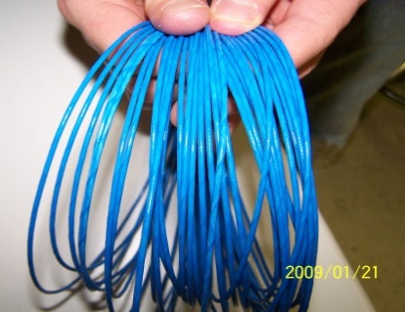
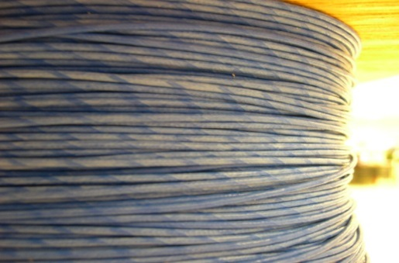
 |  | Visual Inspection Master – Cables Inspection Control Method Note: Always reference the drawing when inspecting. If there is a conflict between the Visual Inspection Master and the drawing, always follow the drawing.
Non-conformance Type | Specification Tolerance | ACCEPT | REJECT | Specification Tolerance | Measurement Method
Integral or single cables Disconnected | TARGET– |  |  | REJECT- (See pictures) | Visually Inspect Turn-On Test: Integral cables Continuity Test: Single cables, wiggle wires during test
Color of Teflon wrapped jacket (003 cables) | ACCEPT- (See pictures) |  |  | REJECT- (See pictures) | Visually Inspect Visually inspect color of jacket
QA100
QA071 Rev. C 10/16/15

Slide 2
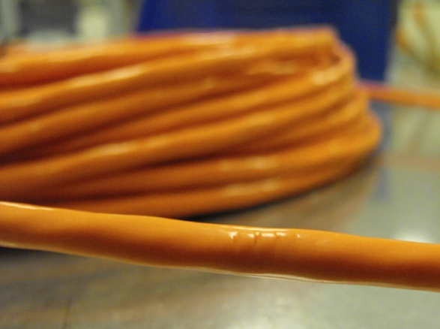
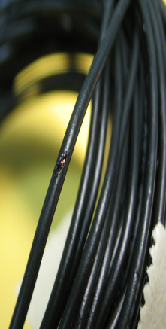
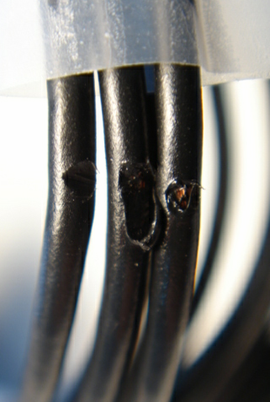
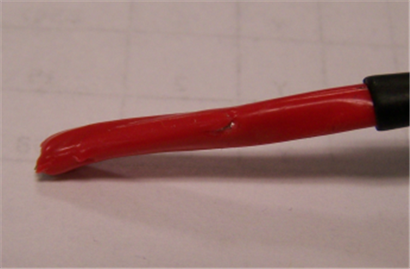
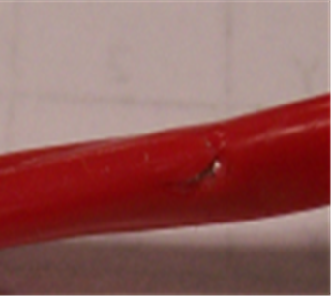
 |  | Visual Inspection Master – Cables Inspection Control Method Note: Always reference the drawing when inspecting. If there is a conflict between the Visual Inspection Master and the drawing, always follow the drawing.
Non-conformance Type | Specification Tolerance | ACCEPT | REJECT | Specification Tolerance | Measurement Method
Damaged Jacket Integral or single cables | TARGET– |  |  | REJECT- (See pictures) | Visually Inspect entire length of cable for damaged wire
Damaged Jacket 625b21/ -001 | ACCEPT- |  |  | REJECT- (See pictures) | Visually Inspect entire length of cable for damaged wire
QA100
QA071 Rev. C 10/16/15

Slide 3
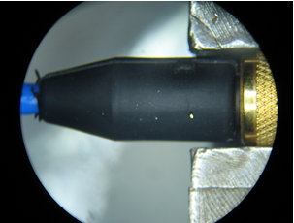
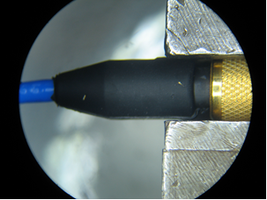
 |  | Visual Inspection Master – Cables Inspection Control Method Note: Always reference the drawing when inspecting. If there is a conflict between the Visual Inspection Master and the drawing, always follow the drawing.
Non-conformance Type | Specification Tolerance | ACCEPT | REJECT | Specification Tolerance | Measurement Method
FOD 034 / 010 cable with AY connector | TARGET– |  |  | REJECT- If gold colored debris is present. | Visually Inspect boots
QA100
Debris on connector boots
QA071 Rev. C 10/16/15

Slide 4
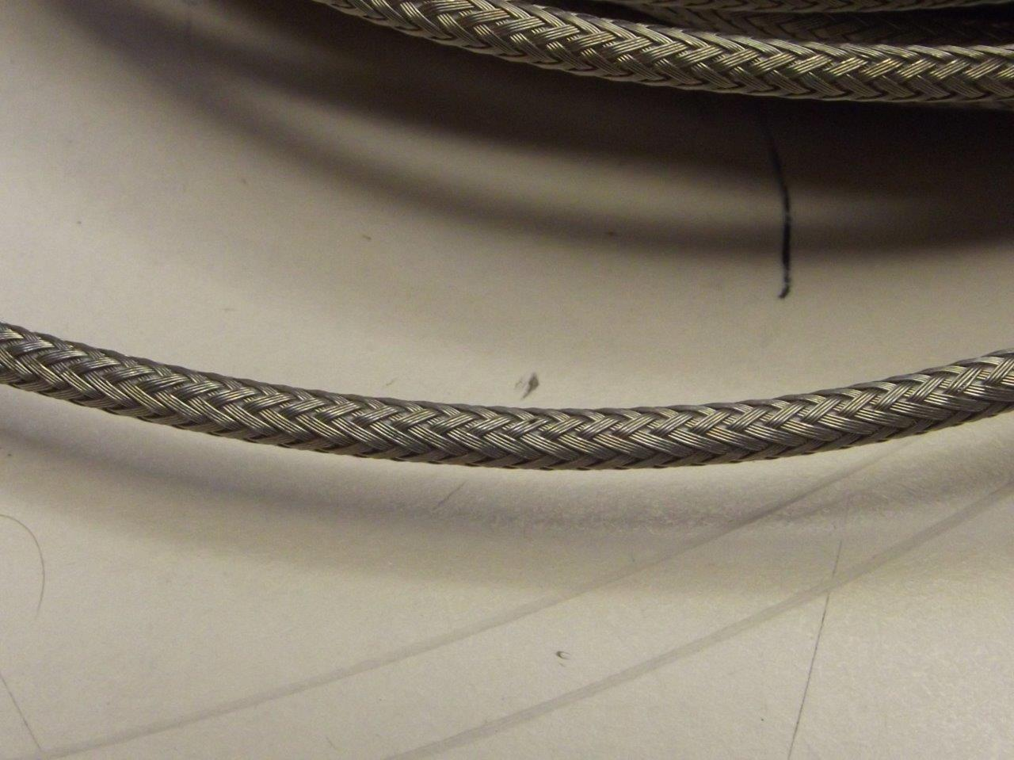
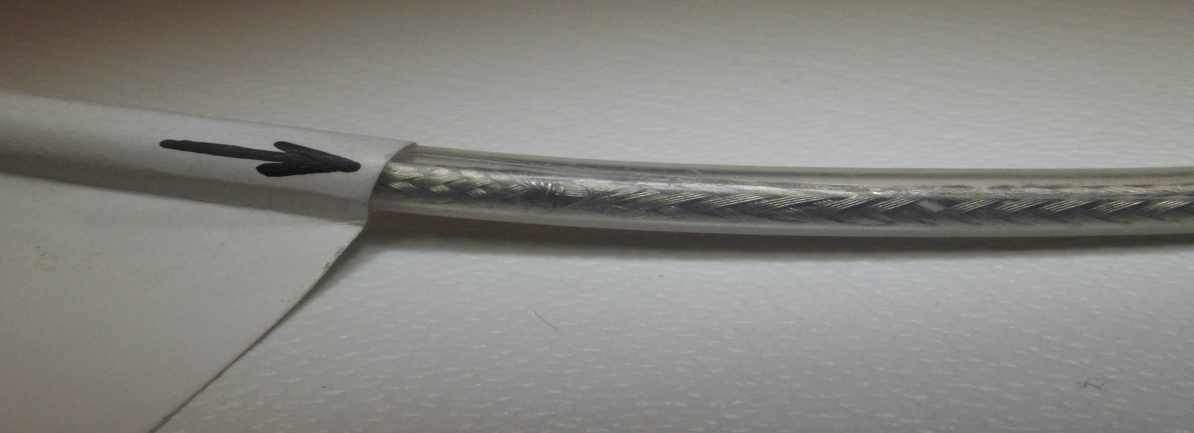
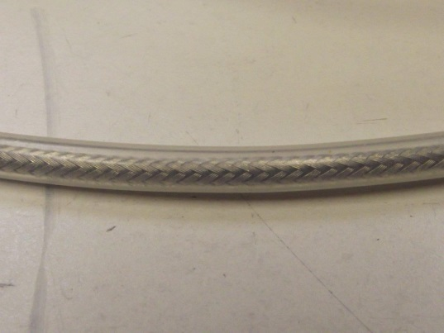
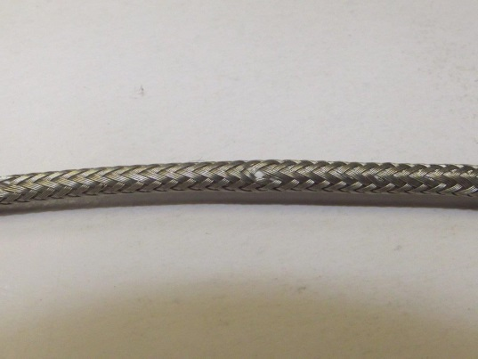
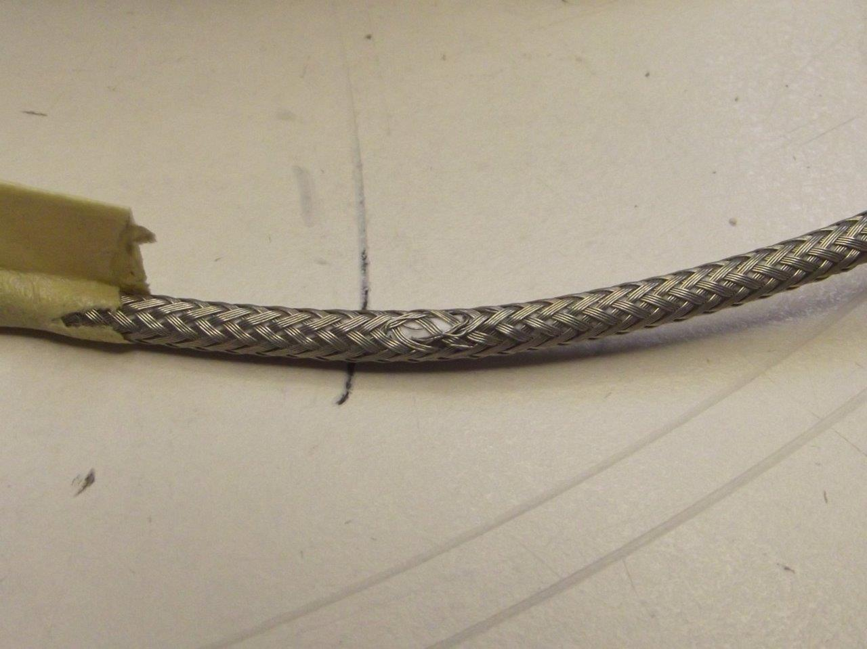
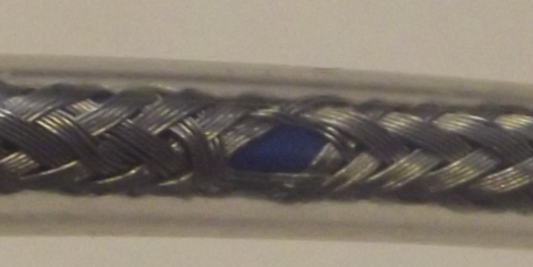
 |  | Visual Inspection Master – Cables Inspection Control Method Note: Always reference the drawing when inspecting. If there is a conflict between the Visual Inspection Master and the drawing, always follow the drawing. |  | QA100
Non-conformance Type | Specification Tolerance | ACCEPT | REJECT | Specification Tolerance | Measurement Method
Braid Separating | TARGET– The surface of the plated shield wire (braiding) is evenly spaced with no jacket showing underneath. |  |  | REJECT- If the braiding is cut / frayed or there is damage to heat shrink or if the jacket is cut. | Visually Inspect
Cont. Braid Separating | ACCEPT- The surface of the braiding is NOT cut / with minimum fraying BUT no damaged to heat shrink and the jacket is not cut. |  |  | REJECT- If the braiding is cut / frayed or there is damage to heat shrink or if the jacket is cut. | Visually Inspect
braiding
Heat shrink
braiding is nicked, cut
QA071 Rev. C 10/16/15

