Slide 1
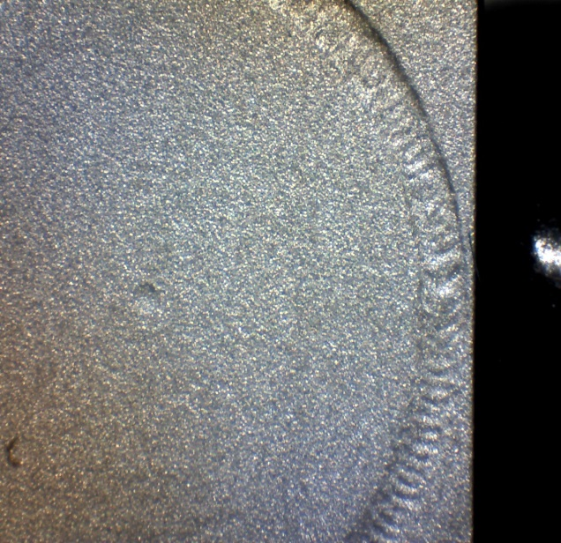
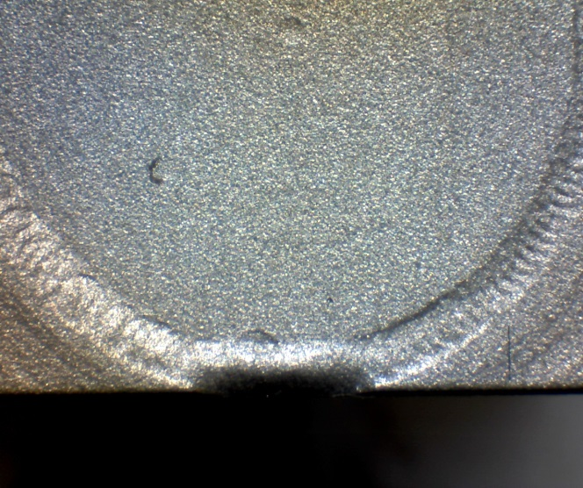
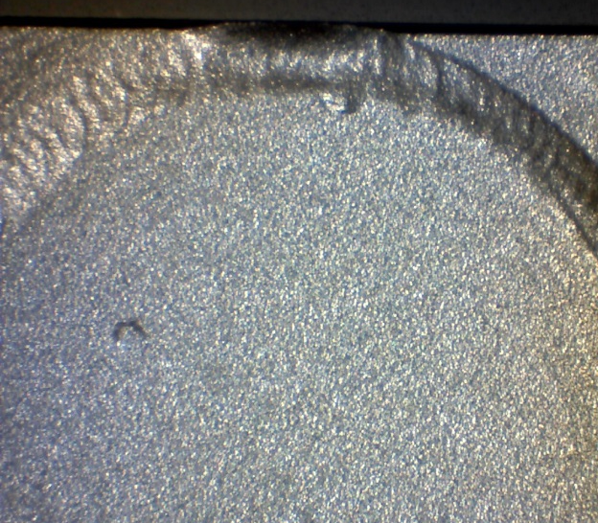
 |  | Visual Inspection Master – Laser Welding Inspection Control Method Note: Always reference the drawing when inspecting. If there is a conflict between the Visual Inspection Master and the drawing, always follow the drawing. 2. Any changes must have the NY Laser Engineer approval.
Non-conformance Type | Specification Tolerance | ACCEPT | REJECT | Specification Tolerance | Measurement Method
Rolled Weld Edge (round lid-welded) | TARGET– Weld joint should not be rolled. ACCEPTABLE- Unless noted in the router, a slightly rolled weld joint is acceptable as long as the shape of the part has not been significantly distorted. |  |  | REJECT- If the weld Joint rolled and the shape of the part has been distorted. If there is any question about whether the part is acceptable, review the part with the supervisor of final inspection. | Visually- under a minimum of a 7X microscope
QA 102 REV:

Slide 2
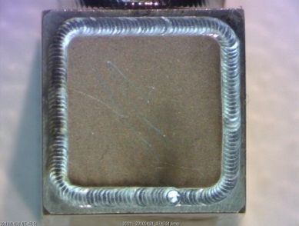
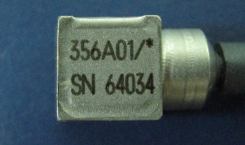
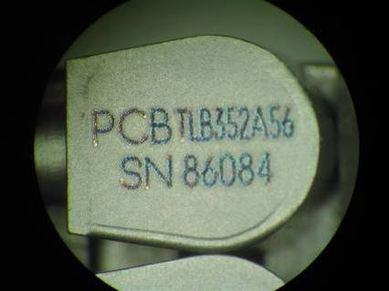
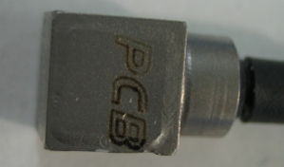
 |  | Visual Inspection Master – Laser Welding Inspection Control Method Note: Always reference the router when inspecting. If there is a conflict between the Visual Inspection Master and the drawing or router, always follow the drawing and router. Any changes must have the NY Laser Engineer approval.
Non-conformance type | Specification Tolerance | ACCEPT | REJECT | Specification Tolerance | Measurement Method
Rolled Weld Edge (square lid-welded) | TARGET– Weld joint should not be rolled. ACCEPTABLE- Unless noted in the router, a slightly rolled weld joint is acceptable as long as the shape of the part has not been significantly distorted. |  |  | REJECT- If the weld Joint rolled and the shape of the part has been distorted. If there is any question about whether the part is acceptable, review the part with the supervisor of final inspection. | Visually- under a minimum of a 7X microscope
QA 102 REV:
Extremely
Rolled edge
Slightly Rolled edge
Rolled edge

Slide 3
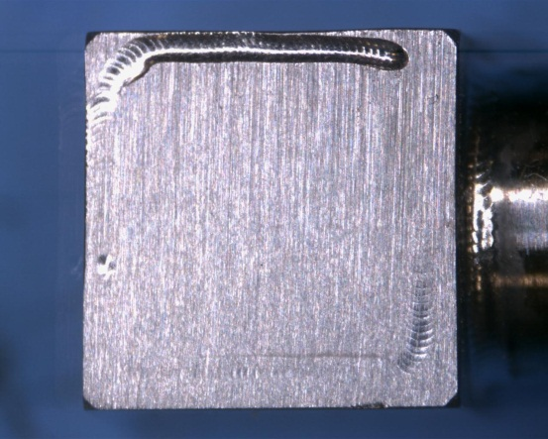
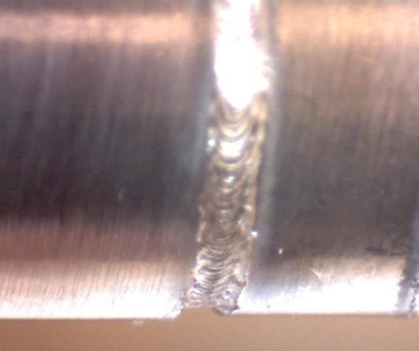
 |  | Visual Inspection Master – Laser Welding Inspection Control Method Note: Always reference the drawing when inspecting. If there is a conflict between the Visual Inspection Master and the drawing, always follow the drawing. Any changes must have the NY Laser Engineer approval.
Non-conformance type | Specification Tolerance | ACCEPT | REJECT | Specification Tolerance | Measurement Method
Excessive negative reinforcement | TARGET- If butt joints, the weld should be approximately level with the two mating surfaces. ACCEPTABLE- If weld has a slight concave. Convex welds (welds with slight humps) are acceptable |  |  | REJECT- If weld Joint is significantly concave | Visually- under a minimum of a 7X microscope
QA 102 REV:

Slide 4
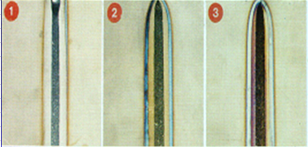
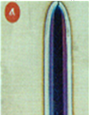
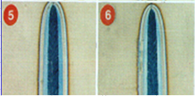
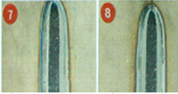
 |  | Visual Inspection Master – Laser Welding Inspection Control Method Note: Always reference the drawing when inspecting. If there is a conflict between the Visual Inspection Master and the drawing, always follow the drawing. Any changes must have the NY Laser Engineer approval
Non conformance type | Specification Tolerance | ACCEPT | REJECT | Specification Tolerance | Measurement Method
Weld Discoloration | TARGET- The weld joint should be free of discoloration. ACCEPTABLE- For materials other than titanium, a slight discoloration of the weld is acceptable. |  |  | REJECT- If the part has dark discoloring along any weld area. | Visually- under a minimum of a 7X microscope
Titanium Weld discoloration | TARGET- The weld joint should be free of discoloration. ACCEPTABLE- If Welded titanium is silver, straw, gold, or brown colored. |  |  | REJECT- If Welded titanium is NOT silver, straw, gold, or brown colored, the material is to be considered scrap and may not be reworked or rewelded. | Visually –under a minimum of a 7X microscope
QA 102 REV:

Slide 5
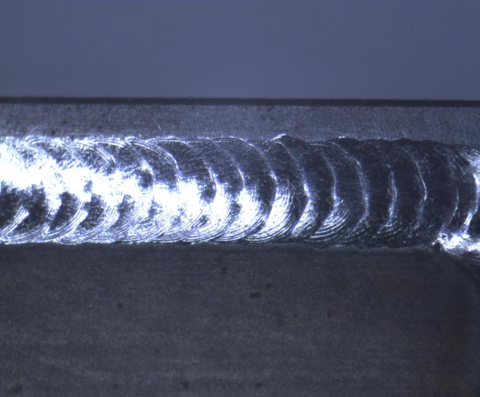
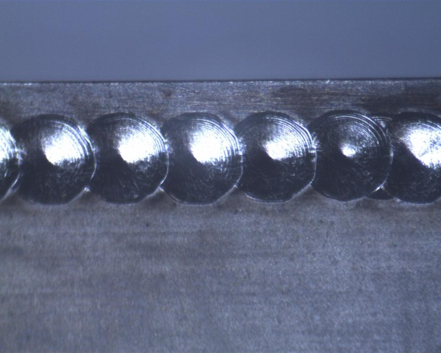
 |  | Visual Inspection Master – Laser Welding Inspection Control Method Note: Always reference the drawing when inspecting. If there is a conflict between the Visual Inspection Master and the drawing, always follow the drawing. Any changes must have the NY Laser Engineer approval
Non-conformance type | Specification Tolerance | ACCEPT | REJECT | Specification Tolerance | Measurement Method
Incomplete weld | ACCEPT- The weld joint should be completely closed |  |  | REJECT- If weld joint is not completely closed. | Visually- under a minimum of a 7X microscope
Insufficient overlap | TARGET- Pulse overlap should be 70 - 85% ACCEPT- If the Pulse overlap is a minimum of 65% |  |  | REJECT- If Pulse overlap less than 65 % | Visually- under a minimum of a 7X microscope
QA 102 REV:

Slide 6
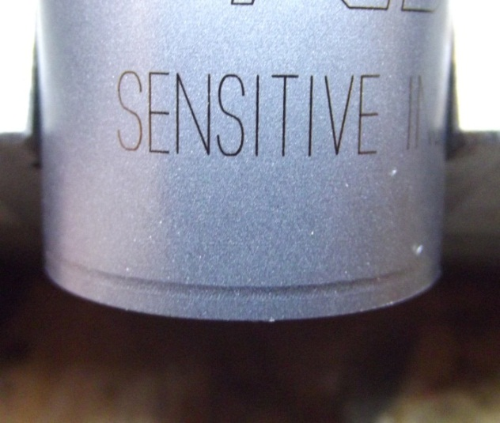
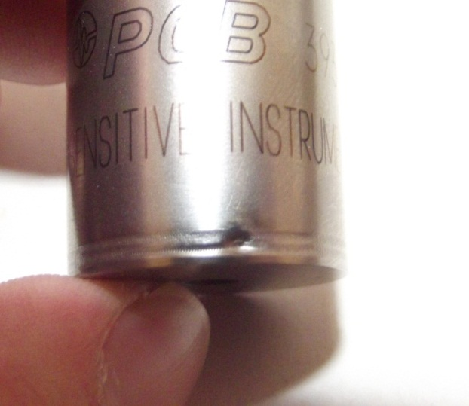
 |  | Visual Inspection Master – Laser Welding Inspection Control Method Note: Always reference the drawing when inspecting. If there is a conflict between the Visual Inspection Master and the drawing, always follow the drawing. Any changes must have the NY Laser Engineer approval
Non-Conformance Type | Specification Tolerance | ACCEPT | REJECT | Specification Tolerance | Measurement Method
Cracked Weld | ACCEPT- If no cracks are visible during inspection |  |  | REJECT- If any cracks are apparent. If there is a question using 7X zoom in the microscope investigate further. | Visually- under a minimum of a 7X microscope
Indent/ Divot in the weld | TARGET- Welds should not be indented. ACCEPT- If these indents are only visible under the microscope |  |  | REJECT- If indented welds are visible by unaided eye. | Visually –under a bright light and unaided eye approx. 9-18” from the eye.
QA 102 REV:

Slide 7
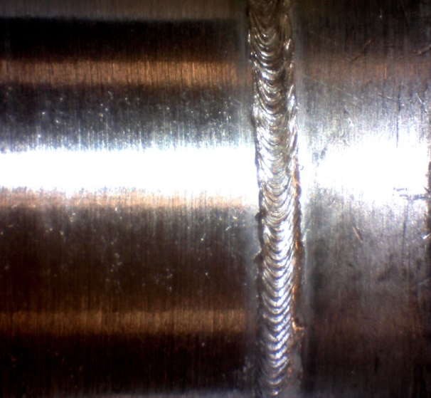
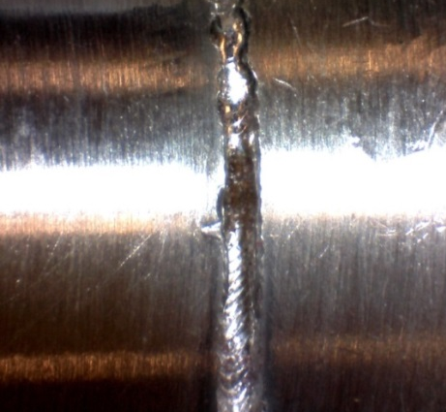
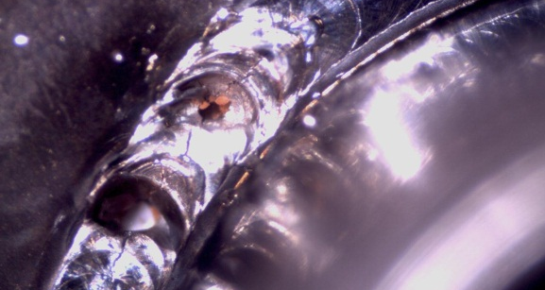
 |  | Visual Inspection Master – Laser Welding Inspection Control Method Note: Always reference the drawing when inspecting. If there is a conflict between the Visual Inspection Master and the drawing, always follow the drawing. Any changes must have the NY Laser Engineer approval
Non-conformance Type | Specification Tolerance | ACCEPT | REJECT | Specification Tolerance | Measurement Method
Holes in Weld | ACCEPT- If holes are not present in the weld. |  |  | REJECT- If holes are visible during inspection. | Visually- under a minimum of a 7X microscope
QA 102 REV:

Slide 8
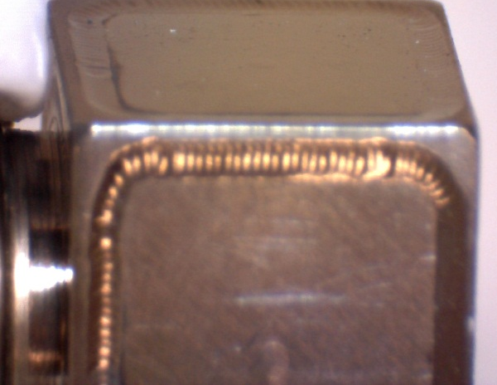
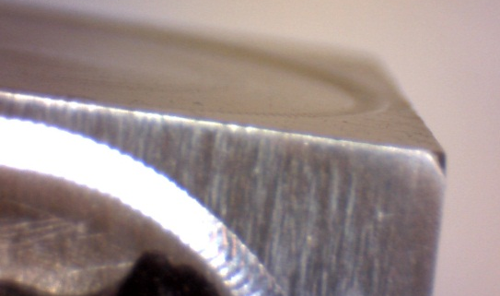
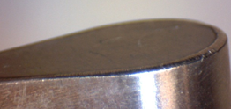
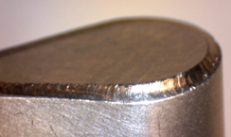
 |  | Visual Inspection Master – Laser Welding Inspection Control Method Note: Always reference the drawing when inspecting. If there is a conflict between the Visual Inspection Master and the drawing, always follow the drawing. Any changes must have the NY Laser Engineer approval
Non-conformance Type | Specification Tolerance | ACCEPT | REJECT | Specification Tolerance | Measurement Method
Raised Covers | ACCEPT- If lid is flush or slightly below housing. |  |  | REJECT- If lid is raised or slightly above housing. Show reject to Supervisor for final disposition. | Visually- under a minimum of a 7X microscope
QA 102 REV:

Slide 9
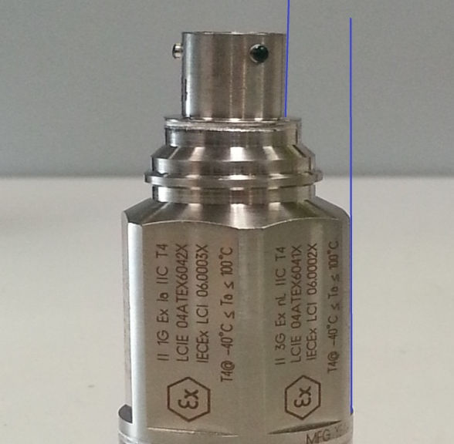
 |  | Visual Inspection Master – Laser Welding Inspection Control Method Note: Always reference the drawing when inspecting. If there is a conflict between the Visual Inspection Master and the drawing, always follow the drawing. NOTICE: All changes must have prior approval of the NY Laser Engineer.
Non-conformance Type | Specification Tolerance | ACCEPT | REJECT | Specification Tolerance | Measurement Method
Weld Spatter (only applies to IMI sensors with top mount connectors) | TARGET– No weld spatter should be noticeable. ACCEPTABLE- If there is minimal weld spatter noticeable. |  |  | REJECT- If excessive weld spatter is visible. | Visually- under a minimum of a 7X microscope
Crooked parts after welding | ACCEPT- If parts are in the correct orientation to each other (either parallel or perpendicular |  |  | REJECT- If parts is not visually in line or perpendicular to the mating component. | Visual- Inspection with an unaided eye approximately 9-18" from the eye.
QA 102 REV:

