Slide 1
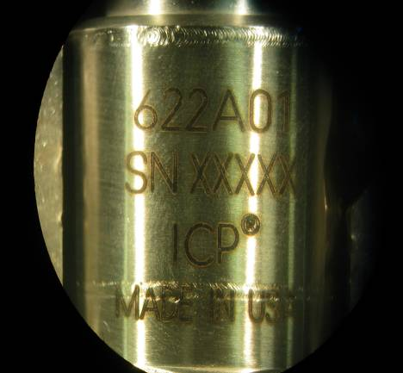
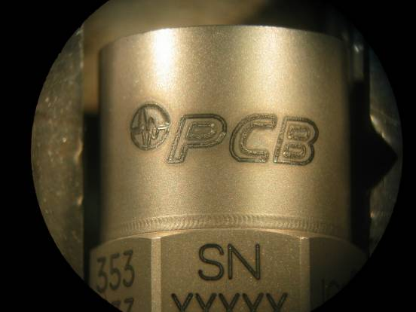
 |  |  |  | QA107 Rev. B 02/13/15
Non-conformance type | Specification Tolerance | ACCEPT | REJECT | Specification Tolerance | Measurement Method
Contrast Etching -Too Dark | TARGET– Etching should be legible to the un-aided eye. |  |  | REJECT- If the etching engraved (too deep) or excessively dark. | Visually- Done by unaided eye.

Slide 2
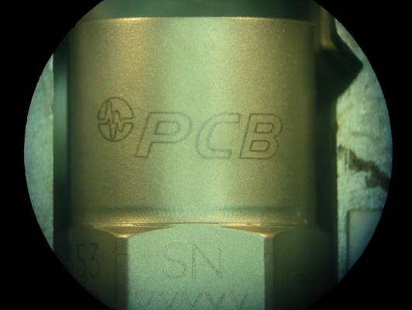
 |  |  |  | QA107 Rev. B 02/13/15
Non-conformance type | Specification Tolerance | ACCEPT | REJECT | Specification Tolerance | Measurement Method
Contrast Etching- Too Light | TARGET– Etching should be legible to the un-aided eye. ACCEPTABLE- If etching is light, but clearly readable to the naked eye. |  |  | REJECT- If the etching is too light and difficult to read. | Visually- Done by unaided eye.

Slide 3
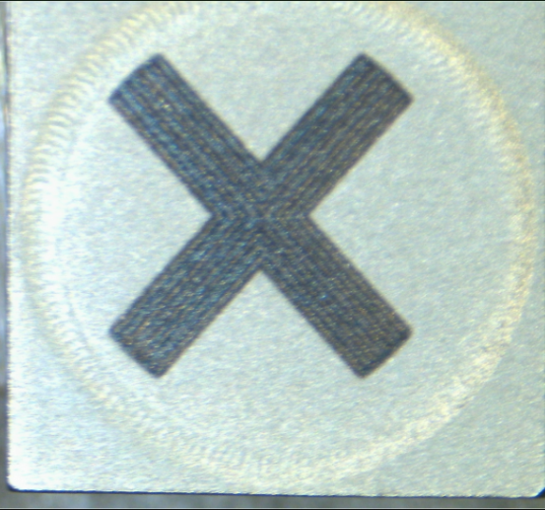
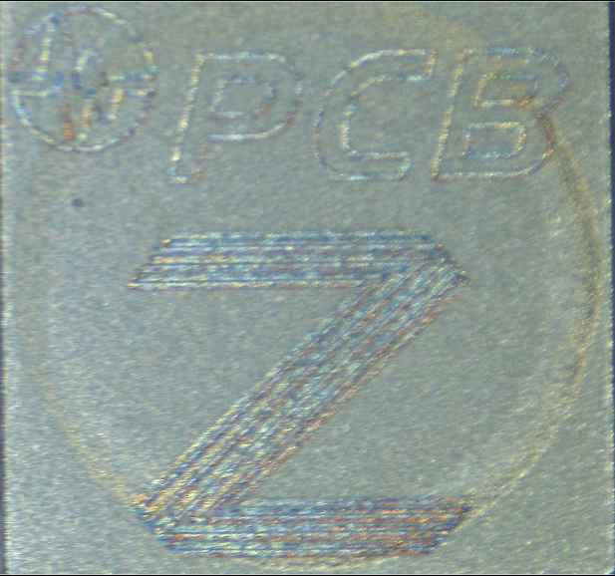
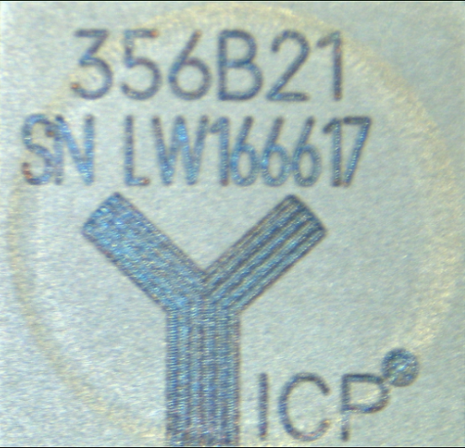
Non-conformance type | Specification Tolerance | ACCEPT | REJECT | Specification Tolerance | Measurement Method
Consistent Different Intensities (depth of etch | TARGET– Etching should be legible to the un-aided eye. ACCEPTABLE- If the etching is light, but is still readable |  |  | REJECT- If the etching is faded in appearance and inconsistent compared to the rest of the etching on the sensor. | Visually- Done by unaided eye.

Slide 4
 |  |  |  | QA107 Rev. B 02/13/15
Non-conformance type | Specification Tolerance | ACCEPT | REJECT | Specification Tolerance | Measurement Method
Centered Etching is off the edge | TARGET– Etching should be on available flat surface on the sensor ACCEPTABLE- If the etching is up against the edge, but not over. |  |  | REJECT- If the etching rolls over an edge. | Visually- Done by unaided eye.

Slide 5
 |  |  |  | QA107 Rev. B 02/13/15
Non-Conformance Type | Specification Tolerance | ACCEPT | REJECT | Specification Tolerance | Measurement Method
Centered Tear Drop Sensor | TARGET– Etching should center in the lid and not on the weld. |  |  | REJECT- If the etching is past the weld joint and over the edge of the sensor. | Visually- Done by unaided eye.
Centered Tear Drop Sensor | ACCEPTABLE- If the etching is on the weld and is readable

Slide 6
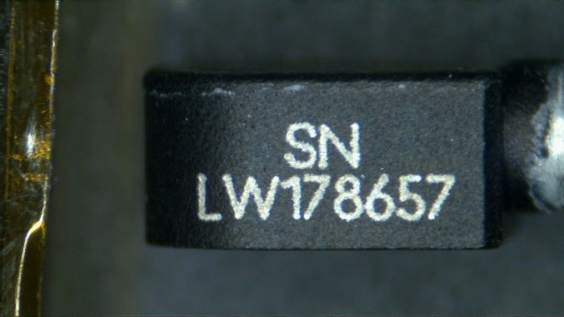
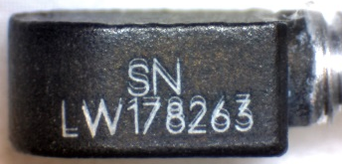
 |  |  |  | QA107 Rev. B 02/13/15
Non-conformance type | Specification Tolerance | ACCEPT | REJECT | Specification Tolerance | Measurement Method
Legible Double Etching | TARGET– Etching should be legible to the un-aided eye. |  |  | REJECT- If there is double etching. | Visually- Done by unaided eye.

Slide 7
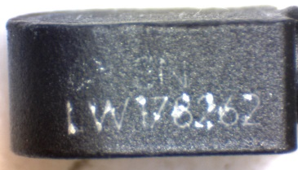
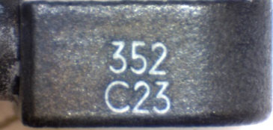
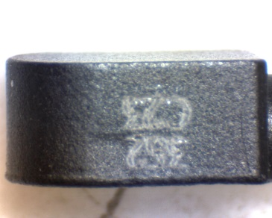
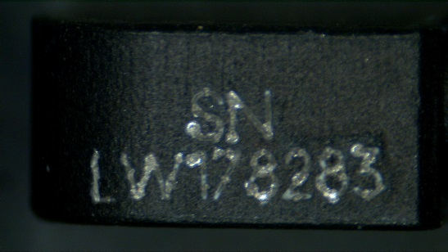
 |  |  |  | QA107 Rev. B 02/13/15
Non-Conformance Type | Specification Tolerance | ACCEPT | REJECT | Specification Tolerance | Measurement Method
Legible Anodized -Tear Drop | TARGET– Etching should be legible to the un-aided eye. |  |  | REJECT- If the etching is blurry or inconsistent | Visually- Done by unaided eye.
Legible Anodized -Tear Drop | ACCEPTABLE- If the chipped anodized coating from the etching does not deform the lettering to make it difficult to read. |  |  | REJECT- If the chipped anodized coating from the etching does deform the lettering to make it difficult to read and/or etching is blurry or inconsistent | Visually- Done by unaided eye.

