Slide 1

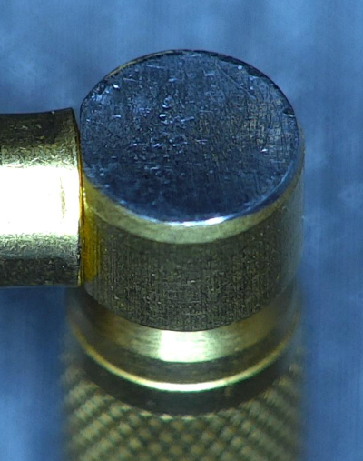
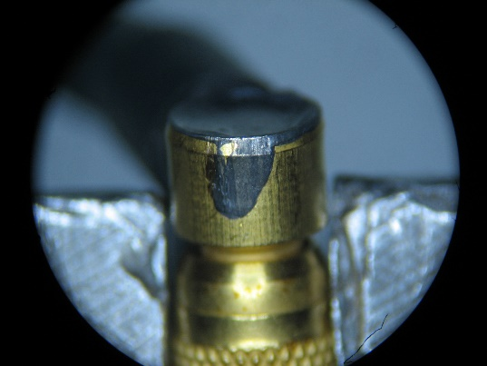
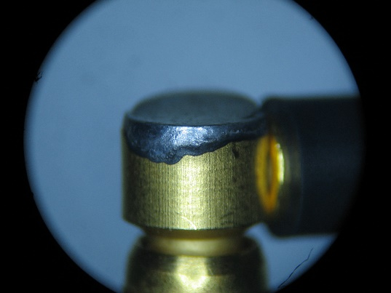
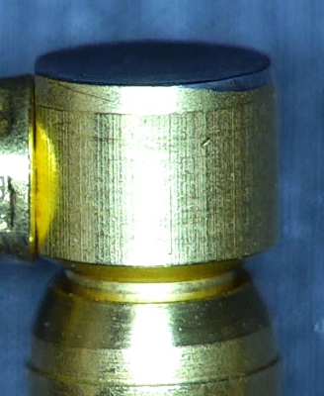
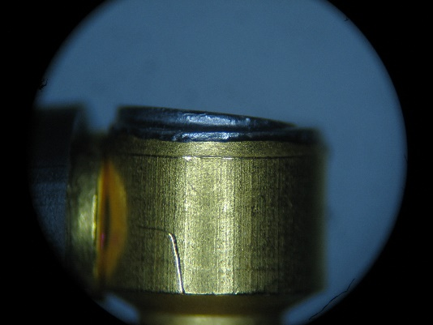
 |  | Visual Inspection Master – (Connectors) Inspection Control Method Note: Always reference the drawing when inspecting. If there is a conflict between the Visual Inspection Master and the drawing, always follow the drawing. |  | QA109
Non-conformance Type | Specification Tolerance | ACCEPT | REJECT | Specification Tolerance | Measurement Method
Excess solder on the outside of the back shell Cover not flat prior to filling the back shell 098AF010BZ | ACCEPT- If the solder is only on the top of the shell (or slightly below). |  |  | REJECT- If Excess solder on the outside of the back shell. | Visually Inspect
 |  |  |  | REJECT- If cover not flat prior to filling the back shell. | Visually Inspect
QA071 Rev. C 10/16/15

Slide 2

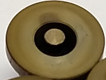
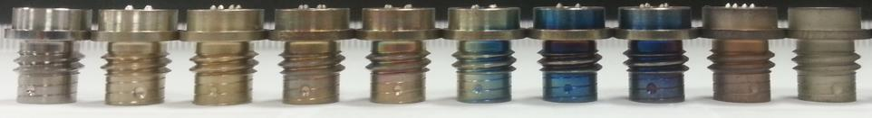
 |  | Visual Inspection Master – (Connectors) Inspection Control Method Note: Always reference the drawing when inspecting. If there is a conflict between the Visual Inspection Master and the drawing, always follow the drawing. |  | QA109
Non-conformance Type | Specification Tolerance | ACCEPT | REJECT | Specification Tolerance | Measurement Method
Color Variation | ACCEPT- |  |  | REJECT- If the pin is discolored. | Visually Inspect
Pin Coloration Titanium Connectors | ACCEPT- If connectors fall within the color range shown in the picture to the right. |  |  | REJECT- If connectors fall outside of the color range shown in the picture to the left. | Visually Inspect
QA071 Rev. C 10/16/15

Slide 3


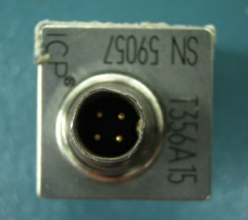
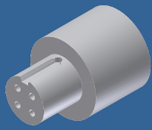
 |  | Visual Inspection Master – (Connectors) Inspection Control Method Note: Always reference the drawing when inspecting. If there is a conflict between the Visual Inspection Master and the drawing, always follow the drawing. |  | QA109
Non-conformance Type | Specification Tolerance | ACCEPT | REJECT | Specification Tolerance | Measurement Method
Missing Insulator AG Connector | ACCEPT- If the isolator is on the AG connector. |  |  | REJECT- If the isolator is missing on the AG connector. | Visually Inspect
Deformed Housing CY Connector | ACCEPT- If gage FITS into the connector smoothly |  |  | REJECT- If gage does not fit into the connector smoothly | Use connector GO/NO-GO gage 38141-01 to inspect for connector deformation and pin location.
QA071 Rev. C 10/16/15

Slide 4
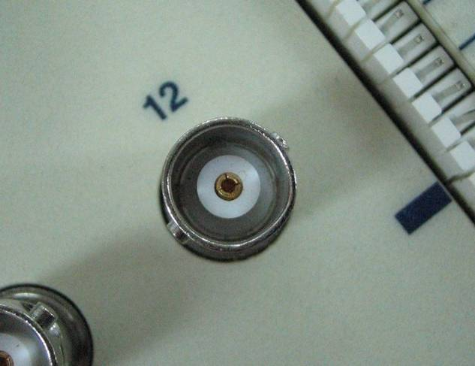
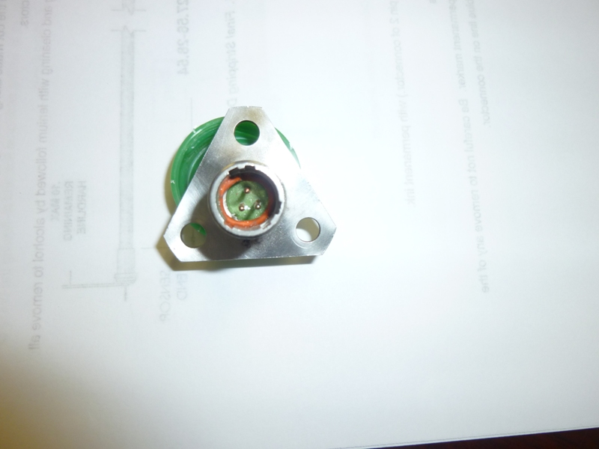
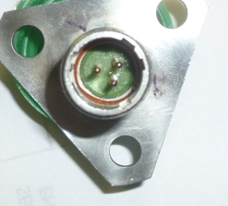
 |  | Visual Inspection Master – (Connectors) Inspection Control Method Note: Always reference the drawing when inspecting. If there is a conflict between the Visual Inspection Master and the drawing, always follow the drawing. |  | QA109
Non-conformance Type | Specification Tolerance | ACCEPT | REJECT | Specification Tolerance | Measurement Method
Deformed Housing All other connectors | ACCEPT- If connector will mate. |  |  | REJECT- If any connector will not mate. | Mating connector GO/ NO GO. Verify all connectors with applicable cable. Use a new cable with each unit to ensure that connectors are acceptable
Unseated or mis-seated "o"- ring Program Product (Trent Vibration Sensor shown.) | ACCEPT- If o-ring has been installed correctly in connector (as shown) |  |  | REJECT- If o-ring has been NOT installed correctly in connector (as shown) | Visually Inspect
QA071 Rev. C 10/16/15

Slide 5
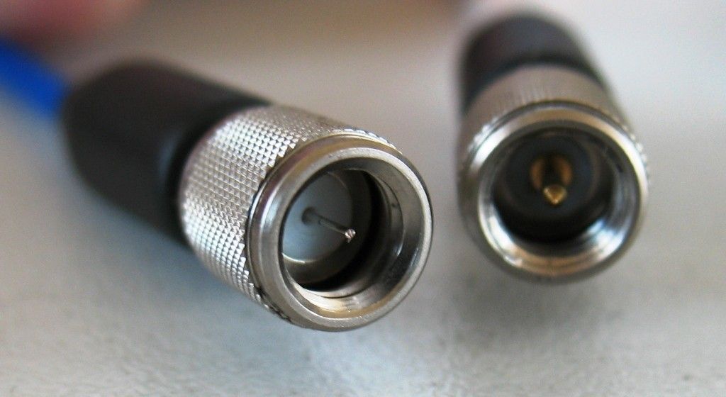
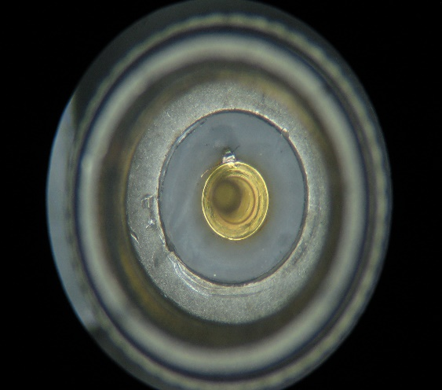
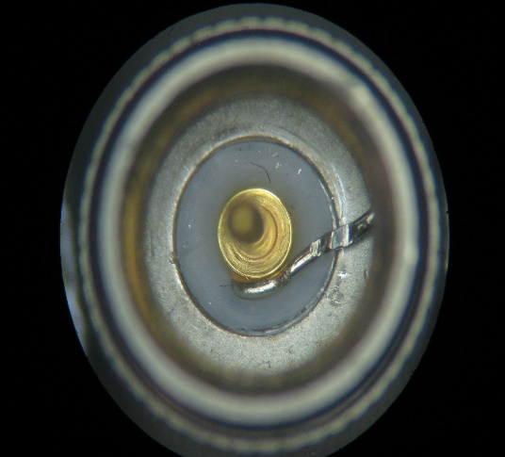
 |  | Visual Inspection Master – (Connectors) Inspection Control Method Note: Always reference the drawing when inspecting. If there is a conflict between the Visual Inspection Master and the drawing, always follow the drawing. |  | QA109
Non-conformance Type | Specification Tolerance | ACCEPT | REJECT | Specification Tolerance | Measurement Method
Coaxial | ACCEPT- If pin is over the lead and flush up against the insulator. Center conductor must be visable. |  |  | REJECT- If pin is missing from the lead. | Visually Inspect
Coaxial | ACCEPT- If lead is trimmed and is NOT touching the threads. Center conductor must be visable. |  |  | REJECT- If lead is NOT trimmed and is touching the threads. | Visually Inspect
Trimmed Lead
UN-trimmed Lead
QA071 Rev. C 10/16/15

Slide 6
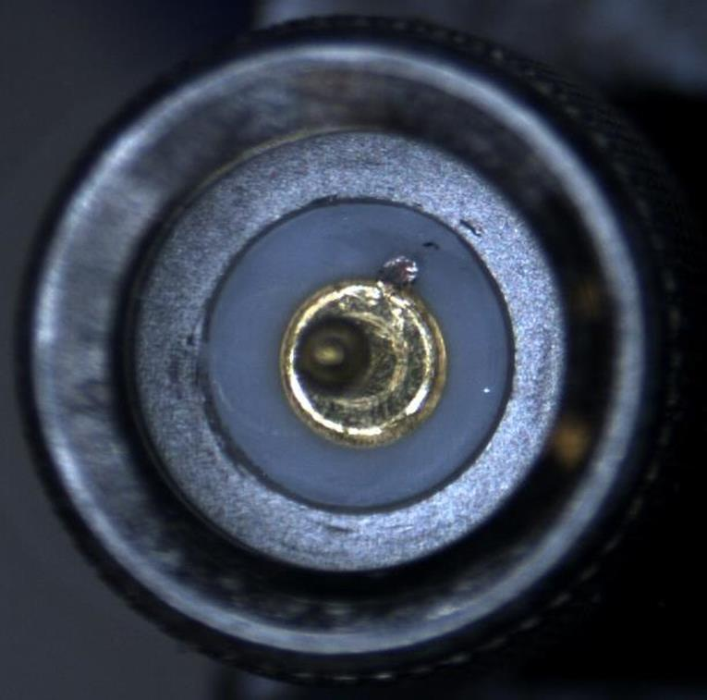
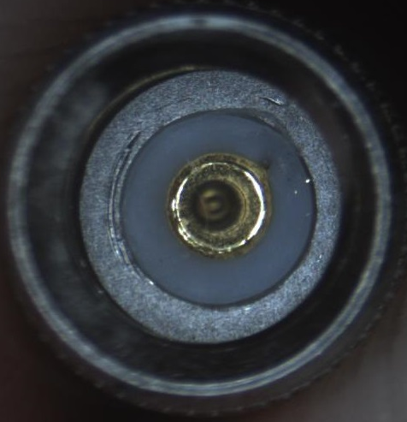
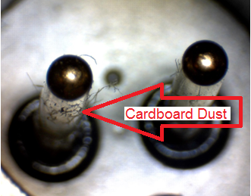
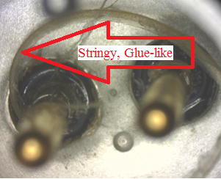
 |  | Visual Inspection Master – (Connectors) Inspection Control Method Note: Always reference the drawing when inspecting. If there is a conflict between the Visual Inspection Master and the drawing, always follow the drawing. |  | QA109
Non-conformance Type | Specification Tolerance | ACCEPT | REJECT | Specification Tolerance | Measurement Method
Coaxial | ACCEPT- If there are NO tool marks on the outside ring (coupling nut) |  |  | REJECT- If tool marks are present on the outside ring (coupling nut) | Visually Inspect
FOD Military Style Connectors | ACCEPT- |  |  | REJECT- If FOD is a flexible stringy glue-like substance. Cardboard dust can be blown/ washed out if present | Visually Inspect
Damage from tooling
QA071 Rev. C 10/16/15

Slide 7
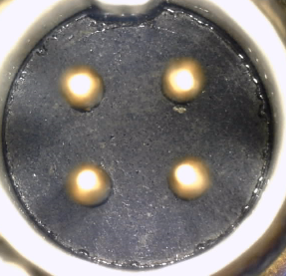
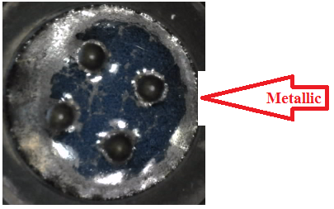
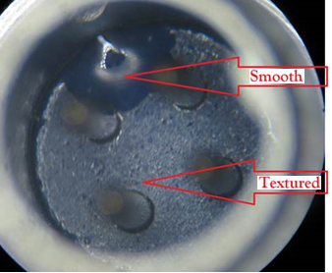
 |  | Visual Inspection Master – (Connectors) Inspection Control Method Note: Always reference the drawing when inspecting. If there is a conflict between the Visual Inspection Master and the drawing, always follow the drawing. |  | QA109
Non-conformance Type | Specification Tolerance | ACCEPT | REJECT | Specification Tolerance | Measurement Method
Glass Surface Texture All | ACCEPT- If no visible defect is present. |  |  | REJECT- If glass surface is Metallic, and more than 1/3 the distance between pin to shell, or pin to pin. | Visually Inspect
QA071 Rev. C 10/16/15

Slide 8
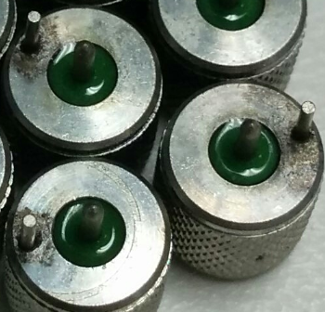
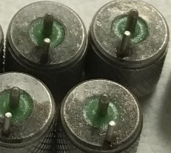
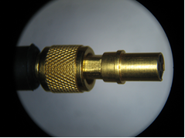
 |  | Visual Inspection Master – (Connectors) Inspection Control Method Note: Always reference the drawing when inspecting. If there is a conflict between the Visual Inspection Master and the drawing, always follow the drawing. |  | QA109
Non-conformance Type | Specification Tolerance | ACCEPT | REJECT | Specification Tolerance | Measurement Method
Braze Flow 070B09 | ACCEPT- |  |  | REJECT- If more than 1/2 of the surface of the shell with the brazed pin in it is covered in braze. | Visually Inspect
Connector assembled incorrectly AY | ACCEPT- The coupling nut completely covers the connector end and spins freely |  |  | REJECT- If the coupling nut is not able to engage mating threads | Visually Inspect
QA071 Rev. C 10/16/15

