Slide 1
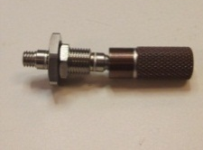
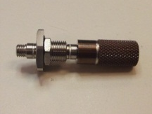
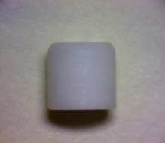
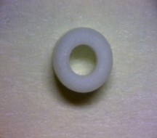
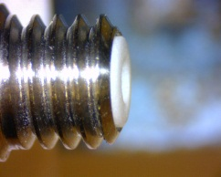
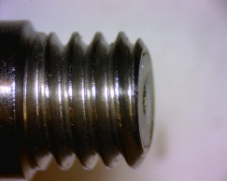
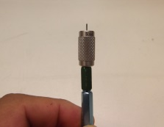
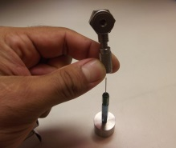
User Guide: Installing Insulator and Checking Socket
I Scope
This procedure describes the proper methods (tasks) to follow for installing the insulator and checking the socket for connectors with 10/32” connector threads.
II Materials Required
1. Calibrated socket test kit
Gap
Flush
III Instructions
A) Use crimping tool to close the connector fingers of the socket.
Place the crimping tool on the end of the connector (figure 1).
Apply gentle pressure inward as you slowly thread on the crimping tool.
Continue to thread the crimping tool onto the connector until it bottoms out and stops threading (figure 2).
Un-thread the crimping tool .
B) Insert white insulator into connector.
Place the insulator on the work surface with the chamfered side facing up (figure 3a & b).
Place the connector over the insulator (figure 4).
Press down until the insulator bottoms out in the connector (figure 5).
C) Trim the insulator so it is flush with edge of connector
Place the adaptor/sensor /connector so that the edge for the connector is off of the work surface.
Place the edge of scalpel knife on the top of the “exposed” insulator and flush up against the edge of the connector (figure 6).
Use a slicing motion, cut off any excess insulation protruding past the edge of the connector (figure 7).
Inspect the cut. NOTE: If the cut is not clean and remnants of torn (instead of cut) insulation is showing, remove the insulator, install a new insulator and re-cut with a new “sharp” blade (figure 8a & b).
D) Test connector with the pin checker.
Verify the calibration due date of the “Socket Test Kit” has not expired (figure 9).
Ensure the pin is straight and with a machined point before staring each new job (figure 10).
Place the alignment fixture onto the pin with the pin pointed up (figure 11).
Turn the pin so that it is pointed down, and allow the alignment fixture to fall off of the pin.
If there is any resistance, or the alignment fixture does not fall off, the pin is bent and must be replaced.
Attach the proper amount of mass to the pin checker per Table 1 (figure 12).
Thread the alignment fixture onto the connector (figure 13).
Insert pin through the alignment fixture and into connector until the pin enters the connector (figure 14).
Lift the mass by holding the alignment fixture. (figure 15).
The contact must be able to hold the weight of the pin & mass.
If no mass is specified for the connector, the contact must be able to at least hold the weight of the sensor / adaptor/ cable and if the cable connector is being tested, pull the connector off manually and there should be some resistance.
If the contact cannot hold the specified weight, remove the insulator and repeat the above steps in replacing the insulator and re-check the contacts.
Remove pin checker from sensor and repeat for all connectors in the job.
(figure 1)
(figure 2)
Chamfer
(figure 3a)
(figure 3b)
(figure 4)
(figure 5)
(figure 6)
(figure 7)
(figure 8a)
(figure 8b)
(figure 9)
(figure 10)
Pin Assembly
Mass
(figure 11)
(figure 12)
(figure 13)
(figure 14a)
CS001 User’s Guide Template Rev. NR 10/30/08 |  | QA1093
 | PAGE 1 of 2 | REV B

Slide 2
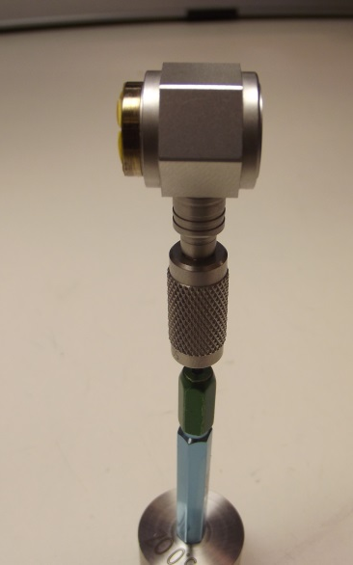
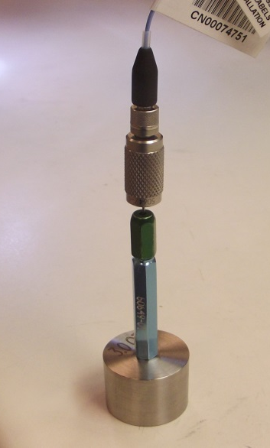
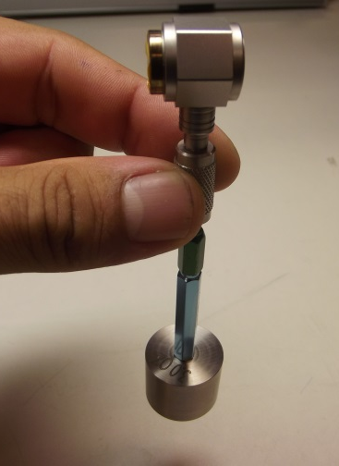
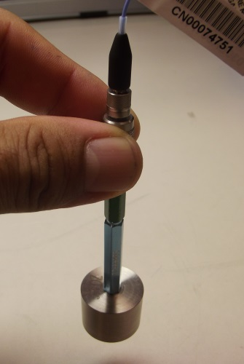
User Guide: Installing Insulator and Pin Socket Checking
Connector Thread | Crimp fixture | Test Pin P/N, Handle P/N | Test Pin Diameter (+.0000 / -.0002) | Mass (oz.)
10-32 | 34017-01 | 50651-01, 50649-01 | 0.030 | 3.0
10-32 with slotted insulator | 52128-01 | 50651-01, 50649-01 | 0.030 | 3.0
Table 1
Adapter / Sensor / Cable
Alignment Fixture
Test Pin
Test Pin Handle
Mass (weight)
Mass (weight)
(figure 14b)
Lift by the alignment fixture
(figure 15)
CS001 User’s Guide Template Rev. NR 10/30/08 |  | QA1093
 | PAGE 2 of 2 | REV B

