Slide 1
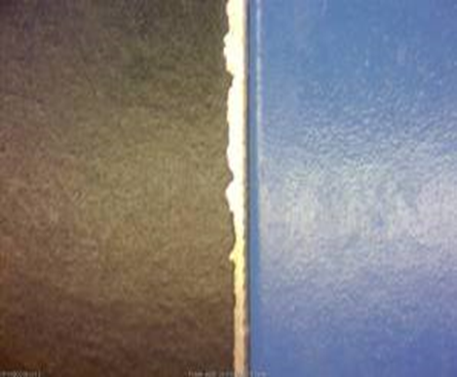
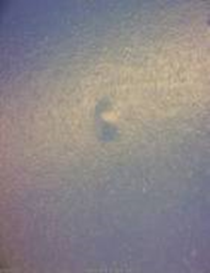
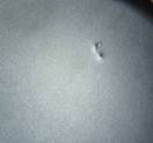
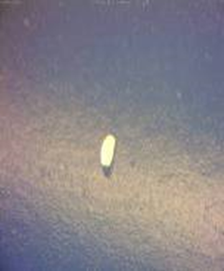
 |  | Visual Inspection Master – (Department) Inspection Control Method Note: Always reference the drawing when inspecting. If there is a conflict between the Visual Inspection Master and the drawing, always follow the drawing. |  | QA111
Non-conformance Type | Specification Tolerance | ACCEPT | REJECT | Specification Tolerance | Measurement Method
Paint - Shaker Body & Housings | TARGET– Smooth appearance. No gross imperfections present |  |  | REJECT- Reject any gross imperfections such as gouges in the coating, large chips, oil spots, staining, flaking, peeling, chalking, or any indication of corrosion. | Visually Inspect - parts should be held at a viewing distance of 18-24 inches.
Paint - Shaker Body & Housings | ACCEPT- Light scratches, runs and sags are permissible. Pits and/or particles fully encapsulated in the paint finish are acceptable provided they are no larger than .060 inches in diameter, .020 inches in height and number no more than six for any twelve inch square area. |  |  | REJECT- Reject parts that fail acceptance criteria. | Visually Inspect - parts should be held at a viewing distance of 18-24 inches.
QA071 Rev. C 10/16/15

Slide 2
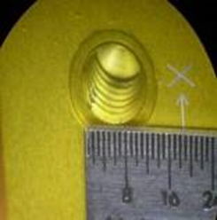
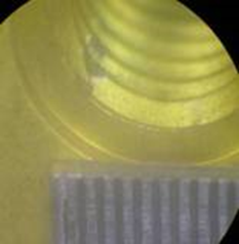
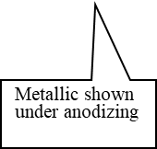
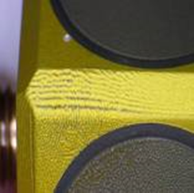
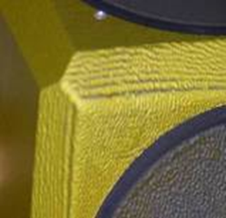
 |  | Visual Inspection Master – (Department) Inspection Control Method Note: Always reference the drawing when inspecting. If there is a conflict between the Visual Inspection Master and the drawing, always follow the drawing. |  | QA111
Non-conformance Type | Specification Tolerance | ACCEPT | REJECT | Specification Tolerance | Measurement Method
Anodizing – internal mounting threads | TARGET– No bare metal showing through anodizing |  |  | REJECT- If any metallic material is showing through the anodizing. | Visually Inspect
Anodizing | ACCEPT – Anodize finish must be smooth |  |  | REJECT- If there is a ripple effect caused by material showing through anodizing | Visually Inspect - parts should be held at a viewing distance of 18-24 inches.
QA071 Rev. C 10/16/15

Slide 3
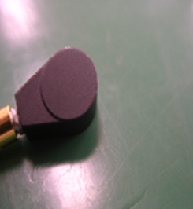
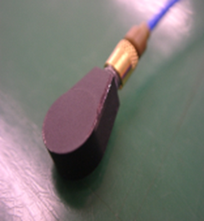
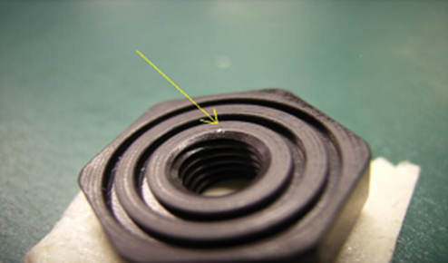
 |  | Visual Inspection Master – (Department) Inspection Control Method Note: Always reference the drawing when inspecting. If there is a conflict between the Visual Inspection Master and the drawing, always follow the drawing. |  | QA111
Non-conformance Type | Specification Tolerance | ACCEPT | REJECT | Specification Tolerance | Measurement Method
Anodizing – Tear-drop Sensors | ACCEPT – If no bare metal is showing through anodize plating. |  |  | REJECT- If any metallic material is showing through the anodizing. | Visually Inspect NOTE: Small bare spots can be touched up with touch-up pen for aluminum anodized finishes.
Anodizing – Mounting Base | ACCEPT – If rack mark is within the first 3 threads per applicable drawing. |  |  | REJECT- If rack mark shows on surface | Visually Inspect NOTE: Small bare spots can be touched up with touch-up pen for aluminum anodized finishes.
QA071 Rev. C 10/16/15

Slide 4
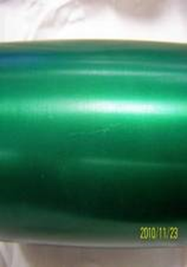
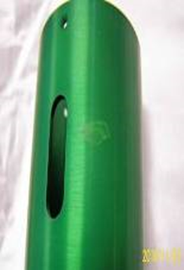
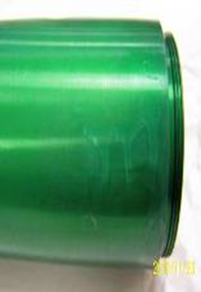
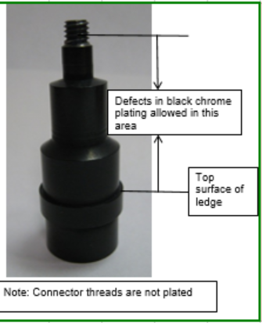
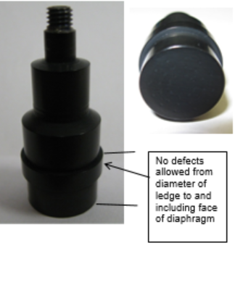
 |  | Visual Inspection Master – (Department) Inspection Control Method Note: Always reference the drawing when inspecting. If there is a conflict between the Visual Inspection Master and the drawing, always follow the drawing. |  | QA111
Non-conformance Type | Specification Tolerance | ACCEPT | REJECT | Specification Tolerance | Measurement Method
Anodizing | ACCEPT – If no bare metal is showing through anodize plating. |  |  | REJECT- If any metallic material is showing through the anodizing. | Visually Inspect
Black chrome plating for model 106M167 | ACCEPT – Small defects allowed in areas shown |  |  | REJECT- if any defects are found in the black chrome plating in the area indicated | Visually Inspect
QA071 Rev. C 10/16/15

Slide 5
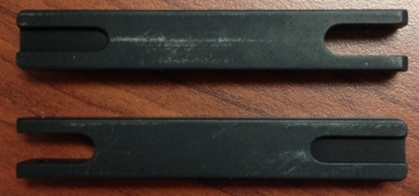
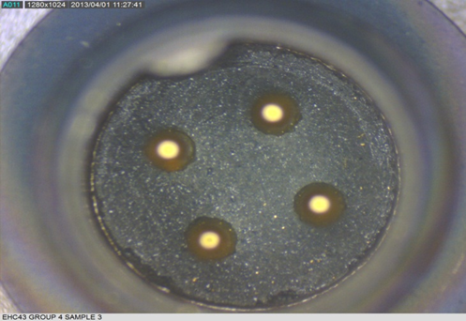
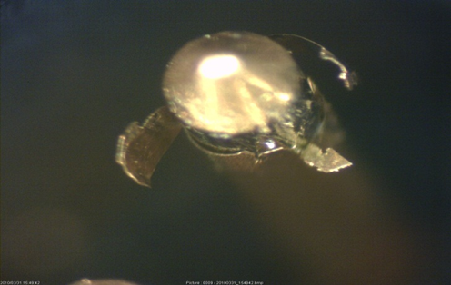
 |  | Visual Inspection Master – (Department) Inspection Control Method Note: Always reference the drawing when inspecting. If there is a conflict between the Visual Inspection Master and the drawing, always follow the drawing. |  | QA111
Non-conformance Type | Specification Tolerance | ACCEPT | REJECT | Specification Tolerance | Measurement Method
Anodizing - handles | ACCEPT – no base metal showing through |  |  | REJECT- if base metal is showing through plating | Visually Inspect
Gold Plating - pins | ACCEPT – no base metal showing through gold |  |  | REJECT – base material shows through due to gold flaking. | Visually Inspect
QA071 Rev. C 10/16/15

