Slide 1
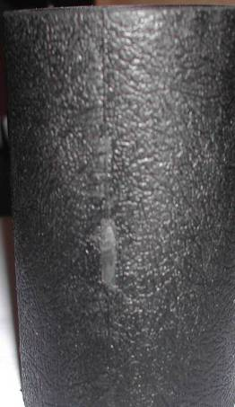
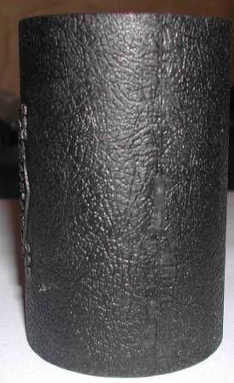
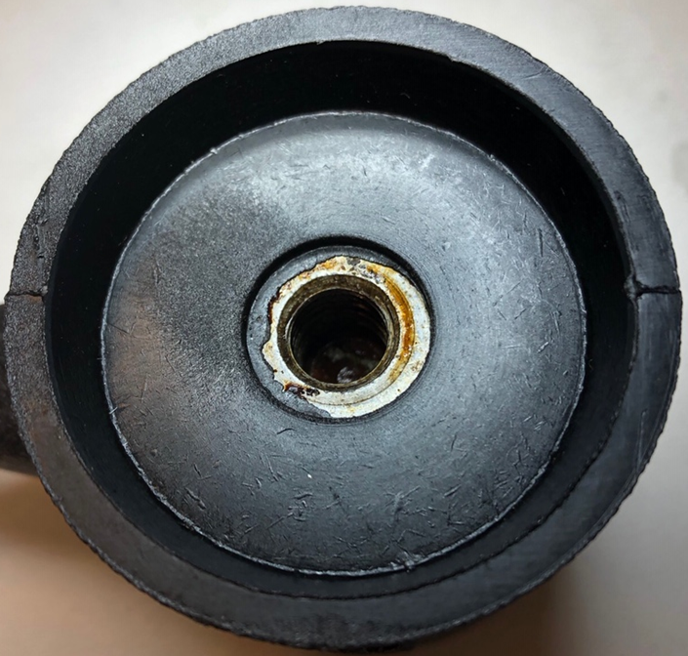
 |  | Visual Inspection Master – Hammers Inspection Control Method Note: Always reference the drawing when inspecting. If there is a conflict between the Visual Inspection Master and the drawing, always follow the drawing. |  | QA112 Rev. I 8/5/2019
Product Type | Specification Tolerance | ACCEPT | REJECT | Specification Tolerance | Measurement Method
HAMMER HEAD Cosmetic - Void | ACCEPT- If parting line surface is flush and smooth. Remainder of surface to have uniform finish. |  |  | REJECT – If parting line surface has excessive flashing. | Visually Inspect
HAMMER HEAD Cosmetic - Flashing | ACCEPT- If hammer has any plastic flashing on face or in threads. |  |  | REJECT- If flashing cannot be removed via normal processing. | Visually Inspect

Slide 2
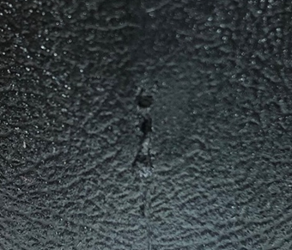
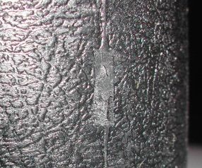
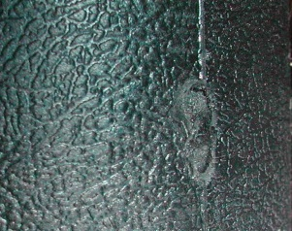
 |  | Visual Inspection Master – Hammers Inspection Control Method Note: Always reference the drawing when inspecting. If there is a conflict between the Visual Inspection Master and the drawing, always follow the drawing. |  | QA112 Rev. I 8/5/2019
Product Type | Specification Tolerance | ACCEPT | REJECT | Specification Tolerance | Measurement Method
HAMMER HEAD Cosmetic - Divot | ACCEPT- If divots, pits, voids, etc. are visible but minor in shape and size. |  |  | REJECT - If divots, pits, voids, etc. are excessively large in size. | Visually Inspect
HAMMER HEAD Cosmetic - Ding | ACCEPT- If dings are minor. |  |  | REJECT- If dings are excessive. | Visually Inspect

Slide 3
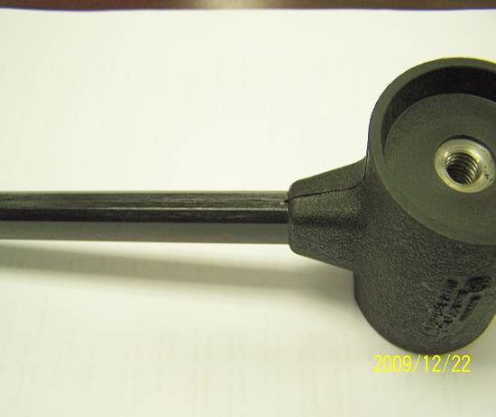
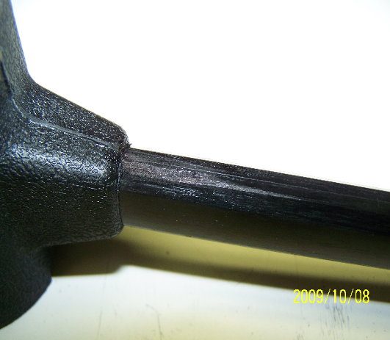
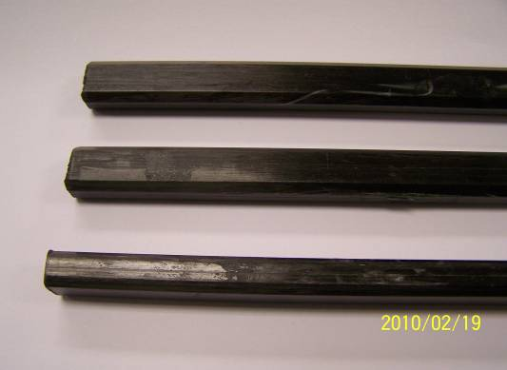
 |  | Visual Inspection Master – Hammers Inspection Control Method Note: Always reference the drawing when inspecting. If there is a conflict between the Visual Inspection Master and the drawing, always follow the drawing. |  | QA112 Rev. I 8/5/2019
Product Type | Specification Tolerance | ACCEPT | REJECT | Specification Tolerance | Measurement Method
HAMMER HANDLE Cosmetic | ACCEPT- If handle has no gouges, scratches, or other damage. Black coating is uniform over entire surface. |  |  | REJECT- If scratches, gouges, or uneven coating etc. are visible. | Visually Inspect
HAMMER HANDLE Cosmetic | . ACCEPT- If coating /finish is smooth |  |  | REJECT - If blemishes on surface, coating is not smooth. | Visually Inspect

Slide 4
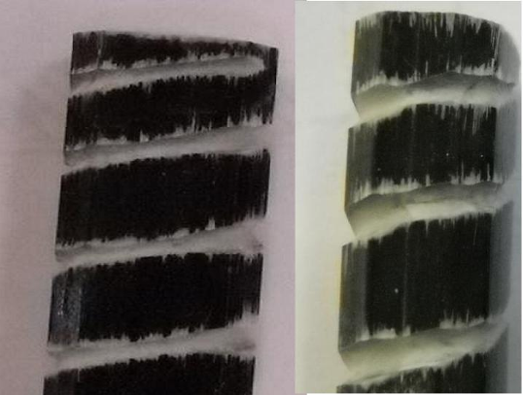
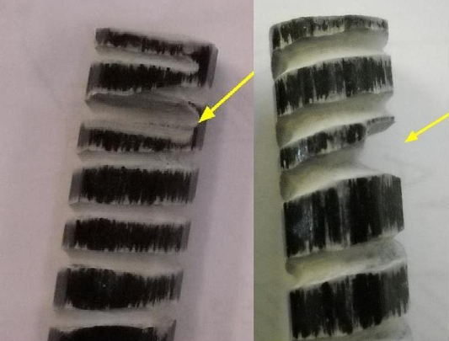
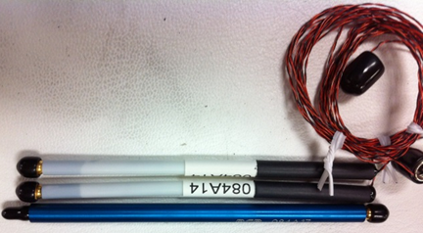
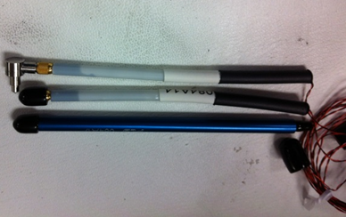
 |  | Visual Inspection Master – Hammers Inspection Control Method Note: Always reference the drawing when inspecting. If there is a conflict between the Visual Inspection Master and the drawing, always follow the drawing. |  | QA112 Rev. I 8/5/2019
Product Type | Specification Tolerance | ACCEPT | REJECT | Specification Tolerance | Measurement Method
HAMMER HANDLE Cosmetic - Grooves | ACCEPT- If groove depth < 060 |  |  | REJECT- If groove depth >.060” | Capiler
HAMMER HANDLE Cosmetic - Grooves | ACCEPT Plastic handles with a slight bend are acceptable. NOTE: this does not affect performance |  |  | REJECT- Plastic handles that have a significant bend | Visually Inspect

Slide 5
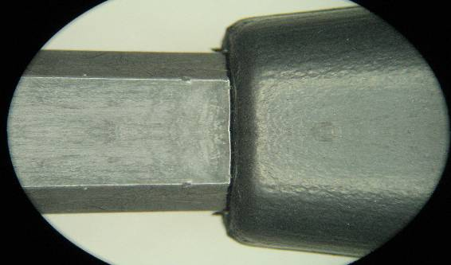
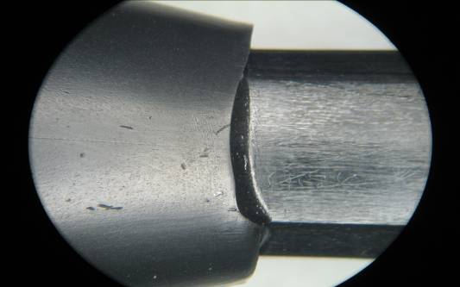
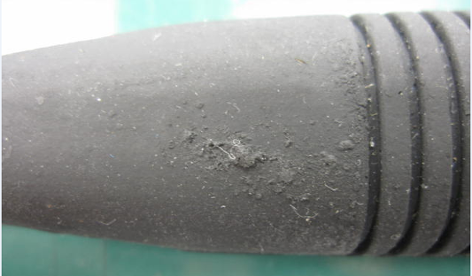
 |  | Visual Inspection Master – Hammers Inspection Control Method Note: Always reference the drawing when inspecting. If there is a conflict between the Visual Inspection Master and the drawing, always follow the drawing. |  | QA112 Rev. I 8/5/2019
Product Type | Specification Tolerance | ACCEPT | REJECT | Specification Tolerance | Measurement Method
HAMMER GRIP Cosmetic | ACCEPT- If grip has no voids or other damage |  |  | Reject – If grip has voids and obvious damage | Visually Inspect

Slide 6
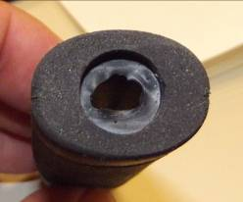
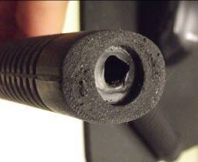
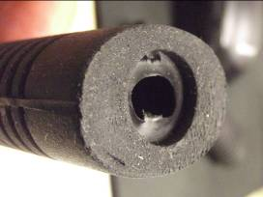
 |  | Visual Inspection Master – Hammers Inspection Control Method Note: Always reference the drawing when inspecting. If there is a conflict between the Visual Inspection Master and the drawing, always follow the drawing. |  | QA112 Rev. I 8/5/2019
Product Type | Specification Tolerance | ACCEPT | REJECT | Specification Tolerance | Measurement Method
HAMMER GRIP Cosmetic | ACCEPT- If grip is smooth, has even surface and no “nicks” |  |  | REJECT - If grip surface is rough, uneven | Visually Inspect
HAMMER GRIP Cosmetic | ACCEPT- |  |  | REJECT- If “nick” in the material | Visually Inspect

Slide 7
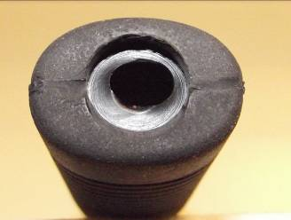
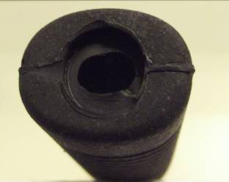
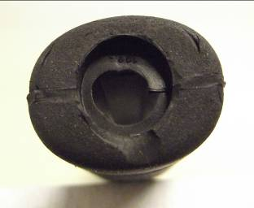
 |  | Visual Inspection Master – Hammers Inspection Control Method Note: Always reference the drawing when inspecting. If there is a conflict between the Visual Inspection Master and the drawing, always follow the drawing. |  | QA112 Rev. I 8/5/2019
Product Type | Specification Tolerance | ACCEPT | REJECT | Specification Tolerance | Measurement Method
HAMMER GRIPS Cosmetic | ACCEPT- If trimming of parting lines and around the edges is smooth |  |  | REJECT - If there is excessive trimming/ not trimmed smooth | Visually Inspect
HAMMER GRIPS Cosmetic | ACCEPT- |  |  | REJECT- If cracks in the rubber or gouging is visible | Visually Inspect

Slide 8
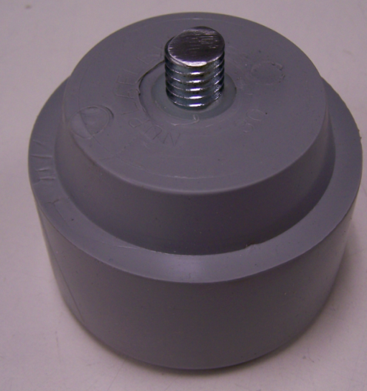
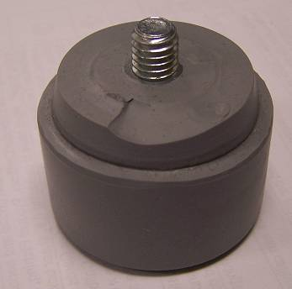
 |  | Visual Inspection Master – Hammers Inspection Control Method Note: Always reference the drawing when inspecting. If there is a conflict between the Visual Inspection Master and the drawing, always follow the drawing. |  | QA112 Rev. I 8/5/2019
Product Type | Specification Tolerance | ACCEPT | REJECT | Specification Tolerance | Measurement Method
HAMMER TIPS Excessive Edge Chamfer | ACCEPT- If bottom surface is evenly flat to allow head to seat properly on hammer with no deformation |  |  | REJECT – If deformation on bottom surface will not allow head to seat properly on hammer or if there is loose material peeling away. | Visually Inspect
HAMMER TIPS Dimensional | ACCEPT- If threaded end perpendicular |  |  | REJECT- If threaded end not perpendicular | Visually Inspect

Slide 9
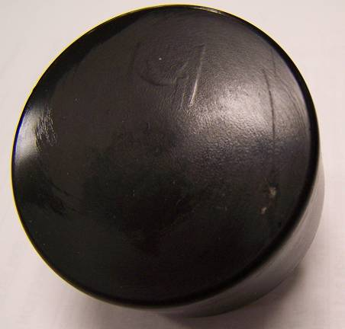
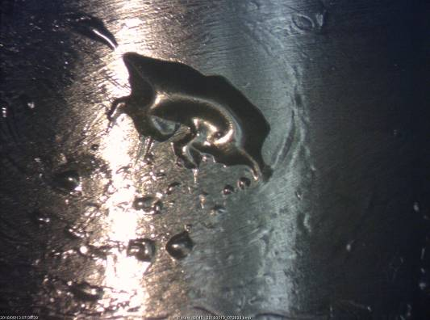
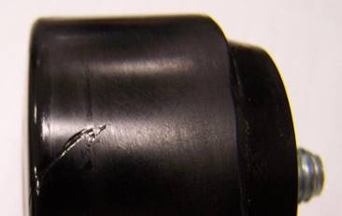
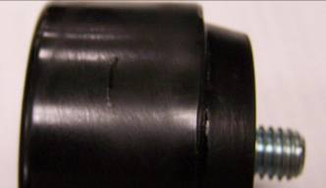
 |  | Visual Inspection Master – Hammers Inspection Control Method Note: Always reference the drawing when inspecting. If there is a conflict between the Visual Inspection Master and the drawing, always follow the drawing. |  | QA112 Rev. I 8/5/2019
Product Type | Specification Tolerance | ACCEPT | REJECT | Specification Tolerance | Measurement Method
HAMMER TIP Mold Imperfections | ACCEPT- If mold deposit appears on top – NOTE: this does not affect performance |  |  | REJECT – if bubbles are visible | Visually Inspect
HAMMER TIP Mold Imperfections | ACCEPT- If mold deposit appears on side – NOTE: this does not affect performance |  |  | REJECT –

Slide 10
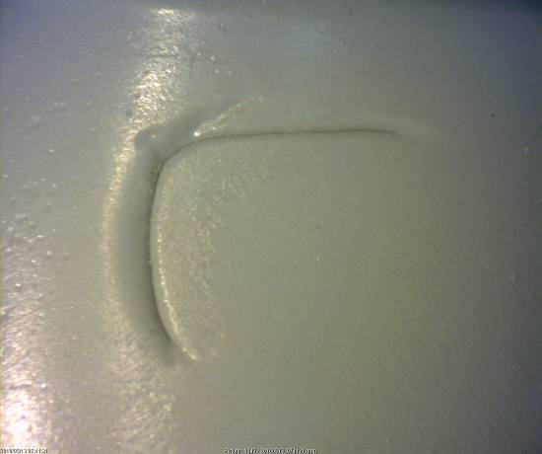
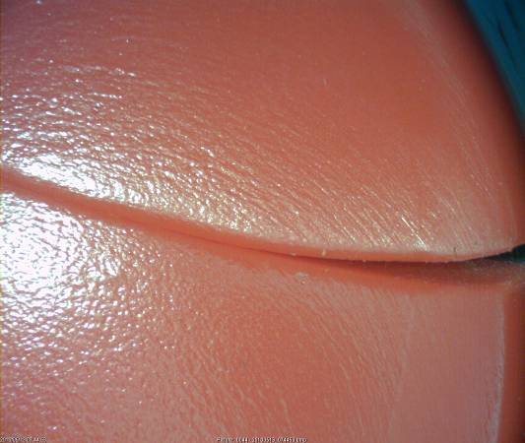
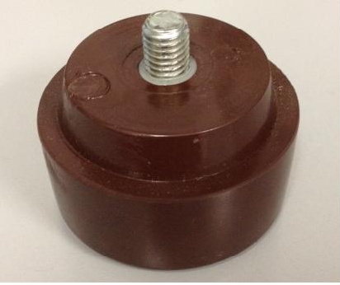
 |  | Visual Inspection Master – Hammers Inspection Control Method Note: Always reference the drawing when inspecting. If there is a conflict between the Visual Inspection Master and the drawing, always follow the drawing. |  | QA112 Rev. I 8/5/2019
Product Type | Specification Tolerance | ACCEPT | REJECT | Specification Tolerance | Measurement Method
HAMMER TIP Mold Deposit on top or side Mold Cut/Slice | ACCEPT- If mold deposit on top or side – NOTE: this does not affect performance |  |  | REJECT- If cut / slice is visible | Visually Inspect
HAMMER TIP Loose Studs | ACCEPT Threaded studs moving up and down and side to side are acceptable. | Example of the threaded studs that may move: |  | REJECT- No examples at this time (all are acceptable) | Visually Inspect

