Slide 1
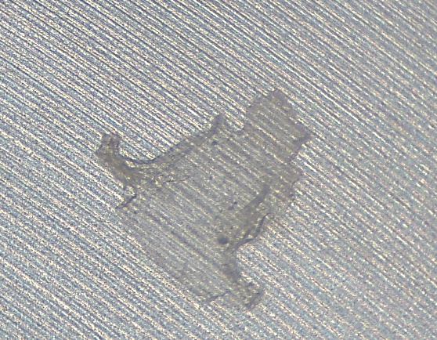
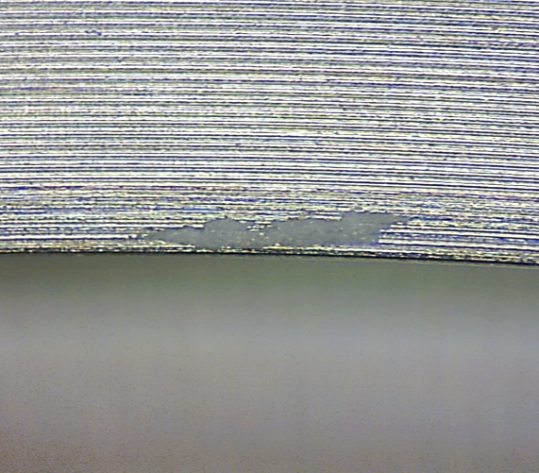
 |  | Visual Inspection Master – 62219-02 Connector Inspection Control Method Note: Always reference the drawing when inspecting. If there is a conflict between the Visual Inspection Master and the drawing, always follow the drawing. |  | QA146
Non-conformance Type | Specification Tolerance | ACCEPT | REJECT | Specification Tolerance | Measurement Method
FOD – Elastic “Gooey” material | ACCEPT- On all external surfaces, after scraping off as much as possible (See Engineering). | N/A |  | RE-WORKABLE - If material can be mechanically removed. Re-clean per procedure. REJECT – in the counter bore or weld area. | Initial inspection by eye, If required 10x power under a microscope
FOD – White powder material | ACCEPT- On all external surfaces |  |  | RE-WORKABLE - If material can be mechanically removed. Re-clean per procedure. REJECT - If not removable. | Initial inspection by eye, If required 10x power under a microscope
QA071 Rev. C 10/16/15

Slide 2
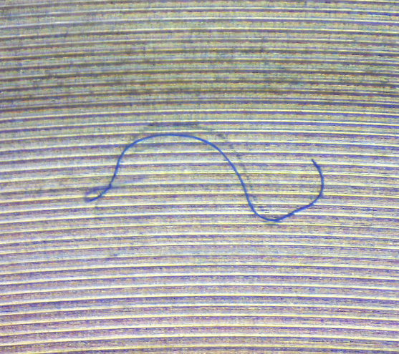
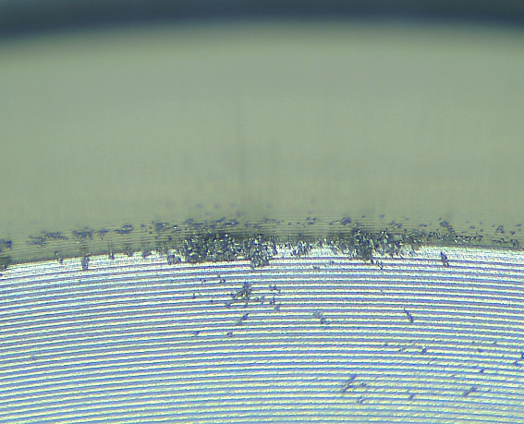
 |  | Visual Inspection Master – 62219-02 Connector Inspection Control Method Note: Always reference the drawing when inspecting. If there is a conflict between the Visual Inspection Master and the drawing, always follow the drawing. |  | QA146
Non-conformance Type | Specification Tolerance | ACCEPT | REJECT | Specification Tolerance | Measurement Method
FOD – Non-attached fibers | ACCEPT - As long as material can be removed |  | N/A | REJECT- N/A | Initial inspection by eye, If required 10x power under a microscope
FOD – Metal Shavings in Counter bore | ACCEPT- N/A | N/A |  | RE-WORKABLE - If material can be mechanically removed. Re-clean per procedure. . | Initial inspection by eye, If required 10x power under a microscope
QA071 Rev. C 10/16/15

Slide 3
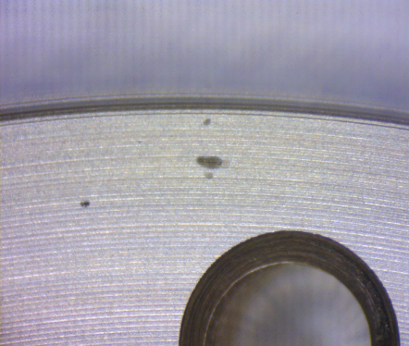
 |  | Visual Inspection Master – 62219-02 Connector Inspection Control Method Note: Always reference the drawing when inspecting. If there is a conflict between the Visual Inspection Master and the drawing, always follow the drawing. |  | QA146
Non-conformance Type | Specification Tolerance | ACCEPT | REJECT | Specification Tolerance | Measurement Method
FOD – Spots/ specks | ACCEPT - If 6 or less spots/ specks are visual performing inspection by eye in counter bore area. ACCEPT - On external features. ACCEPT – In weld area only if spot is > .03” away from weld joint. (Covered by 72112-01 & 72113-01 fixtures) |  |  | REJECT- If more than 6 spots/specks are visual performing inspection by eye in counter bore area. REJECT- if within .03” of the weld joint. (If the spot can still be seen using 72112-01 & 72113-01 fixtures) REJECT- Any size larger than .050 in counter bore area. | Initial inspection by eye, If required 10x power under a microscope
Damage – Nicks/Dings | ACCEPT- On external features. ACCEPT – If Nicks/Dings is flush/recessed with the weld edge (OD) or contact surface. |  |  | REJECT – If nick is a raised burr on the weld edge (OD) or contact surface. | Initial inspection by eye, If required 10x power under a microscope
QA071 Rev. C 10/16/15

Slide 4
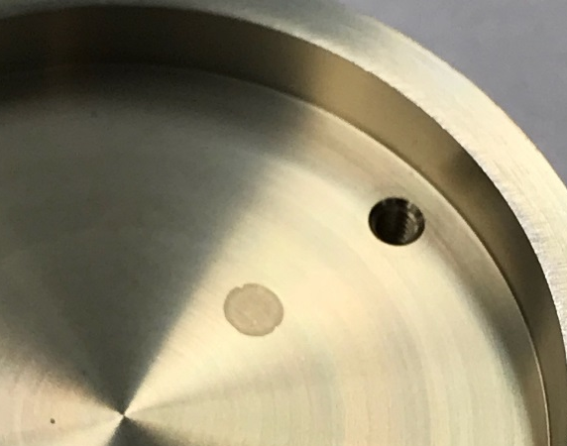
 |  | Visual Inspection Master – 62219-02 Connector Inspection Control Method Note: Always reference the drawing when inspecting. If there is a conflict between the Visual Inspection Master and the drawing, always follow the drawing. |  | QA146
Non-conformance Type | Specification Tolerance | ACCEPT | REJECT | Specification Tolerance | Measurement Method
FOD – Raised Glass | ACCEPT – N/A | N/A |  | REJECT- On inside of counter bore. | Initial inspection by eye, If required 10x power under a microscope
FOD - Staining | ACCEPT- On external surfaces |  |  | RE-WORKABLE - If material can be mechanically removed. Re-clean per procedure. REJECT - If not removable. | Initial inspection by eye, If required 10x power under a microscope
RAISED GLASS
QA071 Rev. C 10/16/15

Slide 5
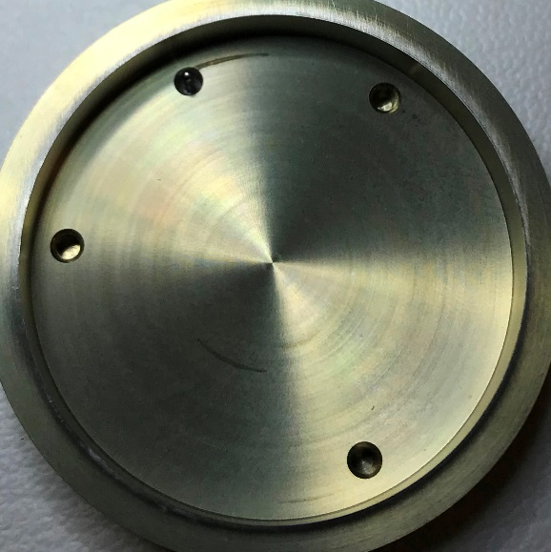
 |  | Visual Inspection Master – 62219-02 Connector Inspection Control Method Note: Always reference the drawing when inspecting. If there is a conflict between the Visual Inspection Master and the drawing, always follow the drawing. |  | QA146
Non-conformance Type | Specification Tolerance | ACCEPT | REJECT | Specification Tolerance | Measurement Method
FOD – Glass Contamination | ACCEPT – N/A | N/A |  | REJECT | Initial inspection by eye, If required 10x power under a microscope
FOD – Fired swirl marks | ACCEPT- All Surfaces |  | N/A | REJECT | Initial inspection by eye, If required 10x power under a microscope
GLASS FRAGMENT
Swirl Marks
QA071 Rev. C 10/16/15

