Slide 1
MTS Quality Management Systems
OHSAS 18001 transition to ISO 45001:2018
Employee Awareness

Slide 2
Attendance

Slide 3
Overview
Background
ISO 45001 in the QMS System
Audit Findings on Our Employees
ISO 45001
  Differences between ISO 45001 and 18001
  Key points of ISO 45001
Summary and Conclusion

Slide 4
Master Quality and EHS Audit Schedule
Audit Name | Schedule Date | Focus Areas | External POCs | MTS POC | Results
QA Internal Sweden/ | 1/28 | ISO 9001 Internal | Cutter | Augustsson, Berggren, Nogander
QA Internal Germany | 1/29 | ISO 9001 Internal | Cutter | Piepenschneider, Gust, Hirschmann
QA External EP | 2/13 | ISO 9001 | Hile | Jordheim
ISO External | TBD | ISO 9001 Sweden | Hile | Jordheim
QA External/Berlin | TBD | ISO 9001 Berlin | Hile | Jordheim
QA Internal /EP | 3/16-25 | EHS 18001-45001 | Cutter | Stelten
EHS External EP | 5/27-29 | EHS 14001, 18001-45001 | Faust | Stelten
ISO External EP | 7/16-17 | ISO 9001 with Installation | Hile | Daley | Need .5d Install
EQHS Internal EP | Oct 13-14 | ISO 9001/1400/EHS1800 - 4500 | Cutter | Daley/Stelten | Transition to 45001
EHS External EP | 11/2-11/6 | EHS 14001, 18001-45001 | Faust | Daley/Stelten | Transition to 45001
ISO External EU | 11/18-11/19 | ISO 9001 Italy, France | Hile | Remote from EP

Slide 5
Background

Slide 6

What is ISO?
The International Organization for Standardization (ISO). It is an independent, non-governmental international organization that brings together experts to share knowledge and develop voluntary, consensus-based, market relevant International Standards that support innovation and provide solutions to global challenges.
Independent and non-governmental
Sharing knowledge
Voluntary INTERNATIONAL standards
Consensus of INTERNATIONAL standards
Innovation and global challenges

Slide 7

OHSAS 18001 to ISO 45001
OHSAS 18001 has been replaced by ISO 45001. This is the new international standard for occupational health and safety. Organizations already certified to OHSAS 18001 will need to upgrade to ISO 45001 by March 2021.

Slide 8
Audit Findings of
Our Employees

Slide 9
Past Internal Audits
4076 | Open | Multiple issues still exist with shelf life products (SHELF LIFE PRODUCT – REPEAT NONCONFORMANCE) | Internal Audit | Wallace | 2020-04-14
4077 | Open | Shelf life products in the vending machines are not removed until days within expiration | Internal Audit | Wallace, | 2020-04-14
4078 | Open | O-RINGS and Hydraulic hoses – REPEAT NONCONFORMANCE: Multiple issues exist | Internal Audit | Wallace, | 2020-04-16
4081 | Open | Validation of Special Processes from Outsourced Vendors | Internal Audit | Karner | 2020-04-16
4083 | Open | Corrective Action input does not meet the intent of the standard in all cases. | Internal Audit | Daley, | 2020-04-17
4073 | Open | Multiple issues exist with QMS documentation REPEAT NONCONFORMANCE | Internal Audit | Daley, | 2020-04-14
4079 | Closed | 7.3: Employees were not able to discuss elements of the awareness clause | Internal Audit | Daley, | 2020-04-16
3967 | Closed | ISO 9001 - Uncontrolled documents in machine shop | Internal Audit | Wallace, | 2019-06-10
4074 | Open | Materials do not meet the requirements of the standard (REPEAT NONCONFORMANCE) | Internal Audit | Daley, | 2020-04-14
3983 | Closed | Documented information not adequately maintained | Internal Audit | Daley, | 2019-07-15
4080 | Closed | Universal Waste not Stored Properly | Internal Audit | Stelten, | 2020-04-16
4082 | Closed | Participation and Consultation requirement are not met (ISO 45001:2018) | Internal Audit | Stelten, | 2020-04-17
4075 | Closed | Lack of Employee Awareness of risks in areas | Internal Audit | Stelten | 2020-04-14

Slide 10
Past External Audits
4096 | Closed | MoC Closure without completion (P3 Observation) | External Audit | Zuiker, Joseph R | Stelten, Randy J | 2020 Jun 11 | Complete
4023 | Open | DNV EHS-Consider the benefits of capturing EHS lessons learned at the completion of the equipment installation process. | External Audit | Nasla, Aspasia S (Sylvia) | Weyhing, Gregory G | 2019 Nov 11
4095 | Open | Lockout Tagout (LOTO) issues an outdated policy and Verification of LOTO training missing | External Audit | Zuiker, Joseph R | Stelten, Randy J | 2020 Jun 08 | In coordination

Slide 11
Past Audit Findings on MTS Employees
Employees not aware EHS risks within their area of responsibility (production employees). They heard something during orientation or by viewing the LMS courses, these general and not specific to the risks they face or pose
Shelf life: Stockroom employees do not manage shelf-life – when they issue the O-rings to the floor, they assume the floor employees are managing the shelf life
Hydraulic Hoses: Stock room employees are not aware that the hydraulic hoses have a shelf life and are not managing the inventory for shelf-life
Objectives: Managers and employees are not aware of the objectives and targets for each of the standards.
Consequences – Repeat nonconformance – Employees were not able to discuss the potential consequences of not following the management system requirements
Policy Statements – Most employees could not describe the policy in their own words, but stated they knew where to find it. I asked them to find it, and they could not find it. It seems the policy was only discussed at orientation with no follow-up or linkage to their priorities.

Slide 12
Past Audit Findings on MTS Employees
Find QMS Documents: Employees did not know how to get to the documents and did not know if procedures or instructions existed. Employees did receive communication on work instructions or procedures since orientation and were given the documents to read, or they were discussed in the LMS training only.
Updating WIs and Procedures. No proactive review and update procedures and WIs. Owners are assigned to the documents and are not reviewing the documents.
NCM. Materials put on shelf are not transferred to nonconforming status consistently. Materials are not being processed timely. Items do not have the proper (or any in some cases) documentation on them.
Mid-Level management no clear understanding of what makes up the various standard. Managers not using management system as intended. Fear: Make a change to their practices/procedures that could make MTS non-compliance.
Environmental Health and Safety Hazards – Employees not aware of the environmental aspects in their area, employees not aware of the hazard board with significant hazards in their area. Could not identify significant hazards.

Slide 13
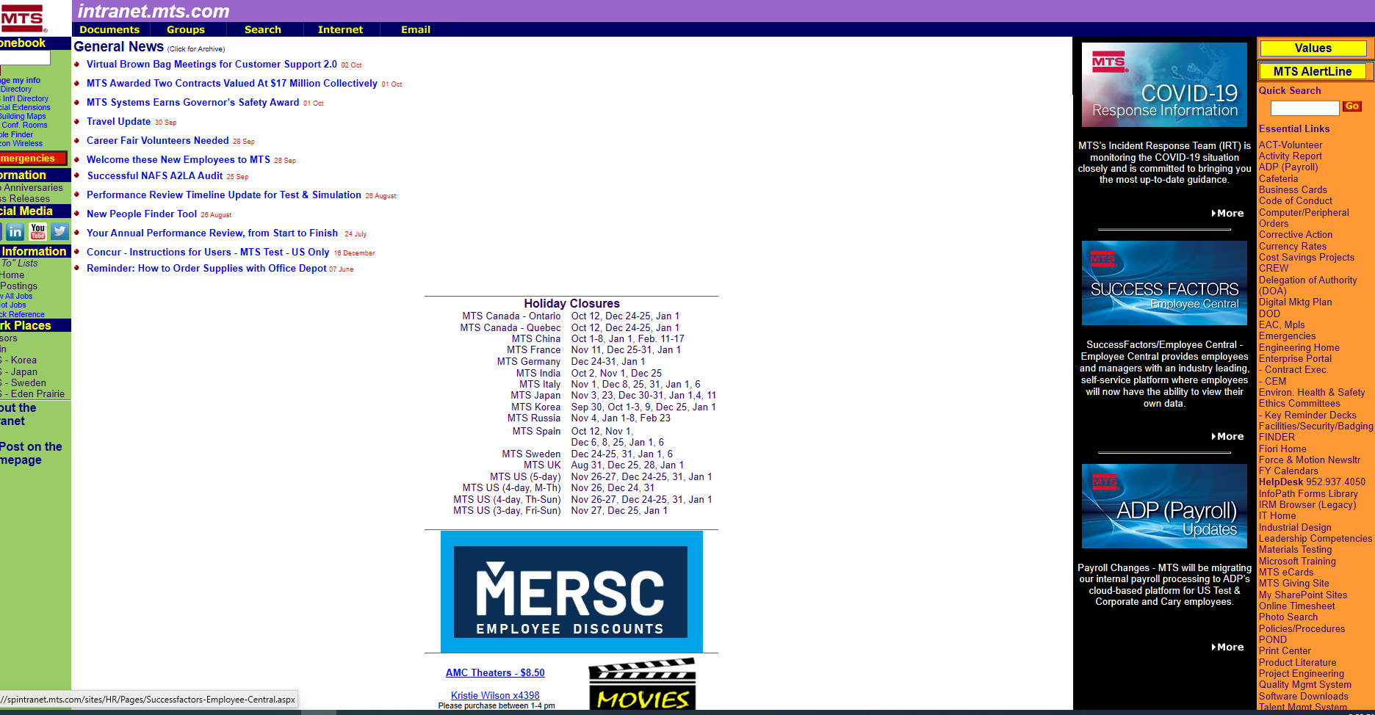
Pumpkin Page
EHS Homepage
QMS
Homepage

Slide 14
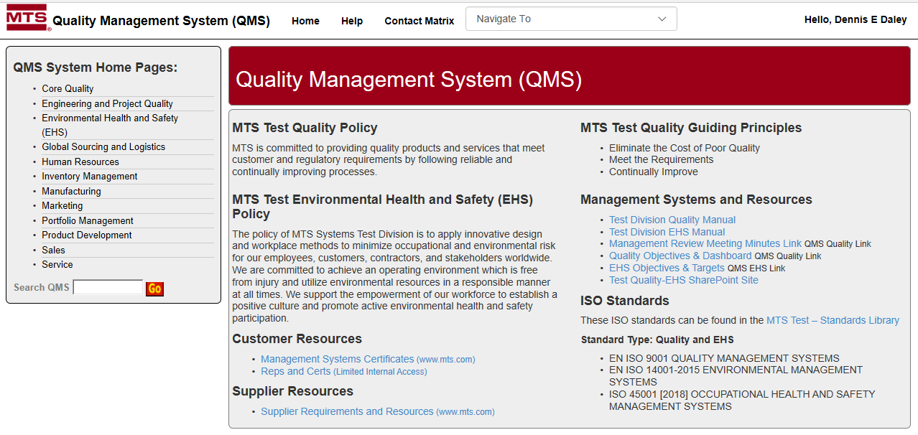
QMS Homepage

Slide 15
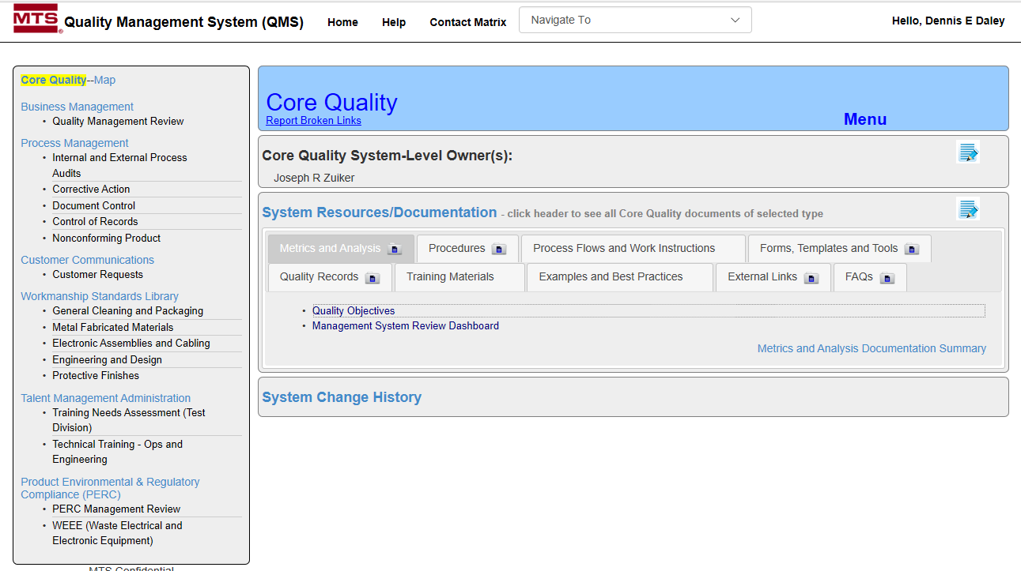
QMS Homepage to Core Quality Page
Quality Objectives
Management Reviews
Audit Scedules

Slide 16
A Must Know: 7.3 Awareness Clause
Quality awareness focus on meeting customer and regulatory requirements
All employees know organization’s QMS controls do this and their role in achieving it
Phrase “persons doing work under the organization’s control” is work in QMS scope, to meet customer requirements, whether work onsite, offsite, or external provider.
QMS quality policy an organization must meet customer and regulatory requirements.
In quality policy, all workers know organization’s customer and regulatory requirements
The quality policy leads to quality objectives.
Quality objectives set metrics for product, service, QMS process, compliance, customers
Objectives focus on customer and regulatory requirements and customer satisfaction.
7.3 Awareness Clause is focused on meeting customer and regulatory requirements
7.3 Awareness Clause leads to Quality Policy that leads to Quality Objectives
Quality Policy sets practices to meet two things: customer and regulatory requirements
Quality Objectives sets metrics how we achieve products, QMS standards, customers
To meet regulation and customer requirements: 7.3 Awareness Clause – Policy -- Objectives

Slide 17
7.3 Awareness Clause…to Quality Policy…to Quality Objectives
In ISO 9001 QMS 7.3 Awareness Clause
MTS Quality Policy
MTS is committed to providing quality products and services that meet customer and regulatory requirements by following reliable and continually improving processes.
MTS Quality Objectives
The policy of MTS Systems Test Division is to apply innovative design and workplace methods to minimize occupational and environmental risk for our employees, customers, contractors, and stakeholders worldwide. We are committed to achieve an operating environment which is free from injury and utilize environmental resources in a responsible manner at all times. We support the empowerment of our workforce to establish a positive culture and promote active environmental health and safety participation.

Slide 18
Memorize Policy or Objectives or ….

Slide 19
QUALITY OBJECTIVES FY20
Goal | Name | Description
1 | On-Time Shipment | Improve Projects, ZISO, and Service Parts on-time shipment
2 | Cost Savings & Efficiency | FY20 Material Cost Savings of $8M vs FY18 Inventory Turns to 4.0 in 4Q20 FY20 Warehouse/MH savings by $1M vs FY19 Annual manufacturing costs by $1.5M Expand Variable Engineering Support Reduce expedited shipping charges
4 | Engineering R&D/CE Management | R&D stage-gate full implementation Controller/RPC-C on/ahead of schedule R&D/CE spend on budget to full year AOP Portfolio metrics to goals for multi-year performance
6 | Strategic Initiatives | Descartes kicked-off; strategy in place LT reduction productionized; on track Aurora support, including Reveal closeout
5 | Organizational Improvements | Team technical succession plans Employee Engagement Action Plan
 | Quality/ EHS | Long term EHS vision for Test & Simulation Deliver on CY19 and CY20 EHS goals Successful audits and maintain certifications Roll out green belt training

Slide 20
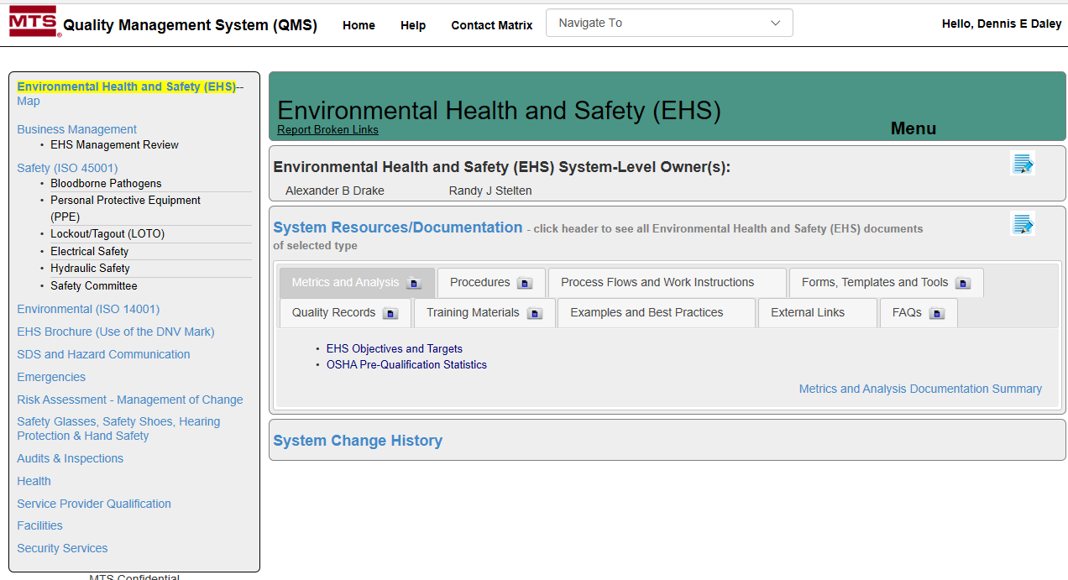
EHS Homepage

Slide 21
All Employees Must Know and Access:
Locations of hazard boards and know the hazards in their area.
QMS Quality homepage to the three policy standards.
QMS Quality homepage to core quality to procedures and WIs.
QMS Quality homepage to the Quality manual.
QMS Quality homepage to targets and objectives.
EHS homepage and EHS objectives and targets.
Know past audit findings and not aloe repeat findings.
Please ensure this information is cascaded down to all employees

Slide 22
ISO 45001 in the MTS QMS System

Slide 23
Three Management Systems at MTS
ISO 9001 (2015): International core quality standards addressing process, customer, leadership, relationships, efficiency
ISO 14001(2015): International environmental management system focused on using resources and reduction of waste.
ISO 45001(2018): International occupational and health management system that focuses on preventing injury and ill-health

Slide 24
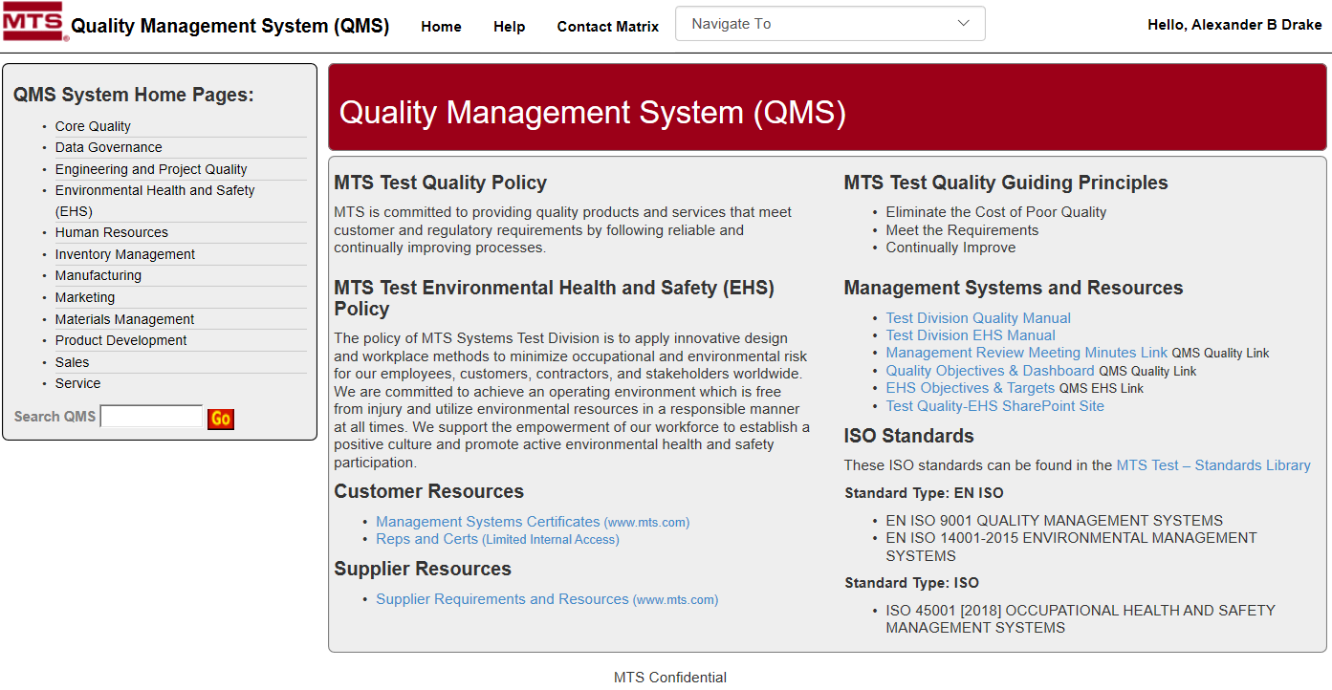
Location of EHS Manual
MTS Homepage easy access section to EHS Manual

Slide 25
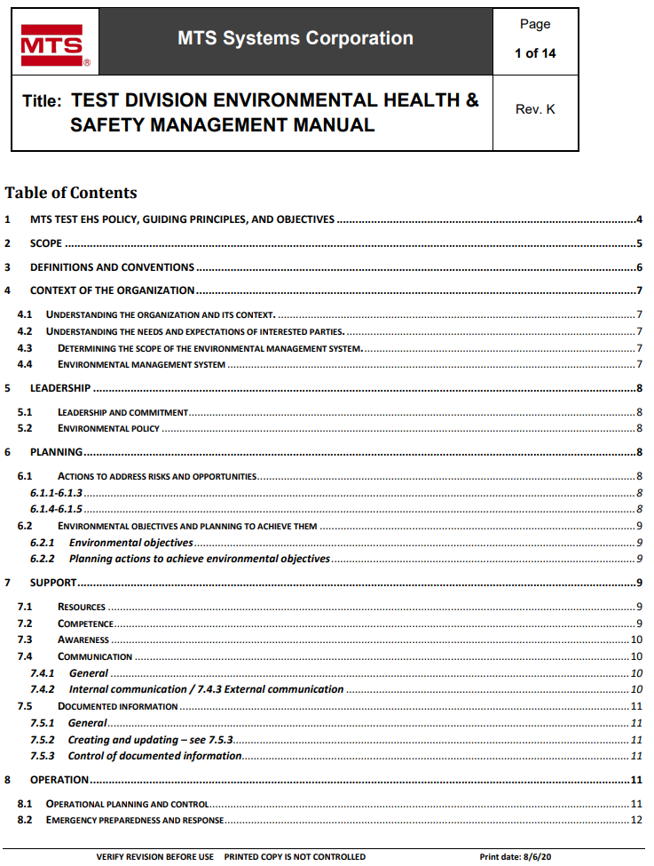
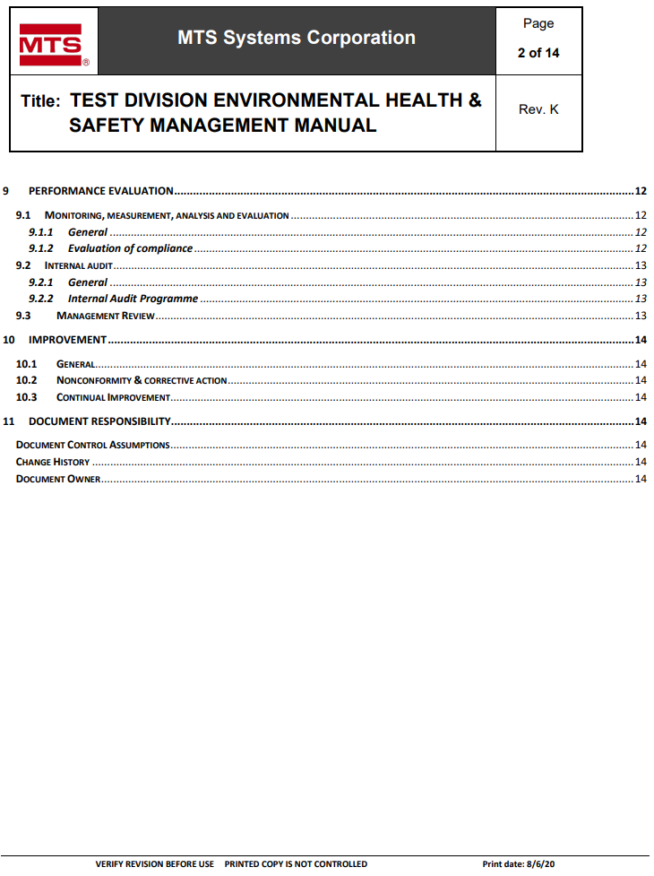
Location of EHS Manual

Slide 26
ISO 45001

Slide 27
The Five Big Changes 18001 to 45001
Business Context: Chapter 4.1, external and internal issues, introduces new clauses for systematic monitoring of business context.
Workers: Chapter 4.2 enhanced focus on needs and expectations for workers and other interested parties and worker involvement.
Risk Management: Chapters 6.1.1, 6.1.2.3, 6.1.4, companies assess and take action to address risks or opportunities that impact (positively or negatively) to enhance health and safety at the workplace.
Leadership and Management Commitment: Chapter 5.1, stronger emphasis on top management to actively engage, accountability for management system.
Objectives and Performance: More focus on objectives as drivers for improvements ( 6.2.1,6.2.2) and performance evaluation (9.1.1).

Slide 28
More 45001 Extended Requirements
Bottom-Up Communication: Participation, consultation and participation of workers (5.4)
Communication (7.4): More prescriptive in “mechanics” of communication: what, when and how to communicate.
Procurement: Including outsourced processes, and contractors (8.1.4)
450001 Communicate Up, Down and Sideways

Slide 29
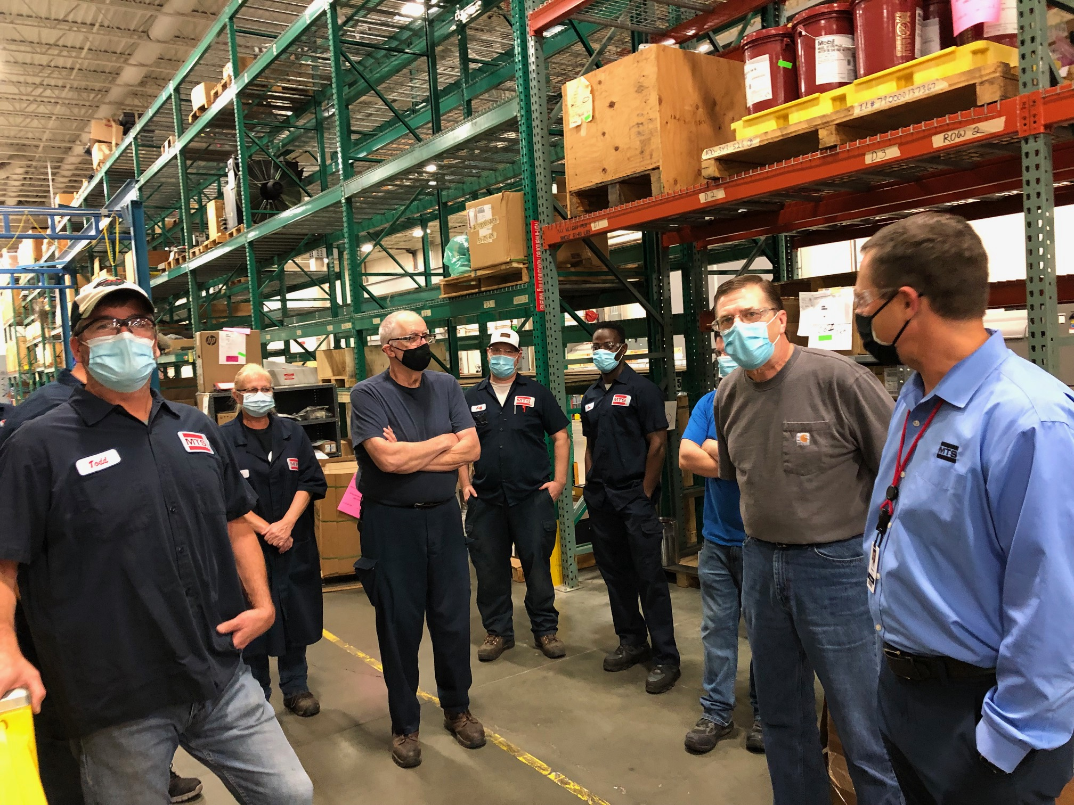
Enhanced Engagement Top Management
MTS Leadership in Monthly Gemba Walks

Slide 30
Example: Bottom-Up Communication
Pic of Safety Committee meeting
MTS Leadership in Monthly Gemba Walks

Slide 31
2020 EHS Communication Plan
Touch Points with Mangers Cascading
Special Presentation (COVID, Corrective Action, QMS, etc.)
Safety Committee Restart with Monthly Meetings
Homepage
Workplace Screens
Townhall Meeting
Created and Executed Structured Communication Plan

Slide 32
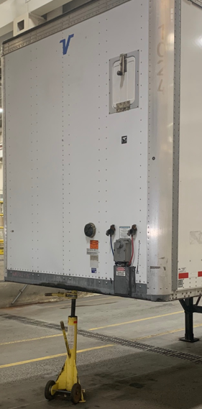
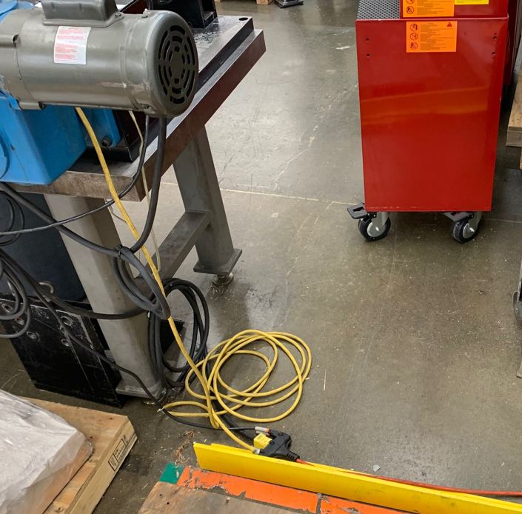
2020 EHS Communication Plan
Weekly EHS Checkup

Slide 33
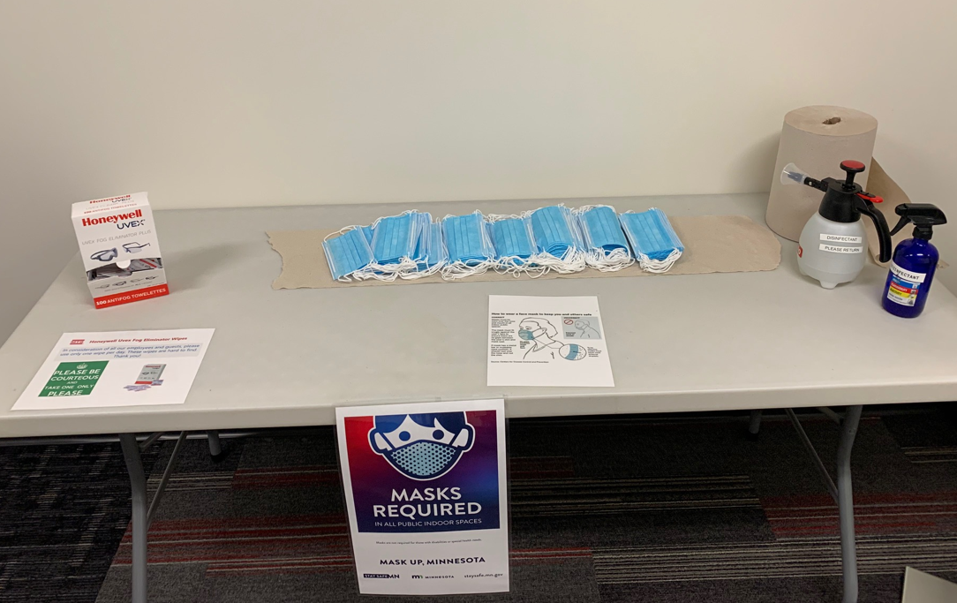
45001 Focus Workers Illness in Workplace
EHS Assumed Role of Covid-19 Response

Slide 34
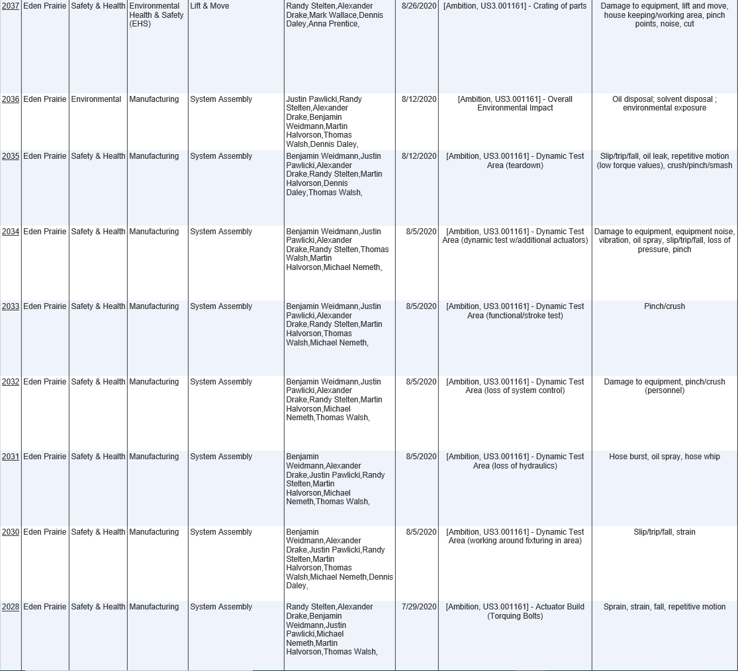
Example: Seek Risks and Opportunities
Ambition/ATC Risk Assessment Followed by plan oversight

Slide 35
Example: Seek Risks and Opportunities
Insert pic of the Ambition Area and three leaders with team huddled around them
Ambition/ATC Risk Assessment Followed by plan oversight

Slide 36
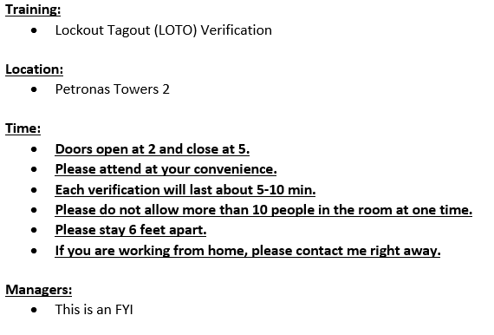
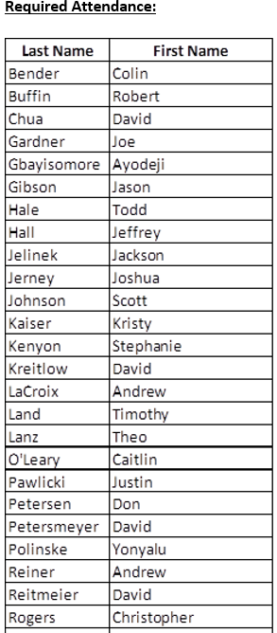
LOTO Verification

Slide 37
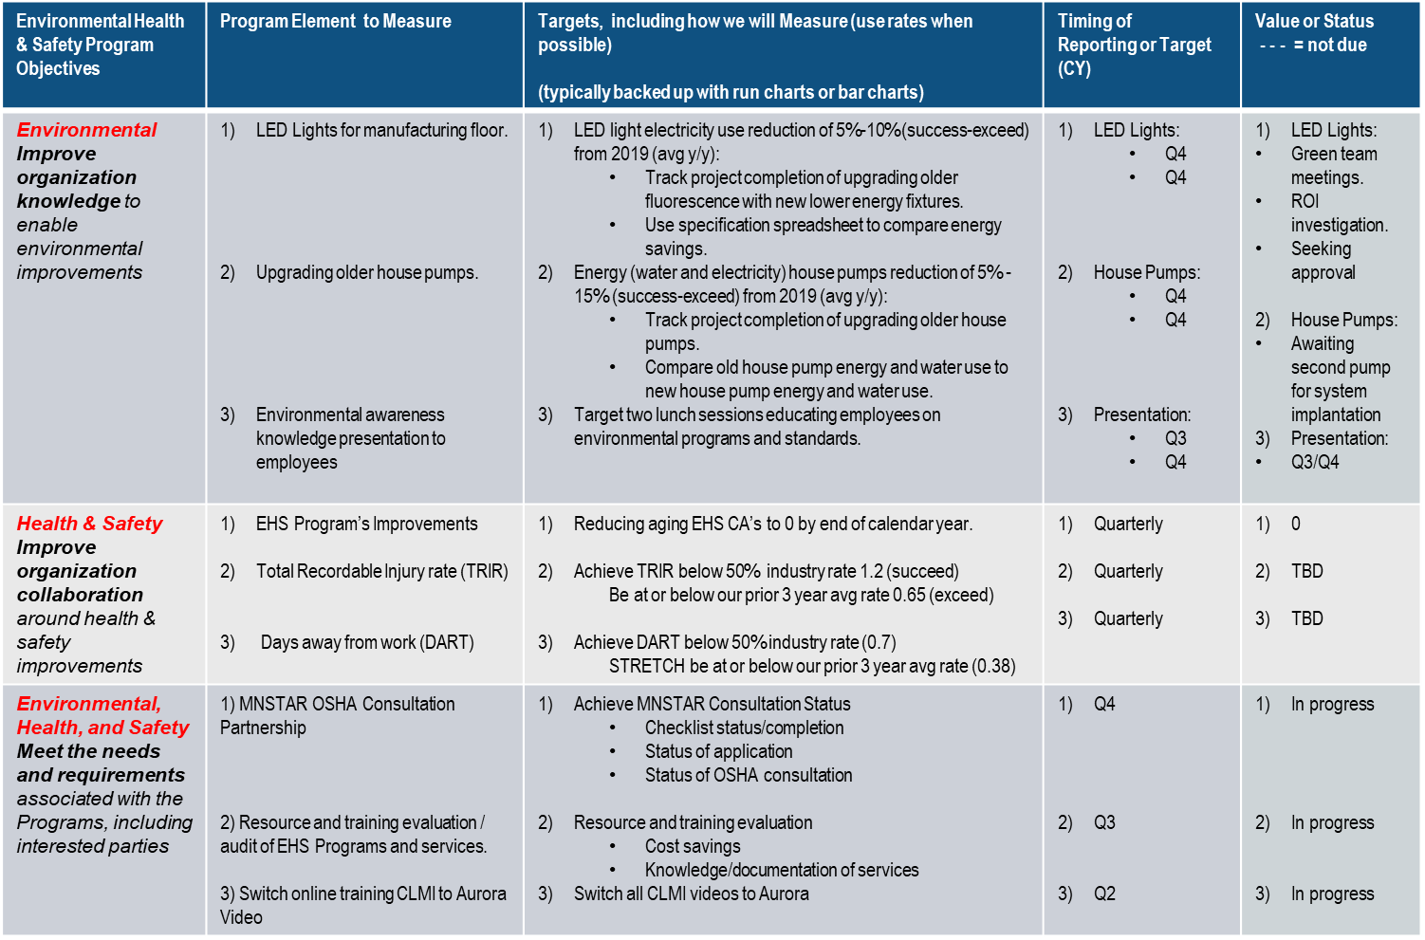
Example: More Focus on 2020 Objectives

Slide 38
Example: Status of 2020 Objectives
Environmental Health & Safety Program Objectives | Program Element to Measure | Targets, including how we will Measure (use rates when possible) (typically backed up with run charts or bar charts) | Timing of Reporting or Target (CY) | Value or Status - - - = not due
Environmental Improve organization knowledge to enable environmental improvements | LED Lights for manufacturing floor. Upgrading older house pumps. Environmental awareness knowledge presentation to employees | Bidding is taking place currently. Once bidding is completed, we will seek approval from purchasing. One pump is being retrofitted and ready for install. Second pump is on track to be built in September 2020. Completed the Notice of Violation (NOV) CA. Will build a presentation and present after COVID-19 Events. | LED Lights: Q4 Q4 House Pumps: Q4 Q4 Presentation: Q3/Q4 | LED Lights: Green team meetings. ROI investigation. Seeking approval House Pumps: Awaiting second pump for system implantation Presentation: Q3/Q4
Health & Safety Improve organization collaboration around health & safety improvements | EHS Program’s Improvements Total Recordable Injury rate (TRIR) Days away from work (DART) | Currently have zero overdue CAs TRIR – 0.74 DART – 0.74 | Quarterly Quarterly Quarterly | 0 Waiting for industry standard Waiting for industry std
EHS Meet the needs and requirements associated with the Programs, including interested parties | 1) MNSTAR OSHA Consultation Partnership 2) Resource and training evaluation / audit of EHS Programs and services. 3) Move online training CLMI to Aurora Video | Created a check list to ensure completion of application Partnered with Travelers Insurance to access Risk Portal. Also partnered with 212 medical clinic to build a one stop shop for workplace injuries. Working to expand on other items (i.e. drug tests, etc.) Majority of videos have switched. | Q4 Q3 Q2 | In progress In progress In progress

Slide 39
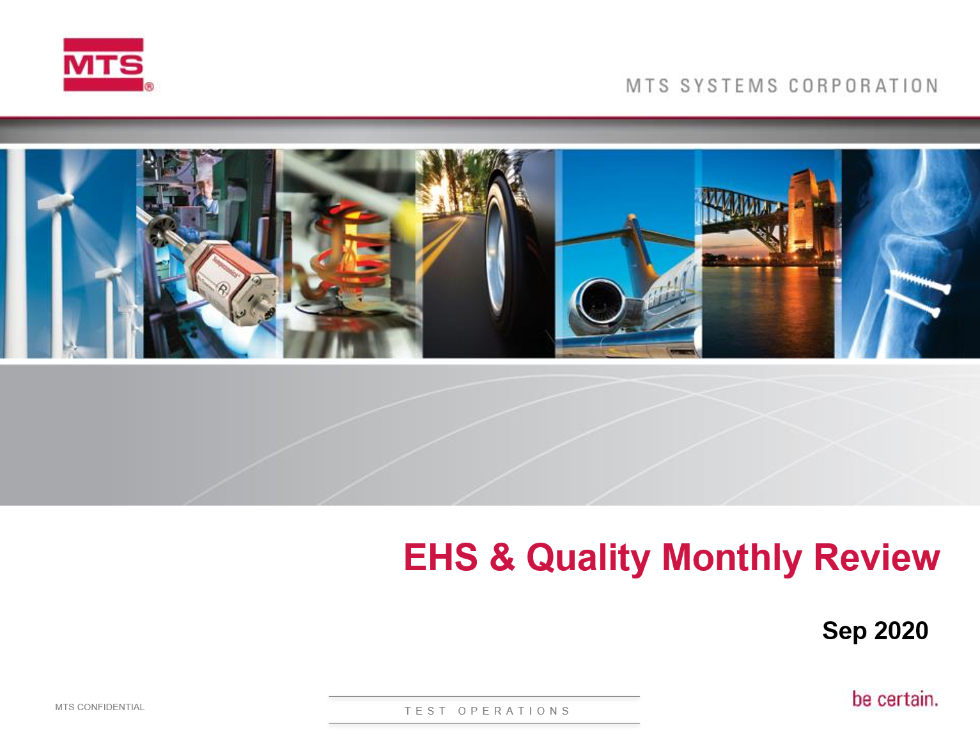
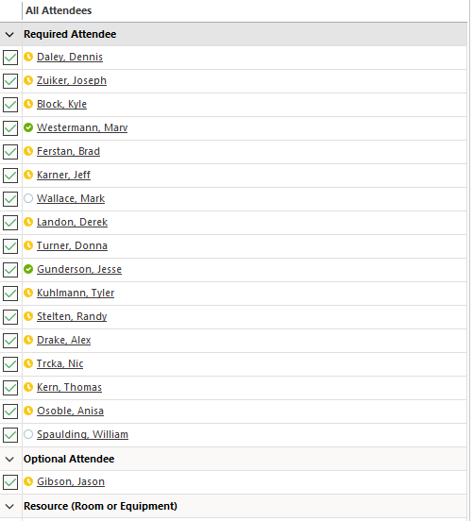
45001 Leaders Actively Engaged
First Thursday of Month Presentaion to VP and Directors

Slide 40
Engaged Procurement and Outsourcing
Seller agrees to provide Buyer with information requested by Buyer such that Buyer has knowledge of Seller’s operations in order for Buyer has analyzed and ensured control of the risks:
the Seller’s activities and operations that impact the Buyer;
Buyer activities and operations that impact the Seller’s workers;
Seller’s activities and operations that impact other interested parties in the workplace.
Seller shall communicate any additional Environmental Health and Safety requirements to safely perform their job task(s) to the Buyer by emailing EHS@MTS.com.
EHS Reviews Outsourcing/Contractor OS&H Expectations

Slide 41
Engaged Procurement and Outsourcing
8.1.4.2 Contractors The organization shall coordinate its procurement process(es) with its contractors, in order to identify hazards and to assess and control the OH&S risks arising from:
  a) the contractors’ activities and operations that impact the organization;
  b) the organization’s activities and operations that impact the contractors’ workers;
  c) the contractors’ activities and operations that impact other interested parties in the workplace.
  The organization shall ensure that the requirements of its OH&S management system are met by contractors and their workers. The organization’s procurement process(es) shall define and apply occupational health and safety criteria for the selection of contractors.
  NOTE It can be helpful to include the occupational health and safety criteria for the selection of contractors in the contractual documents.
Inserted into MTS POs Terms and Conditions

Slide 42
Summary and Conclusion

Slide 43
Summary: Audit Prep Key Takeaways
We must correct past employee findings
Top management enhanced engagement
Much more communication at all levels
Safety Committee vital in enhanced communications
EHS communication plan is critical
Procurement required to seek contractor expectations
QMS is to ensure regulatory and customer requirements

Slide 44
Three Conclusions
1. All employees—at all levels—must locate three pages: (1) QMS Home Page, (2) QMS Core Quality Page, and (3) EHS Home Page
2. All employees—at all levels—should know the 7.3 Awareness Clause: The QMS system exits to meet customer and regulatory requirements system and sets up the MTS Quality Policy and MTS Quality Objectives that exist to ensure regulatory compliance
3. Transition from 18001 to ISO 45001 will require changes at all levels of company (executive, salary, and hourly) with a laser focus on improving the workers health in the workplace.
Please ensure all employees know these three items!

Slide 45
Questions

