Slide 1
MTS Integrated Management System (IMS) Manual ISO 9001:2015 (Quality) ISO 14001:2015 (Environmental) ISO 45001:2018 (Occupational Health & Safety)

Slide 2
What has Changed?
Merged the MTS Quality manual (QM) with the EH&S Quality manual.
The Integrated Management System (IMS) manual now includes:
Quality (ISO 9001)
Environmental (ISO 14001)
Occupational Health and Safety (ISO 45001)
Added MTS/ITW business models:
80/20 Front to Back process
Customer Back Innovation (CBI)
USa
MRD
In-lining
Revised the IMS Manual to reflect current state of the management system.

Slide 3
What is in the IMS Manual?
1 MTS INTEGRATED MANAGEMENT SYSTEM POLICY, GUIDING PRINCIPLES, AND OBJECTIVES
2 SCOPE
Certifications and sites of certifications
3 DEFINITIONS
4 CONTEXT OF THE ORGANIZATION-
Understanding external and internal issues
MTS/ITW business model
5 LEADERSHIP
Roles and responsibilities of Senior Management Team
Consultation and participation of workers

Slide 4
What is in the IMS Manual? (cont.)
6 PLANNING
Actions to address risks and opportunities
IMS objectives and planning to achieve them
7 SUPPORT
Resources, people, infrastructure
Monitoring and measurement resources
Organizational knowledge and competence
Awareness and training
Communication, participation and consultation
Document control - includes all MTS documents

Slide 5
What is in the IMS Manual? (cont.)
8 OPERATION
Operational Planning and Control
Product Realization
Identification of environmental and occupational aspects and risks
Eliminating hazards and reducing risks
Management of change (MOC)
Procurement
Contractors and Outsourcing
Emergency Preparedness and Response
Determination of requirements for products and Services
Design and development of products and services
Customer Back Innovation (CBI)
Production and Service provision
Identification and traceability
Release of products and services
Inspection documentation
Control of nonconforming process outputs, products and services

Slide 6
What is in the IMS Manual? (cont.)
9 PERFORMANCE EVALUATION
Monitoring, measurement, analysis and evaluation
Customer satisfaction
Internal audit
Management Review
10 IMPROVEMENT
Continual Improvement
MTS/ITW business model
80/20 Front to Back business process
Customer Back Innovation (CBI)
Decentralized Entrepreneurial Culture
ITW Business Simplification
80/20 and Product Line Simplification (PLS)
In-lining
Market Rate of Demand (MRD)
Understand, Simplify and act (USa)

Slide 7
What is the MTS Management System?
The MTS Integrated Management System (IMS)
How MTS operates as a company
Documented within the MTS IMS Manual
Includes policies and objectives
Adheres to ISO standards (9001/14001/45001) in US, ISO 9001 in Europe
Inclusive of all operations, processes, and workers within MTS
Nothing is exempt including:
Individuals
Groups/Departments
Processes
Procedures
Documents and Records
All documents and procedures are management system/quality documents and require control!
If you have questions on how to properly control your documents, setup some time to meet with either Justin Pawlicki or Dave Kreitlow.

Slide 8
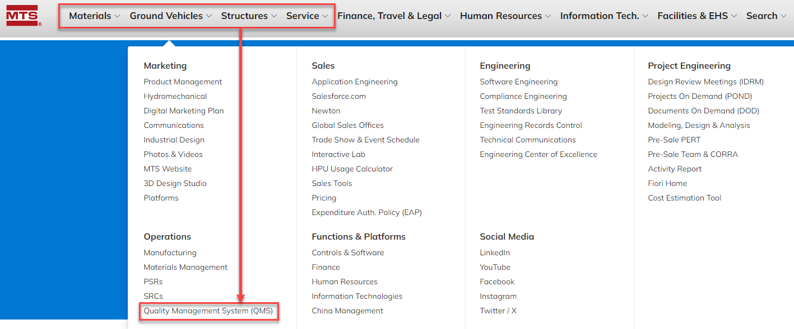
Where Can I Find the IMS Manual?
Use any of the Segment tabs to find the Quality Management System (QMS) Link

Slide 9
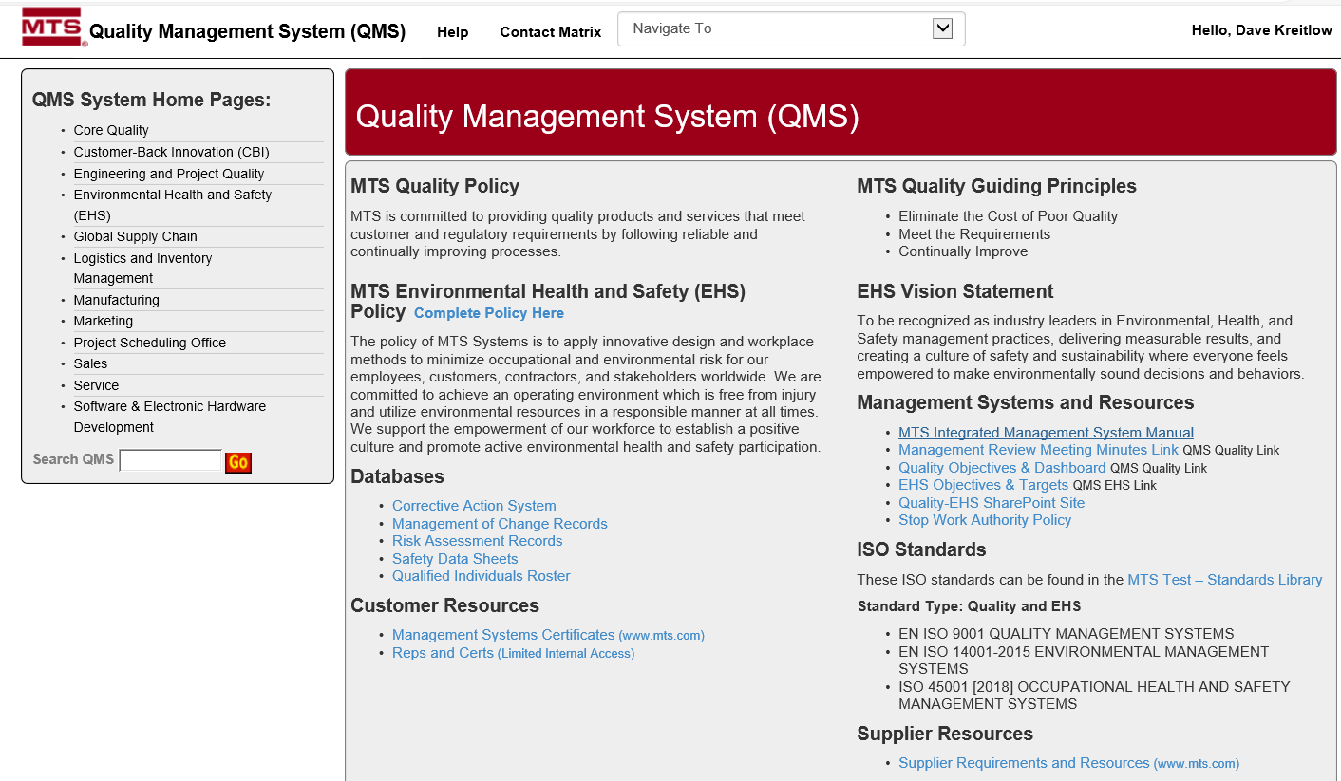
Where Can I Find the IMS Manual?

Slide 10
Wrapping it up…
The Quality and EH&S manuals have been integrated into one IMS manual.
The IMS Manual:
Defines and explains the MTS management system
Demonstrates how MTS meets the requirements of ISO 9001, 14001, and 45001
Defines the MTS/ITW business models
The IMS manual is located on the Quality Management System SharePoint site.

Slide 11
Questions?
If you have any questions about our Integrated Management System and associated IMS Manual, contact Justin Pawlicki or Dave Kreitlow.

