Slide 1
Newton Release 4.1 Training
April 2016
John Gibbs, Tom Owens, Connie Wussow

Slide 2
Agenda
Introductions and General Information
Newton Commerce Updates
Configurator Additions
Enhancements to Current Configurators
Enhancements to Delivery Terms and Transit Times
Other News and Reminders
Future Plans – Newton Road Map
Wrap-up and Q&A

Slide 3
General Info
Phones are muted
Please enter questions via Chat function
Chat questions will be addressed at the end of the WebEx
WebEx is being recorded
Recording will be posted on LMS
Recording will also be posted on Business Partners site

Slide 4
Release 4.1 Commerce Changes and Enhancements
Billing Plan Enhancement
Added Lead Time Details in Pencil Edit
Changed Layout in Pencil Edit
Costs on Part Search Items
Added Korea Sales Org (5400) on March 6th with Korea going live on SAP
Added a loading dialog on the ‘Return to Opportunity’ action
Fixed quote document issues on terms lines running together and how the ‘special terms’ text is displayed
Added note and improved view of Line Level Engineered Content

Slide 5
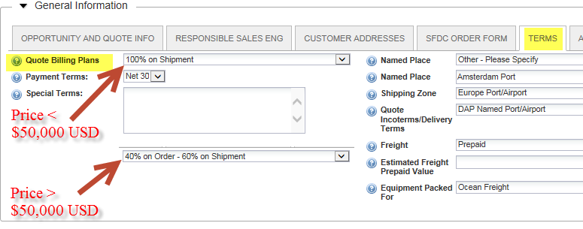
Billing Plan Enhancement
If the total price of your initial quote is less than $50,000 USD, then the Billing Plan defaults to: 100% on Shipment
If greater than $50,000 USD, it defaults to: 40% on Order – 60% on Shipment
Calculation is based on the currency of the Sales Org for that Opportunity
You make the final decision, but these are the preferred MTS Billing Plans

Slide 6
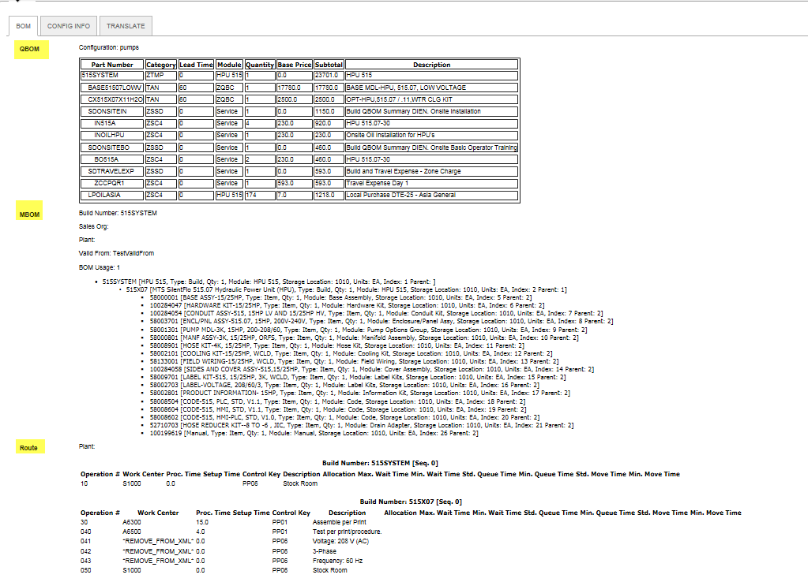
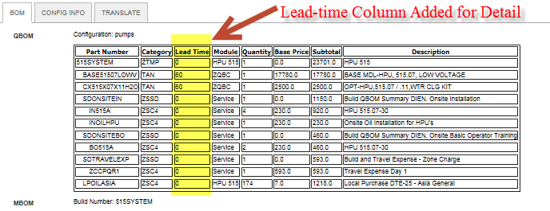
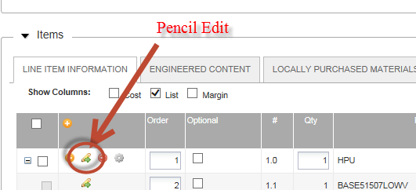
Changed format and added Lead Time details in Pencil Edit

Slide 7
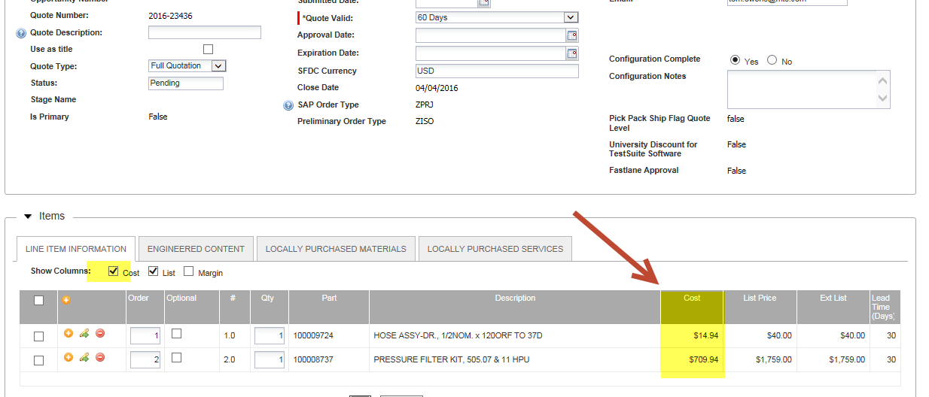
Added Costing for Part Search Items
If you have access to Costing Functionality (RSM and AE) it will bring across the costs for Part Search items

Slide 8
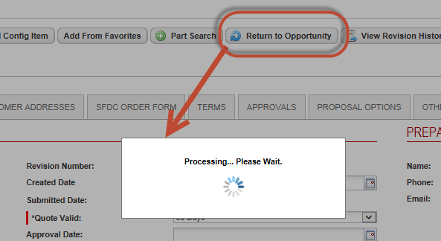
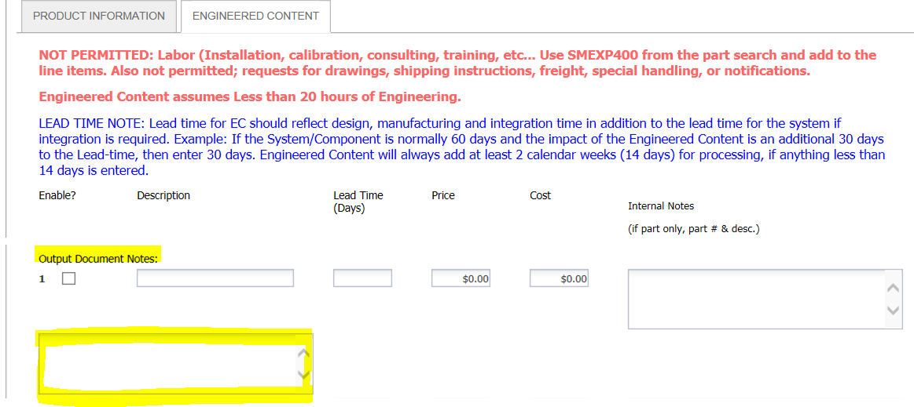
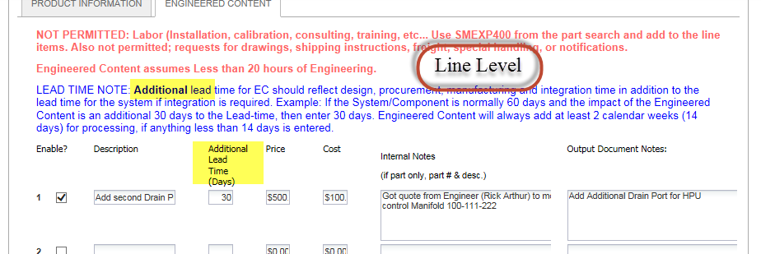
Other Commerce Items
Added a loading dialog on the ‘Return to Opportunity’ action
Added “Additional” notes and corrected small screen wrapping issue for Line Level of Engineered Content

Slide 9
Release 4.1 Configuration Additions and Enhancements
New Configurators
Alignment Fixtures
815/816 Rock Systems (QBOM Only)
Go Live week of April 25th
Enhancements to Existing Configurators
Landmark- Load-frame Station Supervisor (LSS)
515 & HPU Components Enhancements
MTS Materials Science Academic Offer (For EM Systems)
Filter to assist with Application Solutions (EM)
Crank Dyno and EMA enhancements
MS Excel and MS Office Status update
Extended Warranties

Slide 10
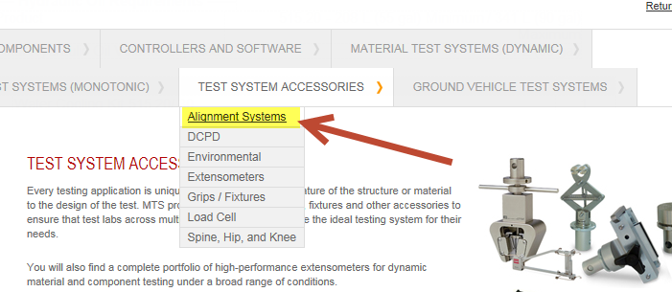
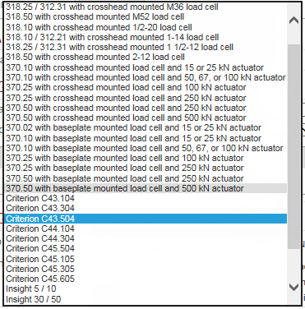
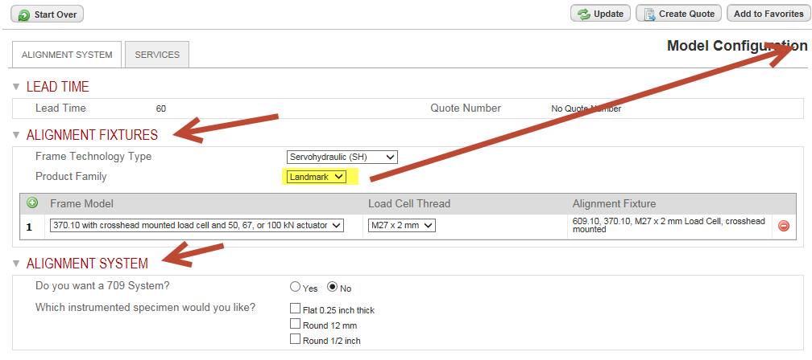
Alignment Systems Configurator
Able to quote Standalone Alignment Fixtures and Systems

Slide 11
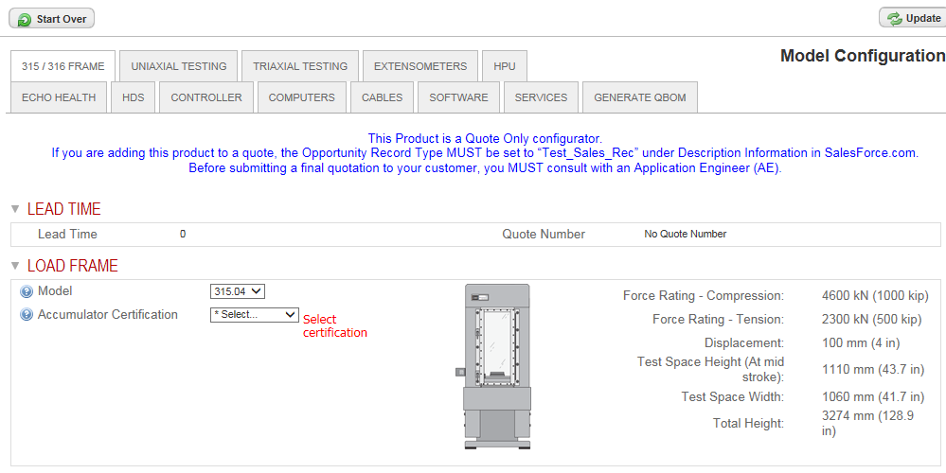
815/816 Rock System Configurator
Located under Material Systems Dynamic & QBOM Configurator
Please work with Greg Pence – Materials AE and look for Video on LMS

Slide 12
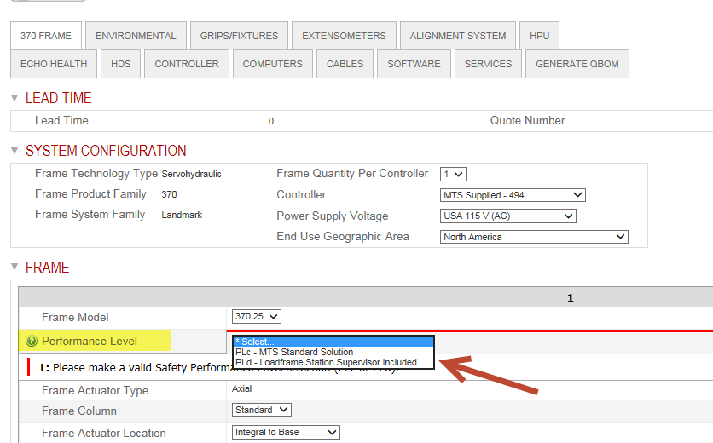
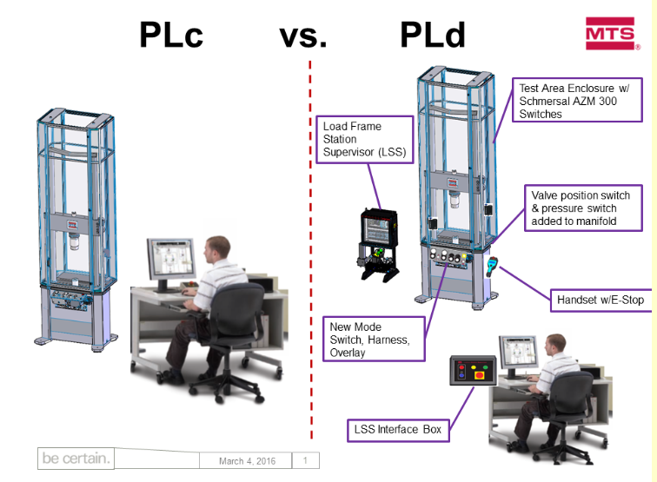
Landmark/Bionix Loadframe Station Supervisor –
Performance Level c and d

Slide 13
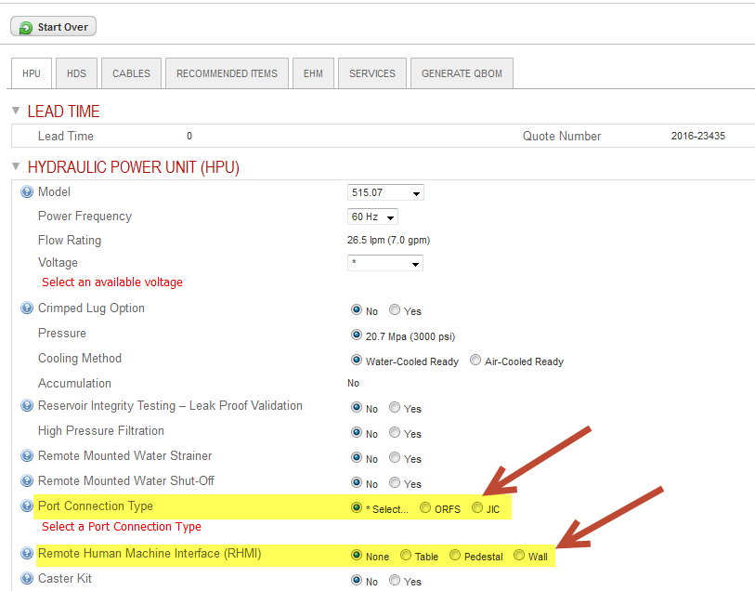
515 HPU Enhancements
Port Connection Type Selection
Remote Human Machine Interface (RHMI) is available for all sizes
Change to Echo Health Monitoring Selection

Slide 14
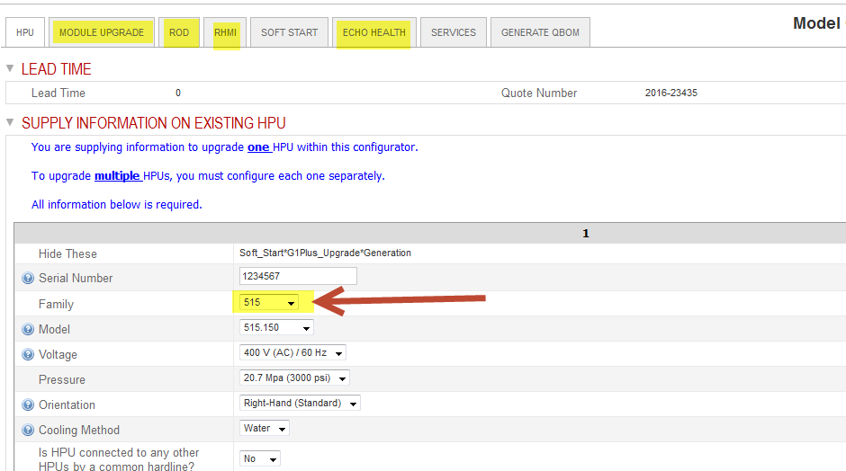
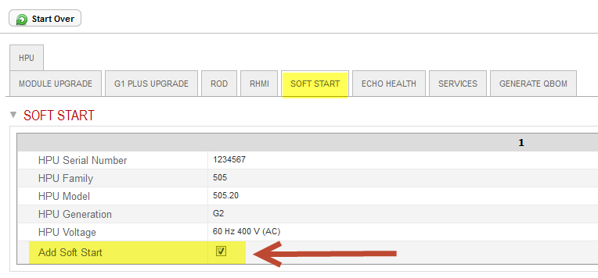
HPU Components Enhancements
515 Module Upgrades
515 RHMI Upgrade
515 EHM Upgrade
505 Soft Start for small HPUs (30 gpm or less)

Slide 15
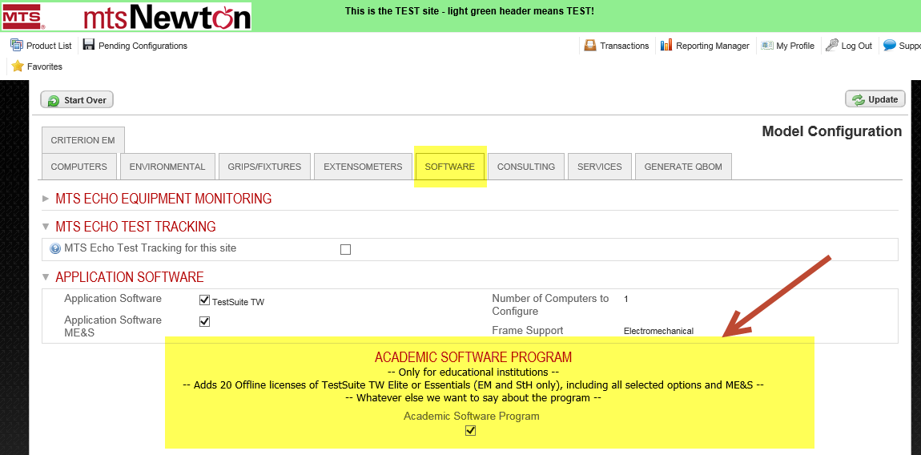
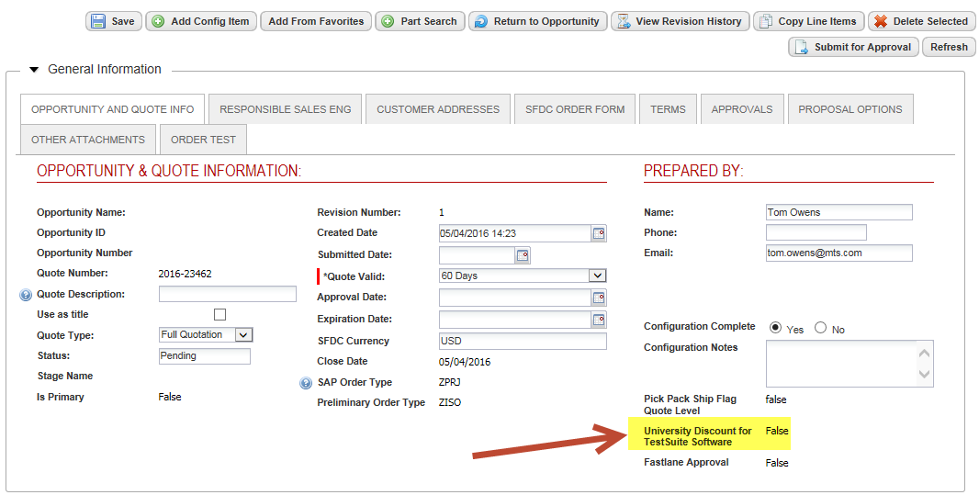
MTS Materials Science Academic Offer
Part of Criterion and Exceed System Configurators
Add Content and Descriptions to Quote
For now discounting is manual, hope to automate for next release

Slide 16
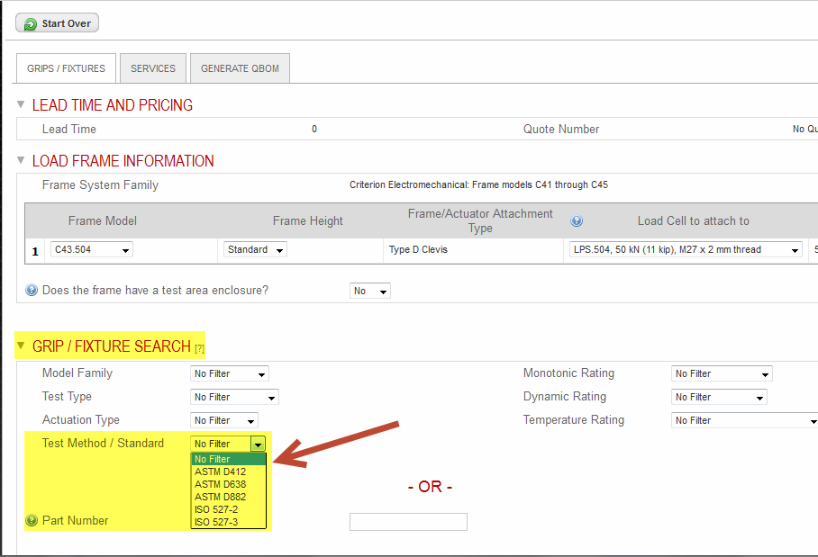
Filtering Accessories for Application Solutions (EM)
Finding appropriate accessories for your Testing Standard
In EM Systems as well as Grips & Fixtures and Extensometers Stand Alone

Slide 17
MS Excel and MS Office Update
Status will remain unchanged
MTS will provide MS Excel as part of any new computer
MTS will not provide MS Office or MS Excel Stand-alone
We encourage Business Partners and Customers to purchase their own copies of MS Products
This is mainly be driven by Microsoft’s licensing processes
We will continue to monitor

Slide 18
Extended Warranties – Added another Year
Now can add up to two years for Extended Warranty for key components
You still need then the appropriate number of Service Contracts for Routine Maintenance
This allows for 3 total years of warranty. Contact your AE if customer requires more than 3 years.

Slide 19
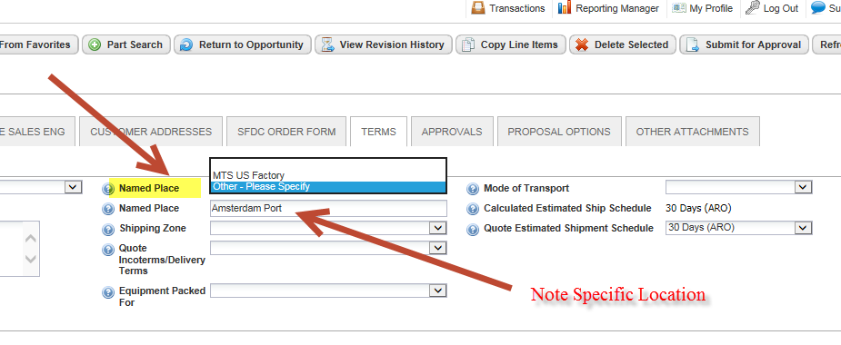
Delivery Terms (INCO Terms 2010)
Select the Named Place
MTS Factory or other Location (Transfer Point)

Slide 20
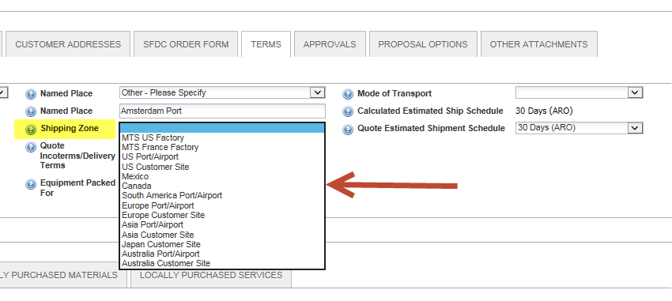
Delivery Terms
Select Shipping Zone – Where is the location of the Named Place

Slide 21
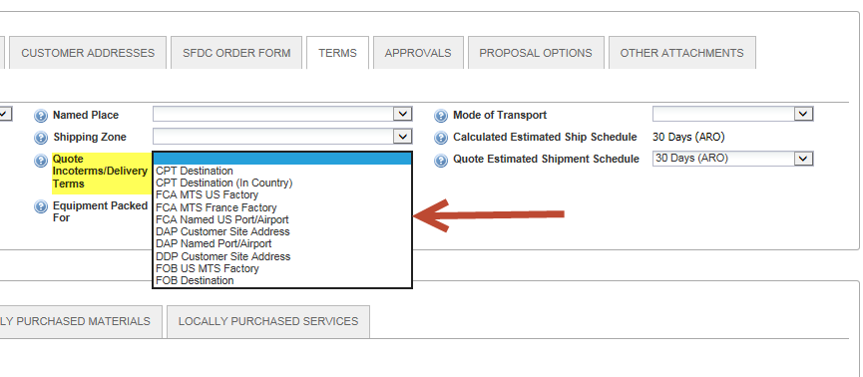
MTS Preferred Delivery Terms
Select Quote Incoterms/Delivery Terms
Select MTS’s Preferred Terms
Based upon your “Shipping Zone” there will be a reduced set of options

Slide 22
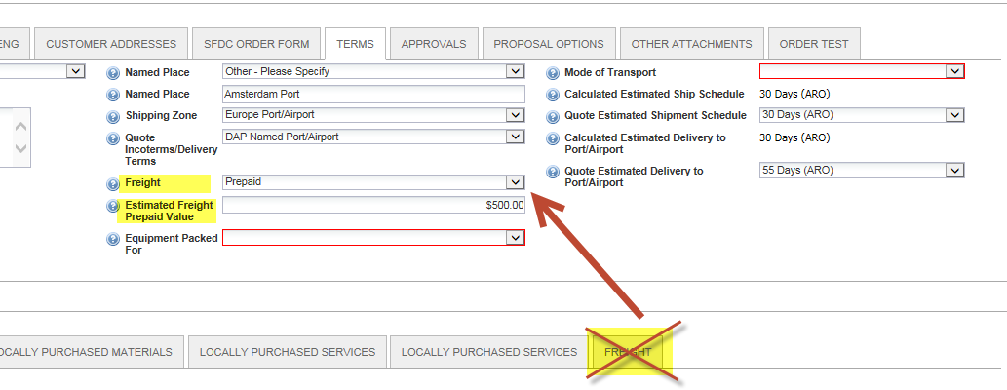
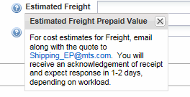
Freight Changes
Removed Existing Freight Tab
The Freight options is based on INCO/Delivery Terms
Prepaid, Prepaid and Charge, Collect
If Prepaid or Prepaid and Charge a Value Field will pop up
This eliminates the Freight Tab

Slide 23
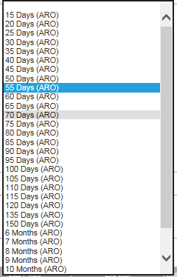
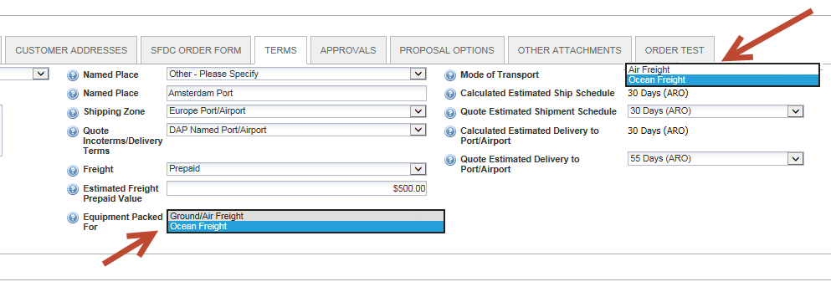
Shipping Enhancements
Select “Equipment Packed For” – Ground/Air or Ocean
Select “Mode of Transport” – This adds in the Transit Time
“Estimated Shipment Schedule” means – Order to ready for shipment from MTS factory (Eden Prairie, Lexington, …)
Added more intervals in Pull Down menu

Slide 24
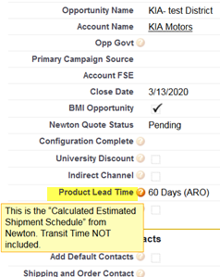
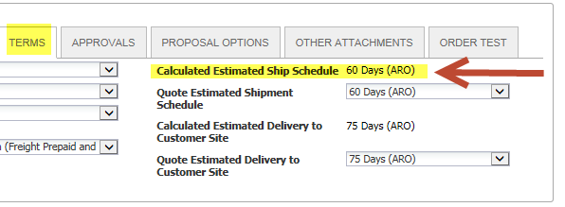
Additional Comments
MTS Preferred Terms – found in SFDC Useful Links Section in Opportunity
SFDC now imports the
“Calculated Estimated Ship Schedule” from Newton

Slide 25
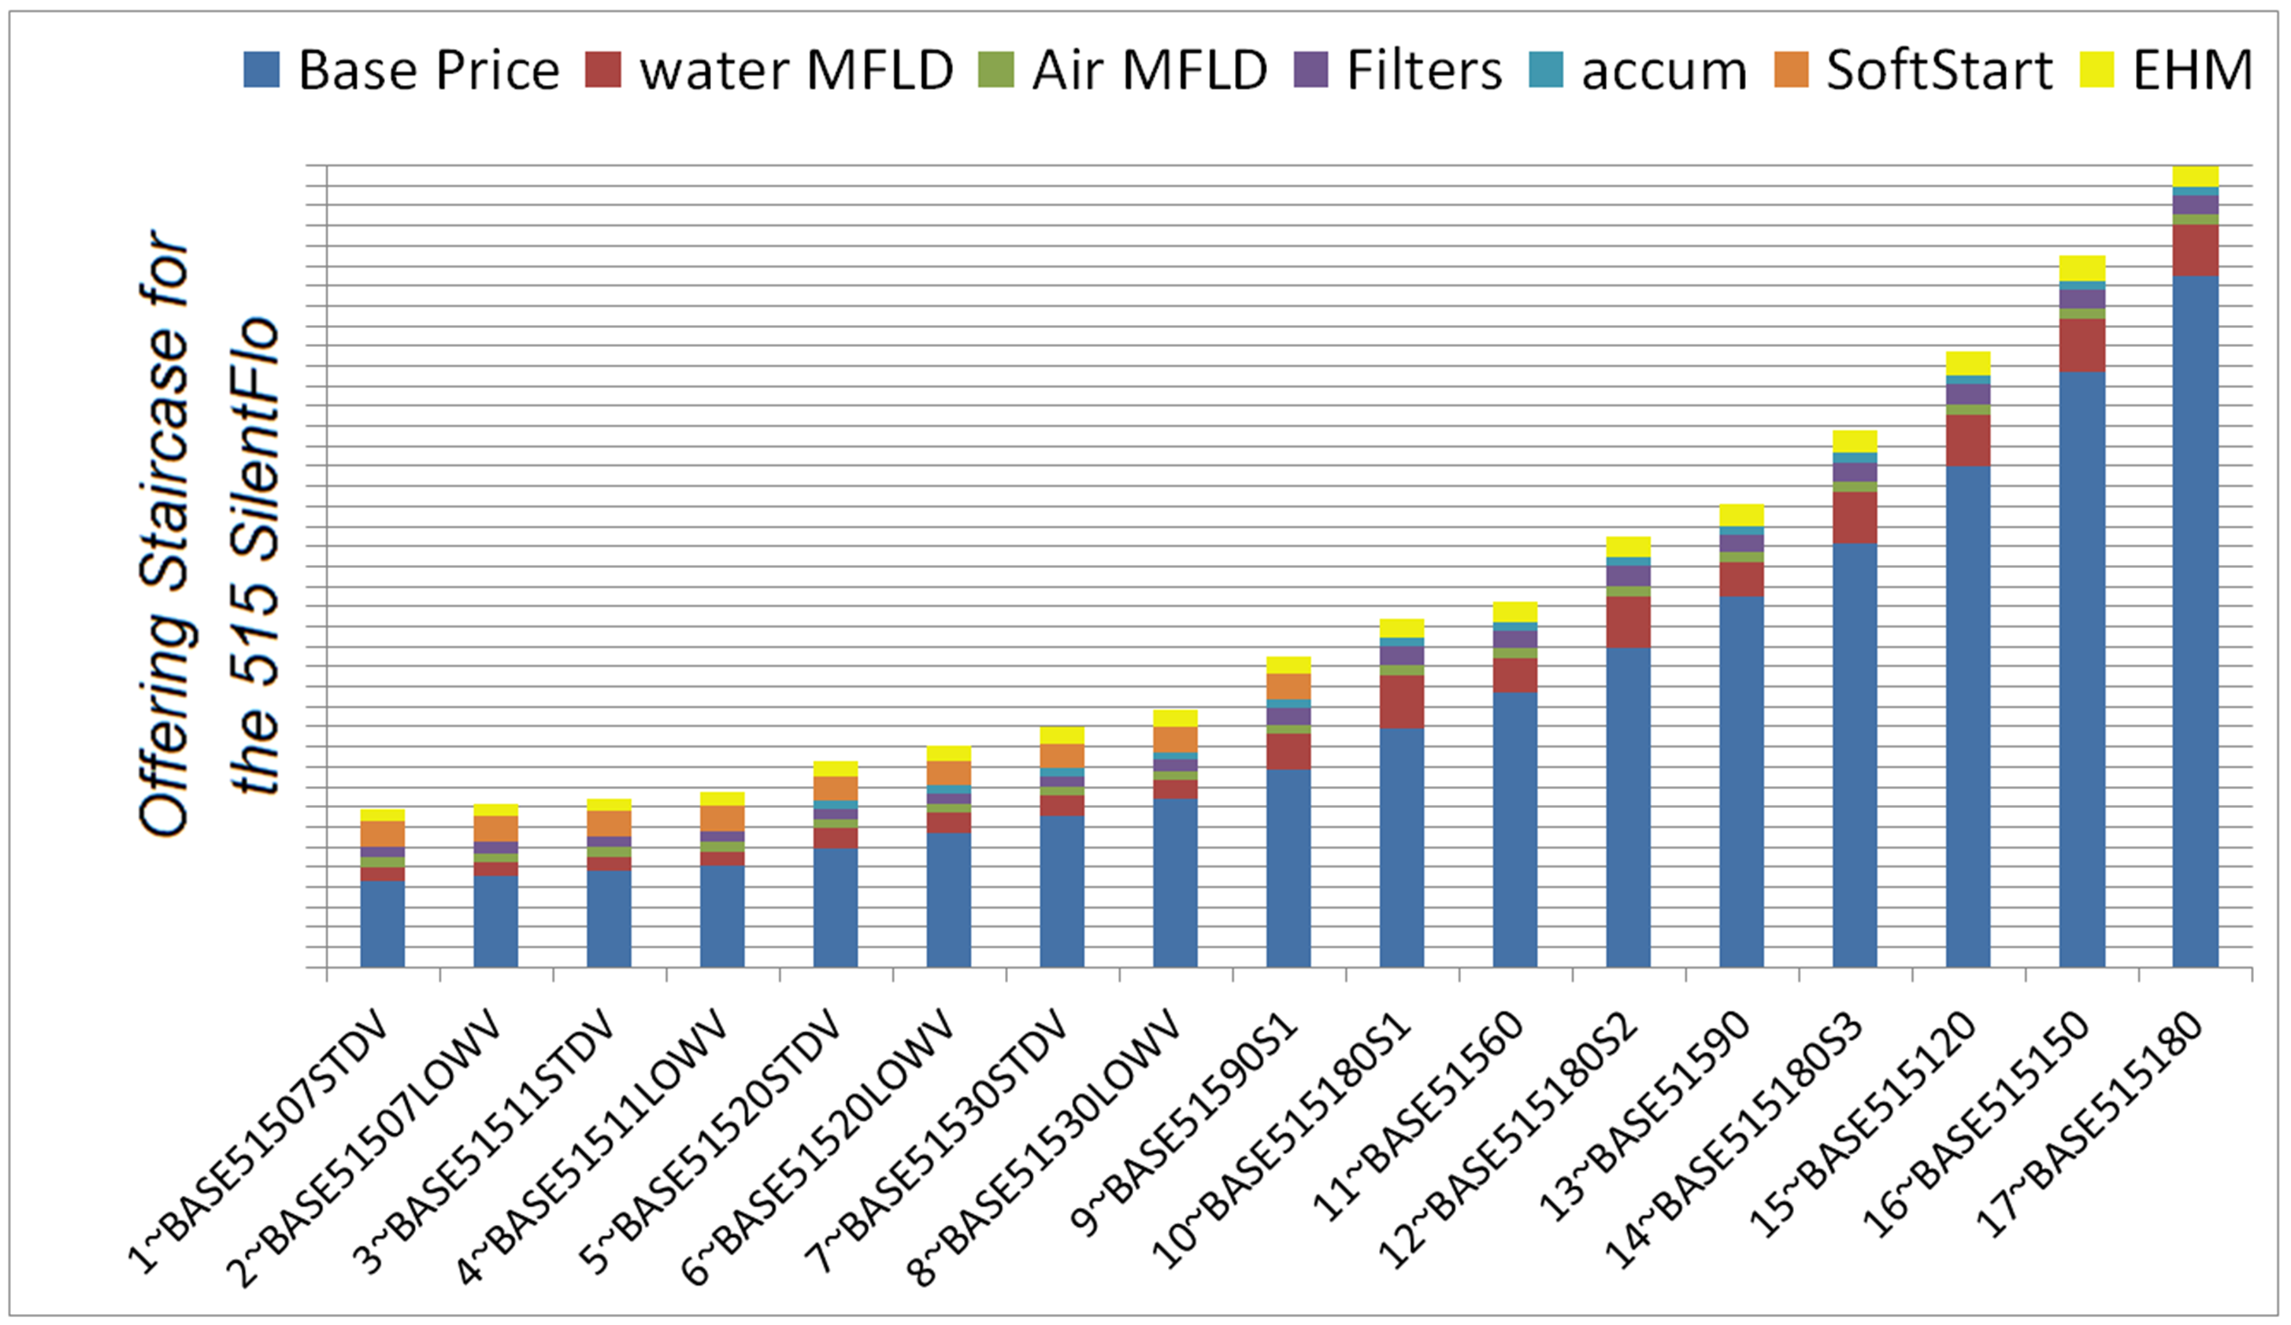
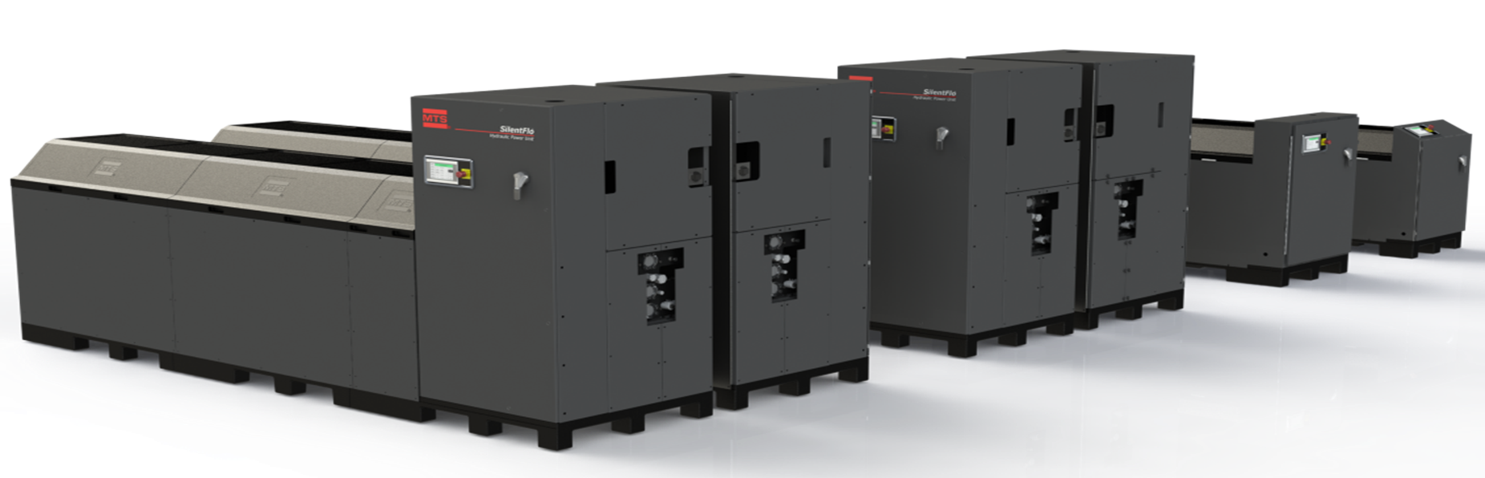
Other News and Reminders
515 HPU Pricing Adjustment
515 SilentFlo – now even greater options to Bundle in or out!
Helps express the value while creating competitive differentiation and flexibility in the offering price.
QBOM Blue Note
Final Terms entered on SOSF do not have to be the same as MTS Preferred Terms listed on our quote

Slide 26
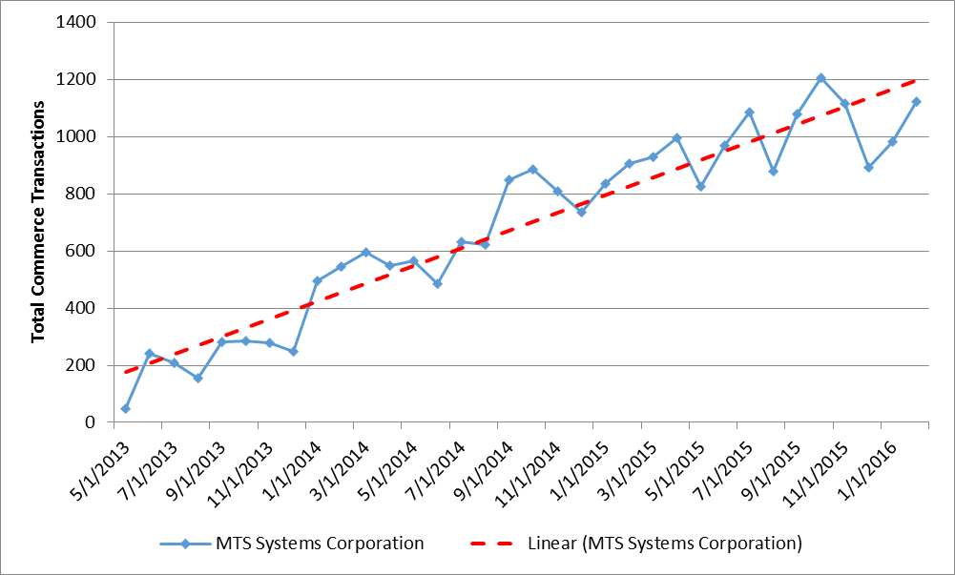
More News and Reminders
225 Issues resolved since Release 4.0
125 resolved during the past 4 months
100 more “migrating” tonight
Lead time disclaimer removed – covered in MTS Terms & Conditions
Newton Usage Increasing!

Slide 27
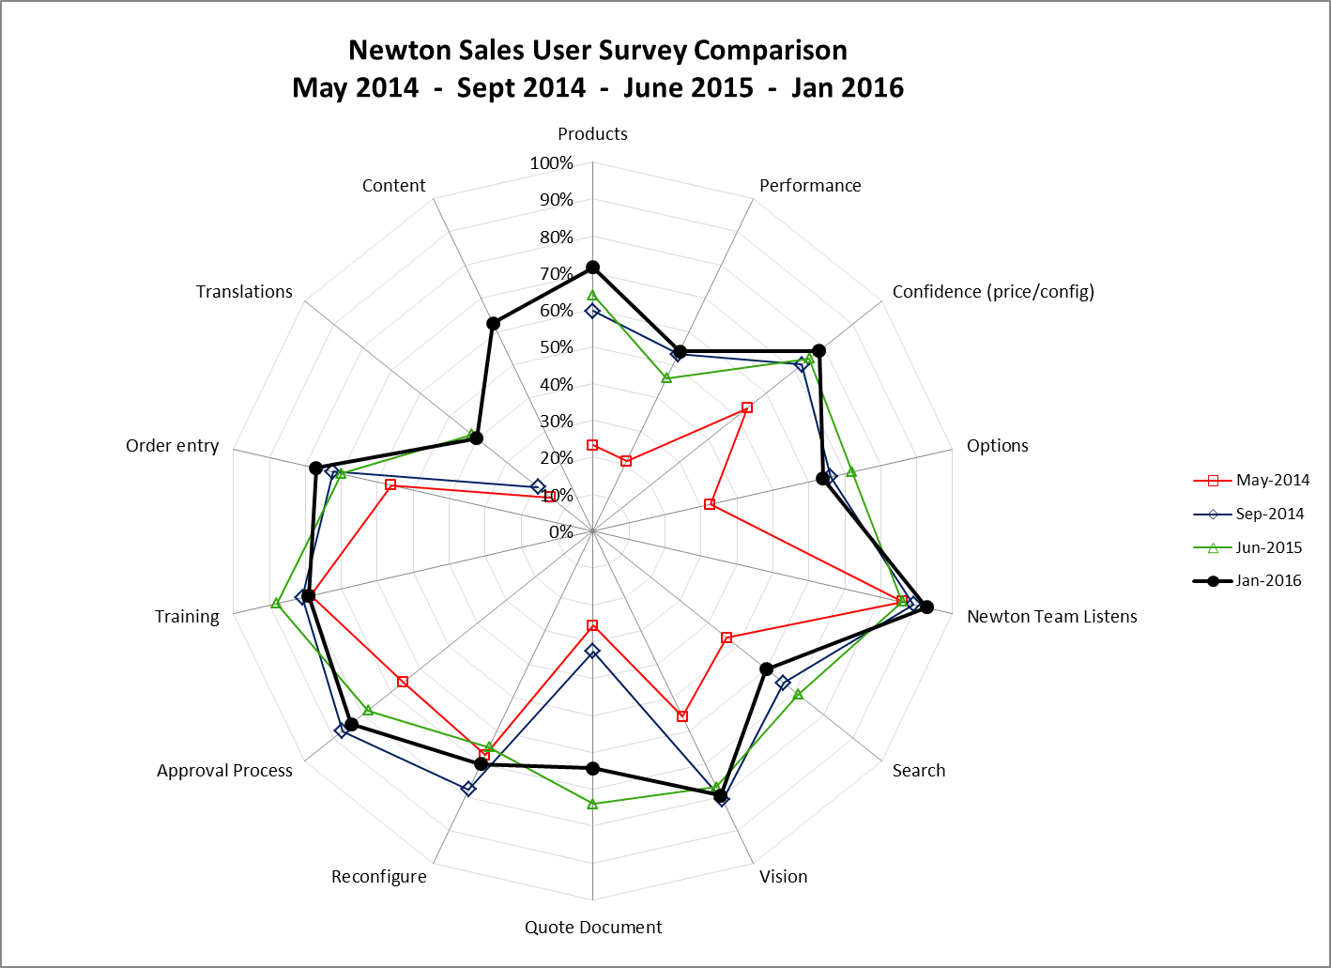
More News and Reminders
Quarterly Regional Newton Forums beginning in May
January Newton Survey
Newton Issue tracking of your SFDC Cases – set up “Alerts” on the Issues list to receive emails with updates of changes

Slide 28
Newton Road-Map
Configurators
Testline
244 G2 Actuator
Mid Tier Actuators
Acumen 3kN &12kN AT systems (R&D)
850 Damper
Functionality
Improved Costing Functions
Document Enhancements & Templates
Freight Estimator
Quoting/Pricing for Product Manual Translation
Controllers to ZISO (CRI Form integration and Lead-time Reduction)

Slide 29
Newton Contacts
John Gibbs
Sales Process Technology Manager
Connie Wussow
Sales Operations Manager
Tom Owens
Configuration Manager

Slide 30
Wrap-up
Thank you for your time and attention
Responses to Chat questions received during the presentation
Open discussion – time permitting
Once again – Thank You!

