Slide 1
Changes to MTS Terms and Conditions
November 2021

Slide 2
Changes to MTS Terms and Conditions
The following changes to the MTS Terms and Conditions will be applied starting November 2021
Until that date please continue to use the current version of the T&Cs
Out of the total 24 sections, only 11 have changes
The most significant change is related to section:
5. Order Cancellation/Termination
The MTS Supplemental Agreement has been updated as well.
http://spintranet.mts.com/sites/legal/Pages/Terms-and-Conditions.aspx

Slide 3
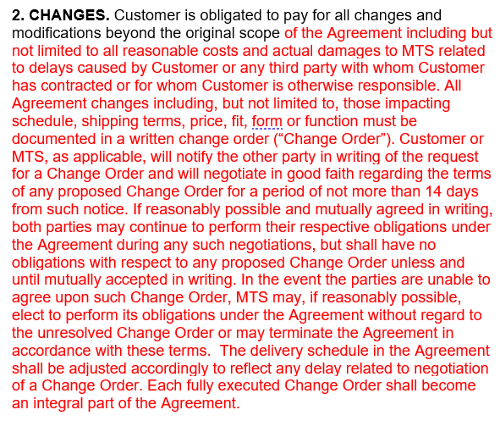
Section 2 – Contract Changes
Current
Future
Manages scope change to reduce MTS risks cost / payment / revenue.

Slide 4
Section 2 – Contract Changes
Language added:
Customer is obligated to pay for all changes and modifications beyond the original scope of the Agreement
Includes changes impacting schedule, shipping terms, price, fit, form, or function and must be documented in a written Change Order (see new Change Order template)
One party will notify the other in writing of the request for a Change Order and the parties will negotiate in good faith regarding the terms of the proposed change for a period of no more than 14 days from notice
Both parties will continue to perform their obligations during the negotiations and will have no obligations with respect to the Change Order until it is mutually accepted in writing
If the parties are unable to agree on the Change Order, MTS may elect to perform it obligations under the Agreement, without regard to the unresolved Change Order, or may terminate the Agreement
The delivery schedule in the Agreement will be adjusted to reflect any delay related to negotiation of a Change Order

Slide 5
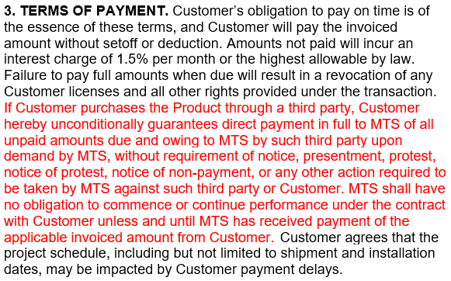
Section 3 – TERMS OF PAYMENT
Current
Future
Identifies that contract payer whether end customer or 3rd party is responsible for timely payments.

Slide 6
Section 3 – TERMS OF PAYMENT
Language added:
Customer’s failure to pay full amounts will result in a revocation of any Customer licenses and other rights provided under the transaction
When Customer purchases the Product through a third party, the Customer guarantees direct payment in full to MTS of all unpaid amounts due by such third party upon demand by MTS without requirement of notice
MTS is not obligated to continue performance under the contract with Customer until MTS has received payment as invoiced
Customer agrees that project schedule, including shipment and installation dates, may be impacted by Customer payment delays

Slide 7
Section 4 – Delivery Terms
Past
New
Updates shipping terms to align with most current Incoterms

Slide 8
Section 4 – Delivery Terms
Language Change:
All US domestic deliveries shall be shipped by MTS from the manufacturing facility of its choice [change from FCA Origin to CPT Destination, freight prepaid and added]
Reference to Incoterms® 2010 changed to “most recent version of Incoterms®”

Slide 9
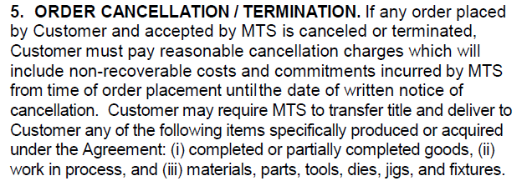
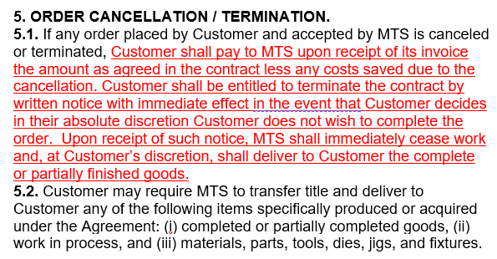
Section 5 – Order Cancellation/Termination
Past
New
Defines language for cancellation that is one of the requirements for percent complete revenue recognition

Slide 10
Section 5 – Order Cancellation/Termination
Language added to 5.1:
If any order placed by Customer and accepted by MTS is canceled or terminated, Customer shall pay to MTS upon receipt of its invoice the amount as agreed in the contract less any costs saved due to the cancelation
Customer shall be entitled to terminate the contract by written notice with immediate effect in the event that Customer decides in their absolute discretion Customer does not wish to complete the order
Upon receipt of such notice, MTS shall immediately cease work and, at Customer’s discretion, shall deliver to customer the complete or partially finished goods

Slide 11
Section 6 – Shipping Dates
Past
New
6. SHIPPING DATES. Shipping dates quoted represent a reasonable estimate of the time required for manufacturing at the time of quotation. These dates will not be construed as promises or contractual agreements to ship or deliver goods unless specifically agreed to in writing. MTS shall have no obligation to ship any Product unless and until MTS has received payment of the applicable invoiced amount from Customer.
Cash management by clarifying that MTS will not ship prior to receipt of contractual payment milestones.

Slide 12
Section 6 – Shipping Dates
Language added:
MTS shall have no obligation to ship any Product unless and until MTS has received payment of the applicable invoice amount from Customer

Slide 13
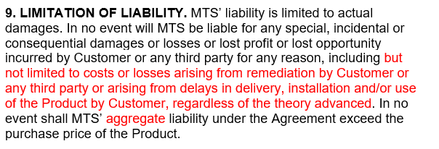
Section 9 – Limitation of Liability
Past
New
Expands liability definition to protect MTS’ exposure.

Slide 14
Section 9 – Limitation of Liability
Highlighted language added:
In no event will MTS be liable for any special, incidental or consequential damages or losses incurred by Customer or any third party including but not limited to costs or losses arising from remediation by Customer or any third party
Also added the word “aggregate” to liability [In no event shall MTS’ aggregate liability under the Agreement exceed the purchase price of the Product]

Slide 15
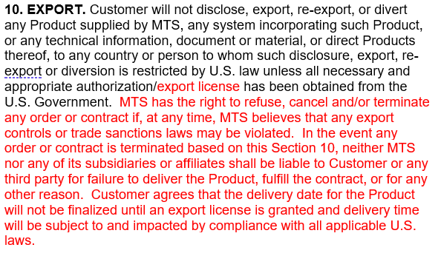
Section 10 – Export
Past
New
Clarifies trade impact to protect MTS’ exposure.

Slide 16
Section 10 – Export
Language added:
MTS has the right to refuse, cancel and/or terminate any order or contract if, at any time, MTS believes that any export controls or trade sanctions laws may be violated. In the event any order or contract is terminated based on this Section 10, neither MTS nor any of its subsidiaries or affiliates shall be liable to Customer or any third party for failure to deliver the Product, fulfill the contract, or for any other reason. Customer agrees that the delivery date for the Product will not be finalized until an export license is granted and delivery time will be subject to and impacted by compliance with all applicable U.S. laws.

Slide 17
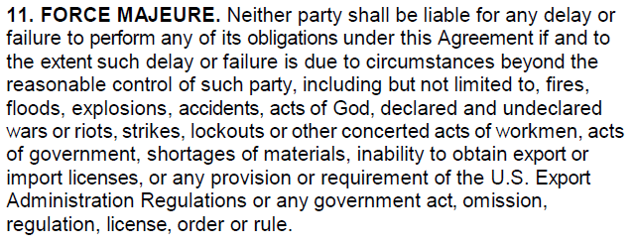
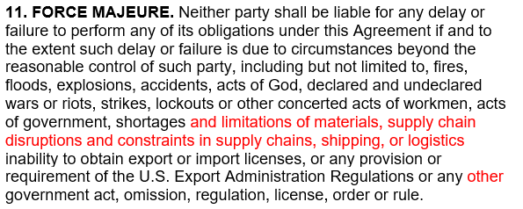
Section 11 – Force Majeure
Past
New
Expands definition to protect MTS’ exposure from events outside of our control.

Slide 18
Section 11 – Force Majeure
Highlighted language added:
Neither party shall be liable for any delay or failure to perform any of its obligations under this Agreement if and to the extent such delay or failure is due to circumstances beyond the reasonable control of such party, including but not limited to, fires, floods, explosions, accidents, acts of God, declared and undeclared wars or riots, strikes, lockouts or other concerted acts of workmen, acts of government, shortages and limitations of materials, supply chain disruptions and constraints in supply chains, shipping, or logistics, inability to obtain export or import licenses, or any provision or requirement of the U.S. Export Administration Regulations, or any other government act, omission, regulation, license, order or rule

Slide 19
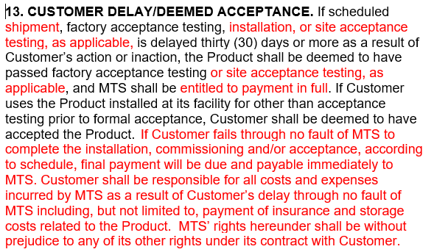
Section 13 – Customer Delay/Deemed Acceptance
Past
New
Expands delay definition to reduce cost / payment / revenue risks for MTS

Slide 20
Section 13 – Customer Delay/Deemed Acceptance
Highlighted language added:
If scheduled shipment, factory acceptance testing, installation, or site acceptance testing, as applicable, is delayed thirty (30) days or more as a result of Customer’s action or inaction, the Product shall be deemed to have passed factory acceptance testing or site acceptance testing, as applicable, and MTS shall be entitled to payment in full.
Language added:
If Customer fails through no fault of MTS to complete the installation, commissioning and/or acceptance, according to schedule, final payment will be due and payable immediately to MTS. Customer shall be responsible for all costs and expenses incurred by MTS as a result of Customer’s delay through no fault of MTS including, but not limited to, payment of insurance and storage costs related to the Product. MTS’ rights hereunder shall be without prejudice to any of its other rights under its contract with Customer

Slide 21
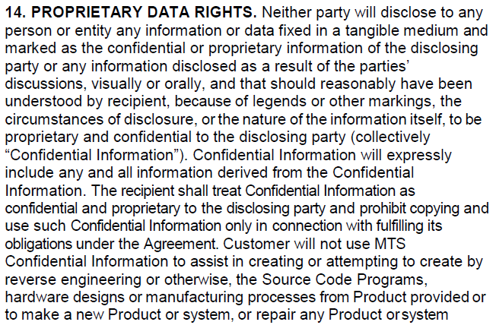
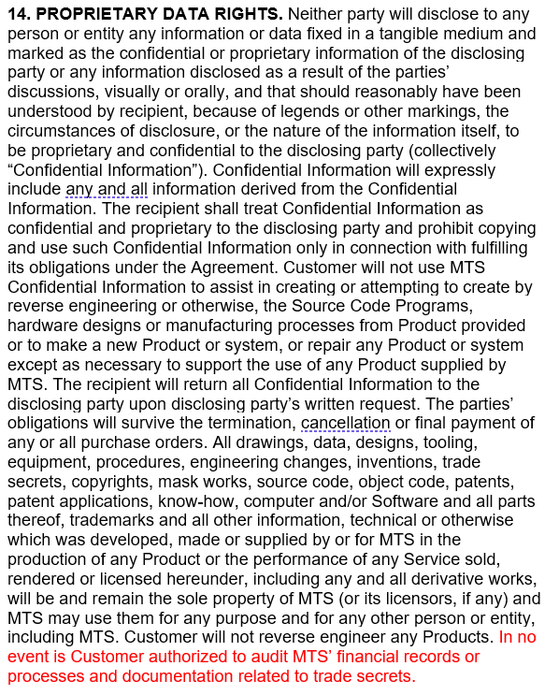
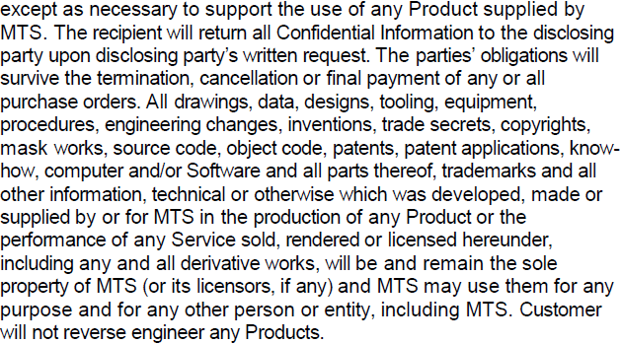
Section 14 – PROPRIETARY DATA RIGHTS
Past
New
Identifies no audit rights

Slide 22
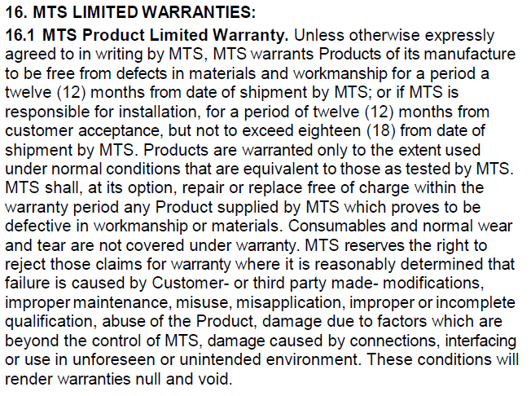
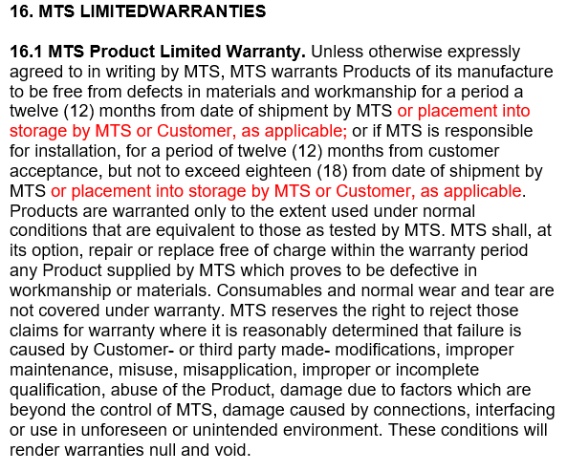
Section 16 – MTS Limited Warranties
Past
New
Manages warranty costs by identifying that placing goods in storage does not extend the warranty validity period.

Slide 23
Section 16 – MTS Limited Warranties
Highlighted language added
16.1 MTS Product Limited Warranty. Unless otherwise expressly agreed to in writing by MTS, MTS warrants Products of its manufacture to be free from defects in materials and workmanship for a period of twelve (12) months from date of shipment by MTS or placement into storage by MTS or Customer, as applicable; or if MTS is responsible for installation, for a period of twelve (12) months from customer acceptance but not to exceed eighteen (18) from date of shipment by MTS or placement into storage by MTS or Customer, as applicable

Slide 24
Section 18 – Nature of Breach
Past
New
Made number of days consistent with standards.

Slide 25
Section 18 – Nature of Breach
Change – Blue highlighted text deleted – Yellow highlighted text added
Liability for material breach under the terms set forth herein shall arise only after written notice is sent to the breaching party and cure of alleged breach [is not initiated] by breaching party does not occur within fifteen (15) [10 days] business days of receipt of notice

