Slide 1
Online Manuals
Todd Koester
Aaron Cook

Slide 2
Overview
Online Manuals moving to Echo
Cut over date is April 5, 2017
Standard Manuals (currently on mts.com)
Custom Systems Documentation (currently on CD)
Benefits
Improved User Interface
Improved Security
Cloud Solution – easily updated
Much improved processes in TechComm

Slide 3
Standard Manuals – Current
Current Manuals Library (Corporate Intranet)
mts.com (Public Internet)

Slide 4
Standard Manuals – Echo
In our future state, manual PDFs are managed in a single location.
(MTS employees can see content identified for audience type ‘MTS’ which may not be visible to the ‘Customer’ or ‘Business Partner’ audience type.)

Slide 5
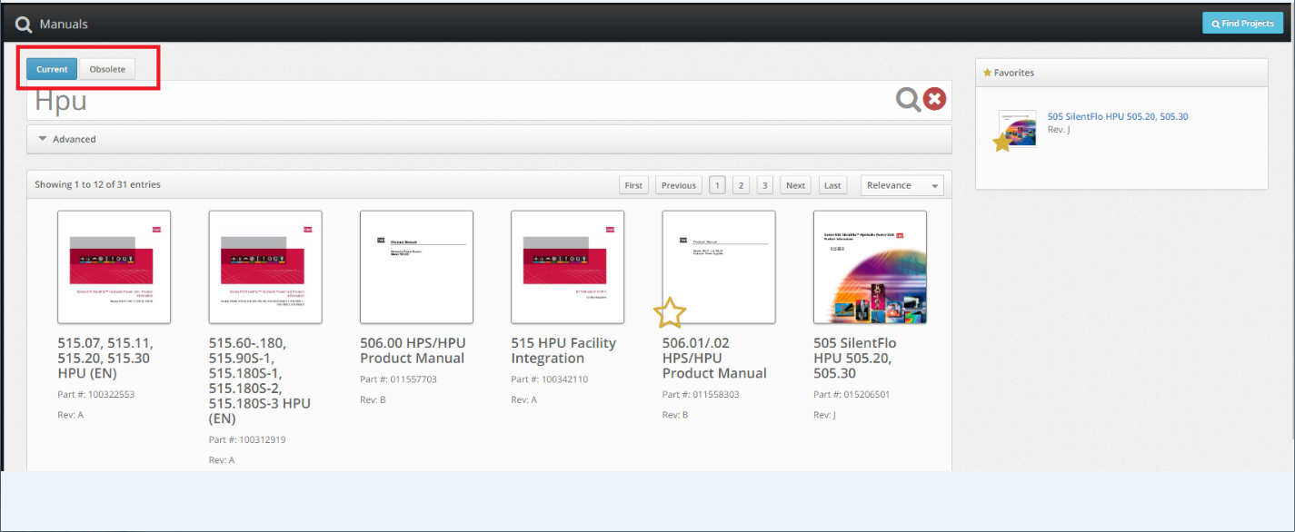
Standard Manuals – Echo
You can search for current or obsolete manuals (customers only can view current manuals):

Slide 6
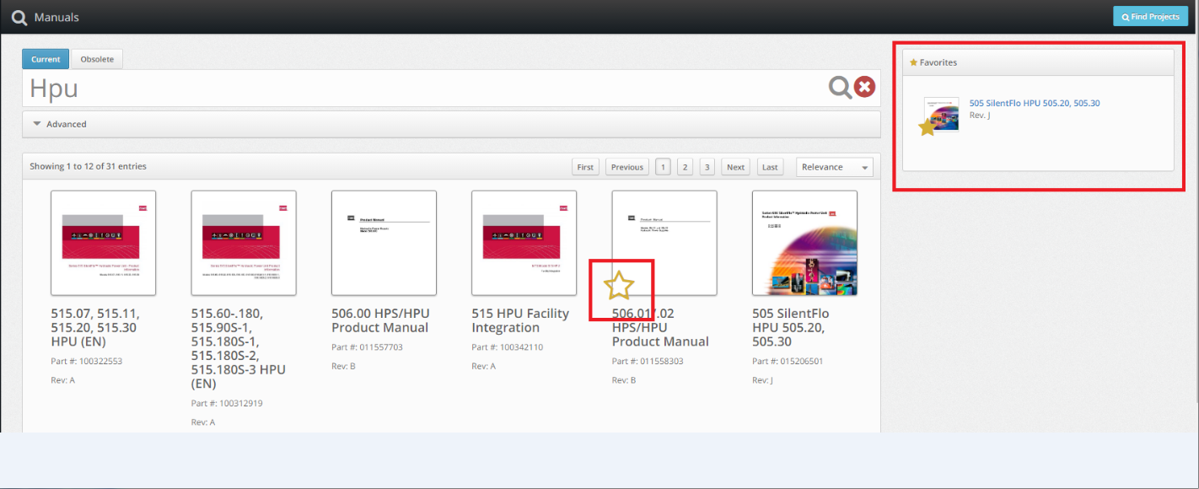
Standard Manuals – Echo
You can set up favorites and have them displayed for easy future reference:

Slide 7
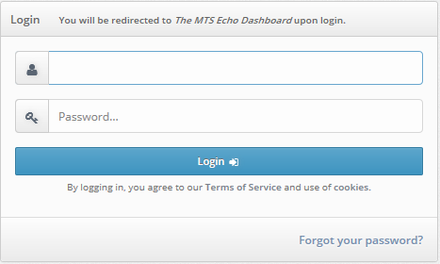
Standard Manuals – Echo
MTS employees have access to standard manuals. Access Echo through this link: https://mtsecho.com/login
Employees enter their MTS email address and GO Domain password.

Slide 8
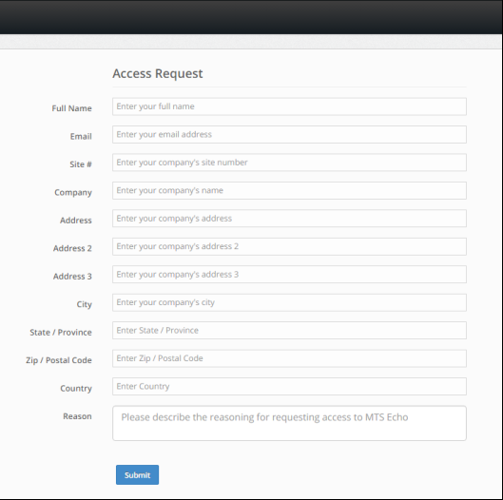
Standard Manuals – Echo
After April 5, customers will re-directed from mts.com to Echo. If they don’t have an account they will sign up to gain access:
The Echo account is free of charge, but now required.

Slide 9
Important Information:
Echo account (free of charge) now required to view standard documentation.
“Seeding” Echo database with customer projects from 1/1/16 – 9/1/17 and pushing out email notification.
Customers will request Echo account and MTS call center will review and grant access if a customer.
MTS employees automatically have access; customers will sign up if they already don’t have an Echo account.

Slide 10
Custom Systems – Current
The project BOM, parts lists, and drawings are compiled as a website, burned to CD and ship with the system.

Slide 11
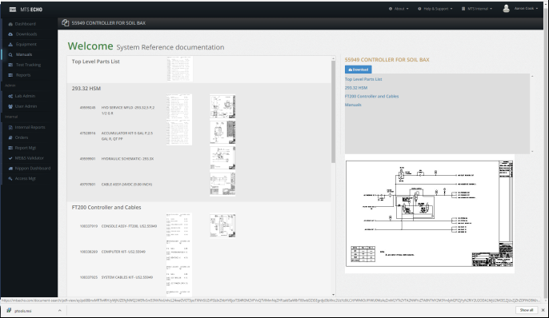
Custom Systems – Echo
The project BOM, parts lists, and drawings are compiled and the Project is uploaded into Echo.

Slide 12
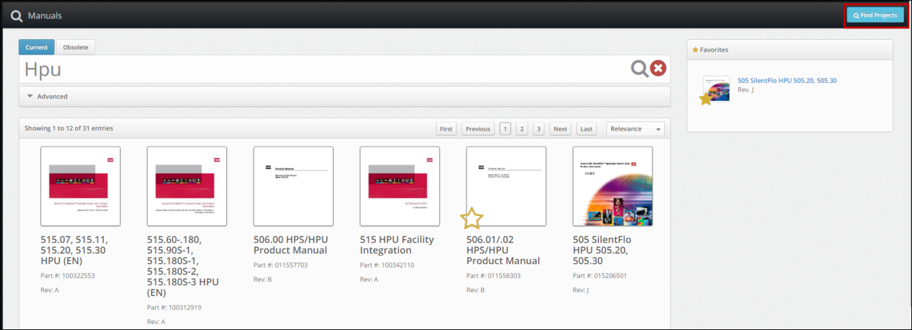
Custom Systems – Echo
MTS employees can find custom projects by clicking Find Projects.

Slide 13
Custom Systems – Echo
Projects can be searched by the Project #, Site #, Company Name or Project Title:

Slide 14
Custom Systems – Echo
Prior to April 5, custom systems can still be found on System Reference Page

Slide 15
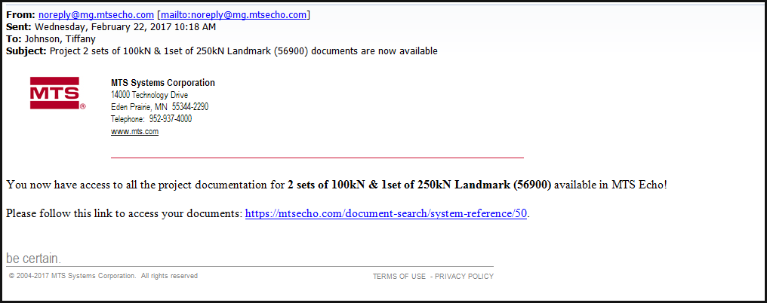
Custom Systems – Echo
Customers receive an email from MTS indicating their project is available for viewing in Echo:

Slide 16
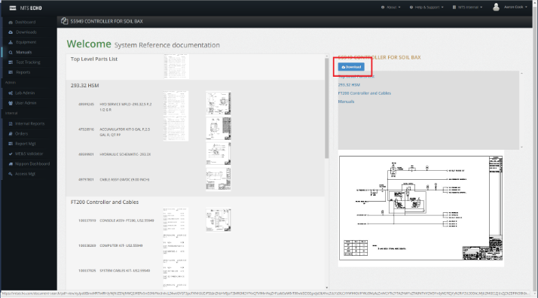
Custom Systems – Echo
Custom content in Echo can be downloaded to disk, and burned to CD if internet access isn’t available at the customer site:

Slide 17
Important Information:
Order entry/TechComm will capture contact information and populate Echo with customer name, email address and site #.
Customer will be sent an email for their specific custom project indicating information will be in Echo.
Customer will log in and view their custom project information.
Customer can grant access for others.
Will honor contracts indicating CDs provided – moving away from this and updating quote text.

Slide 18
Send feedback to:
Todd Koester, TechComm Manager
Aaron Cook, Echo Project Lead

