Slide 1
TSC / ISC / Scheduler – Skills Matrix Training
For closure of CA-2793
03/2017

Slide 2
Background – CA 2793
Untrained FSE’s sent to perform Acumen installation / calibrations
During a routine internal audit, MTS Service received a finding that led to CA 2793
Untrained FSE’s were sent out to customers to install and calibrate new Acumen load frames
This event happened prior to the deployment of Click Schedule as our global scheduling system.
Click Schedule has deterrents built in to warn schedulers in an effort to prevent untrained FSE’s being sent out to perform work they have not been trained on.
TSC’s / ISC’s / Schedulers are the last line in defense in ensuring that adequately trained FSE’s are sent to each and every job at our customers sites.
Ensuring that properly trained FSE’s are sent out to perform work at customer sites is a quality requirement and a top priority for the MTS Service organization.

Slide 3
Training Requirement – CA 2793
Anyone performing the role of FSE scheduling work must be trained in the proper use of the skills matrix and the importance of Click Schedule warning messages
All TSC’s / ISC’s and anyone else that works in the scheduling role must be trained as a part of this corrective action
This includes personnel that “substitute in” for others to schedule FSE’s when they are not available
Service Delivery Managers must take this training as well to ensure that they are aware of the requirements and that their personnel are functioning properly in the scheduling role
Read and Understand this PowerPoint presentation
Read and Understand FS-AD 3247 - Understanding the Global FSE Skills Matrix
Repeat this LMS training module every two years to make sure that all personnel are adequately trained
Training set up as curriculum that will automatically be reassigned every two years.
Acknowledge your understanding of this training session and at the end of the module each time that it is repeated (two year interval)

Slide 4
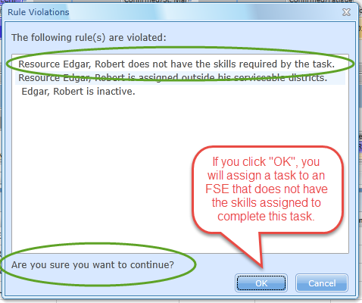
Click / CRM – Skills Enforcement
CRM / Click developed to match trained FSE’s with service product requirements
All service product codes in CRM have skills requirements built into them
No auto-scheduling of service products to an FSE not granted that skill can occur systematically
Schedulers are able to override / ignore all system warnings when manually scheduling possibly leading to a non-compliant situation.
Schedulers must be extremely cognizant of what the error messages are telling them and only override if it does not lead to a non-compliant situation
Click Schedule Rule Violation Example

Slide 5
FSE Global Skills Matrix
Global Skills Matrix developed to build awareness around granted skills
Click Schedule keeps an inventory of skills that have been granted to our FSE’s globally
Data pulled directly from click to maintain accuracy
Service Delivery Managers are responsible for making sure that their FSE’s skills are accurate and properly assigned
Schedulers should raise awareness to the Service Delivery Managers when they see discrepancies or when there are skills gaps in their regions
FSE Skills Matrix Example

Slide 6
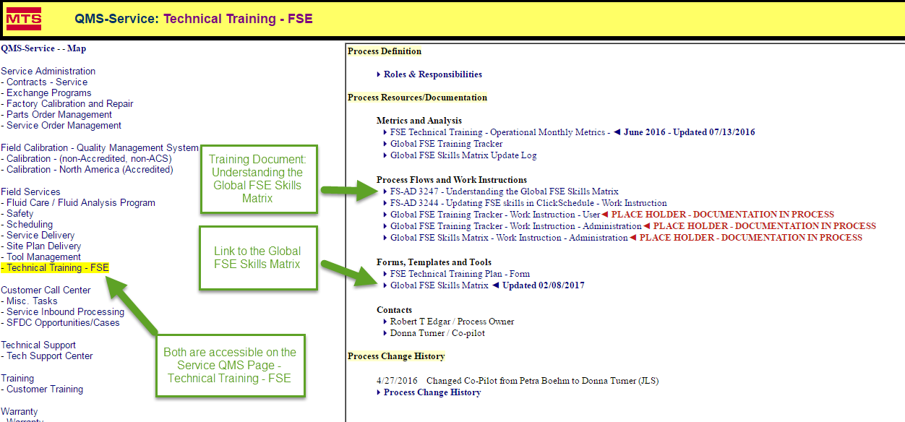
FSE Global Skills Matrix
Global Skills Matrix and training documentation available for review on MTS QMS site
Training documentation developed to ensure that personnel are familiar with the proper use of the FSE Global Training Matrix
Skills Matrix available on the “Technical Training – FSE” Service QMS page.
http://groups.mts.com/ProjectSystem/ProcessHome.asp?mnuSys=SSD&mnuShortName=TechTrn
Technical Training – FSE QMS Page

Slide 7
Next Steps
Review QMS Training Material and Understand the FSE training Matrix for your region
Located on Service “Technical Training – FSE” QMS Page
http://groups.mts.com/ProjectSystem/ProcessHome.asp?mnuSys=SSD&mnuShortName=TechTrn
Read and Understand FS-AD 3247 - Understanding the Global FSE Skills Matrix
Direct any questions that you may have to your Service Delivery Manager
Review and understand the Global Skills Matrix
Review the FSE skills assignments for your region
Use the matrix when deciding the best FSE’s to assign to particular jobs
Report any skills discrepancies to your Service Delivery Manager
Help identify training / skills gaps for your region and bring to your Service Delivery Manager’s attention
Understand skills warnings in Click Schedule
Pay attention to all warning messages that are presented to you as part of the scheduling process
Never schedule an FSE to a job that they lack the skills for that could put MTS Service in a non-compliant situation
Work together with your Service Delivery Manager to resolve these potential situations
Raise questions to your Service Delivery Manager whenever you are unsure and need help deciding on the suitability of an FSE for a particular job or task
Never blindly ignore a Click Schedule skills error message when performing FSE scheduling activities
Scheduling warning messages should always be examined carefully before acknowledging them

