Slide 1
General Motors Management of Change
September 24, 2018 Rev A

Slide 2
What is Management of Change?
General Motors has instituted a program whereas anytime there is a replacement of a piece of equipment we are required to evaluate for any new safety concerns.
All vendors must comply with this program to do business with General Motors.

Slide 3
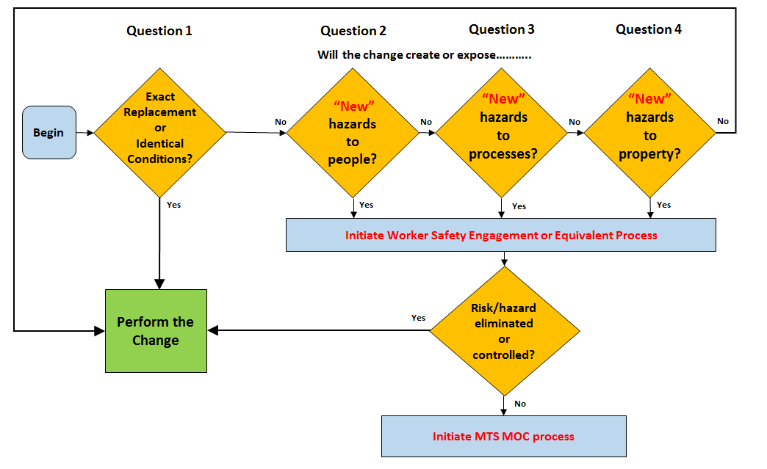
What Does This Mean To You?
Anytime you replace anything you need to validate that no new hazards are created.

Slide 4
What Do I Need To Do?
MTS Field Service must follow procedure FS-OP 4412.
Anytime you replace something you need to complete the Change Validation Checklist.
The MOC Change Validation Checklist Template is available on the QMS page at:
QMS Home > Service > Safety > Forms, Templates, and Tools
You can download the change validation checklist template from the link below.
MOC Change Validation Checklist Version 6.0.xlsx

Slide 5
Change Validation Checklist
The change validation checklist has a header which must be completed each time the checklist is required.
This catalogs the checklist by event and includes a description to help with further identification.
The checklist reference # is the service order number.

Slide 6
Change Validation Checklist
The main body determines what further action is necessary.
If the change is an exact replacement and you can answer yes on line 1 and no on lines 2, 3, and 4 no further action is necessary.
Note that you are looking for “new” hazards created by the change.

Slide 7
New Hazards
If new hazards are created you must complete the remainder of the checklist.
For each type of new hazard that is identified as yes you must document on the validation checklist what actions have been taken to mitigate hazard.

Slide 8
Examples Requiring Management of Change
Replace 407 controller with FlexTest 40 controller
Do cables cause trip hazard?
Is PC monitor safely located to not fall on operator?
Replace 6 inch actuator with 10 inch actuator
Are new pinch points created?
Replace 506 HPU with 505 HPU
Is new lockout/tagout procedure required?

Slide 9
Evaluating Hazards
When a change is made that is not an exact replacement, the FSE will work with the subject matter expert (SME) to identify and mitigate any hazards.
We do not have a single SME for all events. The SME needs to be an expert in the product and risks being evaluated.
If you do not know who an appropriate SME is your manager can help you identify one.
If the change cannot be validated on site escalate to Service Manager

Slide 10
After Completing Change Validation Checklist
After you complete the change validation checklist it needs to be sent to the MTS EH&S manager.
If risk mitigation is required you must inform the customer of the validated change.
Work cannot be completed until all potential new risks have been identified and mitigated.

