Slide 1
General Motors Pre-task Planning
September 28, 2018 Rev A

Slide 2
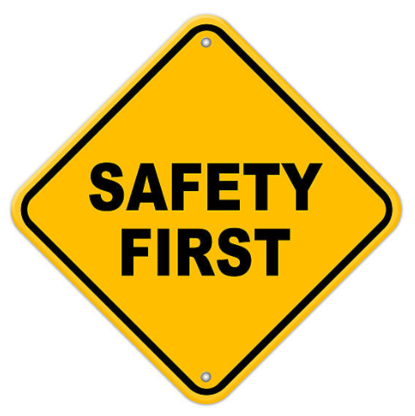
What is a pre-task plan?
General Motors has instituted a program whereas a pre-task plan must be completed prior to performing any onsite work, this is done to access any safety risks that may be present.
All vendors must comply with this program to do business with General Motors.

Slide 3
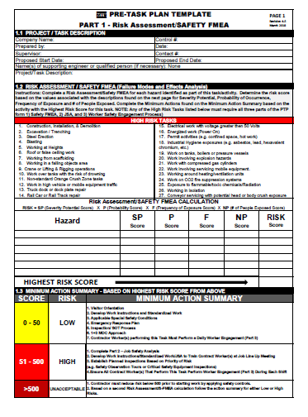
What Does This Mean To You?
Prior to starting any job at General Motors you must fill out a pre-task plan to access the risks involved with the particular task you are performing..

Slide 4
What Do I Need To Do?
MTS Field Service must follow procedure FS-OP 4413. Use FS-OP 4413 when filling out the pre-task template. You can contact your Manager or the quality department if you need assistance.
All pre-task templates should be attached to the service order by the MTS internal service coordinator assigned to the assigned FSE.
You can download the Pre Task Plan Template from the link below. This is also available on the QMS page at:
QMS Home > Service > Safety > Forms, Templates, and Tools
Pre-Task Plan Template

Slide 5
Pre-task planning
The pre-task checklist has a header which must be completed prior to the start of each job.
This identifies the risks associated with the service (tasks) to be performed.

Slide 6
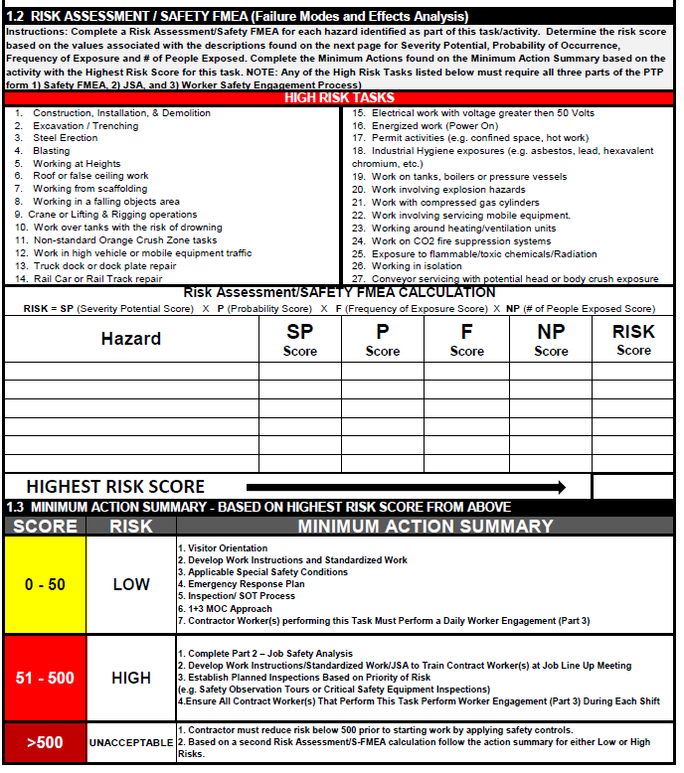
Pre-task planning
Section 1.2 identifies the Risk Assessment/Safety Failure Modes Affect Analysis (FMEA) encountered during the performance of the task. FMEA is calculated based on Severity, Probability, Frequency and Exposure of the event.

Slide 7
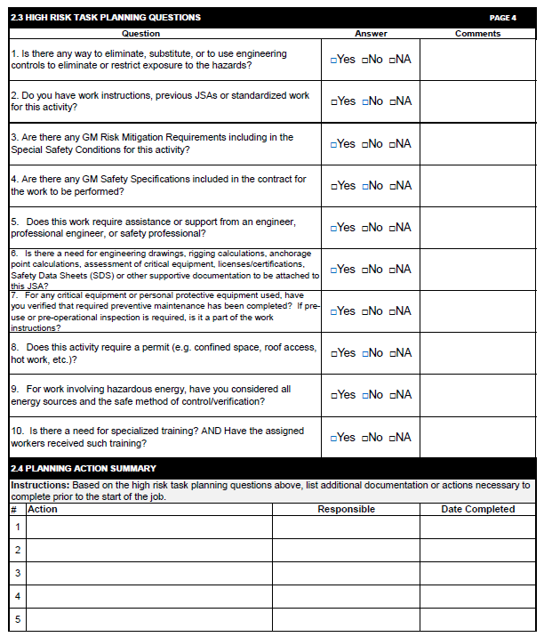
New Hazards
Section 2.3 and 2.4 will walk you through a series of questions that help you to mitigate High Risk hazards.
.

Slide 8
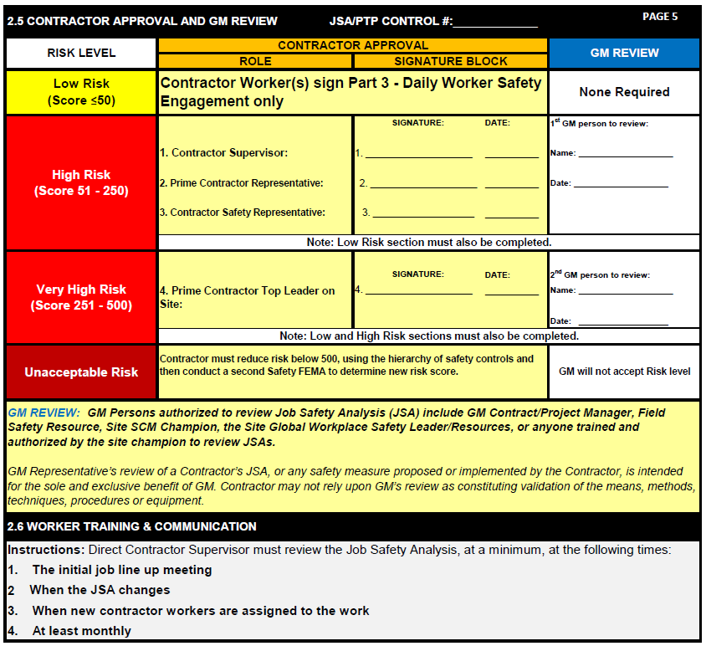
Pre-task planning
Section 2.5 gives the resultant risks must be approved by you and by GM before continuing.

Slide 9
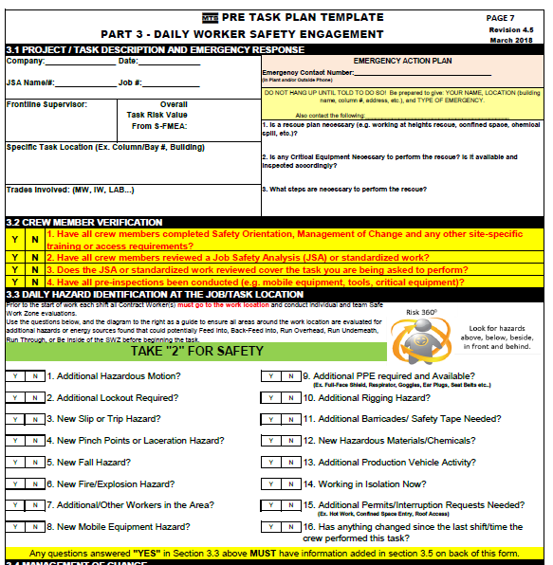
Daily Checklist
Section 3.1 is a daily checklist, this is used to make sure there have been no changes in the Job Hazards.

Slide 10
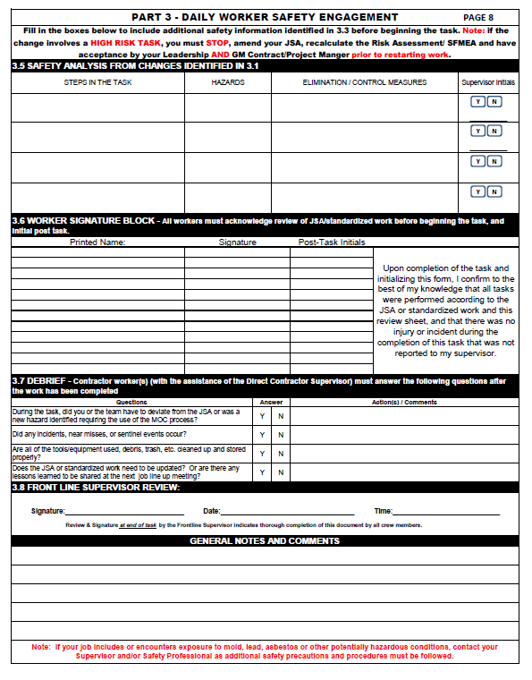
Pre-task planning
If changes to the JHA are identified complete section 3.5- 3.8 and refer to FS-OP 4412 GM management of change to test for changes to people processes or property have occurred.

