Slide 1
Safety
August 24, 2016 rev E

Slide 2
Safety Introduction
MTS is committed to providing employees a safe work environment.
Employees need to recognize their role in safety
Use appropriate safety equipment
Read and understand safety procedures
Read and understand equipment operation procedures
Follow safe work practices
Environmental Health & Safety Home page can be accessed from the intranet home page.
Follow the link on the right side for Environ. Health & Safety

Slide 3
Safety Equipment Requirements
Safety Glasses – Required
Prescription Glasses will be purchased by MTS, (1) pair per year. A current valid prescription is required. A list of providers can be obtained from MTS intranet.
Non-Prescription can be obtained locally.
Safety Glass Procedure EHS-200-114
Safety Shoes - Required
Safety shoes are required for all field service personnel while conducting on-site services.
Metatarsal protection available if required. Contact your manager for details.
Can be ordered or purchased locally.
Safety Shoe Procedure EHS-200-113

Slide 4
Safety Equipment Requirements
Hearing Protection – As needed
Specified areas require hearing protection.
Examples: pump rooms, around high frequency systems, and many industrial areas. Ensure that you have hearing protection available.
Hard Hat – As needed
At many customer locations hard hats are required. Ensure that you have one available as part of your safety equipment.

Slide 5
Safety Equipment Requirements
Lockout / Tag out – Required When Working on Electrical, Hydraulic, or other circuits to prevent unexpected start up
In North America linemans gloves and arc flash protection are required when working on live electrical circuits above 200 Volts
Arc Flash Procedure FS-OP 4403.
Some facilities may require additional safety equipment.
North America – This equipment can be purchased at Grainger or using a P-Card
EU – See Service Manager / EHS coordinator in your country
More Information can be found on the MTS intranet at:
http://groups.mts.com/Safety

Slide 6
Safety Guidelines
Before power is applied to any test system, be sure to review and complete all safety practices that apply to the system.
Locate all hazard placards and signs on equipment. The placards and signs are located strategically on the equipment to call out any crush points and electrical voltage hazards.
Know your controls! Prior to starting equipment, locate the correct hardware and software controls. Know their function and operation. If you do not understand ask and/or review the applicable information until you gain full understanding.
All manuals contain important safety information. Be sure to read the appropriate manual(s) prior to working on the system.

Slide 7
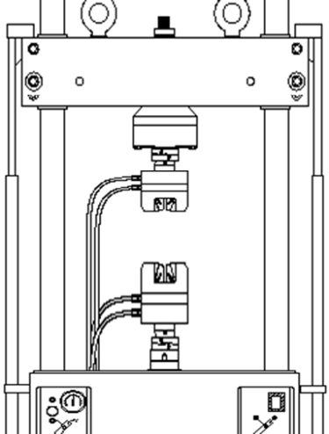
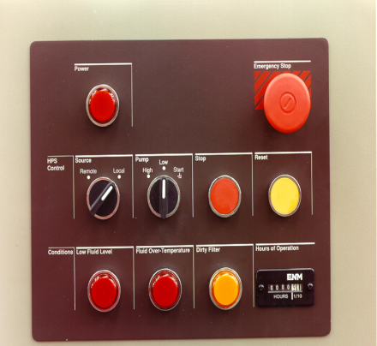
Safety Guidelines
The crush zone is the area between the actuator and load cell. Keep all fingers and hands safely clear. This area is shown in the picture to the right indicated by the yellow caution sign.
The Emergency Stop is designed to remove the hydraulic pressure from a system by causing the hydraulic power unit (HPU) stop.
Know where all the “Emergency Stop Buttons” are located so that you can stop the system quickly in an emergency.
HPU
Load frame
Controller
Emergency Stop Button located in photo, top right red round button. This is on a typical Hydraulic Power Unit.

Slide 8
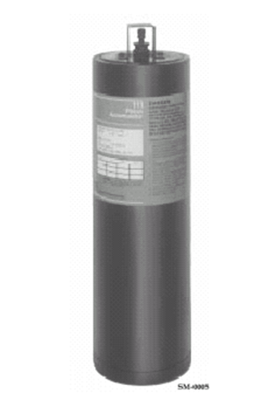
Safety Guidelines
Hydraulic Oil
Mobil DTE 25 is recommended and used on most of the systems by MTS.
This is a petroleum based product.
Hydraulic leaks can occur on a servo hydraulic system. They should be stopped when they occur as soon as possible.
Small, pin-hole type leaks pose extreme danger. Do not attempt to use any part of your body to locate these leaks as the high pressure can cause injury or death.
Accumulator.
An accumulator is under high pressure and contains a nitrogen pre-charge. Even when the hydraulic pressure drops to zero, the pre-charge will remain.
You must bleed off the nitrogen pre-charge prior to removal of accumulator.
Allow the accumulator to bleed off the hydraulic pressure before disconnecting hydraulic lines.
Make sure to us only DRY NITROGEN to pre-charge the accumulator.

Slide 9
Safety Guidelines
Bolts are torqued to specific design requirements to ensure a reliable product.
Anytime a bolt is loosened or the configuration of a component is modified, consult the system assembly drawings.
Most manufacturers recommend to always return a torque wrench to zero when you are finished using it.
Some customers conduct testing that involves human or animal parts.
Blood born contamination can occur and cause diseases such as Hepatitis B.
MTS provides inoculation from Hepatitis B
Ensure with the customer that the equipment/area has been cleaned and is safe
Wear gloves to maximize your protection.

Slide 10
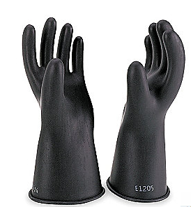
Safety Guidelines
In North America when working with voltage above 200 Volts, you are required to use a combination of lineman's gloves, protectors and ARC flash protection jacket.
MTS policy states that you are required to wear the above mentioned safety gloves and gear if there is potential for a voltage over 200 volts AC.
MTS hydraulic power supplies provide control voltages to controllers.
This is known as a foreign voltage (second or third voltage) which is not controlled by the console power switch or controller power cord.
If the HPU power is on voltage can still be present inside the controller from the HPU cable even after the main console switch has been turned off or the controller power cord removed.
To remove the foreign voltage disconnect HPU or other device from the electrical power source.

Slide 11
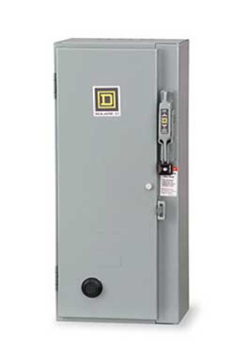
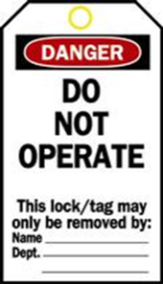
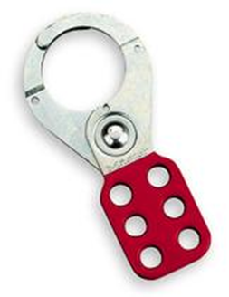
Safety Guidelines
Use lock out tags and confirm all electrical voltage and any stored energy has been removed before proceeding with your work.
Use tags and hasps when working on electrical circuits.
Be aware of foreign voltage and ensure you check with the customer before applying any lock, tags, or hasps.
Always use a volt meter to verify that the power is off.
Test the volt meter before you use it, check another known source.
Check the system to be tested is off and verified to be safe.
Re-check the volt meter, make sure it is not damaged.

Slide 12
Safety Guidelines
The weight of many of our service tools, system components, or replacement parts can cause injury if not lifted correctly.
Use proper lifting techniques
Move item close to your body and lift with your legs
Avoid over-reaching
Avoid twisting
Separate multiple heavy objects and lift individually
Ask for help if object is to heavy
Use mechanical means such as fork truck, hoist, or other equipment to assist when lifting heavy objects

Slide 13
Moving Equipment
Although it is generally considered a customer requirement to have systems moved into place, you may be tasked with helping move new systems to their final location.
Follow all instructions listed in manual or lifting / moving instructions if they are available
If instructions are not available user must perform a risk / hazard analysis to evaluate the possible risks and to help eliminate them
Systems are very heavy and have an unequal distribution of weight. The utmost precaution must be used when moving systems.
Although it may seem easier, try to not use brute strength to move systems. Always use cranes, lifts, wheels, jacks, etc. to move systems
Be especially careful about moving systems that need to moved after having been installed. Original packaging does not exist to help with moving and accessories or modification may have been added making the move more complicated.

Slide 14
Customer Safety Policies
As an FSE you may be required to attend a customer safety presentation if they have one in place. MTS supports these policies of our customers and has policies to comply with them as well. If for any reason you need any special equipment, ensure you have it with you prior to arriving on job site if possible.
Some customers require that individuals coming onto their property submit to testing for the presence of illegal drugs and/or alcohol. MTS fully supports these requests. Additionally, some customers may conduct the testing on site at their property, while others require it to be done by an independent entity. If an independent lab is required by the customer for testing, contact MTS Human Resources to set up.

Slide 15
Safety Equipment Distribution
Your trainer will distribute safety equipment to you for your use
Non prescription safety glasses
Ear protection
Lockout Hasp
Lockout Padlock
Lockout Tag
Lockout Plug
Valve Lockout
Hard Hat
Safety Vest

Slide 16
Safety Equipment Reference
Hard Hat – Grainger 4LN96
Safety Vest – Grainger 3XLU4
Rubber Electrical Glove Class 0 Size 10 – Grainger 4T489
Select correct part number for your size
Cowhide Leather Electrical Glove Protector Size 10 – Grainger 4T557
Select correct part number for your size
Cowhide Glove – Grainger 3ZL49
Select correct part number for your size
Lockout Hasp – 1U177
Lockout Padlock – Grainger 5T807
Lockout Plug – Grainger 5T831
Valve Lockout – Grainger 2AV57

Slide 17
Safety Equipment Charges
For safety equipment that is locally purchased charge to the following:
North America – Use Grainger account or P-Card and charge to GL 929200
EU – Contact local service manager
For safety shoes in North America
Charge to T&E card. Maximum reimbursement 150.00

Slide 18
Safety
Remember
Never give safety a day off!

